Slide 1
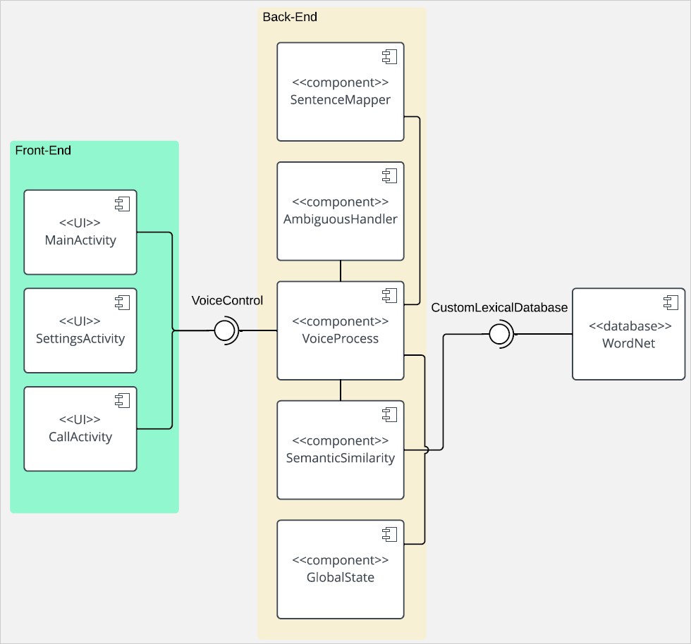
System Architecture

Slide 2
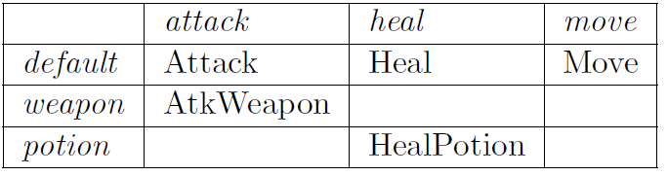
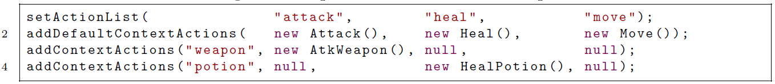
Context-Action Map Table Generator
python generateTable.py game-map.csv GameContextActionMap

Slide 3
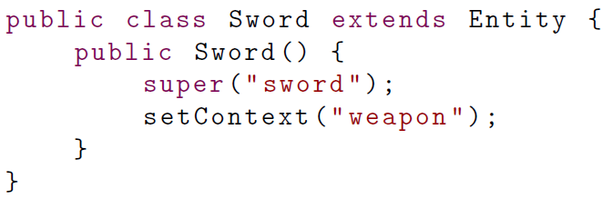
Entity
Object which can be a potential target / context
Build up list of potential targets / contexts in ContextActionMap

Slide 4
Most RPG Voice Commands are Imperative

Slide 5
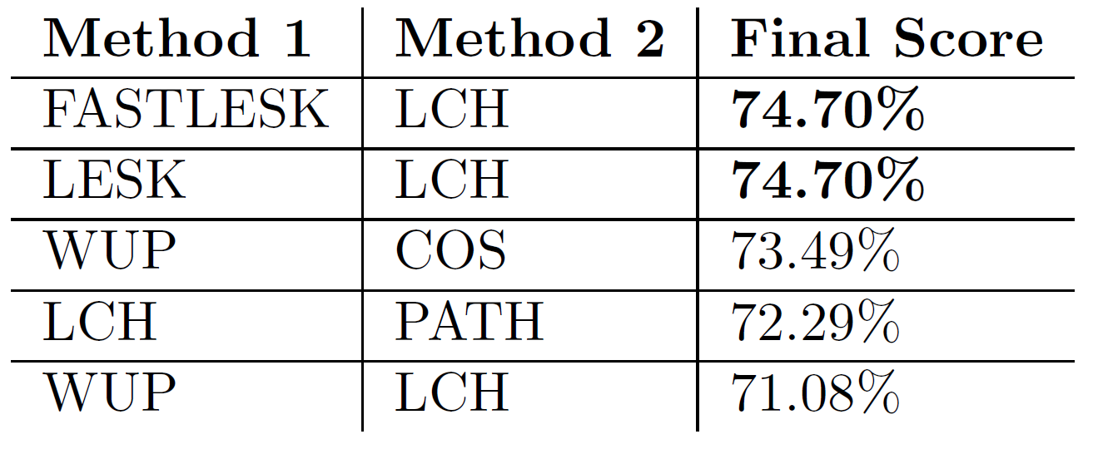
Hybrid Methods

