Slide 1
Voice Recognition RPG
Baron Khan

Slide 2
Adding Voice Commands to a Game
Commands to attack with a sword:
"attack with a sword"
"hit with something sharp"
"use a sword to fight"
"launch an assault with the sword"
"obliterate the enemy with a long weapon“
Commands to heal the player:
"heal"
"recover"
"rest"
"heal with a potion"
"regenerate using an elixir"

Slide 3
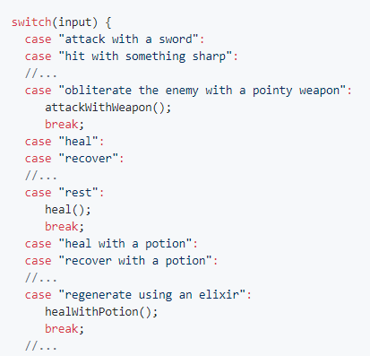
3 years ago…
Ad infinitum…
Strings can be evaluated with a switch statement since Java 7.

Slide 4
1 year ago…
("attack" | "hit") . "with" . ["a"] . ("sword" | "blade")
Several minutes later…
("attack" | "hit" | "obliterate" | ("launch" . "an" . "assault")) . ("with" | "using") . ["a"] . ("sword" | "blade" | ("something" . ("pointy" | "sharp")))

Slide 5
Now…
 | attack | heal
default | AttackDefault | HealDefault
weapon | AttackWeapon
weapon-sharp | AtkWeaponSharp
weapon-blunt | AtkWeaponBlunt
healing-item |  | HealWithItem
game-map.csv

Slide 6
Voice Recognition RPG project
Create a text-based role-playing game controlled using voice commands
Reduce developer workload as much as possible
Three key areas for reducing workload:
Adding voice commands without hard-coding every acceptable phrase
Automatically assign physical properties to objects
Generating new rooms in the game without manually placing objects

Slide 7
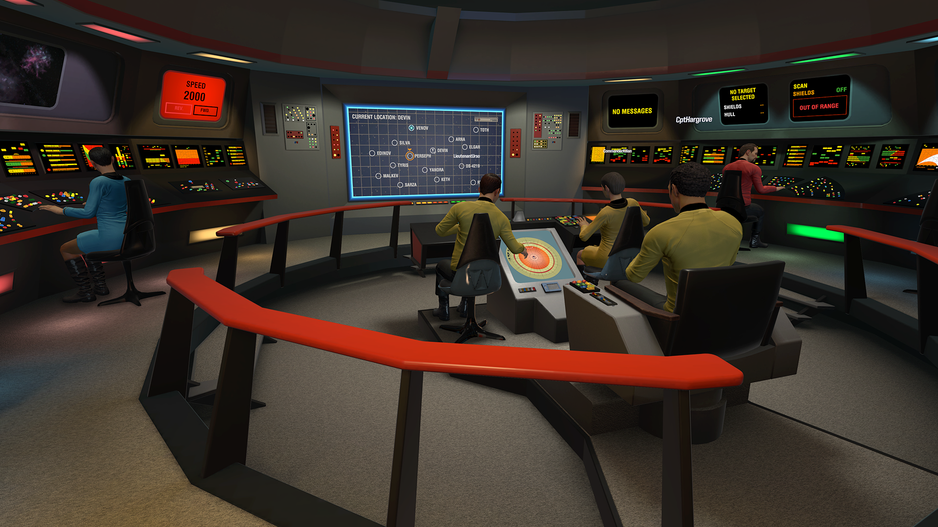

Motivation
Online APIs such as Dialogflow and IBM’s Watson Conversation can be used to easily add commands
1 request = $$$$$
Internet connection required
Privacy?
A Star Trek VR game using IBM’s Watson Conversation

Slide 8
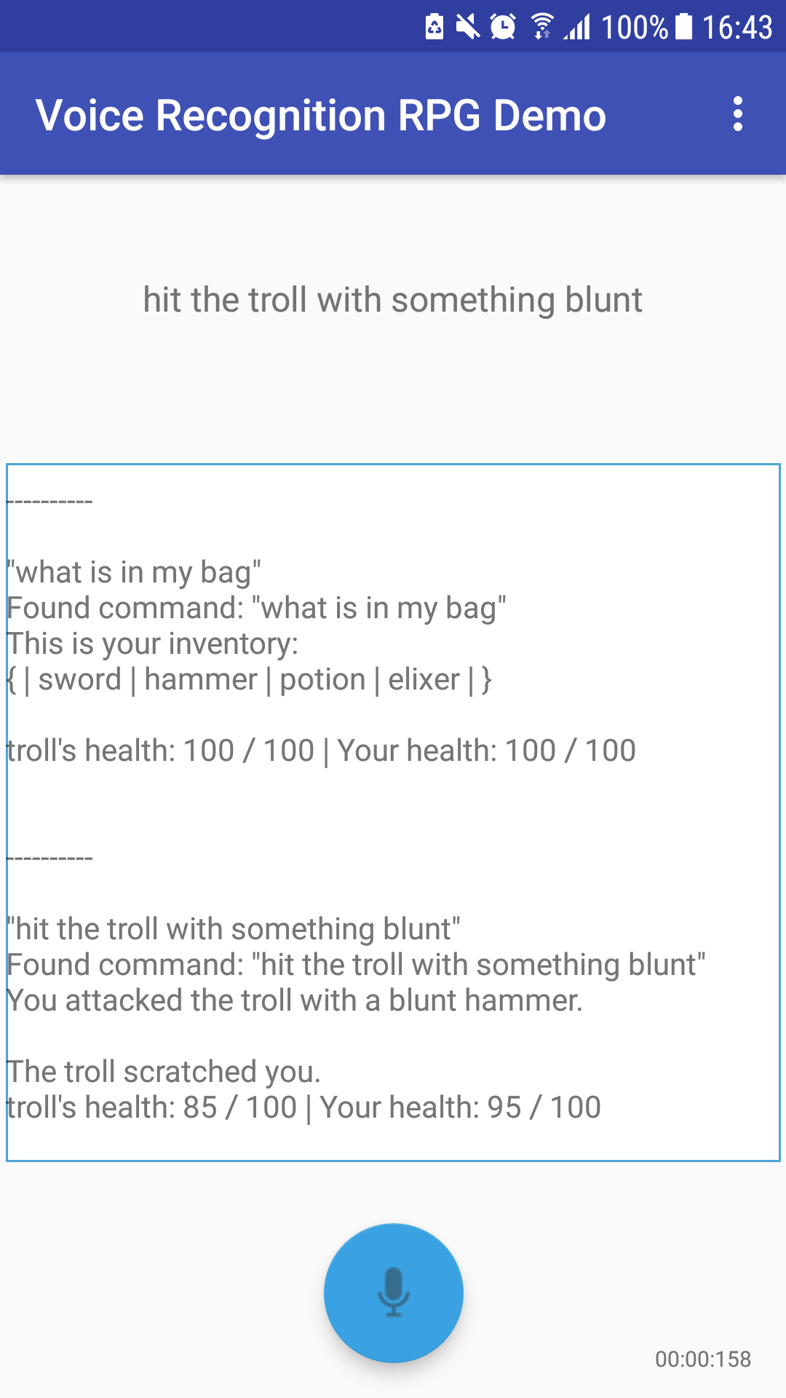
RPG Demo
Two different gameplay styles:
Overworld Mode
Exploration – interacting with objects
Examples: Zork, point-and-click adventure games
Battle Mode
Turn-based – fighting enemies
Examples: Pokémon, Final Fantasy

Slide 9
How it Works: Context-Action Maps
Overworld Mode:
Battle Mode:
 | look | show | cut | break | grab | open
default | LookDefault | ShowDefault | CutDefault | BreakDefault | GrabObject | OpenObject
weapon |  |  | CutWeaponNotSharp | BreakWeaponNotBlunt
weapon-sharp |  |  | CutWeaponSharp | BreakWeaponNotBlunt
weapon-blunt |  |  | CutWeaponNotSharp | BreakWeaponBlunt
vision-item | LookDefault
 | attack | heal | show | look
default | AttackDefault | HealDefault | ShowDefault | LookDefault
weapon | AttackWeapon
weapon-sharp | AttackWeaponSharp
weapon-blunt | AttackWeaponBlunt
healing-item |  | HealItem

Slide 10
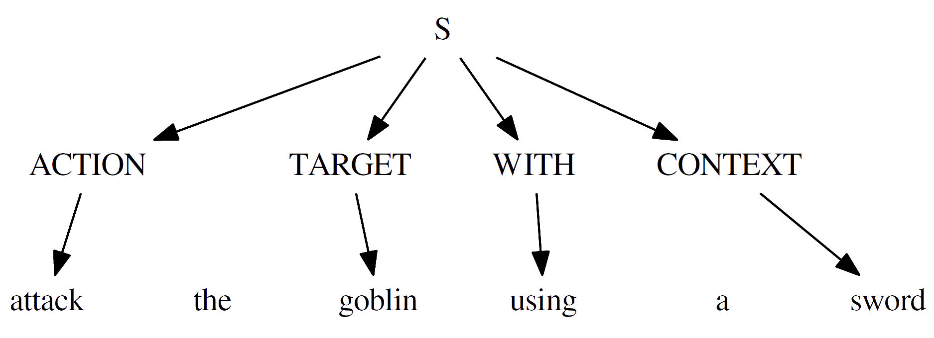
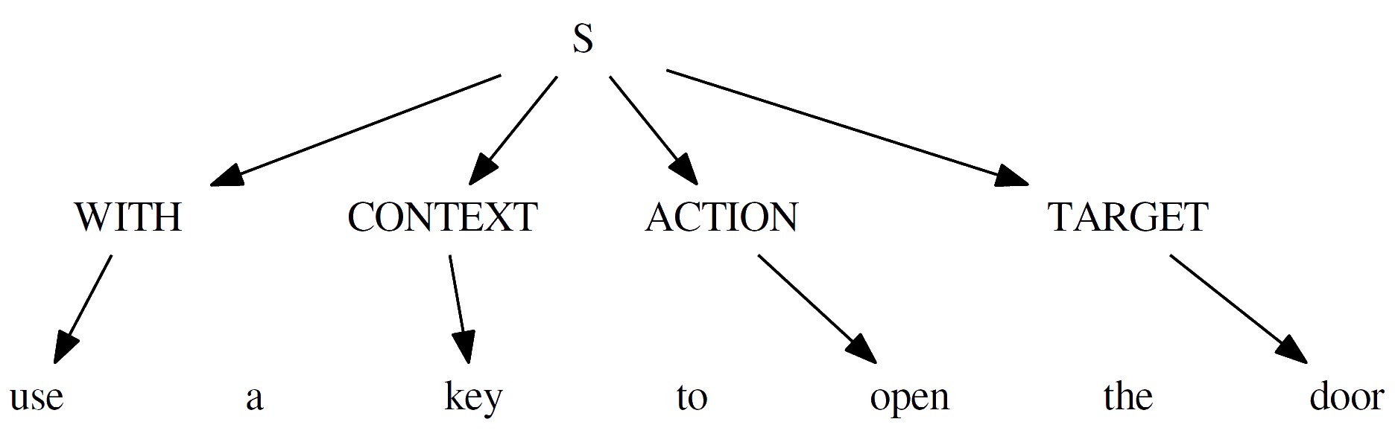
How it Works: Slot-Filling
Alternative grammar:

Slide 11
Heart of the System: WordNet
Created by Princeton University
Large lexical database of English words
Forms hyper-tree of words
Each node is a set of synonyms (synset)
Parent nodes: hypernyms
Used to calculate semantic similarity between two words

Slide 12

Semantic Similarity Methods
Algorithms to calculate similarity of two words using WordNet
Numerous algorithms
Path-based (Wu and Palmer, Leacock and Chodorow)
Information Content / Sense Frequency (Lin, Resnik)
Overlaps in Definitions (Lesk)
Most implementations provided by WS4J library
Some implemented manually (COS, FAST LESK)

Slide 13
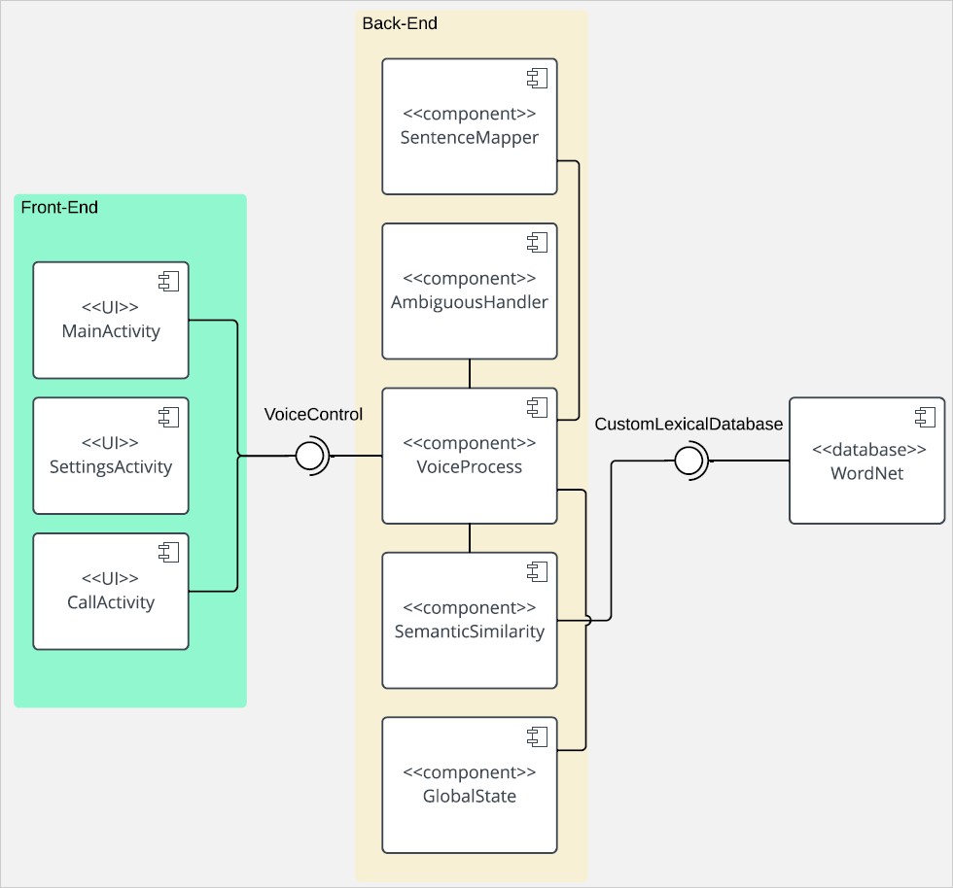
System Architecture

