Slide 1
Voice Recognition RPG
Baron Khan

Slide 2
Adding Voice Commands to a Game
Commands to attack with a sword:
"attack with a sword"
"hit with something sharp"
"use a sword to fight"
"launch an assault with the sword"
"obliterate the enemy with a long weapon“
Commands to heal the player:
"heal"
"recover"
"rest"
"heal with a potion"
"regenerate using an elixir"

Slide 3
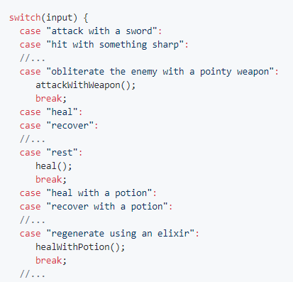
3 years ago…
Ad infinitum…
Strings can be evaluated with a switch statement since Java 7.

Slide 4
1 year ago…
("attack" | "hit") . "with" . ["a"] . ("sword" | "blade")

Slide 5
1 year ago…
("attack" | "hit") . "with" . ["a"] . ("sword" | "blade")
Several minutes later…
("attack" | "hit" | "obliterate" | ("launch" . "an" . "assault")) . ("with" | "using") . ["a"] . ("sword" | "blade" | ("something" . ("pointy" | "sharp")))
An expression for each intent in the game

Slide 6
Now…
CSV file:
 | attack | heal
default | AttackDefault | HealDefault
weapon | AttackWeapon
weapon-sharp | AtkWeaponSharp
weapon-blunt | AtkWeaponBlunt
healing-item |  | HealWithItem

Slide 7
Voice Recognition RPG project
Create a text-based role-playing game controlled using voice commands
Reduce developer workload as much as possible
Three key areas for reducing workload:
Adding voice commands without hard-coding every acceptable phrase
Automatically assign physical properties to objects
Generating new rooms in the game without manually placing objects

Slide 8
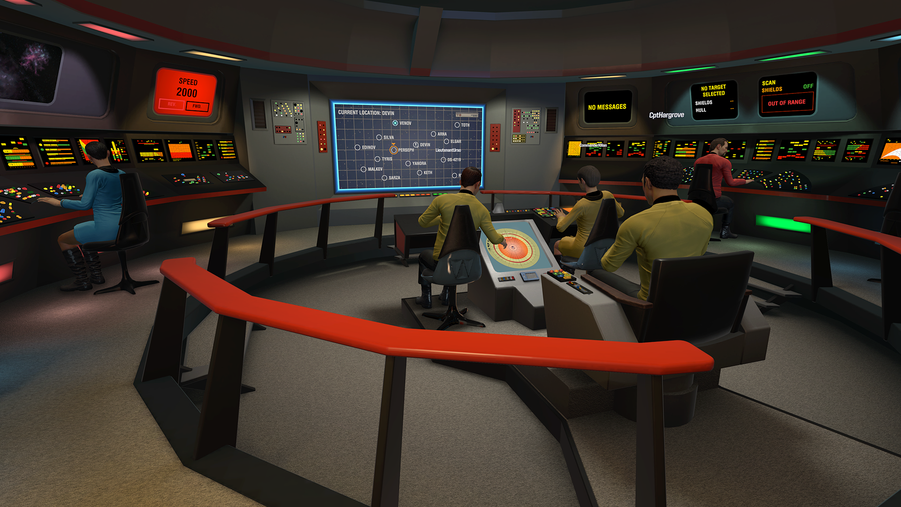
Motivation
Online APIs such as Dialogflow and IBM’s Watson Conversation can be used to easily add commands
A Star Trek VR game using IBM’s Watson Conversation

Slide 9

Motivation
Online APIs such as Dialogflow and IBM’s Watson Conversation can be used to easily add commands
1 request = $$$$$
Internet connection required
Privacy?
A Star Trek VR game using IBM’s Watson Conversation

Slide 10
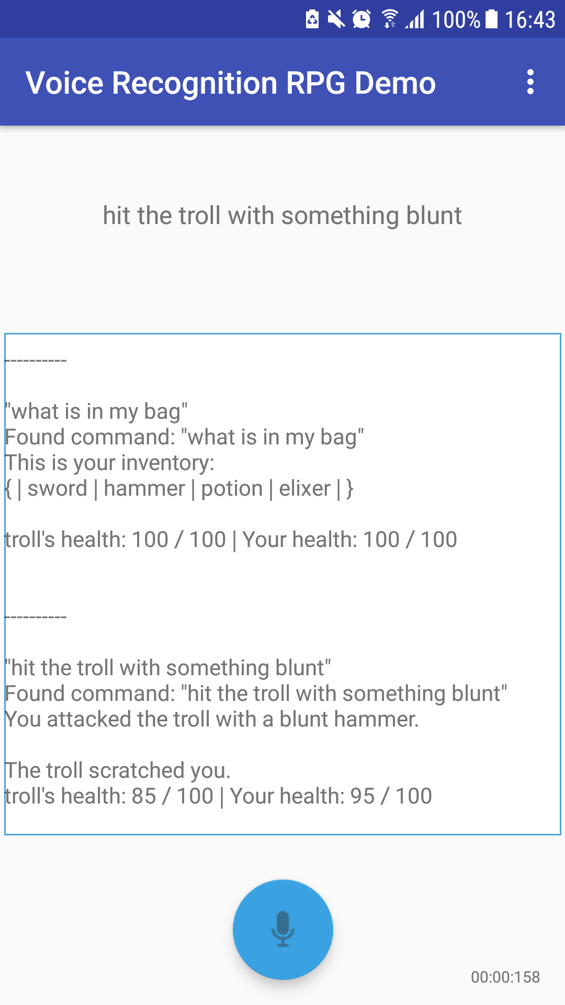
RPG Demo
Two different gameplay styles:
Overworld Mode
Exploration – interacting with objects
Examples: Zork, point-and-click adventure games
Battle Mode
Turn-based – fighting enemies
Examples: Pokémon, Final Fantasy

Slide 11
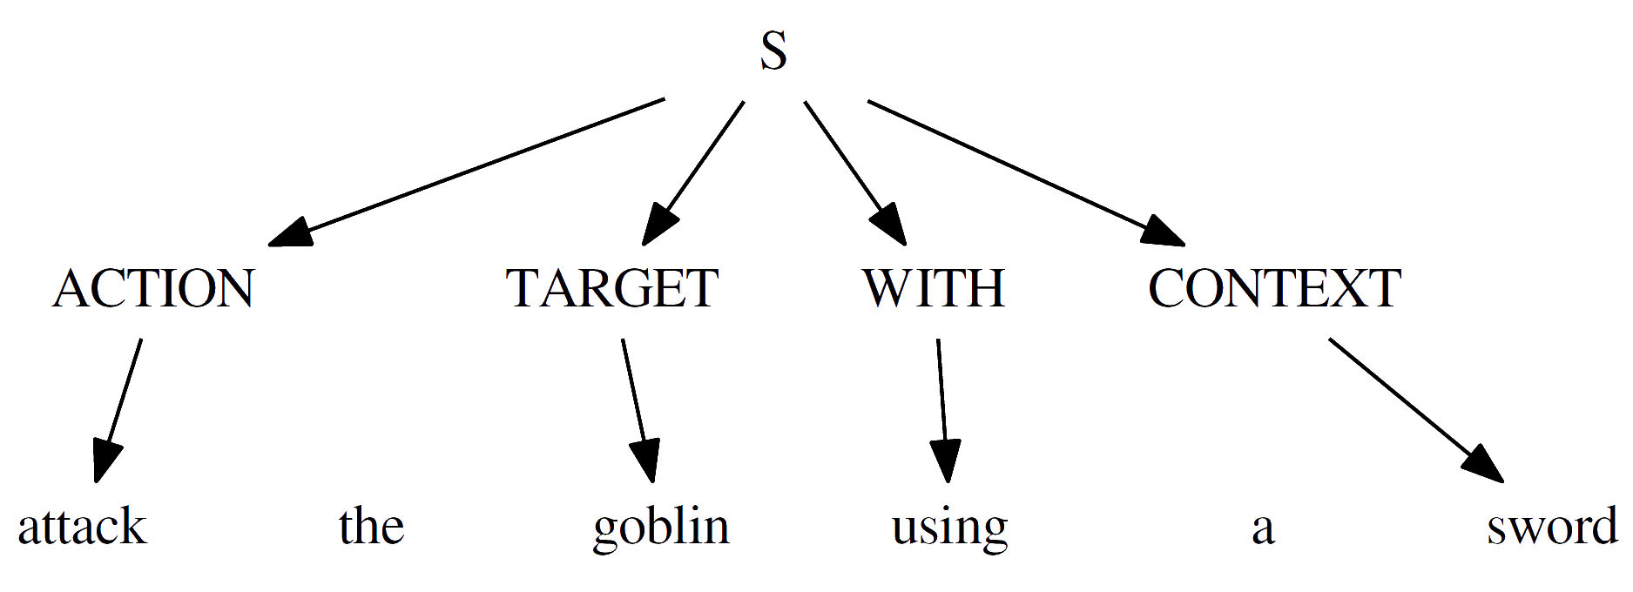
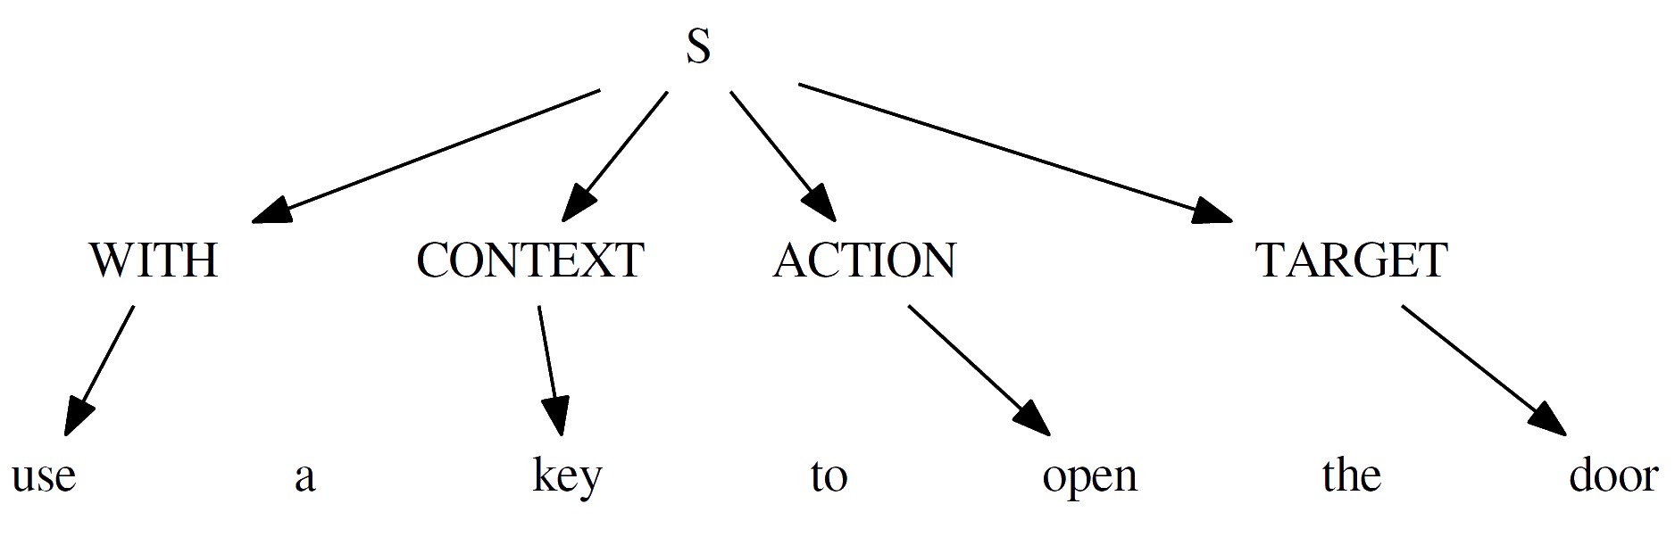
How it Works: Slot-Filling
Alternative grammar:

Slide 12
How it Works: Context-Action Maps
Overworld Mode:
Battle Mode:
action name
 | look | show | cut | break | grab | open
default | LookDefault | ShowDefault | CutDefault | BreakDefault | GrabObject | OpenObject
weapon |  |  | CutWeaponNotSharp | BreakWeaponNotBlunt
weapon-sharp |  |  | CutWeaponSharp | BreakWeaponNotBlunt
weapon-blunt |  |  | CutWeaponNotSharp | BreakWeaponBlunt
vision-item | LookDefault
context type
 | attack | heal | show | look
default | AttackDefault | HealDefault | ShowDefault | LookDefault
weapon | AttackWeapon
weapon-sharp | AttackWeaponSharp
weapon-blunt | AttackWeaponBlunt
healing-item |  | HealItem

Slide 13
Heart of the System: WordNet
Created by Princeton University
Large lexical database of English words
Forms tree of words
Each node is a set of synonyms (synset)
Parent nodes: hypernyms
Used to calculate semantic similarity between two words

Slide 14

Semantic Similarity Methods
Algorithms to calculate similarity of two words using WordNet
Numerous algorithms
Path-based (Wu and Palmer, Leacock and Chodorow)
Information Content (Lin, Resnik)
Overlaps in Definitions (Lesk)
Most implementations provided by WS4J library
Requires ILexicalDatabase interface to be implemented
Some implemented manually (COS, FAST LESK)

Slide 15
How it Works: Pipeline
Input: user’s audio
Output: text response (+ side effect in application)

Slide 16
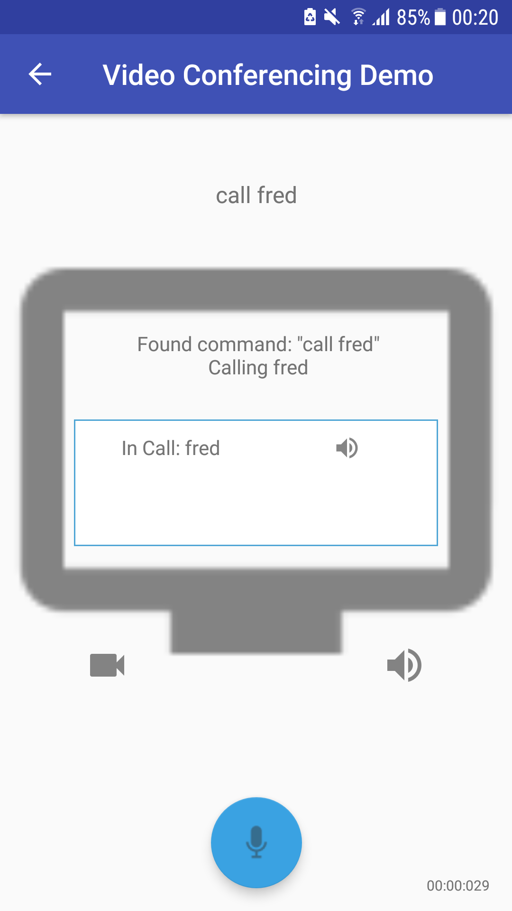
Applied to Other Domains
Video Conferencing commands
Cooking commands
“boil the eggs”
“use a spoon to stir the soup”
 | phone | stop | mute
default | PhoneContact | StopCall | Mute
video | PhoneContact
audio | PhoneContact
contact | PhoneContactAudio | StopCallContact
 | make | stir | boil | pour | serve
default | Make | Stir | Boil | Pour | Serve
spoon | Make | StirSpoon
cooker | Make |  | BoilCooker
food | MakeFood

Slide 17
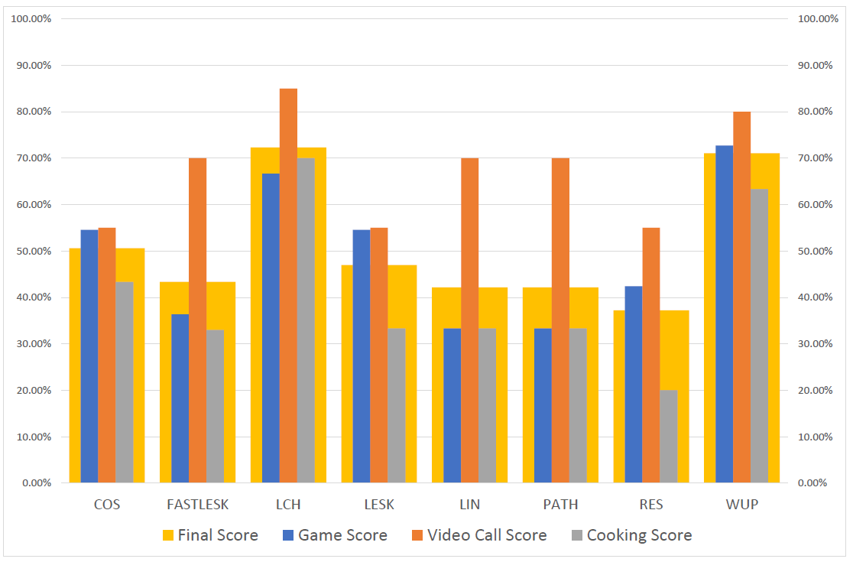
Correctness of Semantic Similarity Methods

Slide 18
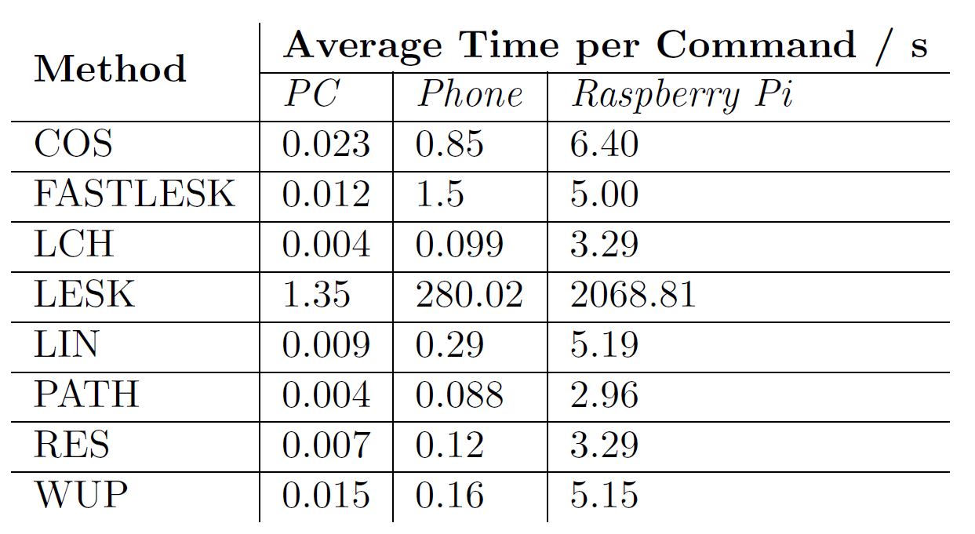
Performance of Semantic Similarity Methods
Near-instantaneous response (<= 0.1s) required

Slide 19
Evaluation of Semantic Similarity Methods
Path-based methods have overall highest accuracy and speed
Wu and Palmer (WUP)
Leacock and Chodorow (LCH)
Different methods perform better in different domains
WUP method chosen for RPG demo
~70% correctness for the best methods in tests

Slide 20
System Features Improve Accuracy
Confirmation and suggestions on ambiguous intents
Chaining multiple commands in one utterance
Detect multiple targets or contexts
Synonym-mapping
Ignoring incorrect matches
Sentence-matching

Slide 21
Application Performance

Slide 22
Three key areas for reducing workload:
Adding voice commands without hard-coding every acceptable phrase
Automatically assign physical properties to objects
Generating new rooms in the game without manually placing objects

Slide 23
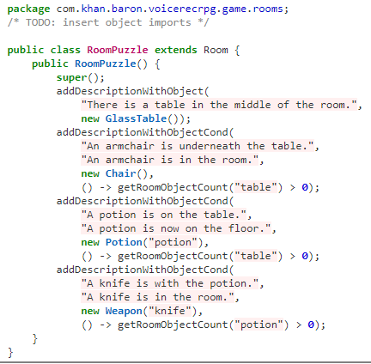
Room Generation from Text
Text description of room → Java source file for room
Use semantic similarity engine to find similar objects in text description
Binary relationships between two objects as conditionals
There is a *table in the middle of the room.
An *armchair is underneath the table.
A *potion is on the table.
A *knife is with the potion.

Slide 24
Summary of Voice Recognition RPG Project
Created prototype for a voice-controlled, text-based RPG on Android
Created offline voice recognition system using WordNet
Good performance with near instantaneous processing on modern devices
Provides good foundation that can be improved upon
Applied to different domains (games, video conferencing, etc)
Created standalone Java library
Evaluation of different semantic similarity methods
Explored other areas for improving development of RPG

Slide 25
Voice Recognition RPG Supplementary Slides
Baron Khan

Slide 26
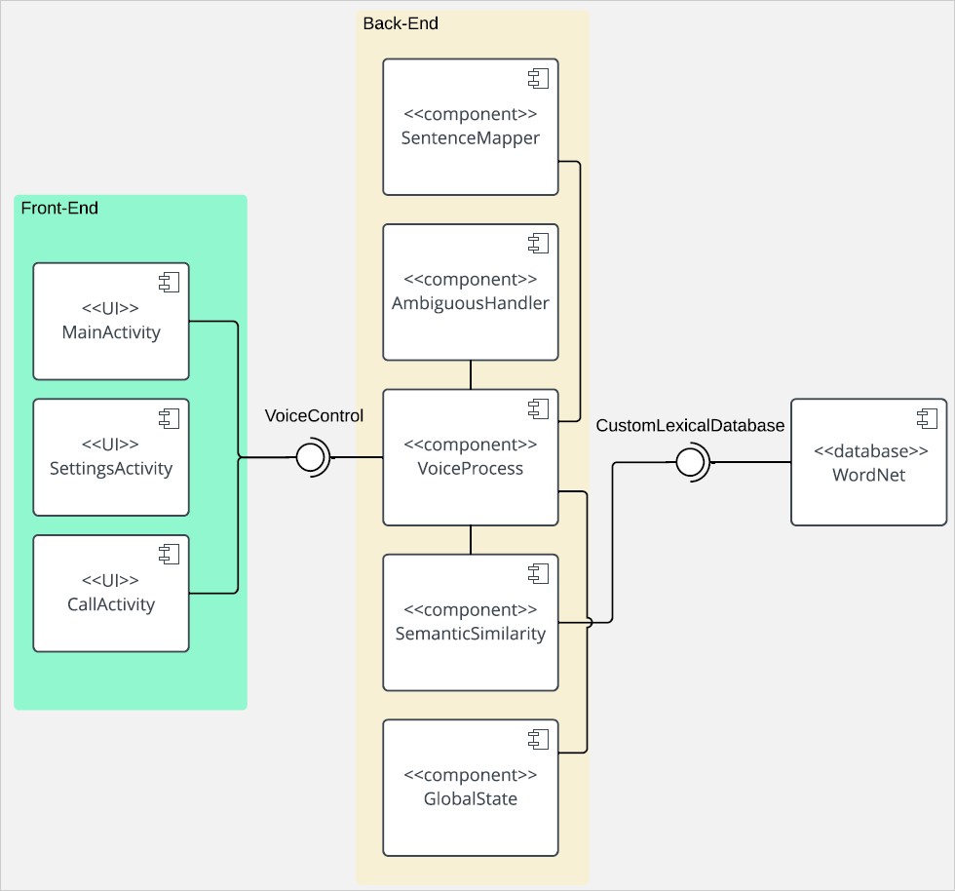
System Architecture

Slide 27
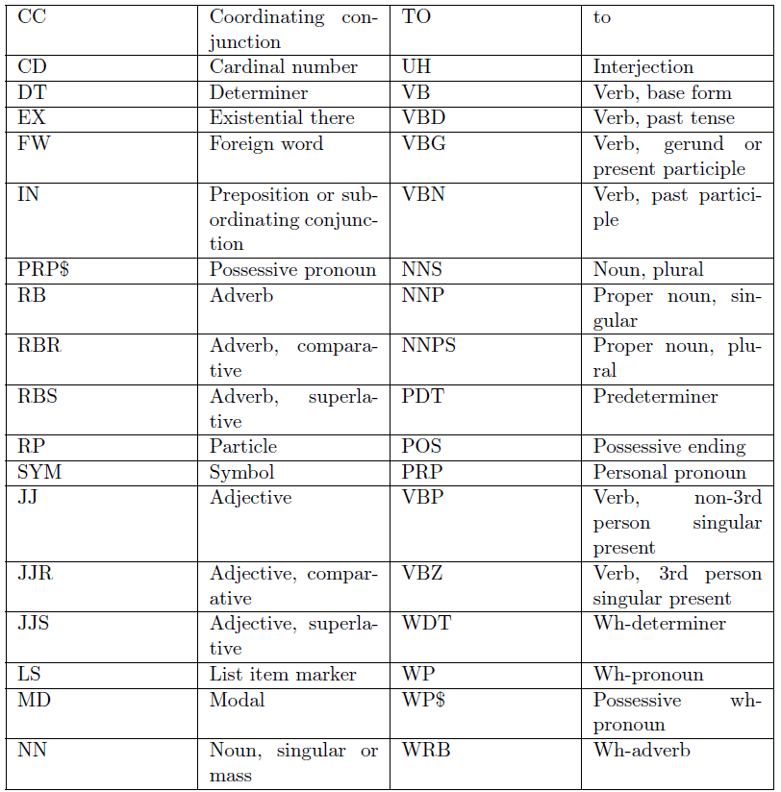
Part-of-Speech (POS) Tagging
Label each word in text with its part-of-speech
Using Stanford POS tagger for Java
Penn Treebank tagset

Slide 28
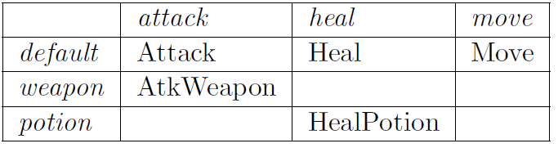
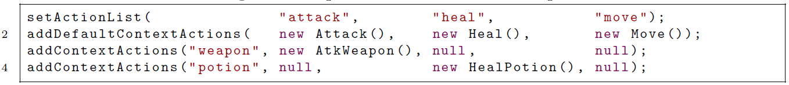
Context-Action Map Table Generator
python generateTable.py game-map.csv GameContextActionMap

Slide 29
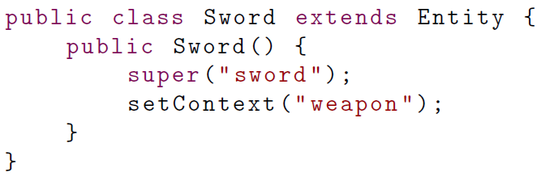
Entity
Object which can be a potential target / context
Build up list of potential targets / contexts in ContextActionMap

Slide 30
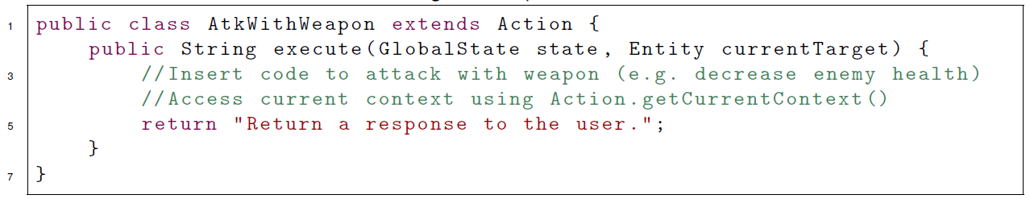
Actions
Wrappers for methods which change the GlobalState of the application.

Slide 31
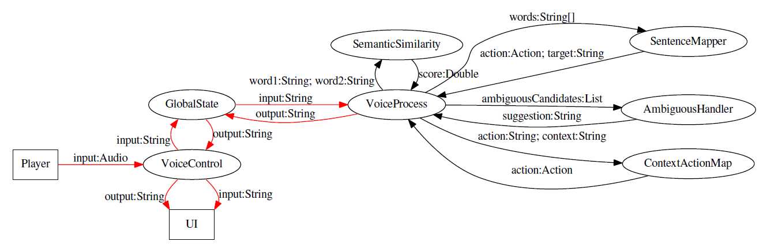
Data Flow

Slide 32
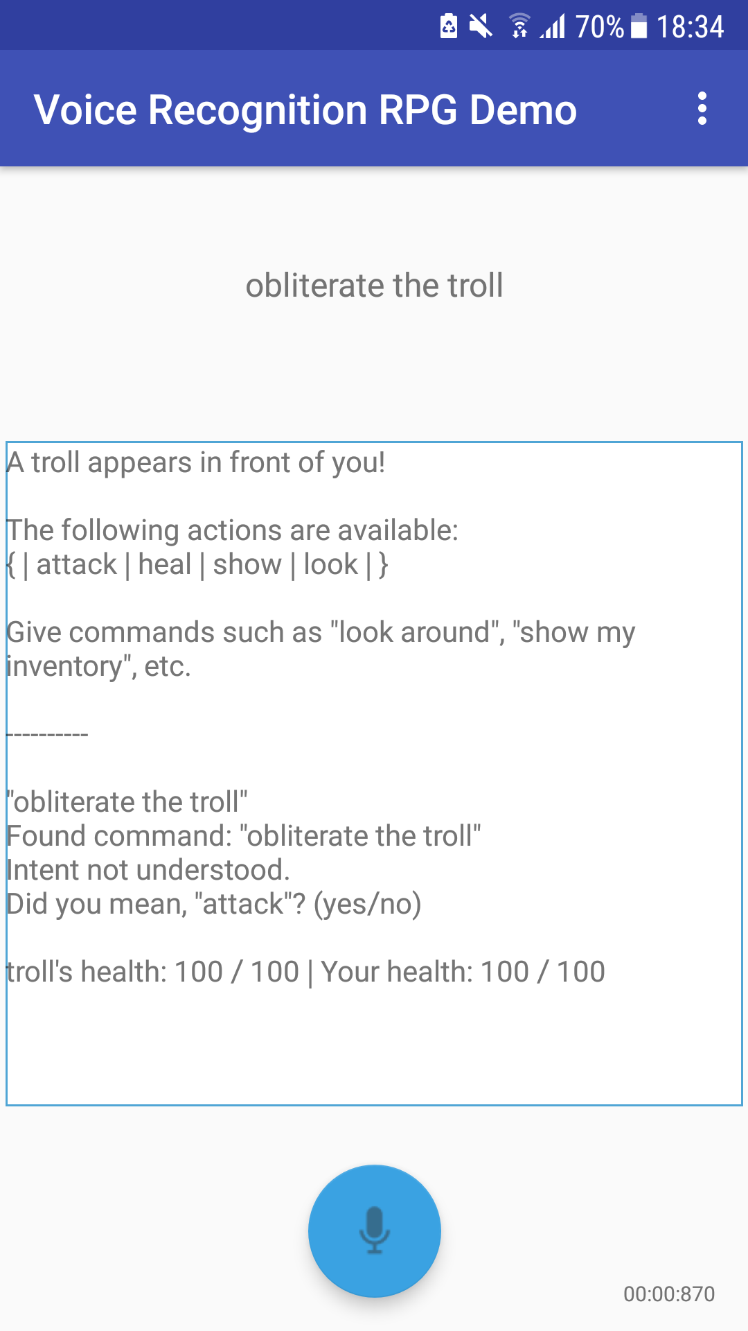
Ambiguous Handler
If action/target/context candidate just below the threshold, marked as ambiguous
If best candidate below threshold, all ambiguous candidates queried
Suggestions given to player in order of score
Until they say, “yes”
> 4 suggestions → show all at once

Slide 33
Most RPG Voice Commands are Imperative

Slide 34
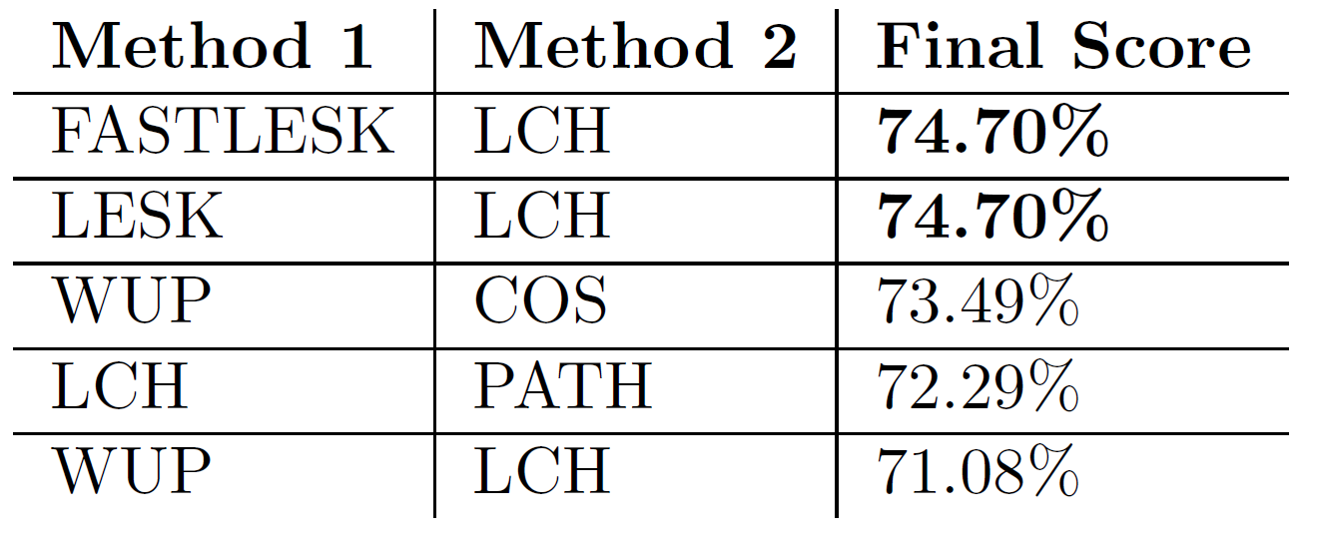
Hybrid Methods

Slide 35
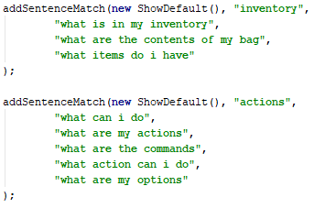
Sentence-Matching
If slot-filling grammar fails (i.e. not imperative)
For questions, greetings, etc.
“What actions can I do?”
“Hello, how are you?”
Can add examples of sentences

Slide 36
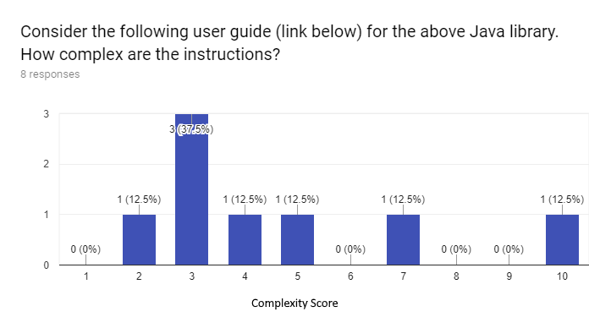
Survey Results

Slide 37
Challenges
Creating the voice recognition system from scratch
Ensuring it works completely offline
Processing the user’s input in the most efficient and correct way
Ensuring it is easy to add voice commands to the game
Android development issues
Issues with compatibility with Java 8

