Slide 1

Концебалов Олег
М8О-409Б-22
Курс: Цифровое искусство и дизайн · Домашнее задание 2

Slide 2
Задание: Серия работ с помощью AI
Тема серии: «Супермаркет» (POV от первого лица — участник компании друзей)
Тип контраста по Иттену: хроматический контраст дополнительных цветов (зелёный - тёплый оранжевый/красный).
Композиция: осевая симметрия + центральная перспектива (leading lines полок/кассы/проходов).
Единая стилистика: semi‑realistic 3D, cinematic lighting, формат 16:9.
Объединяющие мотивы: POV‑рука с чёрными смарт‑часами, зелёные неон‑акценты, один и тот же «герой».

Slide 3
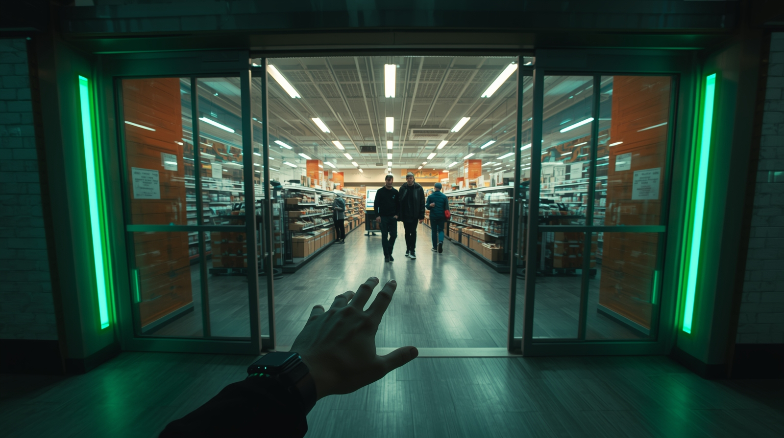
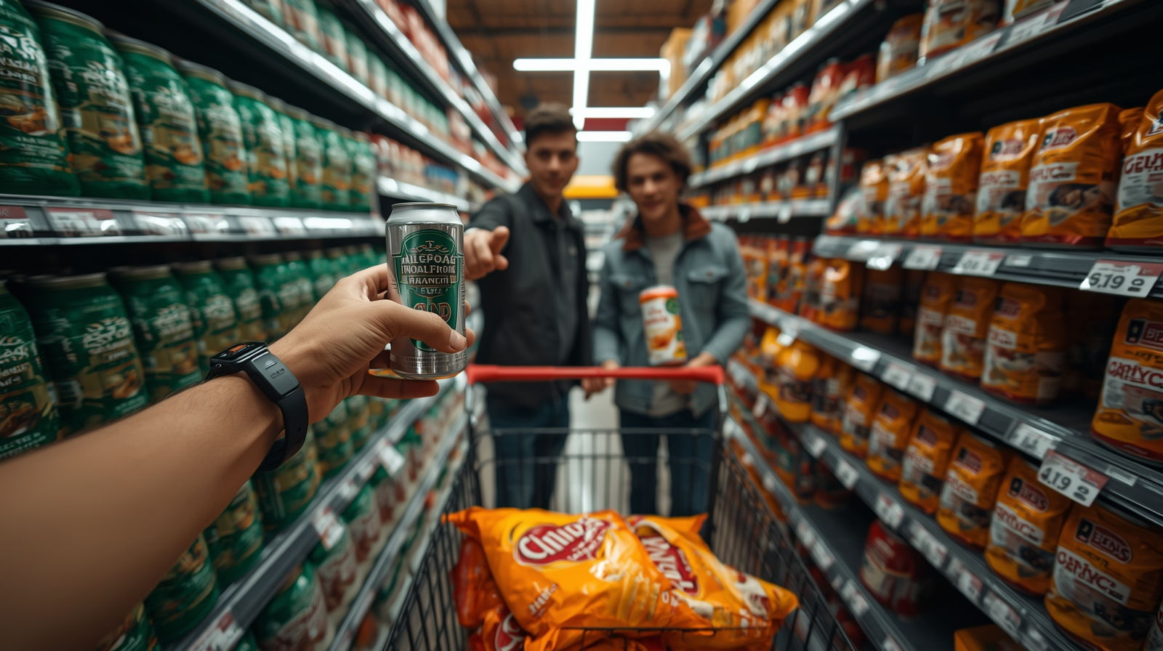
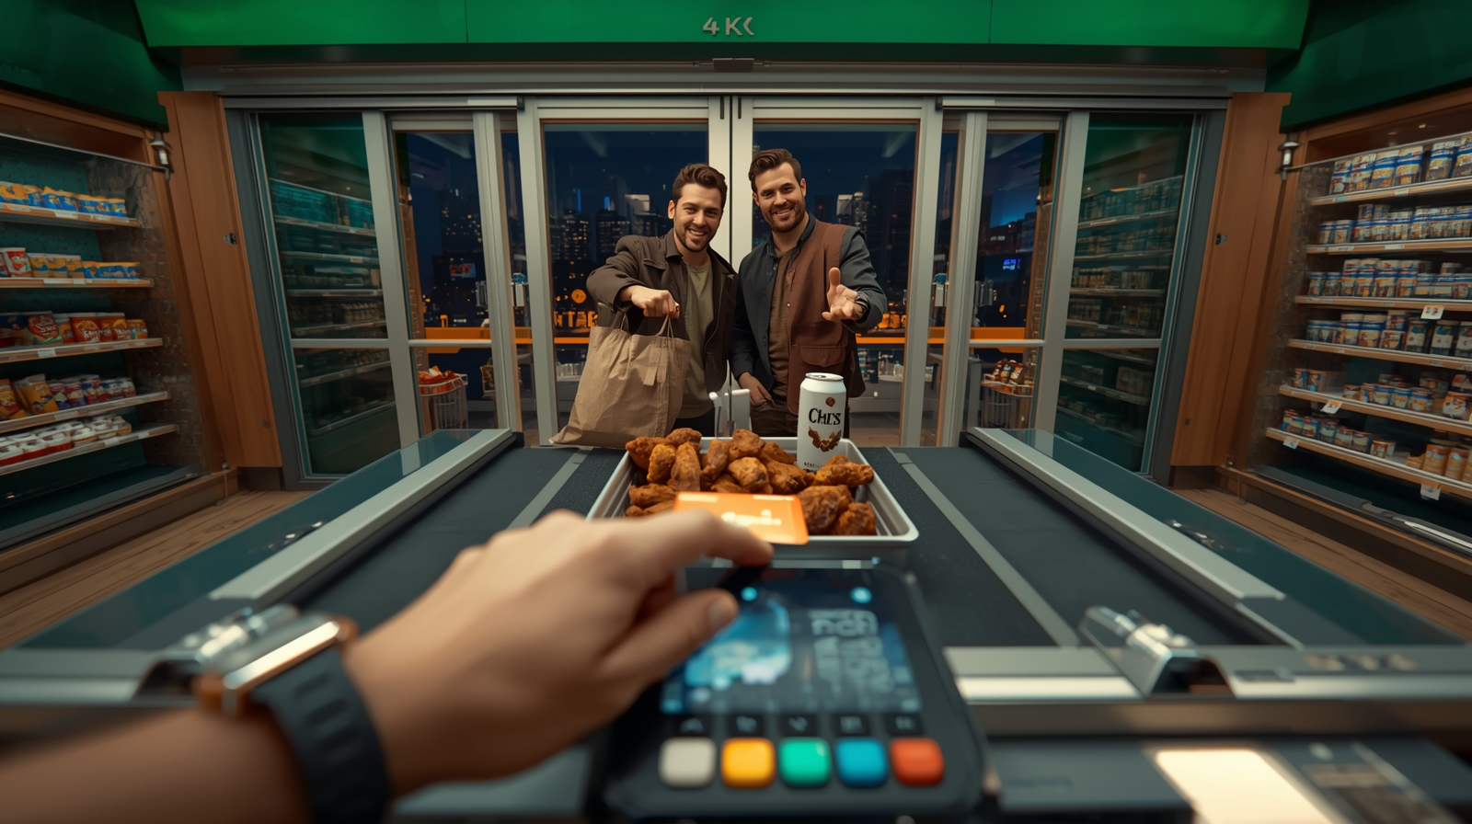
Серия: Супермаркет. Хороший вечер

Slide 4
Работа 1
Prompt:
first-person POV entering a modern Russian supermarket at night, automatic sliding doors opening, a group of friends walking in ahead, green neon accents and warm interior light, shelves and checkout lines forming central perspective, left hand in foreground with a black smartwatch visible, axial symmetry, complementary color contrast green vs warm orange, semi-realistic 3D style, cinematic lighting, soft shadows, high detail, 4k, no visible logos or readable text. Negative prompt: blurry, deformed, extra fingers, extra limbs, text, typography, letters, numbers, watermark, logo, brand text, readable labels, price tags, barcode, signage, low quality, oversharp, noisy background, cluttered composition, kitsch, stock photo look
Negative prompt (append if your model lacks a separate field):
blurry, deformed, extra fingers, extra limbs, text, typography, letters, numbers, watermark, logo, brand text, readable labels, price tags, barcode, signage, low quality, oversharp, noisy background, cluttered composition, kitsch, stock photo look
Tool settings hint:
Aspect ratio 16:9; Style: semi-realistic 3D; Lighting: soft key + subtle rim; Guidance/CFG: middle; Steps: default.
Если делаете видео-арт: здесь — постер-фрейм, а ниже добавьте ссылку на хостинг (Vimeo/YouTube/диск).

Slide 5
Работа 2
Prompt:
first-person POV in a supermarket beverage aisle, framed short section (bounded by a visible endcap in background, no endless rows), outstretched RIGHT hand reaching TOWARD a cold aluminum beer can on the shelf (fingers inches away, NOT holding), LEFT wrist with a black smartwatch partly visible, shopping basket at the bottom of frame with a bright bag of chips and a tray of raw chicken wings for air fryer, chips bags also placed on the adjacent eye-level shelf to the right, TWO MALE FRIENDS clearly visible in the mid-ground choosing chips (one holding a bag, the other pointing), sharp mid-ground faces, no motion blur, friendly expressions, axial symmetry along the aisle, central perspective but depth limited, complementary color contrast green shelf lighting vs warm orange highlights, semi-realistic 3D style, cinematic lighting, soft shadows, high detail, 4k, no readable brand names or labels. Negative prompt: blurry, deformed, extra fingers, extra limbs, text, typography, letters, numbers, watermark, logo, brand text, readable labels, price tags, barcode, signage, low quality, oversharp, noisy background, cluttered composition, kitsch, stock photo look, infinite shelves, beer already in hand
Negative prompt (append if your model lacks a separate field):
blurry, deformed, extra fingers, extra limbs, text, typography, letters, numbers, watermark, logo, brand text, readable labels, price tags, barcode, signage, low quality, oversharp, noisy background, cluttered composition, kitsch, stock photo look
Tool settings hint:
Aspect ratio 16:9; Style: semi-realistic 3D; Lighting: soft key + subtle rim; Guidance/CFG: middle; Steps: default.

Slide 6
Работа 3
Prompt:
first-person POV at a supermarket checkout, RIGHT hand tapping a contactless card on the payment terminal (tap in progress, gentle glow), terminal screen angled toward the viewer with a contactless icon but NO readable text or numbers, LEFT hand holding a shopping bag where chips, a tray of raw chicken wings and a beer can are visible, TWO MALE FRIENDS beyond the cashier lane smiling and looking back at the viewer, sliding doors and night city glow outside, axial symmetry centered on the conveyor and exit line, central perspective, complementary green interior lights vs warm orange accents, semi-realistic 3D style, cinematic lighting, soft shadows, high detail, 4k. Digital watch LEFT hand Negative prompt: blurry, deformed, extra fingers, extra limbs, text, typography, letters, numbers, watermark, logo, brand text, readable labels, price tags, barcode, signage, low quality, oversharp, noisy background, cluttered composition, kitsch, stock photo look
Negative prompt (append if your model lacks a separate field):
blurry, deformed, extra fingers, extra limbs, text, typography, letters, numbers, watermark, logo, brand text, readable labels, price tags, barcode, signage, low quality, oversharp, noisy background, cluttered composition, kitsch, stock photo look
Tool settings hint:
Aspect ratio 16:9; Style: semi-realistic 3D; Lighting: soft key + subtle rim; Guidance/CFG: middle; Steps: default.
Короткое пояснение (1–2 строки): приёмы глитча/нет-арта, что отличает кадр в серии.

