Slide 1


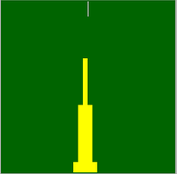

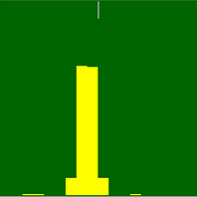
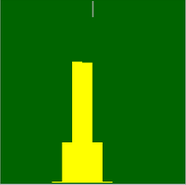
Okno prostokątne
Okno Blackmana
Okno Hamminga
Okno prostokątne
Okno Blackmana
Okno Hamminga

Slide 2

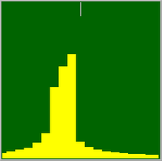
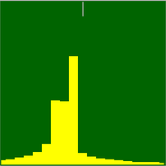

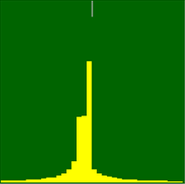
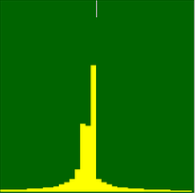
Δf = 0 Hz
Δf = 563 Hz
Δf = 588 Hz
Δf = 0 Hz
Δf = 147 Hz
Δf = 148 Hz

