Slide 1

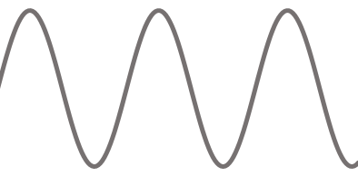
STM32F769
MIKROKONTROLER
ADC
ETHERNET
ZASILANIE

Slide 2
GENERATOR
STM32F769
MIKROKONTROLER
ADC
ETHERNET
ZASILANIE
ANALIZATORWIDMA
OSCYLOSKOP

