Slide 1

The Spiritual Development of Your Child

Slide 2

Deuteronomy 11:18,19 ¹⁸ “You shall therefore ^{[a]}impress these words of mine on your heart and on your soul; and you shall bind them as a sign on your hand, and they shall be as ^{[b]}frontals ^{[c]}on your forehead. ¹⁹ You shall teach them to your sons, talking of them when you sit in your house and when you walk along the road and when you lie down and when you rise up.
Notes:
Every year the parents went to Jerusalem for the festive, by age 12 they tag along with him cause of “bar mitzah” verse 41
<number>

Slide 3
What is wrong with Children today?

Slide 4

Historically, the home, under the guidance of parents has been the spiritual training ground for children.
spiritual training of children outside the home is uncommon in scripture.
There is need for parents to create an atmosphere in the home that is conducive for spiritual development.
Spiritual Development of Your Child
Notes:
Before age Twelve is presupposes that the parents shared their convictions with Jesus. Verse 40 The boy grew up and become strong, filled with wisdom, and God`s grace was on him.
<number>

Slide 5

Constantly under satan's attack
Peer influence – Bad company corrupts.
Uncontrolled Media
If the head of the household falls into sin, the whole family may crumble

Slide 6
Wise Decision
Joshua Decided that…
“And if it seems evil to you to serve the LORD, choose for yourselves this day whom you will serve, whether the gods which your fathers served that were on the other side of the River, or the gods of the Amorites, in whose land you dwell. But as for me and my house, we will serve the LORD." NKJV Josh 24:15

Slide 7

The Christian faith is not a private matter as some would want to put it.
It is a household matter;
It is a community matter
God hold the parents responsible
<number>
Notes:
Verse 44….
<number>

Slide 8

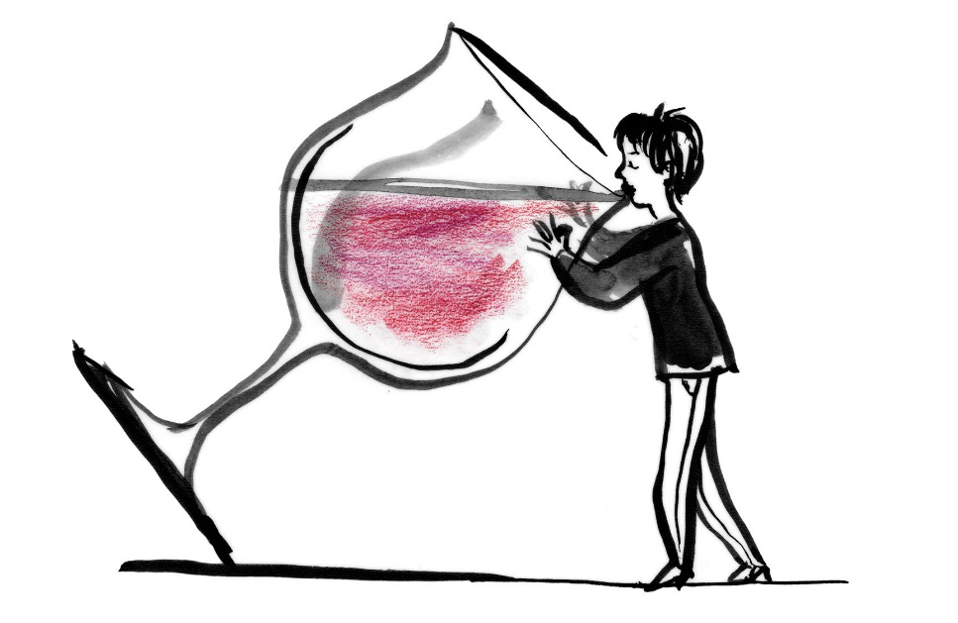

Teach Biblical Principals… Must model what we Teach (what is your attitude towards)
Rated MOVIES
DRINKING
Christian liberties. Galatians 5:13
SMOKING

Slide 9

.Children often see in black and white. .They practice what they see and tend to go overboard. .Consider giving up your liberties.

Slide 10

CHURCH
Look for a church that:
Is good for the whole Family
Good Worship
Challenging teaching in Sunday school
Feeds you spiritually
Allows you to serve
Has a good youth program

Slide 11
Routines for Ages 0-5
Evening Routine
Singing Hymns
Scripture Memory
Reading the Bible
Prayer
For meals(No matter where they are.)
During crisis
Before/After sleep
Listen to Christian Music(a wide variety)
In the car
At home

Slide 12
Let your life be transparent
Children should observe
Observation
Dad/Mom reading bible in the living room
Dad/Mom sharing latest verse - let them check you on the verse
Dad/Mom preparing bible study
Dad/Mom serving in the church
<number>

Slide 13
Dad/Mom speaking in public. Giving testimony
Dad and Mom praying together
<number>

Slide 14

Use holidays to emphasize the spiritual nature of our faith. e.g. Easter and Christmas Teach the folly of santa clause, the worlds view of meeting their needs without God

Slide 15
Age 6 - 10
Build upon what you started
Choose character over doctrine when choosing friends at this stage
Be consistent in going to church with the kids
Continue in scripture memory

Slide 16
Life Goals
Teach on giving – this can start earlier
Require children to participate in church activities
Take their church assignments seriously

Slide 17
As they get Older
Answer questions about:
Social standing and Success
Academics vs. Walk with God
Spiritual activity outside the home
Spiritual activity outside your church

Slide 18

Let your children reap the benefits of having Christian Parents. Let your kids be the ones that stand out in public – because of their Christian heritage.
Notes:
Benefits, like praying for them… verse 49…
<number>

