Slide 1

Cryptanalysis of Retro Block Ciphers
Adam Johnstone – GLJD44 - COMP3012_2024
Notes:
Hello everyone, my name is Adam and today I will be talking to you about my dissertation project, A Cryptanalysis of Retro Block Ciphers

Slide 2
Presentation Outline
Background information
Project Description
Motivation
Approach
Conclusions
Notes:
So, a brief overview of what I will be talking about:
I’ll first introduce some of the basic concepts needed to understand the complexities of my project
I will then move on to provide a formal and an informal description of my project, outlining key points and referencing my research question
After this I will then go on to talk about my motivation for pursuing this project and the implications it could have on the wider cryptographic community
Next, I will detail how I will approach the project, and I will end by summing up my slides

Slide 3
Background
What is cryptanalysis?
What is a block cipher?
Notes:
To start I’m going to break down my project title and give a brief explanation of its components
So, what is cryptanalysis? Essentially it is code breaking. You will have probably heard of Alan Turing and who in WW2 he helped to crack the ENIGMA machine, well he did this through cryptanalysis. Since then, the field has grown significantly introducing new techniques such as linear and differential cryptanalysis as well as enhancements on top of these such as boomerang and side-channel attacks.
Now, what is a block cipher? To boil it down, a block cipher is a type of algorithm widely used in cryptography that operates on fixed length inputs called blocks and produces encrypted output blocks of the same size by repeatedly applying a round function. Notably a block cipher called AES is currently one of the main ways to encrypt data within the modern world.

Slide 4
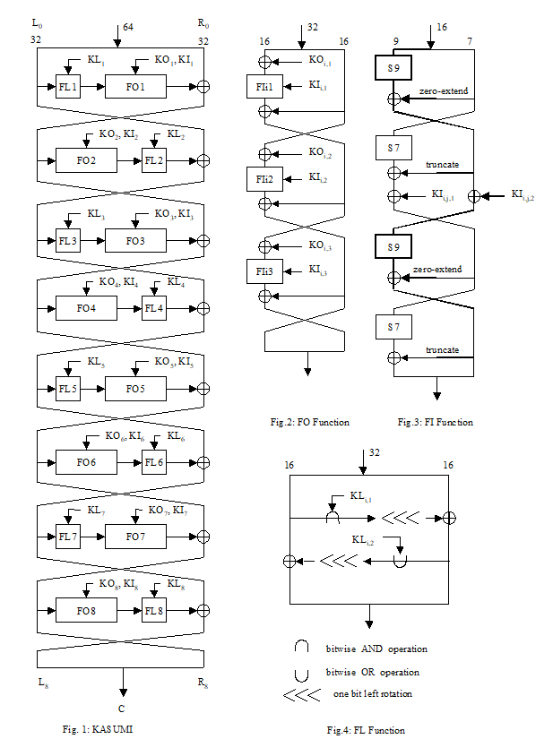
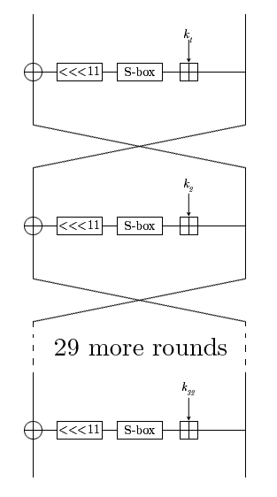
My Project
KASUMI
GOST
Notes:
So how do these terms apply to my project?
Well, I will be performing a cryptanalysis of two block ciphers, KASUMI and GOST, using a technique first introduced by Shamir et al in 2010 called the Sandwich attack. On the screen you will see two diagrams that represent the round functions used within KASUMI (left) and GOST (right). Although the KASUMI diagram looks more complex it is only a 7 round block cipher whereas GOST is a 32 round block cipher suggesting that it is in theory more secure than KASUMI. I plan to test this security with the Sandwich attack which is a type of differential cryptanalysis that builds upon a boomerang attack.
The original boomerang attack splits a cipher into two sub-ciphers where each half contains a number of rounds whereas the Sandwich attack splits the cipher into 3 cascading sub-ciphers.

Slide 5

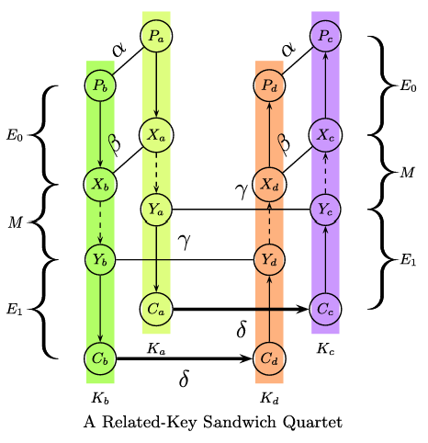
Project Description
Informal
Formal
Can I replicate the findings of published papers
Can the Sandwich attack break GOST
Can I draw conclusions about my research to apply to modern cryptanalysis
Can I apply the Sandwich attack on KASUMI and are the findings from Shamir et al accurate
Can I apply the Related Key Boomerang Attack on GOST and are the findings from Rudskoy accurate
Is the Sandwich attack a feasible method for breaking the GOST block cipher
Is it possible to draw conclusions from my project that suggest the Sandwich attack could be used as a modern attack method
Notes:
So, to describe my project:
Informally I will be using the Sandwich attack to see if I can break the GOST block cipher. I will try to do this by using the information gained from my replication of Shamir et al’s implementation of the Sandwich attack on KASUMI.
Formally, I will be trying to answer the research question, is the sandwich attack a feasible method for breaking the GOST block cipher? To begin answering this I will need to take the existing implementation of the Sandwich attack on KASUMI and adapt it in such a way that it is able to perform on GOST. To help with this transformation I will also implement a Related Key Boomerang attack on GOST from which I can build a sandwich attack on top of.

Slide 6
Project Description
Informal
Formal
Can I replicate the findings of published papers
Can the Sandwich attack break GOST
Can I draw conclusions about my research to apply to modern cryptanalysis
Can I apply the Sandwich attack on KASUMI and are the findings from Shamir et al accurate
Can I apply the Related Key Boomerang Attack on GOST and are the findings from Rudskoy accurate
Is the Sandwich attack a feasible method for breaking the GOST block cipher
Is it possible to draw conclusions from my project that suggest the Sandwich attack could be used as a modern attack method
Notes:
So, to describe my project:
Informally I will be using the Sandwich attack to see if I can break the GOST block cipher. I will try to do this by using the information gained from my replication of Shamir et al’s implementation of the Sandwich attack on KASUMI.
Formally, I will be trying to answer the research question, is the sandwich attack a feasible method for breaking the GOST block cipher? To begin answering this I will need to take the existing implementation of the Sandwich attack on KASUMI and adapt it in such a way that it is able to perform on GOST. To help with this transformation I will also implement a Related Key Boomerang attack on GOST so that I have two starting points from which I need to find the combination of resulting in a Sandwich attack on GOST.

Slide 7
Project Description
Informal
Formal
Can I replicate the findings of published papers
Can the Sandwich attack break GOST
Can I draw conclusions about my research to apply to modern cryptanalysis
Can I apply the Sandwich attack on KASUMI and are the findings from Shamir et al accurate
Can I apply the Related Key Boomerang Attack on GOST and are the findings from Rudskoy accurate
Is the Sandwich attack a feasible method for breaking the GOST block cipher
Is it possible to draw conclusions from my project that suggest the Sandwich attack could be used as a modern attack method
Notes:
So, to describe my project:
Informally I will be using the Sandwich attack to see if I can break the GOST block cipher. I will try to do this by using the information gained from my replication of Shamir et al’s implementation of the Sandwich attack on KASUMI.
Formally, I will be trying to answer the research question, is the sandwich attack a feasible method for breaking the GOST block cipher? To begin answering this I will need to take the existing implementation of the Sandwich attack on KASUMI and adapt it in such a way that it is able to perform on GOST. To help with this transformation I will also implement a Related Key Boomerang attack on GOST so that I have two starting points from which I need to find the combination of resulting in a Sandwich attack on GOST.

Slide 8
Motivation
Sandwich attack created in 2010, hasn’t really been used since despite potentially promising performance improvements
Due to the Sandwich attack being built upon a Boomerang attack, it could suggest that wherever you can perform a Boomerang attack you can perform a Sandwich attack
Could lead to an efficient attack on modern block ciphers
Building upon the limited documentation to aid understanding of the Sandwich attack
Notes:
My motivation for undertaking this project stems from the lack of utilisation of the sandwich attack within the cryptographic community.
Other than the original paper I have only been able to find one other instance of a sandwich attack implementation which was by Jana et al in 2023.
However, in their original paper Shamir et al were able to significantly reduce the time complexity of the best-known attack on KASUMI.
This suggests that the sandwich attack could potentially reduce the time complexity of the best-known attacks on other block ciphers.
Subsequently my project will try to implement the sandwich attack on the GOST block cipher as a stepping stone to generalising the sandwich attack for all block ciphers.
If I am successful in showing that the sandwich attack could reduce the time complexity of the best-known attack on GOST (or at least get close to) then it would be reasonable to say that since some of the best-known attacks on modern block ciphers, (such as AES), utilise Boomerang attacks, from which sandwich attacks stem from, then the sandwich attack could potentially be used to also reduce the time complexity of the best-known attacks on those ciphers.
Were this to be the case then, depending on the time complexity reduction, cryptographic models may have to be adapted to withstand sandwich attacks or changed entirely.
Alternatively, if I prove that the sandwich attack is not applicable to block ciphers in general through my implementation on GOST then I will have provided useful knowledge to the cryptographic community suggesting that the sandwich attack is not a viable method for use within modern cryptanalysis.

Slide 9
My Approach to the Project
Implement the original Sandwich attack on KASUMI proposed by Shamir et al
Implement a Related Key Boomerang Attack on GOST proposed by Rudskoy
Perform some analysis on whether an implementation of a Sandwich attack on GOST would be feasible
If I think it's feasible then implement a Sandwich attack on GOST
If I don’t think it's feasible then add to the Sandwich attack documentation and provide details of my findings e.g. proving why the Sandwich attack doesn’t work on GOST and what would need to change for it to work
Notes:
My approach to this project will try to follow a linear path that should aid me in developing my understand of the topics as well as creating a clear path from the start to the end.
I will begin by replicating the original Sandwich attack on KASUMI as well as a related key boomerang attack on GOST. The reason for also implementing a RKBA on GOST is because this should provide a nice middle ground before implementing the sandwich attack due to the sandwich attack being based on a RKBA.
After this I will then need to perform some probability analysis to see whether the sandwich attack will work within reasonable time on GOST. This is because there is no point implementing an attack that is known to be computationally slower than known attacks.
If I can show the sandwich attack to be feasible on GOST then I will implement it and note down my results to compare to the best-known attacks
If I can’t show the sandwich attack to be feasible then I will add to the Sandwich attack documentation by doing things such as providing more comprehensive pseudocode, creating simpler explanations of the sandwich attack, and by providing worked examples. These currently don’t exist within the cryptographic community so I think that they would be beneficial to create.

Slide 10
Conclusions
Can I use the Sandwich attack to break GOST
Can I break GOST with reasonable constraints
Does this then have implications for modern block ciphers and cryptanalysis
Can I improve upon the Sandwich attack literature to help others understand it more easily
Notes:
To conclude, my project will consist of trying to establish whether an implementation of the Sandwich attack on the GOST block cipher is feasible within reasonable time constraints. This will hopefully provide information on the possibility of generalising the Sandwich attack for all block ciphers and whether its use in modern cryptanalysis is viable.
Thank you all for listening I will now take any questions

Slide 11
Bibliography
Rudskoy, V. (2010). On zero practical significance of “"Key recovery attack on full GOST block cipher with zero time and memory”". Cryptology ePrint Archive, Paper 2010/111. https://eprint.iacr.org/2010/111
Dunkelman, O., Keller, N. & Shamir, A. A Practical-Time Related-Key Attack on the KASUMI Cryptosystem Used in GSM and 3G Telephony. J Cryptol 27, 824–849 (2014). https://doi.org/10.1007/s00145-013-9154-9
Jana, A., Rahman, M., Saha, D., & Paul, G. (2023). Switching the Top Slice of the Sandwich with Extra Filling Yields a Stronger Boomerang for NLFSR-based Block Ciphers. Cryptology ePrint Archive, Paper 2023/1543. https://eprint.iacr.org/2023/1543
3rd Generation Partnership Project, Technical specification group services and system aspects, 3G security. Specification of the 3GPP Confidentiality and Integrity Algorithms; Document 2: KASUMI Specification, V18.0.0 (2024)
Dolmatov, V., Ed., and D. Baryshkov, "GOST R 34.12-2015: Block Cipher "Magma"", RFC 8891, DOI 10.17487/RFC8891, September 2020, <https://www.rfc-editor.org/info/rfc8891>.

