Slide 1

CS M151B / EE M116C
Computer Systems Architecture
Prof. Lei He
Lhe@ee.ucla.edu

Slide 2
What is Computer Architecture?
Computer Architecture
  Instruction Set Architecture
  Machine Organization
Hardware Designer
  circuits, components, timing, functionality, ease of debugging
  “construction engineer”
Computer Architect
  high-level components, how they fit together, how they work together to deliver performance.
  “building architect”
Notes:
A construction-worker has all of the skills necessary to build a building (hammering, sawing, laying concrete), but that doesn’t mean he knows how to build a building. In cse 140, you learned everything you need to know to build a house. But you didn’t learn how to build a house. In this class, we’ll teach you how to take the skills you learned in 140, and build that house.
big picture, high-level view
architect has more control over performance than anyone else on the design team.

Slide 3
Why Computer Architecture?
Industry is rapidly changing
  new problems
  new opportunities
  different tradeoffs
Race for high performance, low power/area
But what will it do for me?
  you want to call yourself a “computer scientist”
  you want to build high performance software
  you need to make a purchasing decision
  you may decide to go into this field!
Notes:
What is it that makes computer architecture so fun?

Slide 4

How do we classify CA?
Application
Operating
System
Compiler
Firmware
Instruction Set
Architecture
Instr. Set Proc.
I/O system
Datapath & Control
Digital Design
Circuit Design
Layout
Coordination of many levels of abstraction
Under a rapidly changing set of forces
Design, Measurement, and Evaluation

Slide 5
Forces on Computer Architecture
Technology
Programming
Languages
Applications
Computer
Architecture
Cleverness
Operating
Systems
History
Notes:
History/Applications matters because
1) People buy computers to run programs
2) Most people don;’t write own programs
3) Documented IDA interface means people ship binary machine code

Slide 6
Instruction Set Architecture
“... the attributes of a [computing] system as seen by the programmer, i.e., the conceptual structure and functional behavior, as distinct from the organization of the data flows and controls the logic design, and the physical implementation.”
– Amdahl, Blaaw, and Brooks, 1964
Instruction Set Architecture (ISA):
  Anything a programmer needs to know to make an assembly-language program work correctly.
    Instruction formats
    What the instructions do
    number and types of registers
    addressing modes, exceptional conditions, ...
  Interface between hardware and low-level software
  Standardizes instructions, machine language bit patterns
  Different implementations of the same architecture
  Can prevent using new innovations

Slide 7
ISA Examples
Alpha (v1, v3) 1992-97
PA-RISC (v1.1, v2.0) 1986-96
Sparc (v8, v9) 1987-95
MIPS (MIPS I, II, III, IV, V) 1986-96
x86 (8086,80286,80386, 1978-
80486,Pentium, MMX, ...)
IA64 Itanium 2002-

Slide 8
MIPS R3000 ISA
Instruction Categories
  Load/Store
  Computational
  Jump and Branch
  Floating Point
    coprocessor
  Memory Management
  Special
Registers
R0 - R31
PC
HI
LO
3 Instruction Formats: all 32 bits wide
OP
rs
rt
rd
sa
funct
OP
rs
rt
immediate
OP
jump target

Slide 9
Organization
Design your hardware to implement the ISA
Capabilities & performance characteristics of principal functional blocks
  (e.g., Registers, ALU, Shifters, Logic Units, ...)
Interconnections of various blocks
Control between blocks
We can have many different implementations of a given ISA
  scaling trends
  new performance enhancing techniques
Notes:
Design state of art organization in 1990

Slide 10
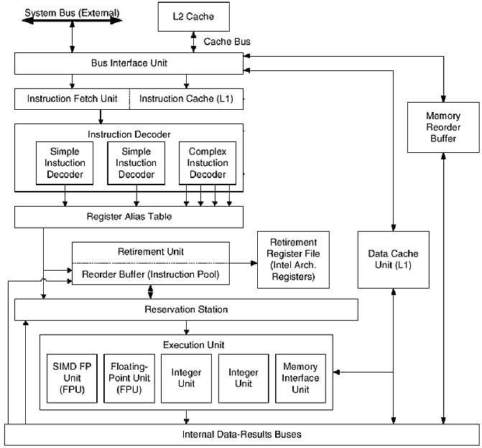
Example Organization - PIII

Slide 11
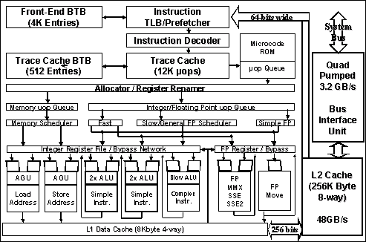
Example Organization 2 - P4

Slide 12
High Level View of a Computer
Processor
Input
Control
Memory
Datapath
Output
Notes:
In terms of the overall picture, by now we have covered all 5 components of the computer.
Today we will talk about how to interface the I/O devices to the processor and memory via busses and the OS software.
Next Wednesday, we will show you how multiple computers can be connected together with a network through the I/O devices.
+1 = 5 min. (X:45)

Slide 13
Performance
1
2
0
0
D
E
C
A
l
p
h
a
2
1
2
6
4
/
6
0
0
1
1
0
0
1
0
0
0
9
0
0
8
0
0
e
7
0
0
c
n
a
m
r
6
0
0
o
f
r
e
P
5
0
0
D
E
C
A
l
p
h
a
5
/
5
0
0
4
0
0
3
0
0
D
E
C
A
l
p
h
a
5
/
3
0
0
2
0
0
D
E
C
A
l
p
h
a
4
/
2
6
6
1
0
0
S
U
N
-
4
/
M
I
P
S
M
I
P
S
I
B
M
I
B
M
P
O
W
E
R
1
0
0
2
6
0
M
/
1
2
0
M
2
0
0
0
R
S
6
0
0
0
H
P
9
0
0
0
/
7
D
E
C
A
X
P
/
5
0
0
0
5
0
1
9
8
7
1
9
8
8
1
9
8
9
1
9
9
0
1
9
9
1
1
9
9
2
1
9
9
3
1
9
9
4
1
9
9
5
1
9
9
6
1
9
9
7
Y
e
a
r

Slide 14
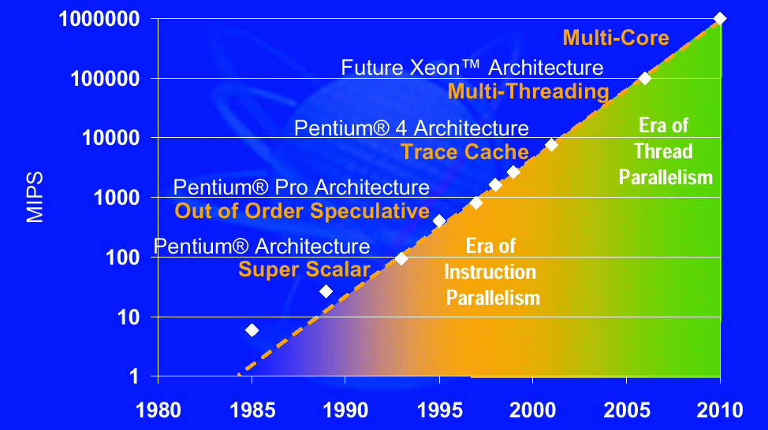
Performance
source: Intel

Slide 15
Power
What is power?
  Energy is measured in Joules
  Power is rate of energy consumption
    Joules per second (Watts)
    Power Density - power/area
Why do we care about this?
  California’s energy crisis?
  Power is dissipated as heat
    Heat is hard to get rid of!
      Workstation processor might use 70 Watts
      Limits how densely components can be packaged
  Battery power is limited!

Slide 16
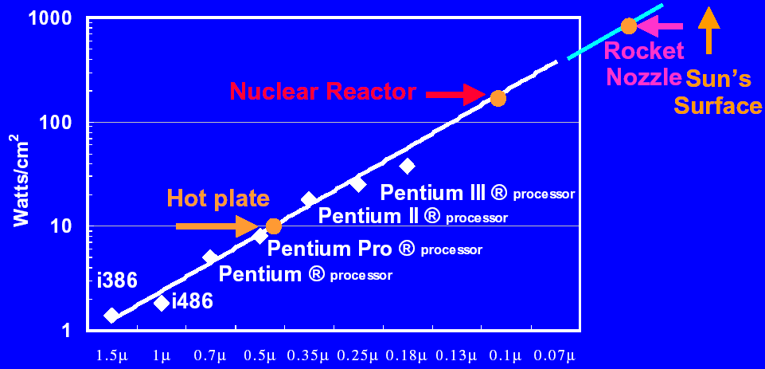
Power Density
source: Fred Pollack - Keynote MICRO32
P4 Willamette - 75 Watts, 217 mm² die, .18μm, 1.75 V, 1.3-2.0 GHz
P4 Northwood - 62-68 Watts, 146 mm² die, .13μm, 1.5 V, 1.4-3.6 GHz

Slide 17
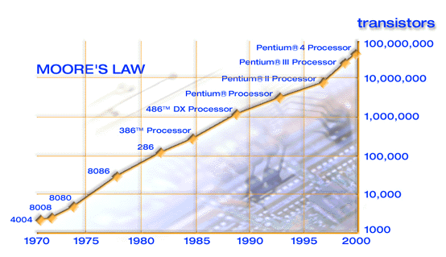
Area
"doubling of transistor density on a manufactured die every year"
source: Intel Website

Slide 18
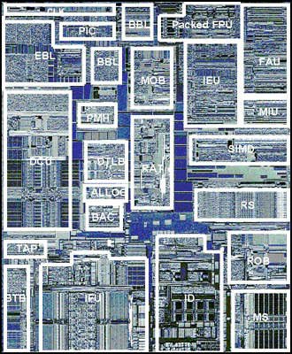
Pentium III Die Photo
EBL/BBL - Bus logic, Front, Back
MOB - Memory Order Buffer
Packed FPU - MMX Fl. Pt. (SSE)
IEU - Integer Execution Unit
FAU - Fl. Pt. Arithmetic Unit
MIU - Memory Interface Unit
DCU - Data Cache Unit
PMH - Page Miss Handler
DTLB - Data TLB
BAC - Branch Address Calculator
RAT - Register Alias Table
SIMD - Packed Fl. Pt.
RS - Reservation Station
BTB - Branch Target Buffer
IFU - Instruction Fetch Unit (+I$)
ID - Instruction Decode
ROB - Reorder Buffer
MS - Micro-instruction Sequencer
1st Pentium III, Katmai: 9.5 M transistors, 12.3 * 10.4 mm in 0.25-mi. with 5 layers of aluminum
source: www.tomshardware.com
Notes:
From http://www.tomshardware.com/cpu/99q3/990810/
Statistics
0.25 micron 5-layer metal CMOS process technology
9.5M transistors
10.2 x 12.1 mm die size (excluding the etch ring)
3-way superscalar out-of-order execution micro-architecture
70 new streaming SIMD instructions:
Comprehensive set of new SIMD-FP instruction set
Additional SIMD-integer MMX Technology instructions
New memory streaming instructions (for FP & integer data types)
Bottom left quadrant
Logic for the front-end of the pipeline resides here.
IFU
Instruction Fetch Unit. Instruction fetch logic and a 16K Byte 4-way set-associative level one
instruction cache resides in this block. Instruction data from the IFU is then forwarded to the ID.
BTB
Branch Target Buffer. This block is responsible for dynamic branch prediction based on the
history of past branch decisions paths.
BAC
Branch Address Calculator. Static branch prediction is performed here to handle the BTB miss
case.
TAP
Testability Access Port. Various testability and debug mechanisms reside within this block.
Bottom right quadrant
Instruction decode, scheduling, dispatch, and retirement functionality is contained within this
quadrant.
ID
Instruction Decoder. This unit is capable of decoding up to 3 instructions per cycle.
MS
Micro-instruction Sequencer. This holds the microcode ROM and sequencer for more complex
instruction flows. The microcode update functionality is also located here.
RS
Reservation Station. Micro-instructions and source data are held here for scheduling and dispatch
to the execution ports. Dispatch can happen out-of-order and is dependent on source data
availability and an available execution port.
ROB
Re-Order Buffer. This supports a 40-entry physical register file that holds temporary write-back
results that can complete out of order. These results are then committed to a separate
architectural register file during in-order retirement.
Top right quadrant
This primarily consists of the execution datapath for the Pentium® III processor.
SIMD
SIMD integer execution unit for MMX Technology instructions.
MIU
Memory Interface Unit. This is responsible for data conversion and formatting for floating point
data types.
IEU
Integer Execution Unit. This is responsible for ALU functionality of scalar integer instructions.
Address calculations for memory referencing instructions are also performed here along with
target address calculations for jump related instructions.
FAU
Floating point Arithmetic Unit. This performs floating point related calculations for both existing
scalar instructions along with support for some of the new SIMD-FP instructions.
PFAU
Packed Floating point Arithmetic Unit. This contains arithmetic execution data-path functionality
for SIMD-FP specific instructions.
Top left quadrant
Functionality in this quadrant is split into assorted functions including bus interface related
functionality, data cache access, and allocation.
ALLOC
Allocator. Allocation of various resources such as ROB, MOB, and RS entries is performed here
prior to micro-instruction dispatch by the RS.
RAT
Register Alias Table. During resource allocation the renaming of logical to physical registers is
performed here.
MOB
Memory Order Buffer. Acts as a separate schedule and dispatch engine for data loads and
stores. Also temporarily holds the state of outstanding loads and stores from dispatch until
completion.
DTLB
Data Translation Look-aside Buffer. Performs the translation from linear addresses to physical
address required for support of virtual memory.
PMH
Page Miss Handler. Hardware engine for performing a page table walk in the event of a TLB
miss.
DCU
Data Cache Unit. Contains the non-blocking 16K Byte 4-way set-associative level one data cache
along with associated fill and write back buffering.
BBL
Back-side Bus Logic. Logic for interface to the back-side bus for accesses to the external unified
level two processor cache.
EBL
External Bus Logic. Logic for interface to the external front-side bus.
PIC
Programmable Interrupt Controller. Local interrupt controller logic for multi-processor interrupt
distribution and boot-up communication.

Slide 19
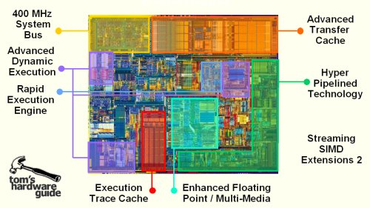
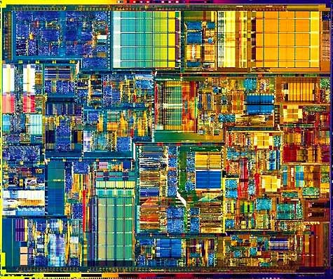
Die Photo of P4

Slide 20
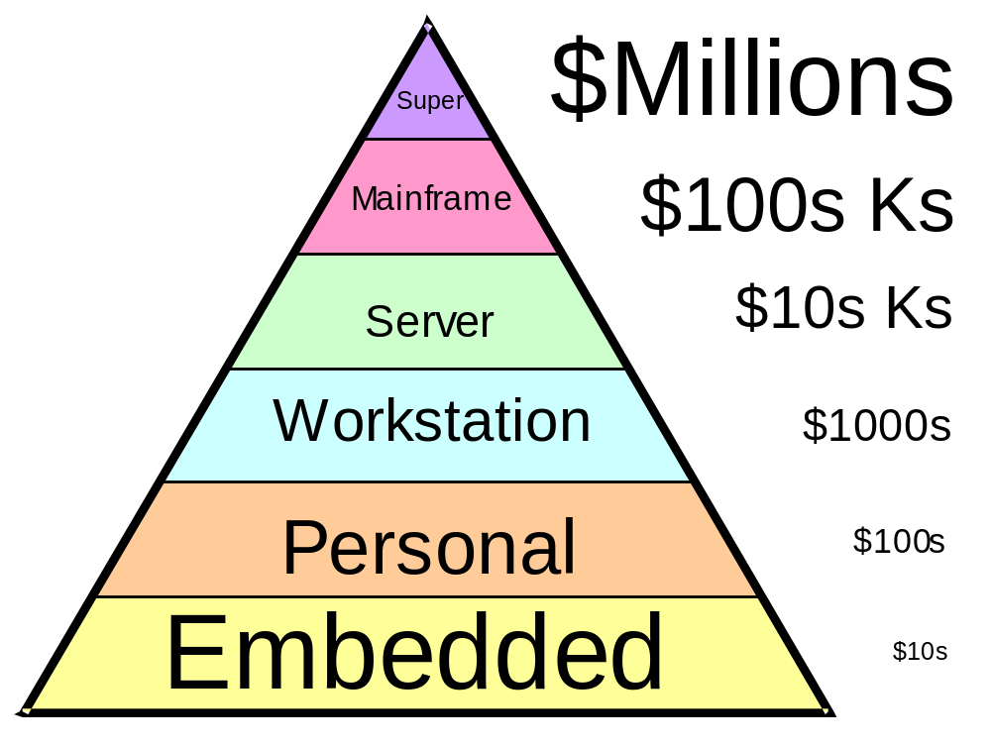
Price/Performance Pyramid
Differences in scale,
not in substance
Figure 3.4 Classifying computers by computational power and price range.
Slide from Prof. B Parhami at UCSB

Slide 21
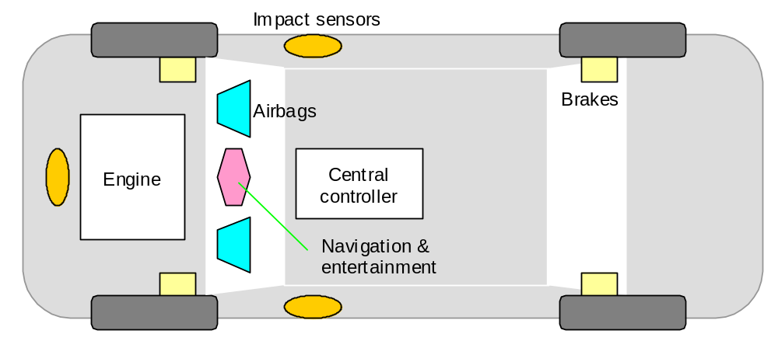
Automotive Embedded Computers
Figure 3.5 Embedded computers are ubiquitous, yet invisible. They are found in our automobiles, appliances, and many other places.
Slide from Prof. B Parhami at UCSB

Slide 22
Generations of Progress
Table 3.2 The 5 generations of digital computers, and their ancestors.
Generation (begun) | Processor technology | Memory innovations | I/O devices introduced | Dominant look & fell
0 (1600s) | (Electro-) mechanical | Wheel, card | Lever, dial, punched card | Factory equipment
1 (1950s) | Vacuum tube | Magnetic drum | Paper tape, magnetic tape | Hall-size cabinet
2 (1960s) | Transistor | Magnetic core | Drum, printer, text terminal | Room-size mainframe
3 (1970s) | SSI/MSI | RAM/ROM chip | Disk, keyboard, video monitor | Desk-size mini
4 (1980s) | LSI/VLSI | SRAM/DRAM | Network, CD, mouse,sound | Desktop/ laptop micro
5 (1990s) | ULSI/GSI/ WSI, SOC | SDRAM, flash | Sensor/actuator, point/click | Invisible, embedded
Slide from Prof. B Parhami at UCSB

Slide 23
What you will learn
Rapidly changing field: doubling every 1.5 years:
  memory capacity
  processor throughput (Due to advances in technology and organization)
Things you’ll be learning:
  how computers work, a basic foundation
  how to analyze their performance (or how not to!)
  issues affecting modern processors (caches, pipelines)

Slide 24
Technology Trends
Memory Gap (Wall)
  Processor speed - 60% / year
  Memory (DRAM) speed - 7% / year
    but capacity doubles every 1.5 years!
Interconnect Scaling Bottleneck (deep submicron effect)
  Interconnect not scaling with transistors
  Size of future structures
  Bypassing results between pipeline stages
Clock scaling
  Deeper pipelines
  Cost of latches and bypass logic

Slide 25
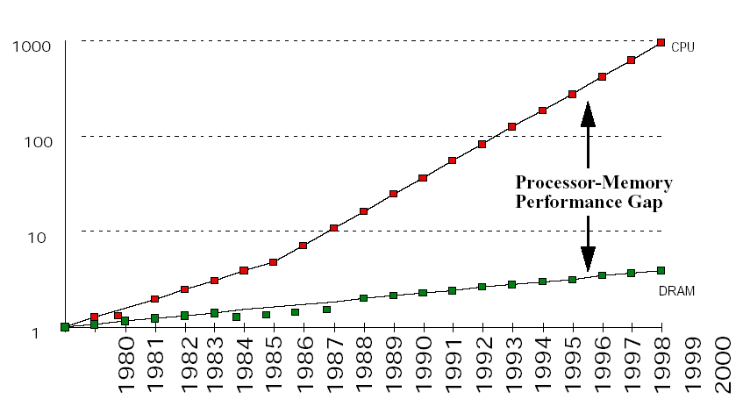
Memory Wall
From: A Case for Intelligent RAM: IRAM
Patterson et al, IEEE MICRO 1997

Slide 26
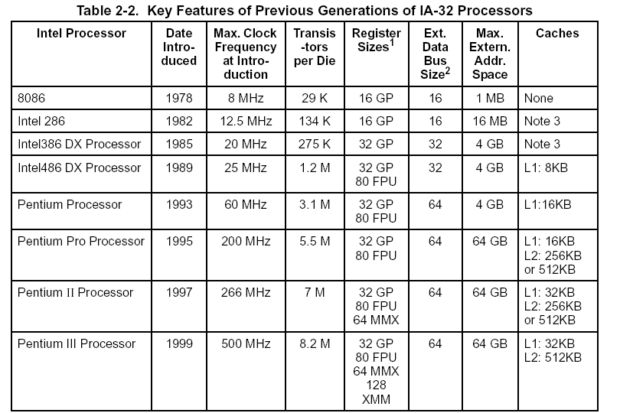
IA-32 History
source: Intel PIII Manual

Slide 27
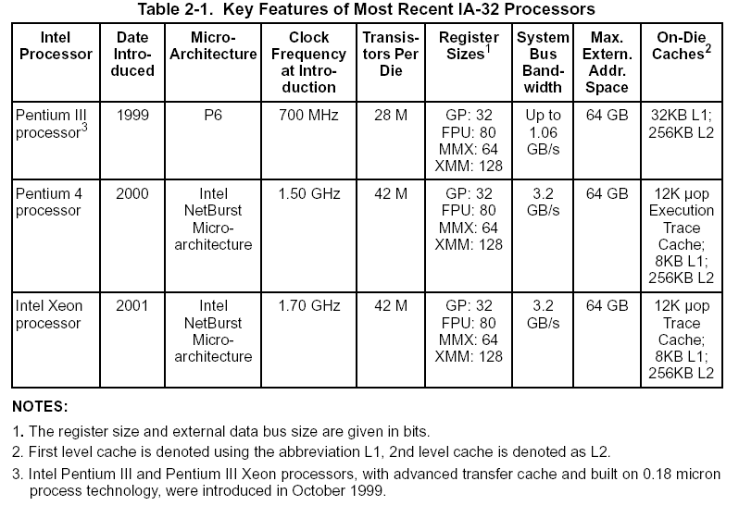
IA-32 History (2)
source: Intel PIII Manual

Slide 28
Levels of Representation
temp = v[k];
v[k] = v[k+1];
v[k+1] = temp;
High Level Language
Program
Note: some
compilers translate
directly to machine
language
Compiler
lw $15, 0($2)
lw $16, 4($2)
sw $16, 0($2)
sw $15, 4($2)
Assembly Language
Program
Assembler
0000 1001 1100 0110 1010 1111 0101 1000
1010 1111 0101 1000 0000 1001 1100 0110
1100 0110 1010 1111 0101 1000 0000 1001
0101 1000 0000 1001 1100 0110 1010 1111
Machine Language
Program
Machine Interpretation
Control Signal
Specification
ALUOP[0:3] <= InstReg[9:11] & MASK
°
°

Slide 29
Key Points
All computers consist of five components
  (1) datapath
  (2) control
  (3) Memory
  (4) Input devices
  (5) Output devices
ISA defines how software can use the hardware
Organization defines how the ISA is implemented
  Heavily influenced by scaling trends
Need to design against constraints of performance, power, area and cost
Challenge: What to do with future silicon real estate?
Processor

