Slide 1

CS M151B / EE M116C
Computer Systems Architecture
Performance
Instructor: Prof. Lei He
<LHE@ee.ucla.edu>
Some notes adopted from Glenn Reinman

Slide 2
Time vs Throughput
Vehicle
Time to San Diego*
Speed
Passengers
Throughput (pmph)
Ferrari
0.75 hours
160 mph
2
320
Greyhound
2 hours
65 mph
60
3900
* obviously this does not include LA traffic!
Time to do the task from start to finish
– execution time, response time, latency
Tasks per unit time
– throughput, bandwidth

Slide 3
Time vs Throughput
Time is measured in time units/job.
Throughput is measured in jobs/time unit.
But “time = 1/throughput” may be false.
  It takes 4 months to grow a tomato.
  Can you only grow 3 tomatoes a year ?
  If you run only one job at a time,
  time = 1/throughput

Slide 4
How To Measure Execution Time?
% time program
... program’s results ...
90.7u 12.9s 2:39 65%
%
user + kernel
wallclock
user CPU time? (time CPU spends running your code)
total CPU time (user + kernel)? (includes op. sys. code)
Wallclock time? (total elapsed time)
  Includes time spent waiting for I/O, other users, ...
Answer depends ...
  For measuring processor speed, we can use total CPU.
  If no I/O or interrupts, wallclock may be better
    more precise (microseconds rather than 1/100 sec)
    can measure individual sections of code

Slide 5
Performance
For “performance”, larger should be better.
  Time is backwards - larger execution time is worse.
CPU performance = 1 / total CPU time
System performance = 1 / wallclock time
These terms only make sense if you know what program is measured ...
  e.g. “The performance on Linpack was 200 MFLOPS”
And if CPU or system only works on 1 program at a time
  This is no longer true in general!
Performance’s units, “inverse seconds”, can be awkward
  Can answer “What was performance?” by “It took 15 seconds.”

Slide 6
Cycles
Every conventional processor has a clock with a fixed cycle time or clock rate
  Rate often measured in MHz = millions of cycles/second
  Time often measured in ns (nanoseconds)
  X MHz corresponds to 1000/X ns (e.g. 500 MHz ↔ 2 ns clock)
How many cycles are required for a given program?
  # cycles = # instructions?
    Does a multiply take as long as an add?
    Floating point ops versus integer ops?
    Memory Latency?
# cycles depends on
  architecture (i.e. how many cycles a given instruction type will take)
  the instruction makeup of the program being evaluated

Slide 7
Definitions
CPU Time = CPU cycles executed * cycle time
CPU cycles = Instructions executed * CPI
Average Clock Cycles per Instruction

Slide 8
Putting It All Together
seconds
One of P&H’s
“big pictures”
CPU Execution Time
Instruction Count
CPI
Clock Cycle Time
=
X
X
instructions
seconds/cycle
cycles/instruction
Note: Instruction count
  Use dynamic instruction count (#instructions executed)
  NOT static instruction count (#instructions in compiled code)

Slide 9
Who Impacts Performance?
CPU Execution Time
Instruction Count
CPI
Clock Cycle Time
=
X
X
Programmer
Compiler Writer
ISA Architect
Machine Architect
Hardware Designer
Materials Scientist
Physicist
Silicon Engineer

Slide 10
Explaining Performance Variation
CPU Execution Time
Instruction Count
CPI
Clock Cycle Time
=
X
X
Same machine, different programs
Same program, different machines, but same ISA
Same program, different ISA’s

Slide 11
Comparing Performance
The fundamental question:
Will computer A run program P
faster than computer B?
Compare clock rates?
Compare CPI?
MIPS?
  Millions of Instructions per Second
    (Instruction Count) / (Execution Time * 10⁶)
    (Clock Rate) / (CPI * 10⁶)
MFLOPS?
Notes:
PowerPC 7450 can execute 1 branch plus 3 other instructions. Other limits apply, but it has 11 functional units, so it’s pretty flexible. But data dependences, mispredicted branches, memory stalls, etc are the killer (to be discussed later in course).

Slide 12
Example from the Text
Execution Time (in seconds) shown:
Which is faster?
But this assumes each program has equal weight
  Program 1 is executed 30% of the time
  Program 2 is executed 70% of the time
How does this change the above calculation?
 | Computer A | Computer B
Program 1 | 1 | 10
Program 2 | 1000 | 100
Total Time | 1001 | 110
Performance_{B}
Performance_{A}
Execution Time_{A}
Execution Time_{B}
1001
110
=
=
= 9.1

Slide 13
Comparing Speeds ...
Computer X is 3 times faster than Y
  “times faster than” (or “times as fast as”) means there’s a multiplicative factor relating quantities
    “X was 3 times faster than Y” → speed(X) = 3 speed(Y)
  “percent faster than” implies an additive relationship
    “X was 25% faster than Y” → speed(X) = (1+25/100) speed(Y)
  “percent slower than” implies subtraction
    “X was 5% slower than Y” → speed(X) = (1-5/100) speed(Y)
    “100% slower” means it doesn’t move at all !
  “times slower than” or “times as slow as” is awkward.
    “X was 3 times slower than Y” means speed(X) = 1/3 speed(Y)
If X is 5% faster than Y, is Y 5% slower than X?

Slide 14
CPI as a Weighted Average
Suppose 1 GHz computer ran short program:
  Load (4 cycles), Shift (1), Add (1), Store (4).
  We have ½ instructions are CPI=4, ½ are CPI=1.
    So weighted average CPI = ½ 4 + ½ 1 = 2.5
    Time = 4 instructions x 2.5 CPI x 1 ns = 10 ns

Slide 15
Benchmarks
A benchmark is a set of programs that are representative of a class of problems.
  We want reproducible results!
  Microbenchmarks – measure one feature of system
    e.g. memory accesses or communication speed
  Kernel – most compute-intensive part of applications
    e.g. Linpack and NAS kernel b’marks (for supercomputers)
  Full application:
    SPEC (int and float)

Slide 16
The SPEC benchmarks
SPEC = System Performance Evaluation Cooperative
  (see www.specbench.org)
  A set of “real” applications along with strict guidelines for how to run them.
  Relatively unbiased means to compare machines.
    Very often used to evaluate architectural ideas
  New versions in 89, 92, 95, 2000, 2004, ...
    SPEC 95 didn’t really use enough memory
  Results are speedup compared to reference machine
    SPEC 95: Sun SPARCstation 10/40 performance = “1”
    SPEC 2000, Sun Ultra 5 performance = “100”
  Geometric mean used to average results

Slide 17
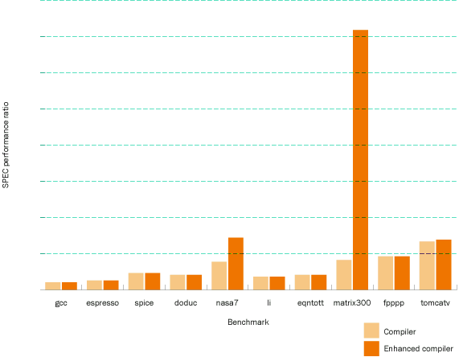
Don’t Forget Compiler Performance
Darker bars show performance with compiler improvements (same machine as light bars)

Slide 18
The SPEC CPU 2000 Suite
SPECint2000 – 12 C/Unix or NT programs
  gzip and bzip2 - compression
  gcc – compiler; 205K lines of messy code!
  crafty – chess program
  parser – word processing
  vortex – object-oriented database
  perlbmk – PERL interpreter
  eon – computer visualization
  vpr, twolf – CAD tools for VLSI
  mcf, gap – “combinatorial” programs
SPECfp2000 – 10 Fortran, 3 C programs
  scientific application programs (physics, chemistry, image processing, number theory, ...)

Slide 19
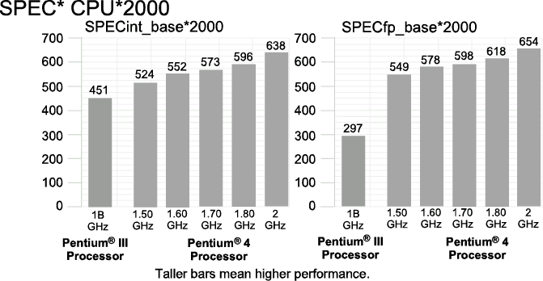
SPEC on Pentium III and Pentium 4

Slide 20
Amdahl’s Law
Suppose:
  total program time = time on part A + time on part B,
  and you improve part A to go p times faster,
then:
  improved time = time on part A/p + time on part B.
The impact of a performance improvement is limited by the percent of execution time affected by the improvement.
Make the common case fast!!
Execution time
after improvement
Execution Time Affected
Amount of Improvement
= + Execution Time Unaffected
Notes:
Do example on board: Suppose 25% of running time is I/O, limited by disk access. Then you can’t improve speed by a factor of 4, no matter how much you improve the processor. Or, if 5% or a program is unparallelizable, you can at most get a factor of 20 speedup running on a parallel supercomputer (even with a gazillion processors) .

Slide 21
Improving Latency
Latency is (ultimately) limited by physics.
  e.g. speed of light
Some improvements are incremental
  smaller transistors shorten distances
  to reduce disk access time, make disks rotate faster
Some improvements can trade latency for CPI
  reducing the size of data cache
Improvements can require new technology
  copper interconnect

Slide 22
Improving Bandwidth
You can improve bandwidth or throughput by throwing money at the problem.
  Use wider buses, more disks, multiple processors, more functional units ...
Two basic strategies:
  Parallelism: duplicate resources.
    Run multiple tasks simultaneously on separate hardware
  Pipelining: break process up into multiple stages
    Reduces the time needed for a single stage
    Build separate resources for each stage.
    Start a new task down the pipe every (shorter) timestep

Slide 23
Key Points
Be careful how you specify performance
Execution time = instructions *CPI *cycle time
Use real applications to measure performance
Throughput and latency are different
Make the common case fast!

