Slide 1

CS M151B / EE M116C
Computer Systems Architecture
ALU Design Part 1
Instructor: Prof. Lei He
<LHE@ee.ucla.edu>
Some notes adopted from Glenn Reinman

Slide 2
Binary Numbers
Consider a 4-bit binary number
Examples of binary arithmetic:
  3 + 2 = 5 3 + 3 = 6
Decimal
Binary
Decimal
Binary
0
0000
4
0100
1
0001
5
0101
2
0010
6
0110
3
0011
7
0111
0
0
1
1
0
0
1
1
+
0
0
1
0
+
0
0
1
1
0
1
0
1
0
1
1
0
Notes:
Here is a quick review of a 4-bit binary number .
The 0 to 7 representation of the number looks like this-what it is is just a binary count.
With this representation, you can perform addition just like adding decimal numbers.
For example here, I show you how to add 3 and 2 with the carry propagates from the 2nd bit to the 3rd bit.
+1 = 21 min. (Y:01)

Slide 3
Two’s Complement Representation
Positive numbers: normal binary representation
Negative numbers: flip bits (0 ←→1) , then add 1
Decimal
-8
-7
-6
-5
-4
-3
-2
-1
0
1
2
3
4
5
6
7
Two’s Complement Binary
1000
1001
1010
1011
1100
1101
1110
1111
0000
0001
0010
0011
0100
0101
0110
0111
Smallest 4-bit
number: -8
Biggest 4-bit
number: 7
Notes:
All of you probably know the 2’s complement representation of negative numbers so this should be a quick review.
You calculate the 2’s compliment representation by taking the bit-wise inverse of the positive number and then add one to 1.
For example, in order to find the 2’s complement representation of negative one:
(a) We first take the bit-wise inverse of 0001 to get 1110.
(b) Then we need to add 1 to it to complete the transformation. This results in 1111.
Notice that in 2’s complement representation, negative numbers always have the most significant bit set to 1 and is referred to as the sign bit.
Consequently, the biggest positive number we can represent with four bits is 7, NOT 8 since 1000 is used to represent negative 8, the smallest negative number
+2 = 23 min. (Y:03)

Slide 4
Two’s Complement Arithmetic
Uses simple adder for + and - numbers
  7 + (- 6) = 1 3 + (- 5) = -2
1
1
1
1
1
0
1
1
1
0
0
1
1
+
1
0
1
0
+
1
0
1
1
0
0
0
1
1
1
1
0
Decimal
2’s Complement Binary
Decimal
2’s Complement Binary
0
0000
-1
1111
1
0001
-2
1110
2
0010
-3
1101
3
0011
-4
1100
4
0100
-5
1011
5
0101
-6
1010
6
0110
-7
1001
7
0111
-8
1000
Notes:
The best thing about 2’s complement representation is that your adder does not have to know about negative number.
You just add the two numbers together and the result will take care of itself.
For example, for the operation 7 minus 6, we simply add negative 6 to positive 7 and ignore the Carry bit coming out of the most significant bit, you will have 0001, the correct result.
+1 = 24 min. (Y:04)

Slide 5
Details of Two’s Complement Notation
Negation
  flip bits and add 1. (Magic! Works for + and -)
  Might cause overflow
Extend sign when loading into large register
  +3 => 0011, 00000011, 0000000000000011
  -3 => 1101, 11111101, 1111111111111101
Overflow detection (need to raise “exception” when answer can’t be represented)
  0101 5
  + 0110 6
  1011 -5 ??!!!

Slide 6
Overflow Detection
0
0
1
0
1
1
0
0
0
0
1
0
2
1
1
0
0
- 4
+
0
0
1
1
3
+
1
1
1
0
- 2
0
1
0
1
5
1
0
1
0
- 6
0
1
1
1
1
0
1
0
0
1
1
1
7
1
1
0
0
- 4
+
0
0
1
1
3
+
1
0
1
1
- 5
1
0
1
0
-6
0
1
1
1
7
So how do we detect overflow?
Notes:
Overflow is signaled by carry out of most-significant bit being different from carry from next bit

Slide 7
Floating Point (FP)
Binary fractions:
  1011₂ = 1x2³ + 0x2² + 1x2¹ + 1x2⁰
AND:
  101.01₂ = 1x2² + 0x2¹ + 1x2⁰ + 0x2⁻¹ + 1x2⁻²
Example:
  .75 = 3/4 = 1/2 + 1/4 = .11₂

Slide 8
Recall Scientific Notation
decimal point
exponent
sign
23
+6.02 x 10
Mantissa
radix (base)
  Issues:
  ° Arithmetic (+, -, *, / )
  ° Representation, Normal form
  ° Range and Precision
  ° Rounding
  ° Exceptions (e.g., divide by zero, overflow, underflow)
  ° Errors
  ° Properties ( negation, inversion, if A = B then A - B = 0 )

Slide 9
IEEE 754 FP Numbers
1
8
23
Single precision
representation of
(-1)^{S} 2^{E-127} (1.M)
S
E
M
sign
bit
exponent:
excess 127
binary integer
mantissa:
sign + magnitude, normalized
binary significand with hidden
integer bit: 1.M
(actual exponent
is e = E - 127)
0 = 0 00000000 00 . . . 0
-1.5 = 1 01111111 10 . . . 0
325 = 101000101 = 1.01000101 x 2⁸
= 0 10000111 01000101000000000000000
.02 = .0011001101100... = 1.1001101100... x 2⁻³
= 0 01111100 1001101100...
range of about 2 X 10⁻³⁸ to 2 X 10³⁸
always normalized (so always leading 1, never shown)
special representation of 0 (E = 00000000)
can do integer compare for greater-than, sign

Slide 10
Double Precision FP (IEEE 754)
1
11
20
32
sign
S
E
M
M
exponent:
excess 1023
binary integer
mantissa:
sign + magnitude, normalized
binary significand with hidden
integer bit: 1.M
actual exponent is e = E - 1023
S
E-1023
N = (-1) 2 (1.M)
52 (+1) bit mantissa
range of about 2 X 10⁻³⁰⁸ to 2 X 10³⁰⁸

Slide 11
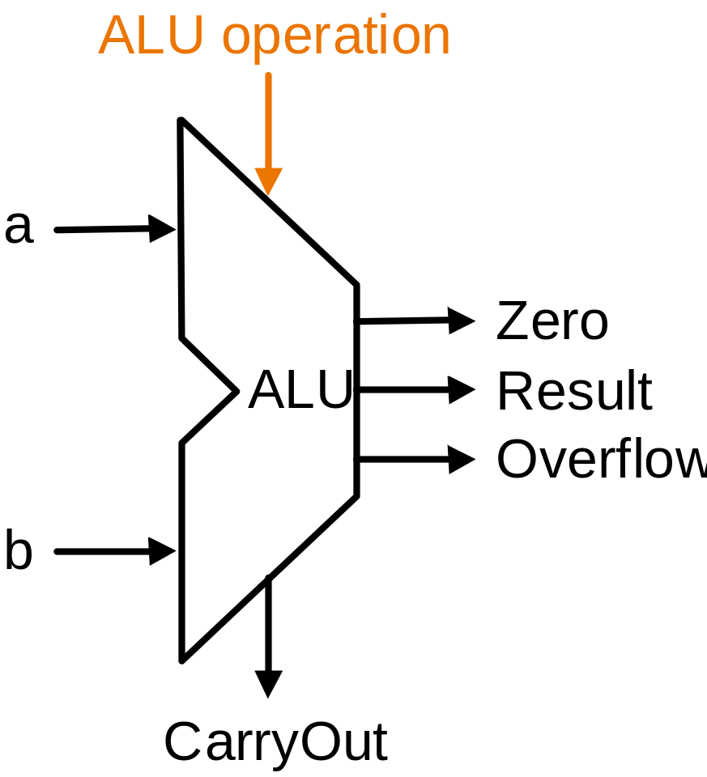
Arithmetic Logic Unit Design
Instruction
Fetch
Instruction
Decode
Operand
Fetch
Execute
Result
Store
Next
Instruction

Slide 12
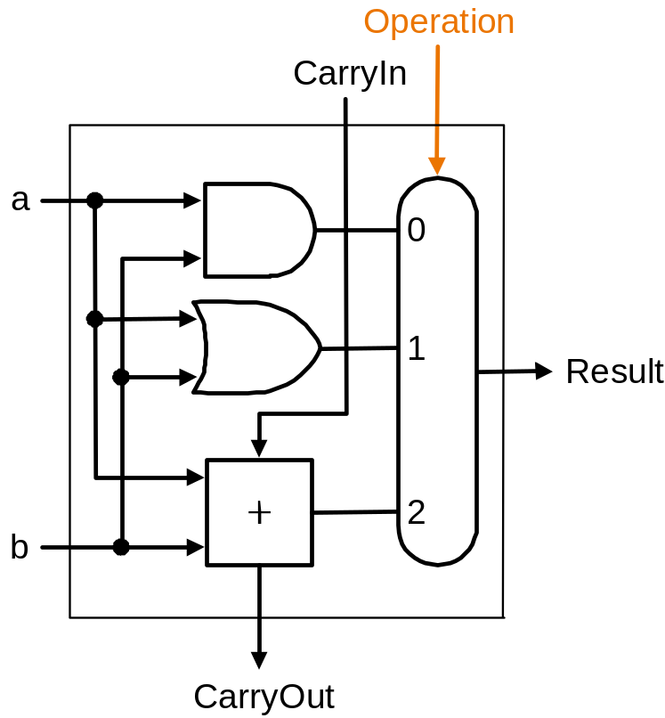
One Bit ALU
Performs AND, OR, and ADD
  on 1-bit operands
  components:
    AND gate
    OR gate
    1-bit adder
    Multiplexor

Slide 13
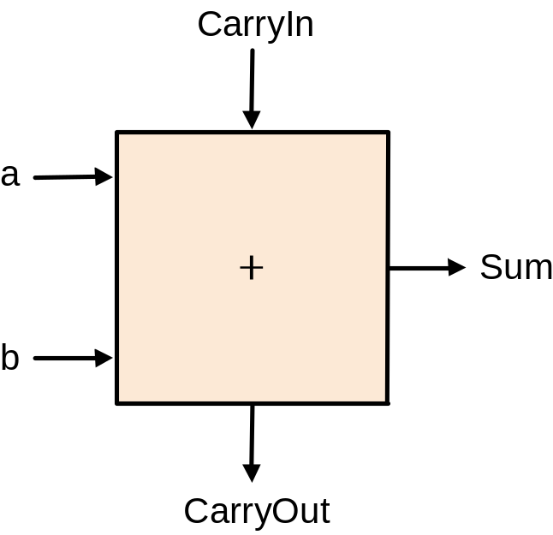
One Bit Full Adder
Also known as a (3,2) adder
Half Adder
  no CarryIn
Inputs |  |  | Outputs |  | Comments
a | b | CarryIn | CarryOut | Sum
0 | 0 | 0 | 0 | 0 | 0+0+0=00
0 | 0 | 1 | 0 | 1 | 0+0+1=01
0 | 1 | 0 | 0 | 1 | 0+1+0=01
0 | 1 | 1 | 1 | 0 | 0+1+1=10
1 | 0 | 0 | 0 | 1 | 1+0+0=01
1 | 0 | 1 | 1 | 0 | 1+0+1=10
1 | 1 | 0 | 1 | 0 | 1+0+1=10
1 | 1 | 1 | 1 | 1 | 1+1+1=11

Slide 14
CarryOut Logic Equation
CarryOut = (!a & b & CarryIn) | (a & !b & CarryIn) | (a & b & !CarryIn) | (a & b & CarryIn)
CarryOut = (b & CarryIn) | (a & CarryIn) | (a & b)
Inputs |  |  | Outputs |  | Comments
a | b | CarryIn | CarryOut | Sum
0 | 0 | 0 | 0 | 0 | 0+0+0=00
0 | 0 | 1 | 0 | 1 | 0+0+1=01
0 | 1 | 0 | 0 | 1 | 0+1+0=01
0 | 1 | 1 | 1 | 0 | 0+1+1=10
1 | 0 | 0 | 0 | 1 | 1+0+0=01
1 | 0 | 1 | 1 | 0 | 1+0+1=10
1 | 1 | 0 | 1 | 0 | 1+0+1=10
1 | 1 | 1 | 1 | 1 | 1+1+1=11

Slide 15
Sum Logic Equation
Sum = (!a & !b & CarryIn) | (!a & b & !CarryIn) | (a & !b & !CarryIn) | (a & b & CarryIn)
Inputs |  |  | Outputs |  | Comments
a | b | CarryIn | CarryOut | Sum
0 | 0 | 0 | 0 | 0 | 0+0+0=00
0 | 0 | 1 | 0 | 1 | 0+0+1=01
0 | 1 | 0 | 0 | 1 | 0+1+0=01
0 | 1 | 1 | 1 | 0 | 0+1+1=10
1 | 0 | 0 | 0 | 1 | 1+0+0=01
1 | 0 | 1 | 1 | 0 | 1+0+1=10
1 | 1 | 0 | 1 | 0 | 1+0+1=10
1 | 1 | 1 | 1 | 1 | 1+1+1=11

Slide 16
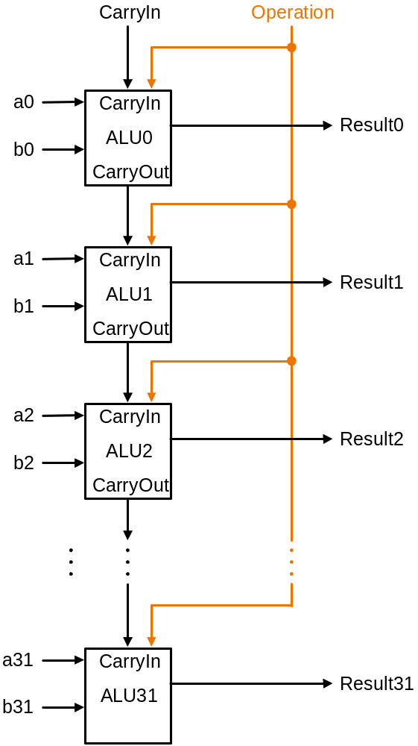
32-bit ALU
Ripple Carry ALU
1-bit ALU
32-bit ALU

Slide 17
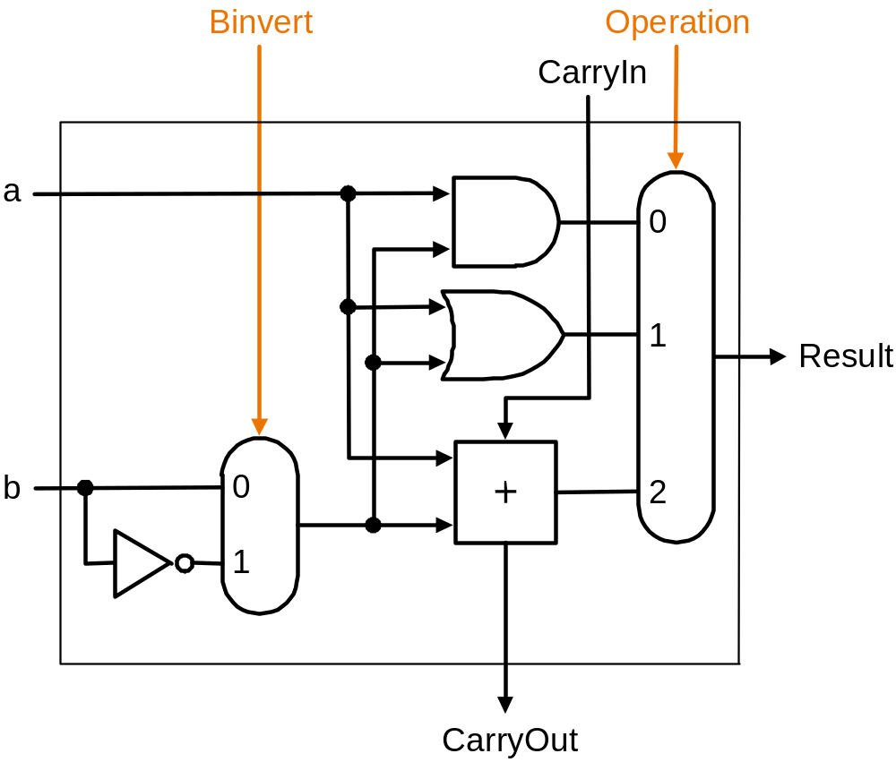
Subtraction?
Expand our 1-bit ALU to include an inverter
  2’s complement: take inverse of every bit and add 1

Slide 18

Overflow
For N-bit ALU
  Overflow = CarryIn[N-1] XOR CarryOut[N-1]
XOR
Overflow
Most significant (N-1) bit ALU

Slide 19
Zero Detection
Conditional Branches
One big NOR gate
Zero = (Result_{N-1}+Result_{N-2}+.... Result₁+Result₀)
Any non-zero result will cause zero detection output to be zero

Slide 20
Set-On-Less-Than (SLT)
SLT produces a 1 if rs < rt, and 0 otherwise
  all but least significant bit will be 0
  how do we set the least significant bit?
  can we use subtraction?
    rs - rt < 0
  set the least significant bit to the sign-bit of (rs - rt)
New input: LESS
New output: SET

Slide 21
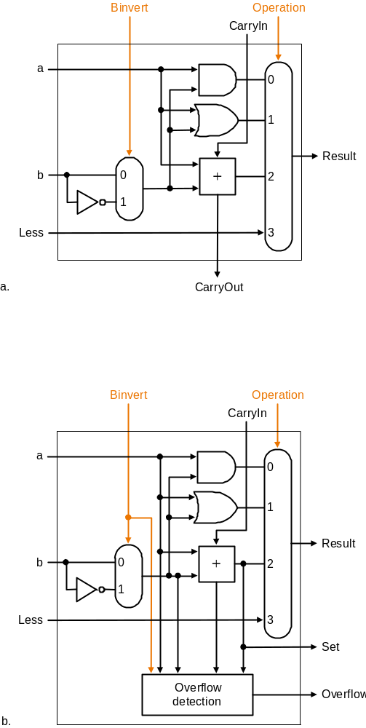
SLT Implementation
All but MSB
Most Significant Bit

Slide 22
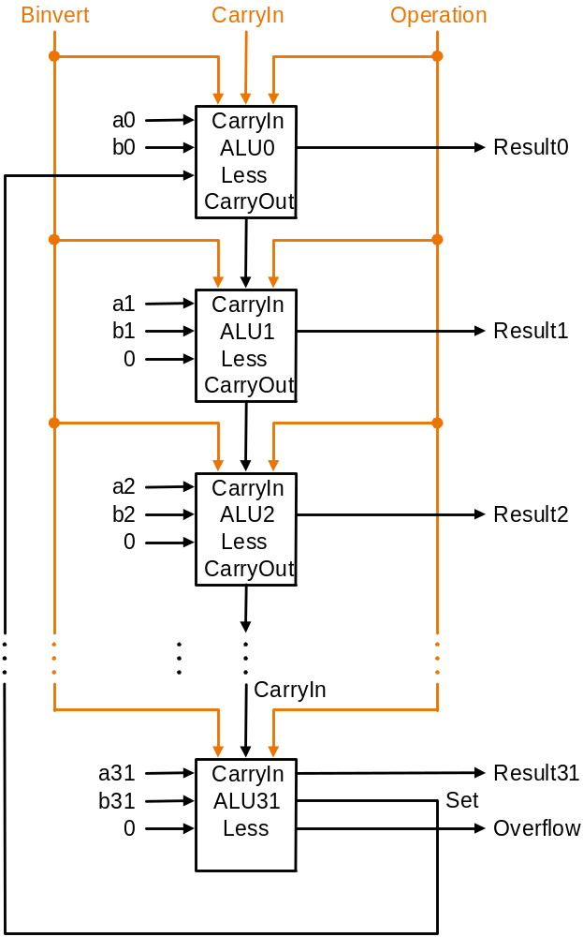
SLT Implementation
Set of MSB is connected to Less of LSB!

Slide 23
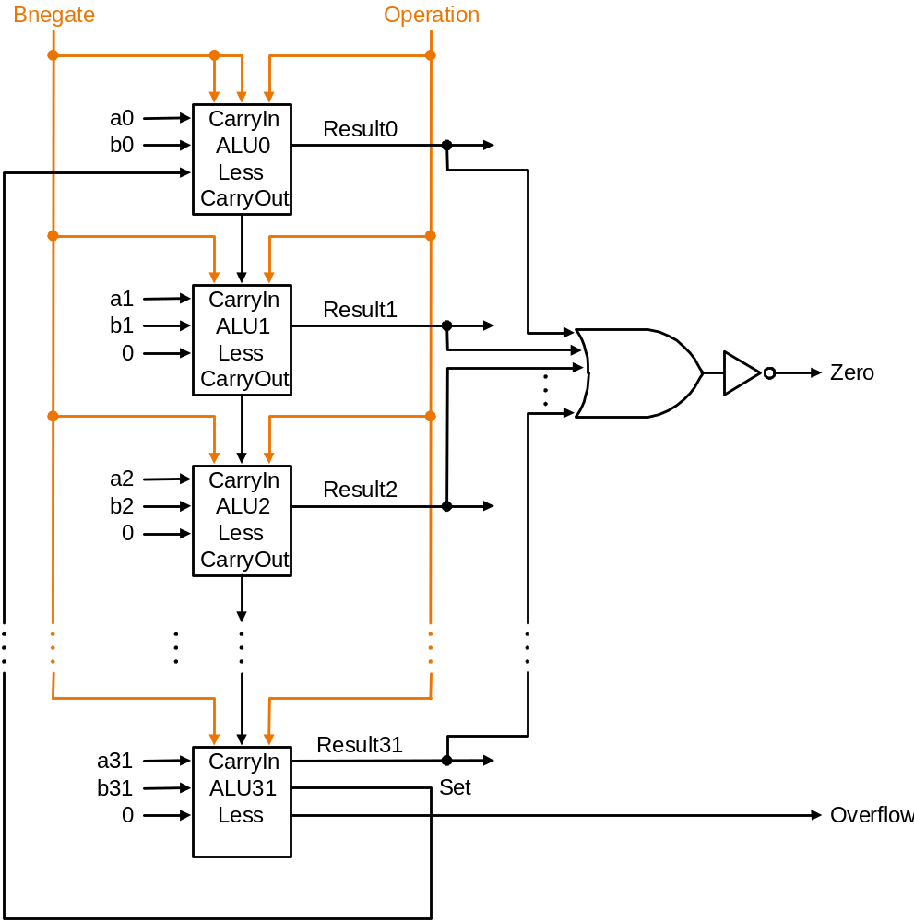
Final Full Adder
You should feel comfortable identifying what signals accomplish:
  add
  sub
  and
  or
  beq
  slt

Slide 24
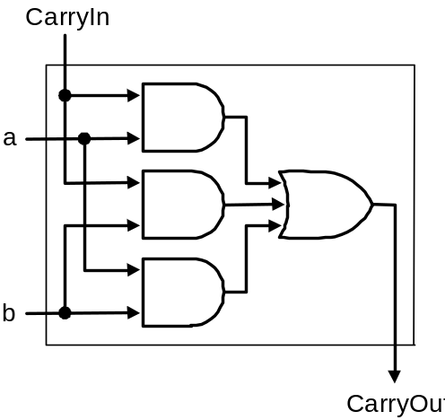
Can We Make a Faster Adder?
Worst case delay for N-bit Ripple Carry Adder
  2N gate delays
  2 gates per CarryOut
  N CarryOuts
We will explore the Carry Lookahead Adder
  Generate - Bit i creates new Carry
    g_{i} = A_{i} & B_{i}
  Propagate - Bit i continues a Carry
    p_{i} = A_{i} | B_{i}

Slide 25
Carry Lookahead Adder (CLA)
Generate - Bit i creates new Carry
  g_{i} = A_{i} & B_{i}
Propagate - Bit i continues a Carry
  p_{i} = A_{i} | B_{i}
Now:
  Cin₁ = g₀ | (p₀ & Cin₀)
  Cin₂ = g₁ | (p₁ & g₀) | (p₁ & p₀ & Cin₀)
  Cin₃ = g₂ | (p₂ & g₁) | (p₂ & p₁ & g₀) | (p₂ & p₁ & p₀ & Cin₀)
This can get expensive if we try a “full” carry lookahead adder!

Slide 26
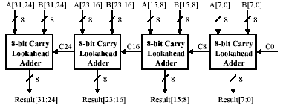
Partial Carry Lookahead Adder
Connect several N-bit Lookahead Adders together
Four 8-bit carry lookahead adders can form a 32-bit partial carry lookahead adder

Slide 27
Hierarchical CLA
C
a
r
r
y
I
n
a
0
C
a
r
r
y
I
n
b
0
R
e
s
u
l
t
0
-
-
3
a
1
b
1
A
L
U
0
a
2
P
0
p
i
b
2
G
0
g
i
a
3
b
3
C
a
r
r
y
-
l
o
o
k
a
h
e
a
d
u
n
i
t
C
1
c
i
+
1
a
4
C
a
r
r
y
I
n
b
4
R
e
s
u
l
t
4
-
-
7
a
5
b
5
A
L
U
1
a
6
P
1
p
i
+
1
b
6
G
1
g
i
+
1
a
7
b
7
C
2
c
i
+
2
a
8
C
a
r
r
y
I
n
b
8
R
e
s
u
l
t
8
-
-
1
1
a
9
a
b
9
A
L
U
2
b
1
0
P
2
p
i
+
2
a
1
0
G
2
g
i
+
2
b
1
1
1
1
C
3
c
i
+
3
a
1
2
C
a
r
r
y
I
n
b
1
2
R
e
s
u
l
t
1
2
-
-
1
5
a
1
3
b
1
3
A
L
U
3
a
1
4
P
3
p
i
+
3
b
1
4
G
3
g
i
+
3
a
1
5
C
4
c
i
+
4
b
1
5
C
a
r
r
y
O
u
t

Slide 28
Multiplication
Quick example
m bits x n bits = m+n bits
More complex than addition
  more area and delay
Multiplicand
1000
x 1001
1000
0000
0000
1000
1001000
Multiplier
Product

Slide 29
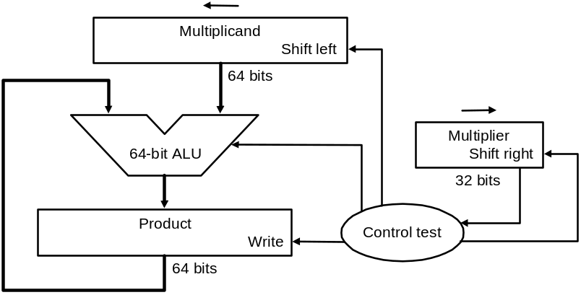
Multiply Version 1
S
t
a
r
t
M
u
l
t
i
p
l
i
e
r
0
=
1
1
.
T
e
s
t
M
u
l
t
i
p
l
i
e
r
0
=
0
M
u
l
t
i
p
l
i
e
r
0
1
a
.
A
d
d
m
u
l
t
i
p
l
i
c
a
n
d
t
o
p
r
o
d
u
c
t
a
n
d
p
l
a
c
e
t
h
e
r
e
s
u
l
t
i
n
P
r
o
d
u
c
t
r
e
g
i
s
t
e
r
2
.
S
h
i
f
t
t
h
e
M
u
l
t
i
p
l
i
c
a
n
d
r
e
g
i
s
t
e
r
l
e
f
t
1
b
i
t
3
.
S
h
i
f
t
t
h
e
M
u
l
t
i
p
l
i
e
r
r
e
g
i
s
t
e
r
r
i
g
h
t
1
b
i
t
3
2
n
d
r
e
p
e
t
i
t
i
o
n
?
N
o
:
<
3
2
r
e
p
e
t
i
t
i
o
n
s
Y
e
s
:
3
2
r
e
p
e
t
i
t
i
o
n
s
D
o
n
e

Slide 30
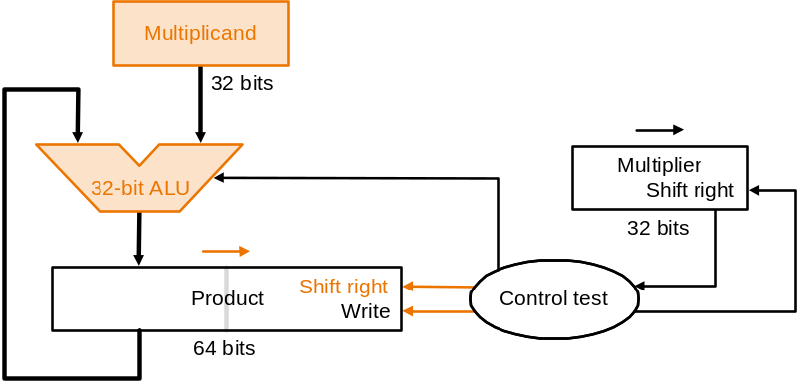
Multiply Version 2
S
t
a
r
t
M
u
l
t
i
p
l
i
e
r
0
=
1
1
.
T
e
s
t
M
u
l
t
i
p
l
i
e
r
0
=
0
M
u
l
t
i
p
l
i
e
r
0
1
a
.
A
d
d
m
u
l
t
i
p
l
i
c
a
n
d
t
o
t
h
e
l
e
f
t
h
a
l
f
o
f
t
h
e
p
r
o
d
u
c
t
a
n
d
p
l
a
c
e
t
h
e
r
e
s
u
l
t
i
n
t
h
e
l
e
f
t
h
a
l
f
o
f
t
h
e
P
r
o
d
u
c
t
r
e
g
i
s
t
e
r
2
.
S
h
i
f
t
t
h
e
P
r
o
d
u
c
t
r
e
g
i
s
t
e
r
r
i
g
h
t
1
b
i
t
3
.
S
h
i
f
t
t
h
e
M
u
l
t
i
p
l
i
e
r
r
e
g
i
s
t
e
r
r
i
g
h
t
1
b
i
t
3
2
n
d
r
e
p
e
t
i
t
i
o
n
?
N
o
:
<
3
2
r
e
p
e
t
i
t
i
o
n
s
Y
e
s
:
3
2
r
e
p
e
t
i
t
i
o
n
s
D
o
n
e

Slide 31
Multiply Version 3
S
t
a
r
t
P
r
o
d
u
c
t
0
=
1
1
.
T
e
s
t
P
r
o
d
u
c
t
0
=
0
P
r
o
d
u
c
t
0
M
u
l
t
i
p
l
i
c
a
n
d
3
2
b
i
t
s
1
a
.
A
d
d
m
u
l
t
i
p
l
i
c
a
n
d
t
o
t
h
e
l
e
f
t
h
a
l
f
o
f
t
h
e
p
r
o
d
u
c
t
a
n
d
p
l
a
c
e
t
h
e
r
e
s
u
l
t
i
n
t
h
e
l
e
f
t
h
a
l
f
o
f
t
h
e
P
r
o
d
u
c
t
r
e
g
i
s
t
e
r
3
2
-
b
i
t
A
L
U
P
r
o
d
u
c
t
S
h
i
f
t
r
i
g
h
t
C
o
n
t
r
o
l
2
.
S
h
i
f
t
t
h
e
P
r
o
d
u
c
t
r
e
g
i
s
t
e
r
r
i
g
h
t
1
b
i
t
W
r
i
t
e
t
e
s
t
6
4
b
i
t
s
3
2
n
d
r
e
p
e
t
i
t
i
o
n
?
N
o
:
<
3
2
r
e
p
e
t
i
t
i
o
n
s
Y
e
s
:
3
2
r
e
p
e
t
i
t
i
o
n
s
D
o
n
e

Slide 32
Key Points
Two’s complement is standard +/- numbers.
ISA drives ALU design
ALU performance, CPU clock speed driven by adder delay
Multiply is expensive

