Slide 1

CS M151B / EE M116C
Computer Systems Architecture
ALU Design Part II
Instructor: Prof. Lei He
<LHE@ee.ucla.edu>
Some notes adopted from Glenn Reinman

Slide 2
Outline
Review of ALU and CLA
Signed multiplication and division
Break
FP representation and operation

Slide 3
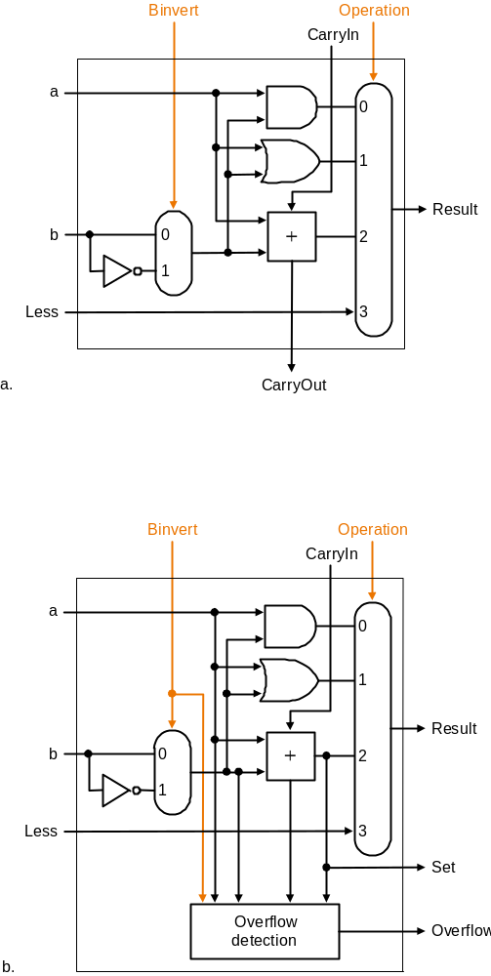
Building blocks
All but MSB
Most Significant Bit

Slide 4
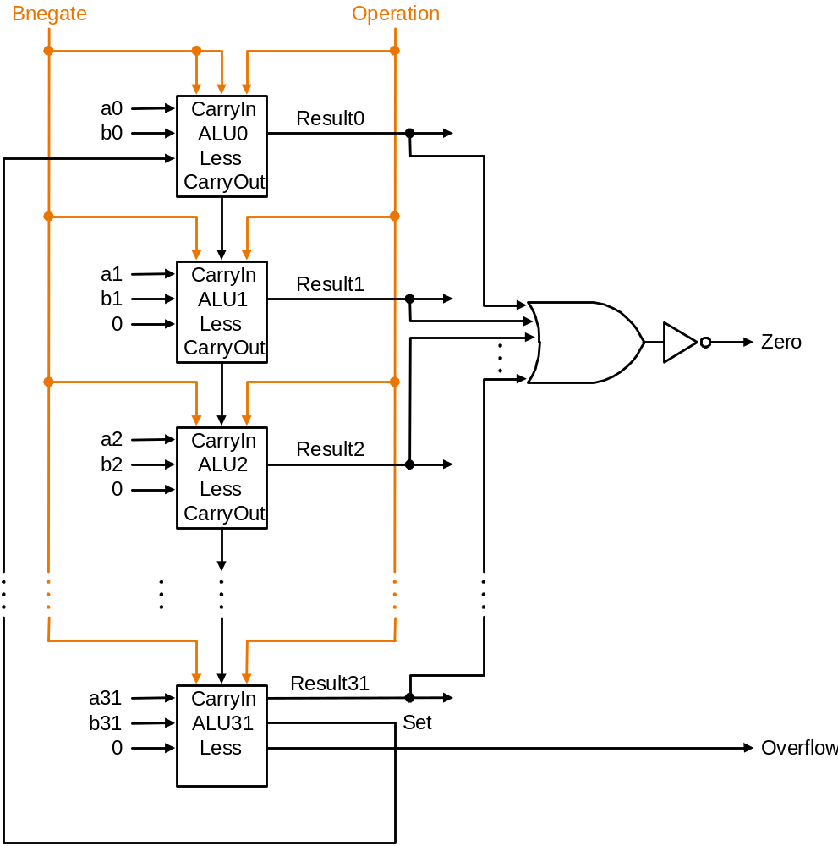
Final Full ALU
You should feel comfortable identifying what signals accomplish:
  add
  sub
  and
  or
  beq
  slt

Slide 5
Carry Look Ahead
c0 = Cin
A B C-out
0 0 0 “kill”
0 1 C-in “propagate”
1 0 C-in “propagate”
1 1 1 “generate”
A0
S
G
B0
P
c1 = g0 + c0 • p0
A1
S
g = A and B
p = A xor B
G
B1
P
c2 = g1 + g0 • p1 + c0 • p0 • p1
A2
S
G
B2
P
c3 = g2 + g1 • p2 + g0 • p1 • p2 + c0 • p0 • p1 • p2
A3
S
G
For hierarchical CLA
G0=g3+g2p3+…
P0=p3p2p1p0
B3
P
c4 = . . .
Notes:
Names: suppose G0 is 1 => carry no matter what else => generates a carry
suppose G0 =0 and P0=1 => carry IFF C0 is a 1 => propagates a carry
Like dominoes
What about more than 4 bits?

Slide 6
Hierarchical CLA
C
L
A
C0
G0= g3+g2p3+…
P0= p3p2p1p0
C1 = G0 + C0 • P0
4-bit
Adder
G1= g7+g6p7+…
P0= p7p6p5p4
C2 = G1 + G0 • P1 + C0 • P0 • P1
4-bit
Adder
C3 = G2 + G1 • P2 + G0 • P1 • P2 + C0 • P0 • P1 • P2
G
4-bit
Adder
P
C4 = . . .

Slide 7
Signed Multiplication?
First, convert both to positive numbers
  remember whether to complement product when done
Then, apply definition of 2’s complement
  need to sign-extend partial products at the end
Booth’s Algorithm
  elegant way to multiply signed numbers
    using same hardware as before and save cycles

Slide 8
Motivation for Booth’s Algorithm
Example 2 x 6 = 0010 x 0110: 0010
x 0110
+ 0000 shift (0 in multiplier) + 0010 add (1 in multiplier) + 0010 add (1 in multiplier) + 0000 shift (0 in multiplier) 00001100
ALU with add or subtract gets same result in more than one way: 6 = – 2 + 8 0110 = – 00010 + 01000 = 11110 + 01000
For example
0010 x 0110 0000 shift (0 in multiplier) – 0010 sub (first 1 in multpl.) . 0000 shift (mid string of 1s) . + 0010 add (prior step had last 1) 00001100

Slide 9
Booth’s Algorithm
middle of run
end of run
beginning of run
0 1 1 1 1 0
Current Bit Bit to the Right Explanation Example Op
1 0 Begins run of 1s 0001111000 sub
1 1 Middle of run of 1s 0001111000 none
0 1 End of run of 1s 0001111000 add
0 0 Middle of run of 0s 0001111000 none
Originally for Speed (when shift was faster than add)
Replace a string of 1s in multiplier with an initial subtract when we first see a one and then later add for the bit after the last one
–1
+ 10000
01111

Slide 10
Booths Example (2 x 7)
Operation Multiplicand Product next?
0. initial value 0010 0000 0111 0 10 -> sub
1a. P = P - m 1110 + 1110 1110 0111 0 shift P (sign ext)
1b. 0010 1111 0011 1 11 -> nop, shift
2. 0010 1111 1001 1 11 -> nop, shift
3. 0010 1111 1100 1 01 -> add
4a. 0010 + 0010
0001 1100 1 shift
4b. 0010 0000 1110 0 done

Slide 11
Booths Example (2 x -3)
Operation Multiplicand Product next?
0. initial value 0010 0000 1101 0 10 -> sub
1a. P = P - m 1110 + 1110 1110 1101 0 shift P (sign ext)
1b. 0010 1111 0110 1 01 -> add + 0010
2a. 0001 0110 1 shift P
2b. 0010 0000 1011 0 10 -> sub + 1110
3a. 0010 1110 1011 0 shift
3b. 0010 1111 0101 1 11 -> nop
4a 1111 0101 1 shift
4b. 0010 1111 1010 1 done

Slide 12
Division
Quick example
Assumptions:
  dividend, divisor, quotient, and remainder are all 32-bit positive values
1101
1000 1101010
-1000
1010
-1000
0010
0101
-0000
1010
-1000
10
Quotient
Divisor
Dividend
Remainder

Slide 13
Divide Version 1
32-bit divisor starts in left half of divisor register
Remainder register is initialized with dividend
D
i
v
i
s
o
r
S
h
i
f
t
r
i
g
h
t
6
4
b
i
t
s
Q
u
o
t
i
e
n
t
6
4
-
b
i
t
A
L
U
S
h
i
f
t
l
e
f
t
3
2
b
i
t
s
R
e
m
a
i
n
d
e
r
C
o
n
t
r
o
l
W
r
i
t
e
t
e
s
t
6
4
b
i
t
s

Slide 14
Divide Version 1
n+1 steps for n-bit operands
Book shows 7 / 2
  Let’s try 7 / 3 (4-bit operands)
S
t
a
r
t
1
.
S
u
b
t
r
a
c
t
t
h
e
D
i
v
i
s
o
r
r
e
g
i
s
t
e
r
f
r
o
m
t
h
e
Q D R
R
e
m
a
i
n
d
e
r
r
e
g
i
s
t
e
r
a
n
d
p
l
a
c
e
t
h
e
r
e
s
u
l
t
i
n
t
h
e
R
e
m
a
i
n
d
e
r
r
e
g
i
s
t
e
r
0000
0011 0000
0000 0111
0000
0011 0000
1101 0111
R
e
m
a
i
n
d
e
r
>
0
R
e
m
a
i
n
d
e
r
<
0
0000
0011 0000
0000 0111
–
T
e
s
t
R
e
m
a
i
n
d
e
r
0000
0001 1000
0000 0111
0000
0001 1000
1110 1111
2
a
.
S
h
i
f
t
t
h
e
Q
u
o
t
i
e
n
t
r
e
g
i
s
t
e
r
t
o
t
h
e
l
e
f
t
,
2
b
.
R
e
s
t
o
r
e
t
h
e
o
r
i
g
i
n
a
l
v
a
l
u
e
b
y
a
d
d
i
n
g
0000
0001 1000
0000 0111
s
e
t
t
i
n
g
t
h
e
n
e
w
r
i
g
h
t
m
o
s
t
b
i
t
t
o
1
t
h
e
D
i
v
i
s
o
r
r
e
g
i
s
t
e
r
t
o
t
h
e
R
e
m
a
i
n
d
e
r
0000
0000 1100
0000 0111
r
e
g
i
s
t
e
r
a
n
d
p
l
a
c
e
t
h
e
s
u
m
i
n
t
h
e
Q
u
R
e
m
a
i
n
d
e
r
r
e
g
i
s
t
e
r
.
A
l
s
o
s
h
i
f
t
t
h
e
o
t
i
e
n
t
r
e
g
i
s
t
e
r
t
o
t
h
e
l
e
f
t
,
s
e
t
t
i
n
g
t
h
e
0000
0000 1100
1111 1011
n
e
w
l
e
a
s
t
s
i
g
n
i
f
i
c
a
n
t
b
i
t
t
o
0
0000
0000 1100
0000 0111
0000
0000 0110
0000 0111
0000
0000 0110
0000 0001
3
.
S
h
i
f
t
t
h
e
D
i
v
i
s
o
r
r
e
g
i
s
t
e
r
r
i
g
h
t
1
b
i
t
0001
0000 0110
0000 0001
0001
0000 0011
0000 0001
3
3
r
d
r
e
p
e
t
i
t
i
o
n
?
N
o
:
<
3
3
r
e
p
e
t
i
t
i
o
n
s
0000
0000 0011
1111 1110
0010
0000 0011
0000 0001
Y
e
s
:
3
3
r
e
p
e
t
i
t
i
o
n
s
0010
0000 0001
0000 0001
D
o
n
e
2
1

Slide 15
Divide Version 2
At most half the divisor has useful information
  cut divisor and ALU in half
D
i
v
i
s
o
r
3
2
b
i
t
s
Q
u
o
t
i
e
n
t
3
2
-
b
i
t
A
L
U
S
h
i
f
t
l
e
f
t
3
2
b
i
t
s
S
h
i
f
t
l
e
f
t
C
o
n
t
r
o
l
R
e
m
a
i
n
d
e
r
t
e
s
t
W
r
i
t
e
6
4
b
i
t
s

Slide 16
Divide Version 3
D
i
v
i
s
o
r
S
t
a
r
t
3
2
b
i
t
s
1
.
S
h
i
f
t
t
h
e
R
e
m
a
i
n
d
e
r
r
e
g
i
s
t
e
r
l
e
f
t
1
b
i
t
3
2
-
b
i
t
A
L
U
2
.
S
u
b
t
r
a
c
t
t
h
e
D
i
v
i
s
o
r
r
e
g
i
s
t
e
r
f
r
o
m
t
h
e
l
e
f
t
h
a
l
f
o
f
t
h
e
R
e
m
a
i
n
d
e
r
r
e
g
i
s
t
e
r
a
n
d
p
l
a
c
e
t
h
e
r
e
s
u
l
t
i
n
t
h
e
l
e
f
t
h
a
l
f
o
f
t
h
e
R
e
m
a
i
n
d
e
r
r
e
g
i
s
t
e
r
S
h
i
f
t
r
i
g
h
t
C
o
n
t
r
o
l
R
e
m
a
i
n
d
e
r
S
h
i
f
t
l
e
f
t
t
e
s
t
R
e
m
a
i
n
d
e
r
>
0
R
e
m
a
i
n
d
e
r
<
0
W
r
i
t
e
–
T
e
s
t
R
e
m
a
i
n
d
e
r
6
4
b
i
t
s
3
a
.
S
h
i
f
t
t
h
e
R
e
m
a
i
n
d
e
r
r
e
g
i
s
t
e
r
t
o
t
h
e
3
b
.
R
e
s
t
o
r
e
t
h
e
o
r
i
g
i
n
a
l
v
a
l
u
e
b
y
a
d
d
i
n
g
l
e
f
t
,
s
e
t
t
i
n
g
t
h
e
n
e
w
r
i
g
h
t
m
o
s
t
b
i
t
t
o
1
t
h
e
D
i
v
i
s
o
r
r
e
g
i
s
t
e
r
t
o
t
h
e
l
e
f
t
h
a
l
f
o
f
t
h
e
i
R
e
m
a
i
n
d
e
r
r
e
g
i
s
t
e
r
a
n
d
p
l
a
c
e
t
h
e
s
u
m
Can we eliminate the quotient register?
n
t
h
e
l
e
f
t
h
a
l
f
o
f
t
h
e
R
e
m
a
i
n
d
e
r
r
e
g
i
s
t
e
r
.
A
l
s
o
s
h
i
f
t
t
h
e
R
e
m
a
i
n
d
e
r
r
e
g
i
s
t
e
r
t
o
t
h
e
l
e
f
t
,
s
e
t
t
i
n
g
t
h
e
n
e
w
r
i
g
h
t
m
o
s
t
b
i
t
t
o
0
3
2
n
d
r
e
p
e
t
i
t
i
o
n
?
N
o
:
<
3
2
r
e
p
e
t
i
t
i
o
n
s
Y
e
s
:
3
2
r
e
p
e
t
i
t
i
o
n
s
D
o
n
e
.
S
h
i
f
t
l
e
f
t
h
a
l
f
o
f
R
e
m
a
i
n
d
e
r
r
i
g
h
t
1
b
i
t

Slide 17
Multiply vs. Divide
Signed Division
  Just make both operands positive and remember the sign
  Must set the sign of the remainder though!
In MIPS
  HI and LOW registers used for 64-bit register
D
i
v
i
s
o
r
M
u
l
t
i
p
l
i
c
a
n
d
3
2
b
i
t
s
3
2
b
i
t
s
3
2
-
b
i
t
A
L
U
3
2
-
b
i
t
A
L
U
S
h
i
f
t
r
i
g
h
t
C
o
n
t
r
o
l
R
e
m
a
i
n
d
e
r
S
h
i
f
t
l
e
f
t
t
e
s
t
P
r
o
d
u
c
t
S
h
i
f
t
r
i
g
h
t
C
o
n
t
r
o
l
W
r
i
t
e
W
r
i
t
e
t
e
s
t
6
4
b
i
t
s
6
4
b
i
t
s
Divide/multiply
Multiply

Slide 18
Floating Point (FP)
Binary fractions:
  1011₂ = 1x2³ + 0x2² + 1x2¹ + 1x2⁰
AND:
  101.01₂ = 1x2² + 0x2¹ + 1x2⁰ + 0x2⁻¹ + 1x2⁻²
Example:
  .75 = 3/4 = 1/2 + 1/4 = .11₂

Slide 19
Recall Scientific Notation
decimal point
exponent
sign
23
+6.02 x 10
Mantissa
radix (base)
  Issues:
  ° Arithmetic (+, -, *, / )
  ° Representation, Normal form
  ° Range and Precision
  ° Rounding
  ° Exceptions (e.g., divide by zero, overflow, underflow)
  ° Errors
  ° Properties ( negation, inversion, if A = B then A - B = 0 )

Slide 20
IEEE 754 FP Numbers
1
8
23
Single precision
representation of
(-1)^{S} 2^{E-127} (1.M)
S
E
M
sign
bit
exponent:
excess 127
binary integer
mantissa:
sign + magnitude, normalized
binary significand with hidden
integer bit: 1.M
(actual exponent
is e = E - 127)
0 = 0 00000000 00 . . . 0
-1.5 = 1 01111111 10 . . . 0
325 = 101000101 = 1.01000101 x 2⁸
= 0 10000111 01000101000000000000000
.02 = .0011001101100... = 1.1001101100... x 2⁻³
= 0 01111100 1001101100...
range of about 2 X 10⁻³⁸ to 2 X 10³⁸
always normalized (so always leading 1, never shown)
special representation of 0 (E = 00000000)
can do integer compare for greater-than, sign

Slide 21
Double Precision FP (IEEE 754)
1
11
20
32
sign
S
E
M
M
exponent:
excess 1023
binary integer
mantissa:
sign + magnitude, normalized
binary significand with hidden
integer bit: 1.M
actual exponent is e = E - 1023
S
E-1023
N = (-1) 2 (1.M)
52 (+1) bit mantissa
range of about 2 X 10⁻³⁰⁸ to 2 X 10³⁰⁸

Slide 22
Range of FP Numbers
Exponent | Fraction | Object
0 | 0 | 0
0 | ≠0 | Denormalized Number
1 to 254 | any | Normalized Number (regular floating point number)
255 | 0 | ± ∞
255 | ≠0 | NaN
Range of the floating point number:
Single precision: 2^{–126}~2¹²⁷ (10^{–38}~10³⁸)
Double Precision: 2^{–1022}~2¹⁰²³ (10^{–308}~10³⁰⁸)
Notes:
Here is a quick review of a 4-bit binary number .
The 0 to 7 representation of the number looks like this-what it is is just a binary count.
With this representation, you can perform addition just like adding decimal numbers.
For example here, I show you how to add 3 and 2 with the carry propagates from the 2nd bit to the 3rd bit.
+1 = 21 min. (Y:01)

Slide 23
FP Addition
How do you add in scientific notation?
    9.962 x 10⁴ + 5.231 x 10²
Basic Algorithm
  1. Align
  2. Add
  3. Normalize
  4. Round
Not exact
  Usually, rounding throws away bits at the end.
  Subtracting two nearly-equal numbers doesn’t lose bits, but answer doesn’t have as many significant bits.

Slide 24
FP Addition
S
i
g
n
E
x
p
o
n
e
n
t
S
i
g
n
i
f
i
c
a
n
d
S
i
g
n
E
x
p
o
n
e
n
t
S
i
g
n
i
f
i
c
a
n
d
S
t
a
r
t
S
m
a
l
l
A
L
U
C
o
m
p
a
r
e
e
x
p
o
n
e
n
t
s
1
.
C
o
m
p
a
r
e
t
h
e
e
x
p
o
n
e
n
t
s
o
f
t
h
e
t
w
o
n
u
m
b
e
r
s
.
S
h
i
f
t
t
h
e
s
m
a
l
l
e
r
n
u
m
b
e
r
t
o
t
h
e
r
i
g
h
t
u
n
t
i
l
i
t
s
e
x
p
o
n
e
n
t
w
o
u
l
d
m
a
t
c
h
t
h
e
l
a
r
g
e
r
e
x
p
o
n
e
n
t
E
x
p
o
n
e
n
t
d
i
f
f
e
r
e
n
c
e
0
1
0
1
0
1
2
.
A
d
d
t
h
e
s
i
g
n
i
f
i
c
a
n
d
s
C
o
n
t
r
o
l
S
h
i
f
t
r
i
g
h
t
S
h
i
f
t
s
m
a
l
l
e
r
3
.
N
o
r
m
a
l
i
z
e
t
h
e
s
u
m
,
e
i
t
h
e
r
s
h
i
f
t
i
n
g
r
i
g
h
t
a
n
d
n
u
m
b
e
r
r
i
g
h
t
i
n
c
r
e
m
e
n
t
i
n
g
t
h
e
e
x
p
o
n
e
n
t
o
r
s
h
i
f
t
i
n
g
l
e
f
t
a
n
d
d
e
c
r
e
m
e
n
t
i
n
g
t
h
e
e
x
p
o
n
e
n
t
B
i
g
A
L
U
A
d
d
O
v
e
r
f
l
o
w
o
r
Y
e
s
u
n
d
e
r
f
l
o
w
?
0
1
0
1
N
o
E
x
c
e
p
t
i
o
n
I
n
c
r
e
m
e
n
t
o
r
S
h
i
f
t
l
e
f
t
o
r
r
i
g
h
t
N
o
r
m
a
l
i
z
e
d
e
c
r
e
m
e
n
t
4
.
R
o
u
n
d
t
h
e
s
i
g
n
i
f
i
c
a
n
d
t
o
t
h
e
a
p
p
r
o
p
r
i
a
t
e
n
u
m
b
e
r
o
f
b
i
t
s
R
o
u
n
d
i
n
g
h
a
r
d
w
a
r
e
R
o
u
n
d
N
o
S
t
i
l
l
n
o
r
m
a
l
i
z
e
d
?
S
i
g
n
E
x
p
o
n
e
n
t
S
i
g
n
i
f
i
c
a
n
d
Y
e
s
D
o
n
e

Slide 25
FP Multiplication
Multiply in scientific notation?
    (9.9 x 10⁴)(5.2 x 10²) = 5.148 x 10⁷
Basic Algorithm
  1. Add exponents
  2. Multiply
  3. Normalize
  4. Round
  5. Set Sign
S
t
a
r
t
n
u
1
.
A
d
d
t
h
e
b
i
a
s
e
d
e
x
p
o
n
e
n
t
s
o
f
t
h
e
t
w
o
m
b
e
r
s
,
s
u
b
t
r
a
c
t
i
n
g
t
h
e
b
i
a
s
f
r
o
m
t
h
e
s
u
m
t
o
g
e
t
t
h
e
n
e
w
b
i
a
s
e
d
e
x
p
o
n
e
n
t
2
.
M
u
l
t
i
p
l
y
t
h
e
s
i
g
n
i
f
i
c
a
n
d
s
3
.
N
i
o
r
m
a
l
i
z
e
t
h
e
p
r
o
d
u
c
t
i
f
n
e
c
e
s
s
a
r
y
,
s
h
i
f
t
i
n
g
t
r
i
g
h
t
a
n
d
i
n
c
r
e
m
e
n
t
i
n
g
t
h
e
e
x
p
o
n
e
n
t
O
v
e
r
f
l
o
w
o
r
Y
e
s
u
n
d
e
r
f
l
o
w
?
N
o
E
x
c
e
p
t
i
o
n
4
.
R
o
u
n
d
t
h
e
s
i
g
n
i
f
i
c
a
n
d
t
o
t
h
e
a
p
p
r
o
p
r
i
a
t
e
n
u
m
b
e
r
o
f
b
i
t
s
N
o
S
t
i
l
l
n
o
r
m
a
l
i
z
e
d
?
Y
e
s
5
.
S
e
t
t
h
e
s
i
g
n
o
f
t
h
e
p
r
o
d
u
c
t
t
o
p
o
s
i
t
i
v
e
i
f
t
h
e
s
i
g
n
s
o
f
t
h
e
o
r
i
g
i
n
a
l
o
p
e
r
a
n
d
s
a
r
e
t
h
e
s
a
m
e
;
i
f
t
h
e
y
d
i
f
f
e
r
m
a
k
e
t
h
e
s
i
g
n
n
e
g
a
t
i
v
e
D
o
n
e

Slide 26
Floating Point Accuracy
Extremely important in scientific calculations
Very tiny errors can accumulate over time
IEEE 754 has four “rounding modes”
  always round up (toward +∞)
  always round down (toward -∞)
  truncate (i.e. round towards zero)
  round to nearest
    => in case of tie, round to nearest even
Requires extra bits in intermediate representations

Slide 27
Extra Bits for FP Accuracy
Guard bits -- bits to the right of the least significant bit of the significand computed for use in normalization (could become significant at that point) and rounding.
IEEE 754 has three extra bits and calls them guard, round, and sticky.

Slide 28
Key Points
Multiplication and Division take much longer than Addition and Subtraction
Floating Point extends the range of numbers that can be represented, but at the expense of precision
FP operations are very similar to integer operations, but have pre- and post- processing
Rounding implementation is critical to accuracy over time

Slide 29
Key Terms and Problems
  Floating point, single/double precision, normalized, scientific notation, biased notation
  Interprets of word (instruction, integer, floating point)
  Ripple carry adder versus carry lookahead adder
  Three versions of multiply/divide algorithms, Booth’s algorithm

