Slide 1

CS M151B / EE M116C
Computer Systems Architecture
Datapath & Control
Instructor: Prof. Lei He
<LHE@ee.ucla.edu>
Some notes adopted from Glenn Reinman

Slide 2
So Far
CPU Execution Time
Instruction Count
CPI
Clock Cycle Time
=
X
X
Instruction Count - Compiler, ISA
CPI, Cycle Time - Processor implementation
Today: Datapath Design
  the “brawn”
Next will be Control
  the “brain”
Simplification:
  ONLY implement a subset of MIPS ISA
Processor
Input
Control
Memory
Datapath
Output

Slide 3
Datapath Design
ISA simplified to contain only:
  memory-reference instructions: lw, sw
  arithmetic-logical instructions: add, sub, and, or, slt
  control flow instructions: beq, j
Generic Implementation:
  use the program counter (PC) to supply instruction address
  get the instruction from memory
  read registers
  use the instruction to decide exactly what to do
All instructions use the ALU after reading the registers

Slide 4
High-Level Overview
D
a
t
a
R
e
g
i
s
t
e
r
#
P
C
A
d
d
r
e
s
s
I
n
s
t
r
u
c
t
i
o
n
R
e
g
i
s
t
e
r
s
A
L
U
A
d
d
r
e
s
s
I
n
s
t
r
u
c
t
i
o
n
R
e
g
i
s
t
e
r
#
m
e
m
o
r
y
D
a
t
a
R
e
g
i
s
t
e
r
#
m
e
m
o
r
y
D
a
t
a

Slide 5
Two Types of Logic Components
Combinational Logic
  Output depends only on the current input values
    (after enough time has elapsed for circuit to stabilize)
Sequential Logic
  Contains state (flop, latch, etc)
    clocked or unclocked
a
f(a,b)
b
falling edge
cycle time
rising edge

Slide 6
Clocking Methodology
D
Q
C
o
m
b
i
n
a
t
i
o
n
a
l
D
Q
F
l
i
p
-
f
l
o
p
l
o
g
i
c
b
l
o
c
k
F
l
i
p
-
f
l
o
p
C
C
t
p
r
o
p
t
c
o
m
b
i
n
a
t
i
o
n
a
l
t
s
e
t
u
p
Rising-edge triggered flip-flop
Delay of combinational logic and the physical characteristics of the flops can impact the cycle time of the clock
Notes:
Remember, we will be using a clocking methodology where all storage elements are clocked by the same clock edge.
Consequently, our cycle time will be the sum of:
(a) The Clock-to-Q time of the input registers.
(b) The longest delay path through the combinational logic block.
(c) The set up time of the output register.
(d) And finally the clock skew.
In order to avoid hold time violation, you have to make sure this inequality is fulfilled.
+2 = 18 min. (X:58)

Slide 7
Storage Element: Register
Register
  Similar to a D Flip Flop BUT:
    N-bit input and output
      there are really N flip-flops
    Write Enable input
  Write Enable:
    0: Data Out will not change
    1: Data Out becomes Data In (on the clock edge)
Write Enable
N
Data
Out
Data In
N
Clk
Notes:
As far as storage elements are concerned, we will need a N-bit register that is similar to the D flip-flop I showed you in class.
The significant difference here is that the register will have a Write Enable input.
That is the content of the register will NOT be updated if Write Enable is zero.
The content is updated at the clock tick ONLY if the Write Enable signal is set to 1.
+1 = 31 min. (Y:11)

Slide 8
Register File for MIPS
We need 32 registers and 3 ports:
  Two 32-bit output buses: (A& B)
  One 32-bit input bus: (W)
Register selection:
  RA selects the register to put on busA
  RB selects the register to put on busB
  RW selects the register to be written via busW when Write Enable is 1
RW
RA
RB
Write Enable
5
5
5
busA
busW
32 32-bit
Registers
32
32
Clk
busB
32
Notes:
We will also need a register file that consists of 32 32-bit registers with two output busses (busA and busB) and one input bus.
The register specifiers Ra and Rb select the registers to put on busA and busB respectively.
When Write Enable is 1, the register specifier Rw selects the register to be written via busW.
In our simplified version of the register file, the write operation will occurs at the clock tick.
Keep in mind that the clock input is a factor ONLY during the write operation.
During read operation, the register file behaves as a combinational logic block.
That is if you put a valid value on Ra, then bus A will become valid after the register file’s access time.
Similarly if you put a valid value on Rb, bus B will become valid after the register file’s access time. In both cases (Ra and Rb), the clock input is not a factor.
+2 = 33 min. (Y:13)

Slide 9
Storage Element: Memory
Memory
  One input bus: Data In
  One output bus: Data Out
Memory word location:
  selected by Address
If Write Enable
  is 0, the memory location is put on Data Out bus
  is 1, the memory location is overwritten by Data In
Clock input (CLK)
  The CLK input is used ONLY during write operation
  For read, memory acts as combinational logic:
    Address valid → Data Out valid after “access time.”
Write Enable
Address
Data In
DataOut
32
32
Clk
Notes:
The last storage element you will need for the datapath is the idealized memory to store your data and instructions.
This idealized memory block has just one input bus (DataIn) and one output bus (DataOut).
When Write Enable is 0, the address selects the memory word to put on the Data Out bus.
When Write Enable is 1, the address selects the memory word to be written via the DataIn bus at the next clock tick.
Once again, the clock input is a factor ONLY during the write operation.
During read operation, it behaves as a combinational logic block.
That is if you put a valid value on the address lines, the output bus DataOut will become valid after the access time of the memory.
+2 = 35 min. (Y:15)

Slide 10
Single Cycle Datapath
CPI of 1
  but cycle time will be long!
Overview
  Instruction Fetch
  Register File and register-register ops
  Memory ops
  Control ops

Slide 11
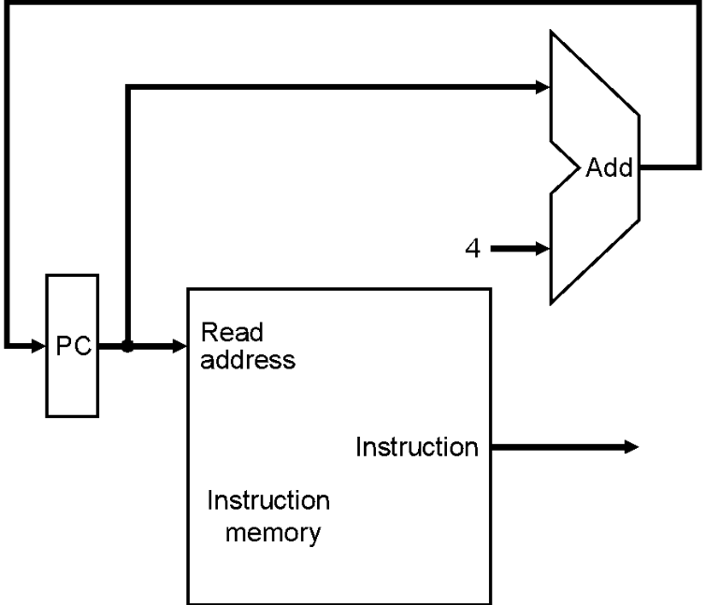
Instruction Fetch Unit
Fetch: instruction -> Mem[PC]
Updating the PC for next instruction
  Sequential Code: PC <- PC + 4
  Branch/Jump: PC <- “something else”
Notes:
Now let’s take a look at the first major component of the datapath: the instruction fetch unit.
The common RTL operations for all instructions are:
(a) Fetch the instruction using the Program Counter (PC) at the beginning of an
instruction’s execution (PC -> Instruction Memory -> Instruction Word).
(b) Then at the end of the instruction’s execution, you need to update the
Program Counter (PC -> Next Address Logic -> PC).
More specifically, you need to increment the PC by 4 if you are executing sequential code.
For Branch and Jump instructions, you need to update the program counter to “something else” other than plus 4.
I will show you what is inside this Next Address Logic block when we talked about the Branch and Jump instructions.
For now, let’s focus our attention to the Add and Subtract instructions.
+2 = 37 min. (Y:17)

Slide 12
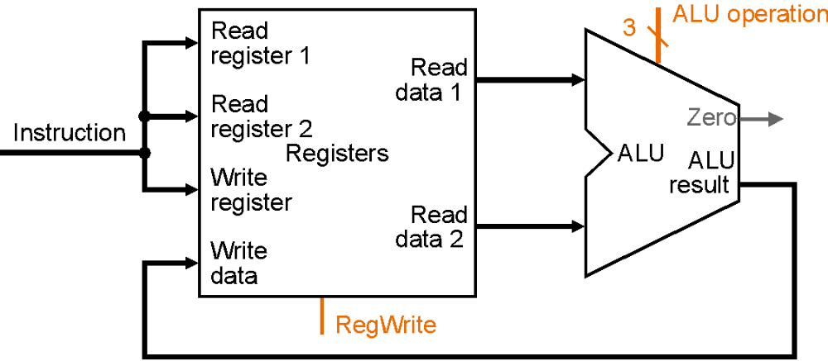
Datapath for R-Type Operations
R[rd] <- R[rs] op R[rt] Example: add rd, rs, rt
  Ra, Rb, and Rw come from rs, rt, and rd fields
  ALUoperation signal depends on op and funct
31
26
21
16
11
6
0
op
rs
rt
rd
shamt
funct
6 bits
5 bits
5 bits
5 bits
5 bits
6 bits
Notes:
And here is the datapath that can do the trick.
First of all, we connect the register file’s Ra, Rb, and Rw input to the Rd, Rs, and Rt fields of the instruction bus (points to the format diagram).
Then we need to connect busA and busB of the register file to the ALU.
Finally, we need to connect the output of the ALU to the input bus of the register file.
Conceptually, this is how it works.
The instruction bus coming out of the Instruction memory will set the Ra and Rb to the register specifiers Rs and Rt.
This causes the register file to put the value of register Rs onto busA and the value of register Rt onto busB, respectively.
But setting the ALUctr appropriately, the ALU will perform either the Add and Subtract for us.
The result is then fed back to the register file where the register specifier Rw should already be set to the instruction bus’s Rd field.
Since the control, which we will design in our next lecture, should have already set the RegWr signal to 1, the result will be written back to the register file at the next clock tick (points to the Clk input).
+3 = 42 min. (Y:22)

Slide 13
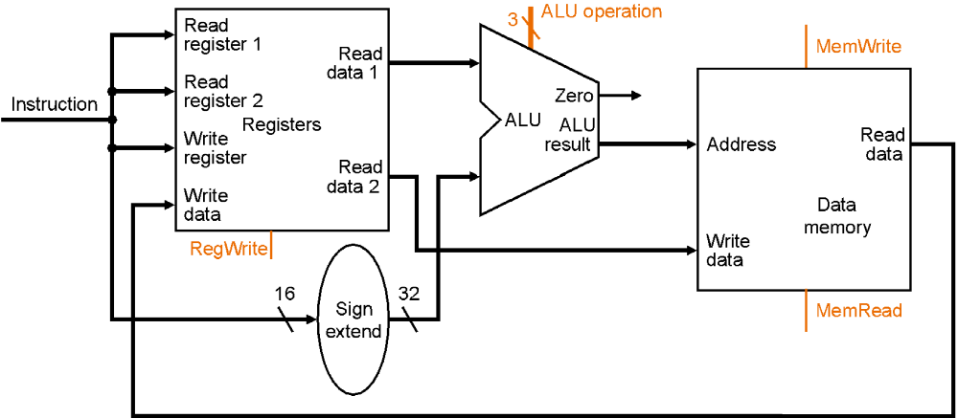
Datapath for Loads
R[rt] <- Mem[R[rs] + SignExt[imm16]] Example: lw rt, rs, imm16
31
26
21
16
0
op
rs
rt
immediate
6 bits
5 bits
5 bits
16 bits
Notes:
Once again we cannot use the instruction’s Rd field for the Register File’s Rw input because load is a I-type instruction and there is no such thing as the Rd field in the I format.
So instead of Rd, the Rt field is used to specify the destination register through this two to one multiplexor.
The first operand of the ALU comes from busA of the register file which contains the value of Register Rs (points to the Ra input of the register file).
The second operand, on the other hand, comes from the immediate field of the instruction.
Instead of using the Zero Extender I used in datapath for the or immediate datapath, I have to use a more general purpose Extender that can do both Sign Extend and Zero Extend.
The ALU then adds these two operands together to form the memory address.
Consequently, the output of the ALU has to go to two places:
(a) First the address input of the data memory.
(b) And secondly, also to the input of this two-to-one multiplexor.
The other input of this multiplexor comes from the output of the data memory so we can place the output of the data memory onto the register file’s input bus for the load instruction.
For Add, Subtract, and the Or immediate instructions, the output of the ALU will be selected to be placed on the input bus of the register file.
In either case, the control signal RegWr should be asserted so the register file will be written at the end of the cycle.
+3 = 60 min. (Y:40)

Slide 14
Datapath for Stores
Mem[R[rs] + SignExt[imm16]] <- R[rt] Example: sw rt, rs, imm16
31
26
21
16
0
op
rs
rt
immediate
6 bits
5 bits
5 bits
16 bits
Notes:
Once again we cannot use the instruction’s Rd field for the Register File’s Rw input because load is a I-type instruction and there is no such thing as the Rd field in the I format.
So instead of Rd, the Rt field is used to specify the destination register through this two to one multiplexor.
The first operand of the ALU comes from busA of the register file which contains the value of Register Rs (points to the Ra input of the register file).
The second operand, on the other hand, comes from the immediate field of the instruction.
Instead of using the Zero Extender I used in datapath for the or immediate datapath, I have to use a more general purpose Extender that can do both Sign Extend and Zero Extend.
The ALU then adds these two operands together to form the memory address.
Consequently, the output of the ALU has to go to two places:
(a) First the address input of the data memory.
(b) And secondly, also to the input of this two-to-one multiplexor.
The other input of this multiplexor comes from the output of the data memory so we can place the output of the data memory onto the register file’s input bus for the load instruction.
For Add, Subtract, and the Or immediate instructions, the output of the ALU will be selected to be placed on the input bus of the register file.
In either case, the control signal RegWr should be asserted so the register file will be written at the end of the cycle.
+3 = 60 min. (Y:40)

Slide 15
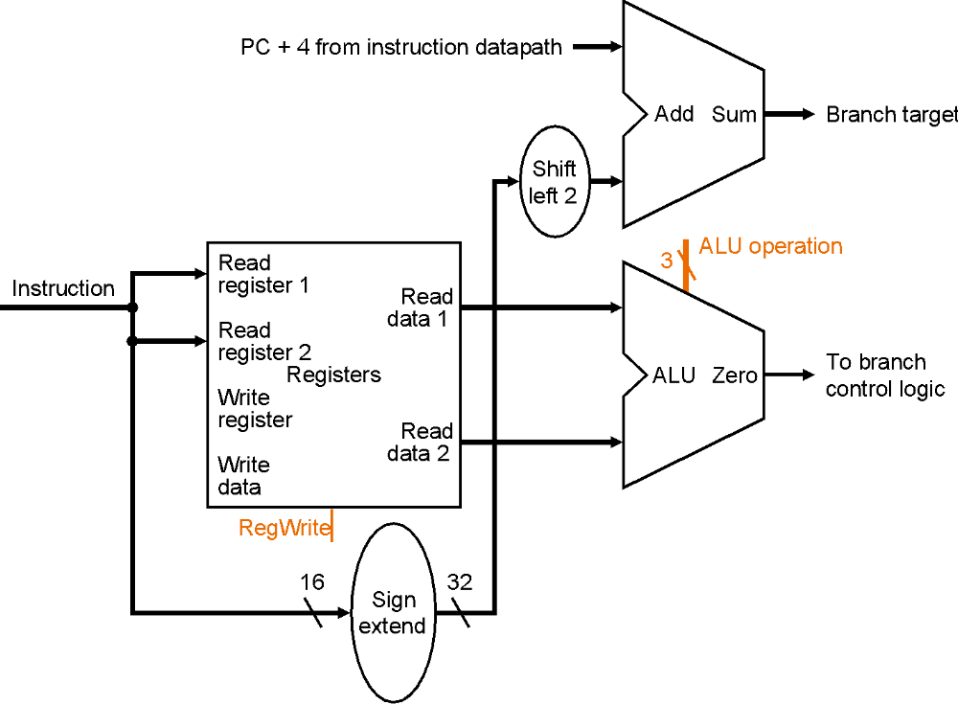
Datapath for Branches
beq rs, rt, imm16 We need to compare Rs and Rt
31
26
21
16
0
op
rs
rt
immediate
6 bits
5 bits
5 bits
16 bits
Notes:
The datapath for calculating the branch condition is rather simple.
All we have to do is feed the Rs and Rt fields of the instruction into the Ra and Rb inputs of the register file.
Bus A will then contain the value from the register selected by Rs.
And bus B will contain the value from the register selected by Rt.
The next thing to do is to ask the ALU to perform a subtract operation and feed the output Zero to the next address logic.
How does the next address logic block look like?
Well, before I show you that, let’s take a look at the binary arithmetic's behind the program counter (PC).
+2 = 67 min. (Y:47)

Slide 16
Computing the Next Address
PC is a 32-bit byte address into instruction memory:
  Sequential operation: PC<31:0> = PC<31:0> + 4
  Branch: PC<31:0> = PC<31:0> + 4 + SignExt[Imm16] * 4
We don’t need the 2 least-significant bits because:
  The 32-bit PC is a byte address
  And all our instructions are 4 bytes (32 bits) long
  The 2 LSB's of the 32-bit PC are always zeros
Notes:
In theory, the Program Counter (PC) is a 32-bit byte address into the Instruction memory.
The Program Counter is increment by four after each sequential instruction.
When a branch is taken, we need to sign extend the 16 bit immediate field, multiply this sign extended value by four, and add it to the sequential instruction address (PC + 4).
Why does this magic number “4” always come up? Well the reason is that the 32-bit PC is a byte address and all MIPS instructions are four bytes, or 32 bits, long.
In other words, if we keep a 32-bit Program Counter, then the two least significant bits of the Program Counter will always be zeros.
And if these two bits are always zeros, there is no reason to have hardware to keep them.
So in practice, we will simply the hardware by using a 30 bit program counter.
That is, we will build a Program Counter that only keep tracks of the upper 30 bits (<31:2>) of the instruction address because we know the 2 least significant bits will always be 0s.
Then instead of always increase the Program Counter by four for sequential operation, we only have to increase it by 1.
And for branch operation, we don’t need to multiply the sign extended immediate field by four before adding to the sequential PC (PC + 1).
And when we apply the program counter to the address of the instruction memory, we need to attach two zeros to its least significant bits.
+3 = 70 min. (Y:50)

Slide 17
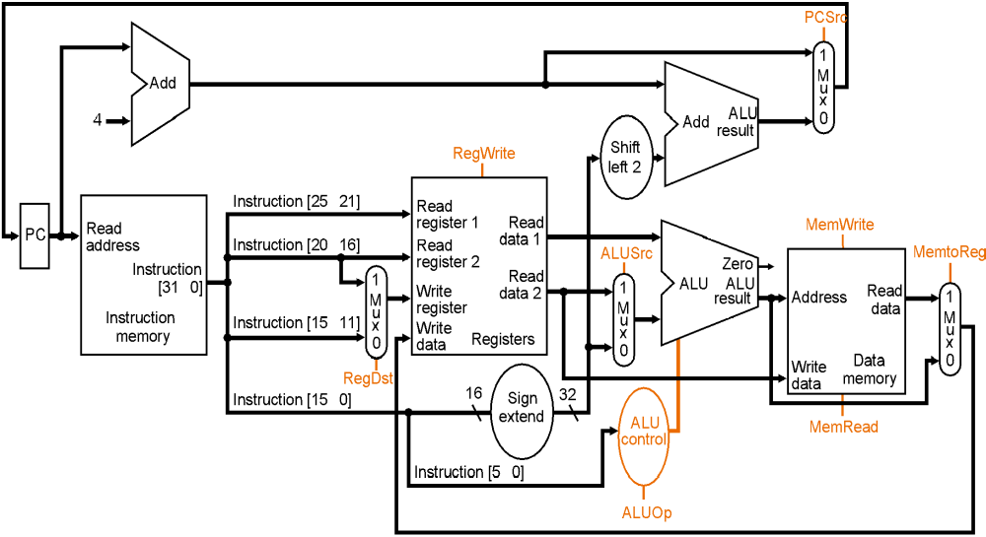
Complete Single Cycle Datapath
Notes:
So here is the single cycle datapath we just built.
If you push into the Instruction Fetch Unit, you will see the last slide showing the PC, the next address logic, and the Instruction Memory.
Here I have shown how we can get the Rt, Rs, Rd, and Imm16 fields out of the 32-bit instruction word.
The Rt, Rs, and Rd fields will go to the register file as register specifiers while the Imm16 field will go to the Extender where it is either Zero and Sign extended to 32 bits.
The signals ExtOp, ALUSrc, ALUctr, MemWr, MemtoReg, RegDst, RegWr, Branch, and Jump are control signals.
And I will show you how to generate them on Friday.
+2 = 80 min. (Z:00)

Slide 18
Questions??
Break!!
Notes:
In theory, the Program Counter (PC) is a 32-bit byte address into the Instruction memory.
The Program Counter is increment by four after each sequential instruction.
When a branch is taken, we need to sign extend the 16 bit immediate field, multiply this sign extended value by four, and add it to the sequential instruction address (PC + 4).
Why does this magic number “4” always come up? Well the reason is that the 32-bit PC is a byte address and all MIPS instructions are four bytes, or 32 bits, long.
In other words, if we keep a 32-bit Program Counter, then the two least significant bits of the Program Counter will always be zeros.
And if these two bits are always zeros, there is no reason to have hardware to keep them.
So in practice, we will simply the hardware by using a 30 bit program counter.
That is, we will build a Program Counter that only keep tracks of the upper 30 bits (<31:2>) of the instruction address because we know the 2 least significant bits will always be 0s.
Then instead of always increase the Program Counter by four for sequential operation, we only have to increase it by 1.
And for branch operation, we don’t need to multiply the sign extended immediate field by four before adding to the sequential PC (PC + 1).
And when we apply the program counter to the address of the instruction memory, we need to attach two zeros to its least significant bits.
+3 = 70 min. (Y:50)

Slide 19
R-Type Datapath
Need ALUsrc=1, ALUop=“add”, MemWrite=0, MemToReg=0,
RegDst = 0, RegWrite=1 and PCsrc=1.
Notes:
So here is the single cycle datapath we just built.
If you push into the Instruction Fetch Unit, you will see the last slide showing the PC, the next address logic, and the Instruction Memory.
Here I have shown how we can get the Rt, Rs, Rd, and Imm16 fields out of the 32-bit instruction word.
The Rt, Rs, and Rd fields will go to the register file as register specifiers while the Imm16 field will go to the Extender where it is either Zero and Sign extended to 32 bits.
The signals ExtOp, ALUSrc, ALUctr, MemWr, MemtoReg, RegDst, RegWr, Branch, and Jump are control signals.
And I will show you how to generate them on Friday.
+2 = 80 min. (Z:00)

Slide 20
Load Datapath
What control signals do we need for load??
Notes:
So here is the single cycle datapath we just built.
If you push into the Instruction Fetch Unit, you will see the last slide showing the PC, the next address logic, and the Instruction Memory.
Here I have shown how we can get the Rt, Rs, Rd, and Imm16 fields out of the 32-bit instruction word.
The Rt, Rs, and Rd fields will go to the register file as register specifiers while the Imm16 field will go to the Extender where it is either Zero and Sign extended to 32 bits.
The signals ExtOp, ALUSrc, ALUctr, MemWr, MemtoReg, RegDst, RegWr, Branch, and Jump are control signals.
And I will show you how to generate them on Friday.
+2 = 80 min. (Z:00)

Slide 21
Store Datapath
Notes:
So here is the single cycle datapath we just built.
If you push into the Instruction Fetch Unit, you will see the last slide showing the PC, the next address logic, and the Instruction Memory.
Here I have shown how we can get the Rt, Rs, Rd, and Imm16 fields out of the 32-bit instruction word.
The Rt, Rs, and Rd fields will go to the register file as register specifiers while the Imm16 field will go to the Extender where it is either Zero and Sign extended to 32 bits.
The signals ExtOp, ALUSrc, ALUctr, MemWr, MemtoReg, RegDst, RegWr, Branch, and Jump are control signals.
And I will show you how to generate them on Friday.
+2 = 80 min. (Z:00)

Slide 22
Branch Datapath
31
26
21
16
0
op
rs
rt
immediate
6 bits
5 bits
5 bits
16 bits
Notes:
So here is the single cycle datapath we just built.
If you push into the Instruction Fetch Unit, you will see the last slide showing the PC, the next address logic, and the Instruction Memory.
Here I have shown how we can get the Rt, Rs, Rd, and Imm16 fields out of the 32-bit instruction word.
The Rt, Rs, and Rd fields will go to the register file as register specifiers while the Imm16 field will go to the Extender where it is either Zero and Sign extended to 32 bits.
The signals ExtOp, ALUSrc, ALUctr, MemWr, MemtoReg, RegDst, RegWr, Branch, and Jump are control signals.
And I will show you how to generate them on Friday.
+2 = 80 min. (Z:00)

Slide 23
Jump?
Instruction [25-0]
<<2
PC+4 [31-28]
6 bits
26 bits
j format
OP
target

Slide 24
Single Cycle Datapath
Need to add control signals!

Slide 25
ALU Control
5 function ALU:
Desired function is based on opcode and function (in R-format) fields - so can we simplify the main control?
4 instruction formats - each has unique ALUOp
  R-format - 10 load (lw) - 00
  store (sw) - 00 branch (beq) - 01
Main control gives 2-bit ALUOp based on opcode only, ALU Control generates 3-bit ALUCtrl signal
ALU Control Input | Function
000 | AND
001 | OR
010 | add
110 | subtract
111 | set on less than

Slide 26
ALU Control
6-bit opcode
6-bit function
main
control
ALU
control
2-bit ALUOp
3-bit ALUCtrl
To ALU
opcode | ALUOp | instruction | function | ALU Action | ALUCtrl
lw | 00 | load word | XXXXXX | add | 010
sw | 00 | store word | XXXXXX | add | 010
beq | 01 | branch equal | XXXXXX | subtract | 110
R-type | 10 | add | 100000 | add | 010
R-type | 10 | subtract | 100010 | subtract | 110
R-type | 10 | AND | 100100 | AND | 000
R-type | 10 | OR | 100101 | OR | 001
R-type | 10 | SLT | 101010 | SLT | 111

Slide 27
Control and Datapath
0
M
u
A
L
U
x
A
d
d
r
e
s
u
l
t
1
A
d
d
S
h
i
f
t
P
C
S
r
c
R
e
g
D
s
t
l
e
f
t
2
4
B
r
a
n
c
h
M
e
m
R
e
a
d
I
n
s
t
r
u
c
t
i
o
n
[
3
1
2
6
]
C
o
n
t
r
o
l
M
e
m
t
o
R
e
g
A
L
U
O
p
M
e
m
W
r
i
t
e
A
L
U
S
r
c
R
e
g
W
r
i
t
e
R
e
a
d
I
n
s
t
r
u
c
t
i
o
n
[
2
5
2
1
]
R
e
a
d
P
C
a
d
d
r
e
s
s
r
e
g
i
s
t
e
r
1
R
e
a
d
I
n
s
t
r
u
c
t
i
o
n
[
2
0
1
6
]
R
e
a
d
d
a
t
a
1
Z
e
r
o
I
n
s
t
r
u
c
t
i
o
n
0
r
e
g
i
s
t
e
r
2
[
3
1
–
0
]
M
W
r
i
t
e
R
e
g
i
s
t
e
r
s
d
R
e
a
d
0
A
L
U
A
L
U
A
d
d
r
e
s
s
R
e
a
d
I
n
s
t
r
u
c
t
i
o
n
u
r
e
g
i
s
t
e
r
a
t
a
2
M
r
e
s
u
l
t
d
a
t
a
1
m
e
m
o
r
y
x
u
M
I
n
s
t
r
u
c
t
i
o
n
[
1
5
1
1
]
1
W
r
i
t
e
x
D
a
t
a
u
d
a
t
a
1
m
e
m
o
r
y
x
W
r
i
t
e
0
d
a
t
a
I
n
s
t
r
u
c
t
i
o
n
[
1
5
0
]
1
6
S
i
g
n
3
2
e
x
t
e
n
d
A
L
U
c
o
n
t
r
o
l
I
n
s
t
r
u
c
t
i
o
n
[
5
0
]

Slide 28
R-format
0
M
u
A
L
U
x
A
d
d
r
e
s
u
l
t
1
A
d
d
S
h
i
f
t
P
C
S
r
c
4
R
e
g
D
s
t
l
e
f
t
2
B
r
a
n
c
h
M
e
m
R
e
a
d
I
n
s
t
r
u
c
t
i
o
n
[
3
1
2
6
]
C
o
n
t
r
o
l
M
e
m
t
o
R
e
g
A
L
U
O
p
M
e
m
W
r
i
t
e
A
L
U
S
r
c
R
e
g
W
r
i
t
e
R
e
a
d
I
n
s
t
r
u
c
t
i
o
n
[
2
5
2
1
]
R
e
a
d
P
C
a
d
d
r
e
s
s
r
e
g
i
s
t
e
r
1
R
e
a
d
I
n
s
t
r
u
c
t
i
o
n
[
2
0
1
6
]
R
e
a
d
d
a
t
a
1
Z
e
r
o
I
n
s
t
r
u
c
t
i
o
n
0
r
e
g
i
s
t
e
r
2
[
3
1
–
0
]
M
W
r
i
t
e
R
e
g
i
s
t
e
r
s
d
R
e
a
d
0
A
L
U
A
L
U
A
d
d
r
e
s
s
R
e
a
d
I
n
s
t
r
u
c
t
i
o
n
u
r
e
g
i
s
t
e
r
a
t
a
2
M
r
e
s
u
l
t
d
a
t
a
1
m
e
m
o
r
y
x
u
M
I
n
s
t
r
u
c
t
i
o
n
[
1
5
1
1
]
1
W
r
i
t
e
x
D
a
t
a
u
d
a
t
a
1
m
e
m
o
r
y
x
W
r
i
t
e
0
d
a
t
a
I
n
s
t
r
u
c
t
i
o
n
[
1
5
0
]
1
6
S
i
g
n
3
2
e
x
t
e
n
d
A
L
U
c
o
n
t
r
o
l
I
n
s
t
r
u
c
t
i
o
n
[
5
0
]
RegDst | ALUSrc | MemtoReg | RegWrite | MemRead | MemWrite | Branch | ALUOp
1 | 0 | 0 | 1 | 0 | 0 | 0 | 10

Slide 29
Loads
0
M
u
A
L
U
x
A
d
d
r
e
s
u
l
t
1
A
d
d
S
h
i
f
t
P
C
S
r
c
4
R
e
g
D
s
t
l
e
f
t
2
B
r
a
n
c
h
M
e
m
R
e
a
d
I
n
s
t
r
u
c
t
i
o
n
[
3
1
2
6
]
C
o
n
t
r
o
l
M
e
m
t
o
R
e
g
A
L
U
O
p
M
e
m
W
r
i
t
e
A
L
U
S
r
c
R
e
g
W
r
i
t
e
R
e
a
d
I
n
s
t
r
u
c
t
i
o
n
[
2
5
2
1
]
R
e
a
d
P
C
a
d
d
r
e
s
s
r
e
g
i
s
t
e
r
1
R
e
a
d
I
n
s
t
r
u
c
t
i
o
n
[
2
0
1
6
]
R
e
a
d
d
a
t
a
1
Z
e
r
o
I
n
s
t
r
u
c
t
i
o
n
0
r
e
g
i
s
t
e
r
2
[
3
1
–
0
]
M
W
r
i
t
e
R
e
g
i
s
t
e
r
s
d
R
e
a
d
0
A
L
U
A
L
U
A
d
d
r
e
s
s
R
e
a
d
I
n
s
t
r
u
c
t
i
o
n
u
r
e
g
i
s
t
e
r
a
t
a
2
M
r
e
s
u
l
t
d
a
t
a
1
m
e
m
o
r
y
x
u
M
I
n
s
t
r
u
c
t
i
o
n
[
1
5
1
1
]
1
W
r
i
t
e
x
D
a
t
a
u
d
a
t
a
1
m
e
m
o
r
y
x
W
r
i
t
e
0
d
a
t
a
I
n
s
t
r
u
c
t
i
o
n
[
1
5
0
]
1
6
S
i
g
n
3
2
e
x
t
e
n
d
A
L
U
c
o
n
t
r
o
l
I
n
s
t
r
u
c
t
i
o
n
[
5
0
]
RegDst | ALUSrc | MemtoReg | RegWrite | MemRead | MemWrite | Branch | ALUOp
0 | 1 | 1 | 1 | 1 | 0 | 0 | 00

Slide 30
Store
0
M
u
A
L
U
x
A
d
d
r
e
s
u
l
t
1
A
d
d
S
h
i
f
t
P
C
S
r
c
4
R
e
g
D
s
t
l
e
f
t
2
B
r
a
n
c
h
M
e
m
R
e
a
d
I
n
s
t
r
u
c
t
i
o
n
[
3
1
2
6
]
C
o
n
t
r
o
l
M
e
m
t
o
R
e
g
A
L
U
O
p
M
e
m
W
r
i
t
e
A
L
U
S
r
c
R
e
g
W
r
i
t
e
R
e
a
d
I
n
s
t
r
u
c
t
i
o
n
[
2
5
2
1
]
R
e
a
d
P
C
a
d
d
r
e
s
s
r
e
g
i
s
t
e
r
1
R
e
a
d
I
n
s
t
r
u
c
t
i
o
n
[
2
0
1
6
]
R
e
a
d
d
a
t
a
1
Z
e
r
o
I
n
s
t
r
u
c
t
i
o
n
0
r
e
g
i
s
t
e
r
2
[
3
1
–
0
]
M
W
r
i
t
e
R
e
g
i
s
t
e
r
s
d
R
e
a
d
0
A
L
U
A
L
U
A
d
d
r
e
s
s
R
e
a
d
I
n
s
t
r
u
c
t
i
o
n
u
r
e
g
i
s
t
e
r
a
t
a
2
M
r
e
s
u
l
t
d
a
t
a
1
m
e
m
o
r
y
x
u
M
I
n
s
t
r
u
c
t
i
o
n
[
1
5
1
1
]
1
W
r
i
t
e
x
D
a
t
a
u
d
a
t
a
1
m
e
m
o
r
y
x
W
r
i
t
e
0
d
a
t
a
I
n
s
t
r
u
c
t
i
o
n
[
1
5
0
]
1
6
S
i
g
n
3
2
e
x
t
e
n
d
A
L
U
c
o
n
t
r
o
l
I
n
s
t
r
u
c
t
i
o
n
[
5
0
]
RegDst | ALUSrc | MemtoReg | RegWrite | MemRead | MemWrite | Branch | ALUOp
X | 1 | X | 0 | 0 | 1 | 0 | 00

Slide 31
BEQ
0
M
u
A
L
U
x
A
d
d
r
e
s
u
l
t
1
A
d
d
S
h
i
f
t
P
C
S
r
c
4
R
e
g
D
s
t
l
e
f
t
2
B
r
a
n
c
h
M
e
m
R
e
a
d
I
n
s
t
r
u
c
t
i
o
n
[
3
1
2
6
]
C
o
n
t
r
o
l
M
e
m
t
o
R
e
g
A
L
U
O
p
M
e
m
W
r
i
t
e
A
L
U
S
r
c
R
e
g
W
r
i
t
e
R
e
a
d
I
n
s
t
r
u
c
t
i
o
n
[
2
5
2
1
]
R
e
a
d
P
C
a
d
d
r
e
s
s
r
e
g
i
s
t
e
r
1
R
e
a
d
I
n
s
t
r
u
c
t
i
o
n
[
2
0
1
6
]
R
e
a
d
d
a
t
a
1
Z
e
r
o
I
n
s
t
r
u
c
t
i
o
n
0
r
e
g
i
s
t
e
r
2
[
3
1
–
0
]
M
W
r
i
t
e
R
e
g
i
s
t
e
r
s
d
R
e
a
d
0
A
L
U
A
L
U
A
d
d
r
e
s
s
R
e
a
d
I
n
s
t
r
u
c
t
i
o
n
u
r
e
g
i
s
t
e
r
a
t
a
2
M
r
e
s
u
l
t
d
a
t
a
1
m
e
m
o
r
y
x
u
M
I
n
s
t
r
u
c
t
i
o
n
[
1
5
1
1
]
1
W
r
i
t
e
x
D
a
t
a
u
d
a
t
a
1
m
e
m
o
r
y
x
W
r
i
t
e
0
d
a
t
a
I
n
s
t
r
u
c
t
i
o
n
[
1
5
0
]
1
6
S
i
g
n
3
2
e
x
t
e
n
d
A
L
U
c
o
n
t
r
o
l
I
n
s
t
r
u
c
t
i
o
n
[
5
0
]
RegDst | ALUSrc | MemtoReg | RegWrite | MemRead | MemWrite | Branch | ALUOp
X | 0 | X | 0 | 0 | 0 | 1 | 01

Slide 32
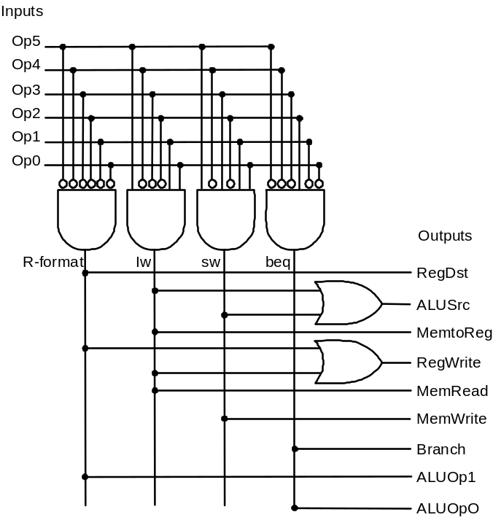
Controller
 |  | R-format | lw | sw | beq
Opcode |  | 000000 | 100011 | 101011 | 000100
Outputs | RegDst | 1 | 0 | X | X
 | ALUSrc | 0 | 1 | 1 | 0
 | MemtoReg | 0 | 1 | X | X
 | RegWrite | 1 | 1 | 0 | 0
 | MemRead | 0 | 1 | 0 | 0
 | MemWrite | 0 | 0 | 1 | 0
 | Branch | 0 | 0 | 0 | 1
 | ALUOp1 | 1 | 0 | 0 | 0
 | ALUOp2 | 0 | 0 | 0 | 1

Slide 33
Up Next
Multicycle Implementation
Why isn’t single cycle enough?
  control is relatively simple
  CPI is 1, but cycle time must be long enough for every instruction to complete!
  branch instruction versus load instruction
    loads require instruction fetch, register access, ALU, memory access, register access
    branches require instruction fetch, register access, ALU
  and this is for a simplified processor!
    no floating point ops, no multiply or divide

Slide 34
Key Points
CPU is just a collection of state and combinational logic
We just designed a very rich processor, at least in terms of functionality
Execution time = Insts * CPI * Cycle Time
  where does the single-cycle machine fit in?

