Slide 1

CS M151B / EE M116C
Computer Systems Architecture
Instruction Set Architecture
Instructor: Prof. Lei He
<LHE@ee.ucla.edu>
Some notes adopted from Glenn Reinman

Slide 2
Useful Vocabulary
superscalar processor: executes more than one instruction per cycle
cycle: smallest unit of time in a processor
throughput: the amount of work that can be performed by a computer system or component in a given period of time
latency: the length of time it takes to respond to an event
parallelism: the ability to do more than one thing at once
pipelining: overlapping parts of a large task to increase throughput without decreasing latency

Slide 3
Instruction Execution Stages
Obtain instructions from program storage
Determine required actions and instruction size
Locate and obtain operand data
Compute result value or status
Deposit results in storage for later use
Determine successor instruction
Instruction
Fetch
Instruction
Decode
Operand
Fetch
Execute
Result
Store
Next
Instruction

Slide 4

The Instruction Set Architecture
That part of the architecture that is visible to the programmer
  instruction formats
  opcodes (available instructions)
  number and types of registers
  storage access, addressing modes
  exceptional conditions
Application
Operating
System
Compiler
Firmware
Instruction Set
Architecture
Instr. Set Proc.
I/O system
Datapath & Control
Digital Design
Circuit Design
Layout

Slide 5
Overall Goals of ISA
Can be implemented by simple hardware
Can be implemented by fast hardware
Instructions do useful things
Easy to write (or generate) machine code

Slide 6
Key ISA Decisions
Operations
  how many?
  which ones?
  length?
Operands
  how many?
  location
  types
  how to specify?
Instruction format
  size
  how many formats?
destination operand
operation
a = b + c
source operands

Slide 7
Main ISA Classes
CISC (“Complex Instruction Set Computers”)
  Digital’s VAX (1977) and Intel’s x86 (1978)
  large # of instructions
  many specialized complex instructions
RISC (“Reduced Instruction Set Computers”)
  almost all machines of 80’s and 90’s are RISC
    MIPS, PowerPC, DEC Alpha, IA64
  relatively fewer instructions
  enable pipelining and parallelism

Slide 8
Instruction Length
Variable:
Fixed:
x86 – Instructions vary from 1 to 17 Bytes long
VAX – from 1 to 54 Bytes
MIPS, PowerPC, and most other RISC’s:
all instruction are 4 Bytes long

Slide 9
Instruction Length
Variable-length instructions (x86, VAX):
  - require multi-step fetch and decode
  + allow for a more flexible and compact instruction set
  (motivated by scarce instruction memory at the time)
Fixed-length instructions (RISC’s)
  + allow easy fetch and decode
  + simplify pipelining and parallelism
  - instruction bits are scarce
All MIPS instructions are 32 bits long

Slide 10
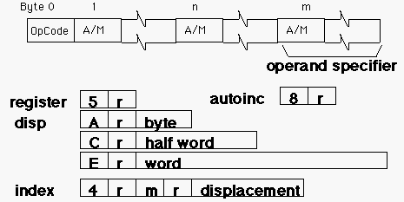
Instruction Formats
What does each bit mean?
Having many different instruction formats...
  complicates decoding
  uses instruction bits (to specify the format)
VAX 11 instruction format

Slide 11
MIPS Instruction Formats
6 bits
5 bits
5 bits
5 bits
5 bits
6 bits
r format
i format
j format
OP
rs
rt
rd
sa
funct
OP
rs
rt
immediate
OP
target
for instance, “add r1, r2, r3” has
  OP=0, rs=2, rt=3, rd=1, sa=0, funct=32
  000000 00010 00011 00001 00000 100000
opcode (OP) tells the machine which format

Slide 12
Where Are the Operands?
Operands can be in registers or in memory
Registers
  All computers have a small set of registers
    Memory to hold values that will be used soon
    Typical instruction will use 2 or 3 register values
  Some advantages of a small number of registers:
    It requires fewer bits to specify which one.
    Less hardware
    Faster access (shorter wires, fewer gates)
    Faster context switch (when all registers need saving)
  Some advantages of a larger number:
    Fewer load and store instructions needed
    Easier to do several operations at once

Slide 13
How Many Registers?
VAX – 16 registers
  R15 is program counter (PC)
    Elegant! Loading R15 is a jump instruction
x86 – 8 general purpose regs Fine print – some restrictions apply
  Plus floating point and special purpose registers
Most RISC’s have 32 int and 32 floating point regs
  Plus some special purpose ones
    PowerPC has 8 four-bit “condition registers”, a “count register” (to hold loop index), and others.
Itanium (IA64) has 128 fixed, 128 floating point, and 64 “predicate” registers

Slide 14
Where Do Operands Reside?
Stack machine:
  no registers, just a stack of value locations
  “Push A” loads memory location A onto the stack, this value is now the top of stack (1st entry of stack).
  “Pop A” stores the top of stack into memory location A, then removes the top of stack.
  “Add” places the sum of the first two stack entries in the 2nd entry of the stack, then removes the top of stack.
Accumulator machine:
  Only 1 register (called the “accumulator”)
  Instructions include “store” and “acc ← acc + mem”
Register-Memory machine :
  Arithmetic instructions can use data in registers and/or memory
Load-Store Machine (aka Register-Register Machine):
  Arithmetic instructions can only use data in registers.

Slide 15
Comparing the Number of Instructions
Code sequence for C = A + B
Stack
Accumulator
Register-Memory
Load-Store
Push A
Load A
Add C, A, B
Load R1,A
Push B
Add B
Load R2,B
Add
Store C
Add R3,R1,R2
Pop C
Store C,R3

Slide 16
Load-Store Architectures
can do:
add r1=r2+r3
load r3, M(address)
store r1, M(address)
forces heavy dependence on registers, which is exactly what you want in today’s CPUs
can’t do:
add r1=r2+M(address)
- more instructions
+ fast implementation (e.g., easy pipelining)

Slide 17
Alternate ISA’s
A = X*Y + X*Z
Stack Accumulator Reg-Mem Load-store

Slide 18
How Many Operands?
Two-address code: target is same as one operand
  E.g., x = x + y
Three-address code: target can be different
  E.g. x = y + z
  x86 doesn’t have three-address instructions; others do
Some operands are also specified implicitly
  “condition code” setting shows if result was +, 0, or –
  PowerPC’s “Branch on count” uses special “count register”
Well-known ISA’s have 0-4 (explicit) operands
  PowerPC has “float multiply add”, r = x + y*z
  It also has fancy bit-manipulation instructions

Slide 19
Addressing Modes
Where do we get the operand?
Immediate #25
  The operand (25) is part of the instruction
Register R3 (sometimes written $3)
  The operand is the contents of register 3
Register indirect M[R3]
  Use contents of R3 as address into memory; find the operand there
Base+Displacement M[R3 + 160]
  Add the displacement (160) to contents of R3, look in that memory location for the operand
    If register is PC, this is “PC-relative addressing”
All our example ISA’s have the above modes

Slide 20
More Addressing Modes
Base+Index M[R3 + R4]
  Add contents of R3 and R4 to get memory address
Autoincrement M[R3++] (or M[R3+=d])
  Find value in memory location designated by R3, but also increment R3
    Useful for accessing array elements
    Autodecrement is similar
Scaled Index M[R3 + R4*d] (VAX and x86)
  Multiply R4 by d (d is typically 1,2,4, or 8), then add R3 to get memory address
Memory Indirect M[ M[R3] ] (only VAX)
  Find number in memory location R3, use THAT as address into memory to find
None of the above are included in MIPS ISA

Slide 21
VAX Addressing Mode Usage
Half of all references were register-mode
Remaining half distributed as follows:
Similar measurements show that
  16 bits is enough for the immediate field 75-80% of the time
  16 bits is enough for displacement 99% of the time
Program | Base + Displacement | Immediate | Scaled Index | Memory Indirect | All Others
TEX | 56% | 43% | 0% | 1% | 0%
Spice | 58% | 17% | 16% | 6% | 3%
GCC | 51% | 39% | 6% | 1% | 3%

Slide 22
MIPS Addressing Modes
register
add $1, $2, $3
immediate
addi $1, $2, #35
base + displacement
lw $1, 24($2)
OP
rs
rt
rd
sa
funct
rd
OP
rs
rt
immediate
rs
immediate
value
rt
register indirect
 disp = 0
absolute
 (rs) = 0
displacement

Slide 23
Registers vs. Memory
Arithmetic instruction operands must be registers,
— only 32 registers provided
Compiler associates variables with registers
What about programs with lots of variables?
Control
Input
Memory
Datapath
Output
Processor
I/O

Slide 24
Memory Organization
Viewed as a large, single-dimension array, with an address.
A memory address is an index into the array
"Byte addressing" means that the index points to a byte of memory.
0
8 bits of data
1
8 bits of data
2
8 bits of data
3
8 bits of data
4
8 bits of data
5
8 bits of data
6
8 bits of data
...

Slide 25
Memory Organization
Bytes are nice, but most data items use larger "words"
For MIPS, a word is 32 bits or 4 bytes.
2³² bytes with byte addresses from 0 to 2³²-1
2³⁰ words with byte addresses 0, 4, 8, ... 2³²-4
Words are aligned
i.e., what are the least 2 significant bits of a word address?
0
32 bits of data
4
32 bits of data
Registers hold 32 bits of data
8
32 bits of data
12
32 bits of data
...

Slide 26
MIPS ISA Decisions
Instruction length
  all instructions are 32 bits long
How many registers?
  32 general purpose registers (R0 always 0)
Where do operands reside?
  load-store architecture
Instruction formats
  three (r-, i-, and j-format)
Operands
  3-address code
  immediate, register, and base+displacement modes

Slide 27
MIPS Operations
arithmetic
  add, subtract, multiply, divide, ...
logical
  and, or, shift left, shift right, ...
data transfer
  load word, store word
conditional branch
  beq & bne are PC-relative, since most targets are nearby
unconditional jump
  jump, jump register, branch and link

Slide 28
Conditional Branches
Decision making instructions
  alter the control flow,
  i.e., change the "next" instruction to be executed
MIPS conditional branch instructions:
bne $t0, $t1, Label
beq $t0, $t1, Label
Example: if (i==j) h = i + j;
bne $s0, $s1, Label
add $s3, $s0, $s1
Label: ....
How do we specify the target address of a branch?
  studies show that almost all conditional branches go relatively short distances from the current PC
  specify a relative branch target address! (RELATIVE TO PC+4)
op rs rt 16 bit address

Slide 29
More Conditional Branches
We have: beq, bne, what about Branch-if-less-than?
New instruction slt:
if $s1 < $s2 then
$t0 = 1
slt $t0, $s1, $s2 else
$t0 = 0
beq, bne, and slt can be used to build all fundamental branch conditions
  always, !=, ==, >, <=, >=, <, ...
  note that the assembler needs a register to do this
Notes:
Board work: Binary Numbers

Slide 30
Unconditional Branches
jump (j)
  26-bit word address (represents 28-bit byte address)
jump and link (jal)
  procedure calls - modifies PC; saves PC+4 to $ra
jump register (jr)
  returns
  jumps larger than the given 26 bits
instruction
6
26
4
28
PC
jump destination address
00

Slide 31
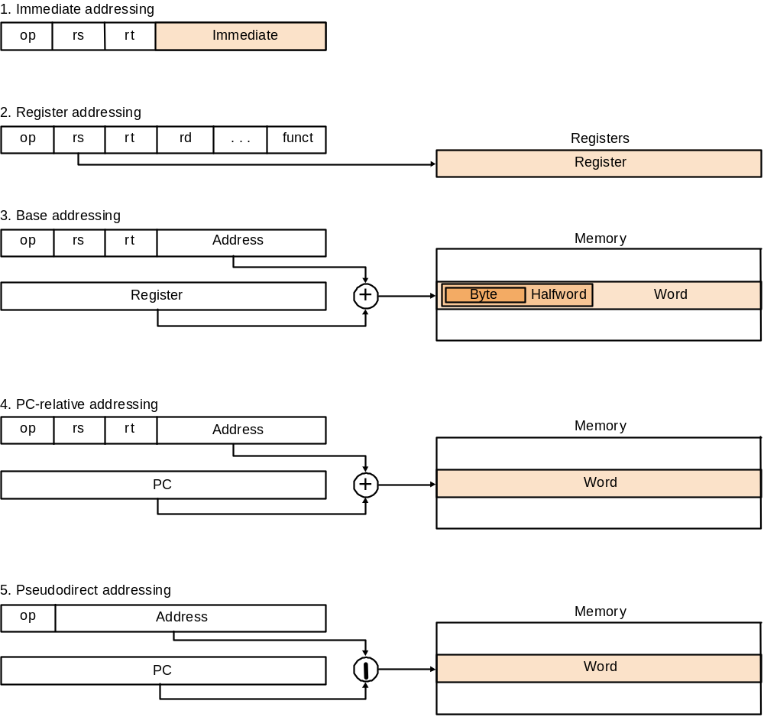
Addressing Modes, Data and Control Transfer

Slide 32
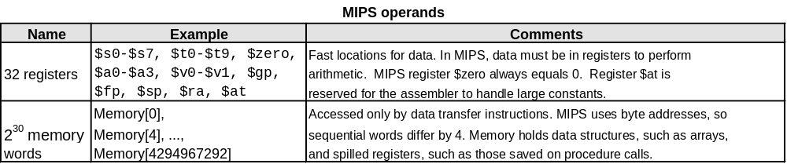
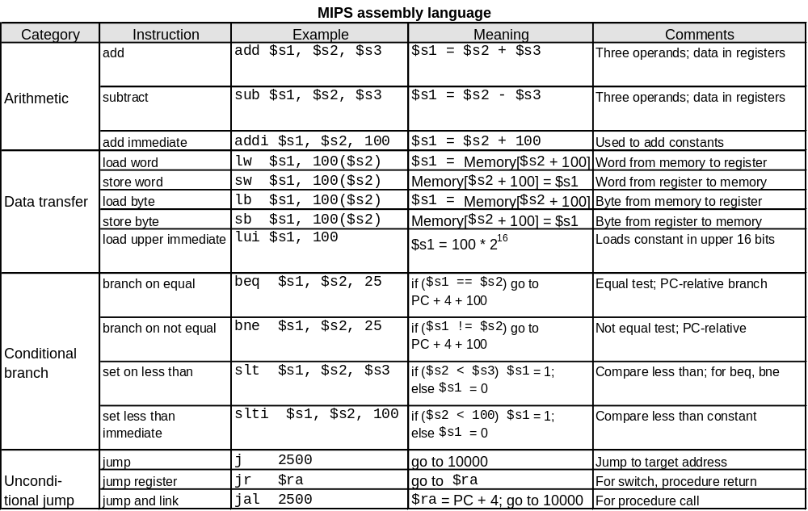
To Summarize:

Slide 33

Example
Can we figure out the code?
assume:
  $4 holds the base address of array v[]
  $5 holds the integer k
swap(int v[], int k);
{ int temp;
temp = v[k]
v[k] = v[k+1];
v[k+1] = temp;
}
swap:
sll $2, $5, 2
add $2, $4, $2
lw $15, 0($2)
lw $16, 4($2)
sw $16, 0($2)
sw $15, 4($2)
jr $31

Slide 34
Intel x86 evolution
1978: Intel 8086 announced (16 bit architecture)
1980: The 8087 floating point coprocessor added
1982: The 80286 - more ops, 24-bit address space
1985: The 80386 - 32-bit address space + new modes
1989-1995: The 80486, Pentium, and Pentium Pro add a few instructions
1997: MMX is added (Pentium II is P. Pro + MMX)
1999 Pentium III (same architecture)
2000 Pentium 4 (144 new multimedia instructions)
2001 Itanium – new ISA (can still execute x86 code)

Slide 35
Intel x86
See your textbook for a more detailed description
Complexity:
  Instructions from 1 to 17 bytes long
  one operand must act as both a source and destination
  one operand can come from memory
  complex addressing modes
  e.g., “base or scaled index with 8 or 32 bit displacement”
Saving grace:
  the most frequently used instructions are not too difficult to build
  compilers avoid the portions of the architecture that are slow

Slide 36
MIPS ISA Tradeoffs
6 bits
5 bits
5 bits
5 bits
5 bits
6 bits
OP
rs
rt
rd
sa
funct
OP
rs
rt
immediate
OP
target
What if?
  64 registers
  20-bit immediates
  4 operand instruction (e.g. Y = X + A + B)
Notes:
The question I want them to ponder is how they would have accommodated these features in the MIPS ISA. Interesting to note that MIPS does not at all make efficient use of the instruction bit space. Opcode space is used fairly sparsely, rs and sa are never used in same instruction

Slide 37
Key Points
MIPS is a general-purpose register, load-store, fixed-instruction-length architecture.
MIPS is optimized for fast pipelined performance, not for low instruction count
Four principles of IS architecture
  regularity produces simplicity
  smaller is faster
  good design demands compromise
  make the common case fast

Slide 38
Recent Developments
Long instruction -64 bit for x86
  VLIW – Very Long Instruction Word
    1 “packet” has multiple instructions
    Tera MTA has 26, 21, and 14 bit-long RISC operations (plus 3 “lookahead” bits) in 64 bits
    Intel Itanium has three 41-bit RISC ops (plus 5 “type” bits) in 128-bit packet
JVM (Java Virtual Machine)
  a new level of abstraction
    between Java language and ISA
  stack based – is this a good choice??
ARM (Advanced RISC Machine)
  Open IP licensing
  Mixed 16-32 bits for low power

