Slide 1
CS151B/EE M116C
Computer Systems Architecture
Winter 2003
Memory Locality and Caches
Instructor: Prof. Lei He
<LHE@ee.ucla.edu>
Some notes adopted from Tullsen and Carter at UCSD, and Reinman at UCLA

Slide 2
The five components
Computer
Control
Input
Memory
Datapath
Output

Slide 3
Memory technologies
SRAM
  access time: 3-10 ns. (on-processor SRAM can be 1-2 ns.)
  cost: $100 per MByte (??).
DRAM
  access times: 30 - 60 ns
  cost: $0.50 per MByte.
Disk
  access times: 5 to 20 million ns
  cost of $0.01 per MByte.
We want SRAM’s access time and disk’s capacity.
Disclaimer: Access times and
prices are approximate and
constantly changing. (2/2002)

Slide 4
The Problem with Memory
It’s expensive (and perhaps impossible) to build a large, fast memory
  “fast” meaning “low latency”
    why is low latency important?
To access data quickly:
  it must be physically close
  there can’t be too many layers of logic
Solution: Move data you are about to access to a nearby, smaller, memory cache
  Assuming you can make good guesses about what you will access soon.

Slide 5
A Memory Hierarchy
CPU
SRAM
memory
on-chip “level 1” cache
small,
fast
SRAM
memory
off-chip “level 2” cache
DRAM
memory
big, slower,
cheaper/bit
main memory
huge,
very slow,
very cheap
Disk memory
disk

Slide 6
Cache Basics
In running program, main memory is data’s “home location”.
  Addresses refer to location in main memory.
  “Virtual memory” allows disk to extend DRAM
    We’ll study virtual memory later
When data is accessed, it is automatically moved into cache
  Processor (or smaller cache) uses cache’s copy
  Data in main memory may (temporarily) get out-of-date
    But hardware must keep everything consistent.
  Unlike registers, cache is not part of ISA
    Different models can have totally different cache design

Slide 7
The Principle of Locality
Memory hierarchies take advantage of memory locality.
  The principle that future memory accesses are near past accesses.
Two types of locality:
  Temporal locality - near in time: we will often access the same data again very soon
  Spatial locality - near in space/distance: our next access is often very close to recent accesses.
This sequence of addresses has both types of locality
1, 2, 3, 1, 2, 3, 8, 8, 47, 9, 10, 8, 8 ...

Slide 8
What is Cached?
Taking advantage of temporal locality:
  bring data into cache whenever its referenced
  kick out something that hasn’t been used recently
Taking advantage of spatial locality:
  bring in a block of contiguous data (cacheline), not just the requested data.
Some processors have instructions that let software influence cache:
  Prefetch instruction (“bring location x into cache”)
  “Never cache x” or “keep x in cache” instructions

Slide 9
Cache Vocabulary
cache hit: access where data is found in the cache
cache miss: access where data is NOT in the cache
cache block size or cache line size: the amount of data that gets transferred on a cache miss.
instruction cache (I-cache): cache that only holds instructions
data cache (D-cache): cache that only holds data
unified cache: cache that holds both data & instructions
A typical processor today has separate “Level 1” I- and D-caches on
the same chip as the processor (and possibly a larger, unified “L2”
on-chip cache), and larger L2 (or L3) unified cache on a separate chip.

Slide 10
Cache Issues
On a memory access
  How does hardware know if it is a hit or miss?
On a cache miss
  where to put the new data?
  what data to throw out?
  how to remember what data is where?

Slide 11
A Simple Cache
Fully associative: any line of data can go anywhere in cache
LRU replacement strategy: make room by throwing out the least recently used data.
A very small cache:
4 entries, each holds a four-byte
word, any entry can hold any word.
the tag identifies
the addresses of
the cached data
tag
data

Slide 12
Fully Associative Cache
address stream:
4 00000100
8 00001000
12 00001100
4 00000100
8 00001000
20 00010100
4 00000100
8 00001000
20 00010100
24 00011000
12 00001100
8 00001000
4 00000100
tag
data

Slide 13
An even simpler cache
Keeping track of when cache entries were last used (for LRU replacement) in big cache needs lots of hardware and can be slow.
In a direct mapped cache, each memory location is assigned a single location in cache.
  Usually* done by using a few bits of the address
  We’ll let bits 2 and 3 (counting from LSB = “0”) of the address be the index
* Some machines use a pseudo-random hash of the address

Slide 14
Direct Mapped Cache
address stream:
4 00000100
8 00001000
12 00001100
4 00000100
8 00001000
20 00010100
4 00000100
8 00001000
20 00010100
24 00011000
12 00001100
8 00001000
4 00000100
tag
data

Slide 15
A Better Cache Design
Direct mapped caches are simpler
  Less hardware; possibly faster
Fully associative caches usually have fewer misses.
Set associative caches try to get best of both.
  An index is computed from the address
  In a “k-way set associative cache”, the index specifies a set of k cache locations where the data can be kept.
    k=1 is direct mapped.
    k=cache size (in lines) is fully associative.
  Use LRU replacement (or something else) within the set.
2-way set associative cache
Two places to look for
data with index “0”
index
tag data tag data
0
1
2
3
...

Slide 16
2-Way Set Associative Cache
address stream:
4 00000100
8 00001000
12 00001100
4 00000100
8 00001000
20 00010100
4 00000100
8 00001000
20 00010100
24 00011000
12 00001100
8 00001000
4 00000100
Memory address
tag | index | offset
index
tag
data
tag
data

Slide 17
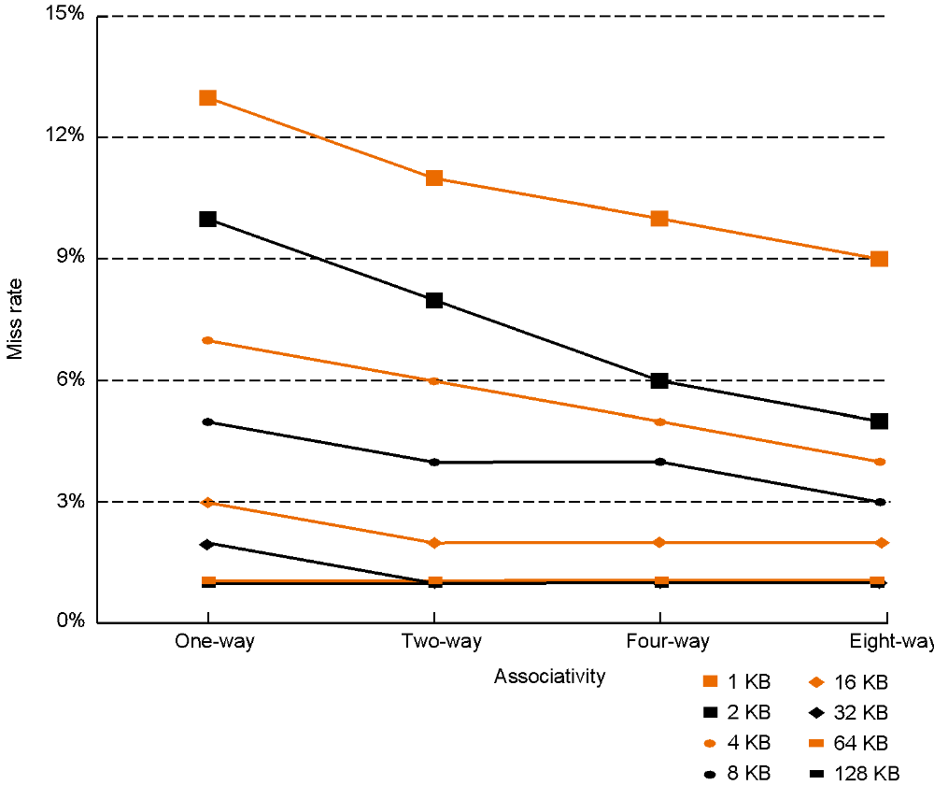
Cache Associativity

Slide 18
Longer Cache Blocks
Large cache blocks take advantage of spatial locality
  Less tag space is needed (for a given capacity cache)
Too large a block size can waste cache space
Large blocks require longer transfer times
tag data (room for big block)

Slide 19
Larger block size in action
address stream:
4 00000100
8 00001000
12 00001100
4 00000100
8 00001000
20 00010100
4 00000100
8 00001000
20 00010100
24 00011000
12 00001100
8 00001000
4 00000100
tag
data (8 bytes)

Slide 20
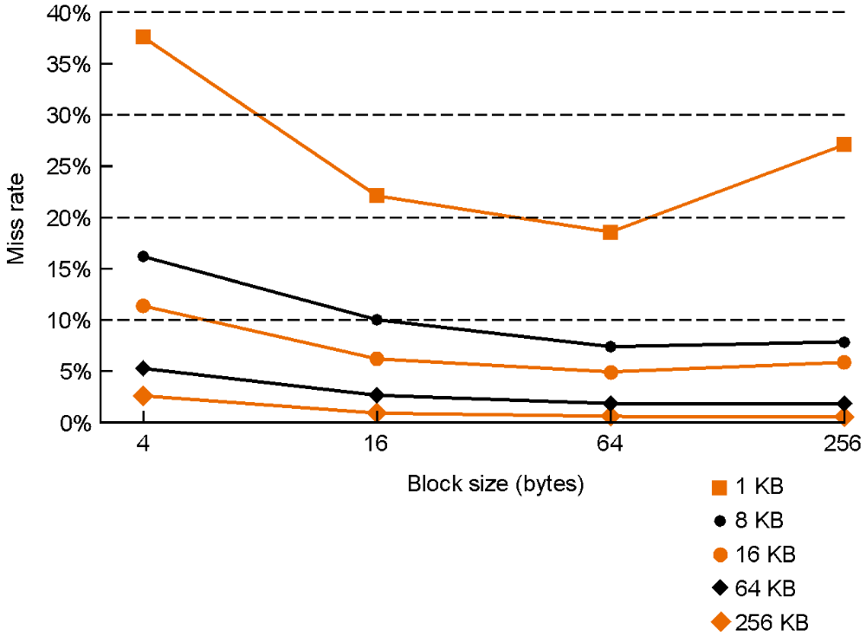
Block Size and Miss Rate

Slide 21
Cache Parameters
Cache size = Number of sets * block size * associativity
128 blocks, 32-byte blocks, direct mapped
  Size = ?
128 KB cache, 64-byte blocks, 512 sets,
  associativity = ?
index
tag
data
tag
data

Slide 22
Details
What bits should we use for the index?
How do we know if a cache entry is empty?
Are stores and loads treated the same?
What if a word overlaps two cache lines??
How does this all work, anyway???

Slide 23
Choosing bits for the index
If line length is n Bytes, the low-order log₂n bits of a Byte-address give the offset of address within a line.
The next group of bits is the index -- this ensures that if the cache holds X bytes, then any block of X contiguous Byte addresses can co-reside in the cache.
    (Provided the block starts on a cache line boundary.)
The remaining bits are the tag.
Anatomy of an address:
tag | index | offset

Slide 24
Is a cache entry empty?
Problem: when a program starts up, cache is empty.
  It might contain stuff left from previous application
  How do you make sure you don’t match an invalid tag?
Solution: an extra “valid” bit per cacheline
  Entire cache can be marked “invalid” on context switch.

Slide 25
Handling a Cache Access
Use index and tag to access cache and determine hit/miss.
If hit, return requested data.
If miss, select a block to be replaced, and access memory or next lower cache (possibly stalling the processor).
  load entire missed cache line into cache
  return requested data to CPU (or higher cache)
If next lower memory is a cache, goto step 1 for that cache

Slide 26
Putting it all together
64 KB cache, direct-mapped, 32-byte cache block
31 30 29 28 27 ........... 17 16 15 14 13 12 11 10 9 8 7 6 5 4 3 2 1 0
tag
index
11
word offset
16
valid
tag
data
0
1
2
...
...
...
...
2045
2046
2047
64 KB / 32 bytes =
2 K cache blocks/sets
256
=
hit/miss
32

Slide 27
A set associative cache
32 KB cache, 2-way set-associative, 16-byte blocks
31 30 29 28 27 ........... 17 16 15 14 13 12 11 10 9 8 7 6 5 4 3 2 1 0
tag
index
10
word offset
18
valid
tag
data
valid
tag
data
0
1
2
...
...
...
...
1021
1022
1023
32 KB / 16 bytes / 2 =
1 K cache sets
=
=
hit/miss

Slide 28
Dealing with Stores
Stores must be handled differently than loads, because...
  they don’t necessarily require the CPU to stall.
  they change the content of cache
    Creates a memory consistency question ... how do you ensure memory gets the correct value - the one that we have recently written to the cache?

Slide 29
Policy decisions for stores
Do you keep memory and cache identical?
  write-through cache: all writes go to both cache and main memory
  write-back cache: writes go only to cache. Modified cache lines are written back to memory when the line is replaced.
Do you make room in cache for store miss?
  write-allocate: on a store miss, bring target line into the cache.
  write-around: on a store miss, ignore cache

Slide 30
Dealing with stores
On a store hit, write the new data to cache
  In a write-through cache, write the data immediately to memory
  In a write-back cache
    Mark the line as dirty
      means cache has correct value, but memory doesn’t
    On any cache miss in a write-back cache, if the line to be replaced in the cache is dirty, write it back to memory
On a store miss,
  In a write-allocate cache,
    Initiate a cache block load from memory.
  In a write-around cache,
    Write directly to memory.

Slide 31
Cache Alignment
memory address:
tag index offset
A cache line is all the data whose address share the tag and index.
  Example: Suppose offset of 5 bits,
    Bytes 0-31 form the first cache line
    Bytes 32-63 form the second, etc.
  When you load location 40,
  cache gets Bytes 32-63
This results in
  no overlap of cache lines
  easy to find if address is in cache (no additions)
  easy to find the data within the cache line
Think of memory as organized into cache-line sized pieces (because in reality, it is!)
Memory
0
1
2
3
4
5
6
7
8
9
10
.
.
.
.
.
.

Slide 32
Cache Vocabulary
miss penalty: extra time required on a cache miss
hit rate: fraction of accesses that are cache hits
miss rate: 1 - hit rate

Slide 33
A Performance Model
TCPI = BCPI + MCPI
  TCPI = Total CPI
  BCPI = Base CPI = CPI assuming perfect memory
  MCPI = Memory CPI = cycles waiting for memory per instruction
BCPI = peak CPI + PSPI + BSPI
  PSPI = pipeline stalls per instruction
  BSPI = branch hazard stalls per instruction
MCPI = accesses/instruction * miss rate * miss penalty
  this assumes we stall the pipeline on both read and write misses, that the miss penalty is the same for both, that cache hits require no stalls.
  If the miss penalty or miss rate is different for I-cache and D-cache (which is common), then
  MCPI = InstMR*InstMP + DataAccesses/inst*DataMR*DataMP

Slide 34
Cache Performance
Instruction cache miss rate of 4%, data cache miss rate of 9%, BCPI = 1.0, 20% of instructions are loads and stores, miss penalty = 12 cycles, TCPI = ?
Unified cache, 25% of instructions are loads and stores, BCPI = 1.2, miss penalty of 10 cycles. If we improve the miss rate from 10% to 4% (e.g. with a larger cache), how much do we improve performance?
BCPI = 1, miss rate of 8% overall, 20% loads, miss penalty 20 cycles, never stalls on stores. What is the speedup from doubling the cpu clock rate?

Slide 35
Average Memory Access Time
AMAT = Time for a hit + Miss Rate x Miss penalty

Slide 36
Three types of cache misses
Compulsory misses
  number of misses needed to bring every cache line referenced by program into an infinitely large cache.
Capacity misses
  number of misses in a fully associative cache of the same size as the cache in question minus the compulsory misses.
Conflict misses
  number of misses in actual cache minus number there would be in a fully-associative cache of the same size.
Total misses = (Compulsory + Capacity + Conflict) misses
Ex: 4 blocks, direct-mapped, 1 word per cache line
  Reference sequence: 4, 8, 12, 4, 8, 20, 4, 8, 20, 24, 12, 8, 4
    Compulsory misses:
    Capacity misses:
    Conflict misses:

Slide 37
So, then, how do we decrease...
1
4
%
Compulsory misses?
Capacity misses?
Conflict misses?
1
2
%
1
0
%
e
p
y
t
r
8
%
e
p
e
t
a
r
6
%
s
s
i
M
4
%
2
%
C
a
p
a
c
i
t
y
0
%
1
2
4
8
1
6
3
2
6
4
1
2
8
C
a
c
h
e
s
i
z
e
(
K
B
)
O
n
e
-
w
a
y
F
o
u
r
-
w
a
y
T
w
o
-
w
a
y
E
i
g
h
t
-
w
a
y

Slide 38
LRU Replacement Algorithms
Not needed for direct-mapped caches
Requires one bit per set for 2-way set-associative,
  8 bits per set for 4-way (2 bits per entry)
  24 bits per set for 8-way, etc.
Can be approximated with log n bits per set (NMRU)
Another approach is to use random replacement within a set
  Miss rate is about 10% higher than LRU.
Highly associative caches (like page tables, which we’ll get to) use a different approach.

Slide 39
Caches in Current Processors
Often direct mapped level 1 cache (closest to CPU), associative further away
Split I and D level 1 caches (for throughput rather than miss rate), unified further away.
Write-through and write-back are both common, but never write-through all the way to memory.
Cache line size at least 32 bytes, getting larger.
Usually cache is non-blocking
  processor doesn’t stall on a miss, but only on the use of a miss (if even then)
  this means the cache must be able to handle multiple outstanding accesses.

Slide 40
DEC Alpha 21164 Caches
ICache and DCache -- 8 KB, Direct Mapped, 32-Byte lines
L2 cache -- 96 KB, 3-way Set Associative, 32-Byte lines
L3 cache -- 1 MB, Direct Mapped, 32-byte lines (but different L3’s can be used)
I-Cache
Unified
L2
Cache
Off-Chip
L3 Cache
21164
CPU
D-Cache

Slide 41
Cache Review
memory address:
tag index offset
DEC Alpha 21164’s L2 cache:
  96 KB, 3-way set associative, 32-Byte lines
  64 bit addresses
Questions
  How many “offset” bits?
  How many “index” bits?
  How many “tag” bits?
  Draw cache picture – how do you tell if it’s a hit?
  What are the tradeoffs to increasing
    cache size
    cache associativity
    block size

Slide 42
Key Points
Caches give illusion of a large, cheap memory with the access time of a fast, expensive memory.
Caches take advantage of memory locality, specifically temporal locality and spatial locality.
Cache design presents many options (block size, cache size, associativity) that an architect must combine to minimize miss rate and access time to maximize performance.

