Slide 1
CS151B/EE M116C
Computer Systems Architecture
Multiprocessors and multithreading
Instructor: Prof. Lei He
<LHE@ee.ucla.edu>
Some notes adopted from Reinman at UCLA

Slide 2
Multiprocessors
Can a number of processors working together improve performance?
  Will 100 processors run an application 100 times faster than 1 processor? 50 times faster?
How much will this coordinated effort cost us?
How do we allow these processors to work together?
The answers to this span many other fields
  Operating systems
  Compilers
  Physical Design

Slide 3
Classifying Multiprocessors
Interconnection Network
  bus
  network
Memory Topology
  UMA (uniform memory access)
  NUMA (non-uniform memory access)
Programming Model
  Shared Memory - all processors shares a single memory address space
  Message Passing - each processor has a private memory and can only access this memory
    Inter-processor communication is through explicit messages
memory
access time
seen by a
given CPU

Slide 4
Parallel Programming
Shared-memory programming requires synchronization to provide mutual exclusion and prevent race conditions
  locks (no simultaneous writing)
  Barriers (to synchronize)
Parallelism in an application
  Is this the same as ILP (instruction level parallelism)?
  Examples?

Slide 5
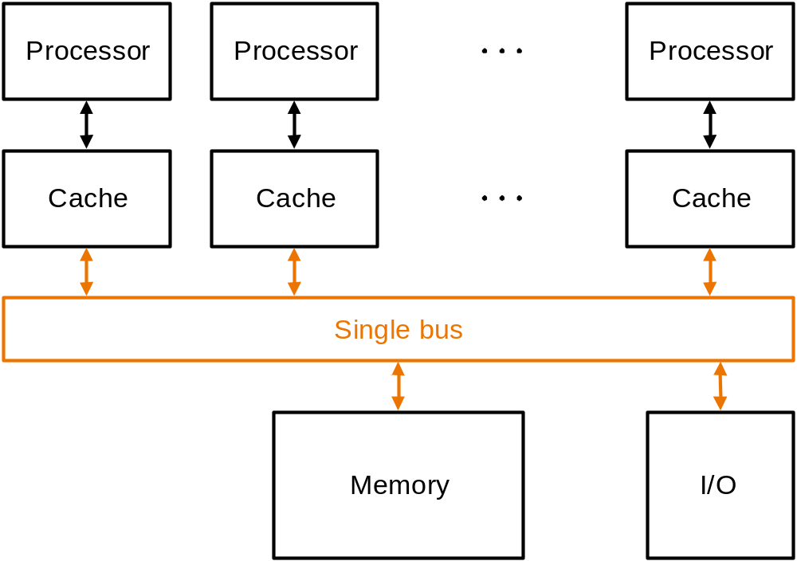
Shared Memory Multiprocessors
Cache coherence problem:
  What happens when a block cached by two processors is written by one processor?

Slide 6
Cache Coherency
Write-update
  when a processor writes, it broadcasts the new data over the bus
  all copies in the caches of other processors are updated
Write-invalidate
  before writing, invalidate all other copies of the cached block
  used in most commercial cache-based multiprocessors
Much easier on a bus-based multiprocessor

Slide 7
Cache Coherency
A good protocol will avoid unnecessary invalidations and updates
MESI (Illinois)
  Each cache line is in one of four states
    Modified
    Exclusive
    Shared
    Invalid

Slide 8
Snooping
P
r
o
c
e
s
s
o
r
P
r
o
c
e
s
s
o
r
P
r
o
c
e
s
s
o
r
S
n
o
o
p
C
a
c
h
e
t
a
g
S
n
o
o
p
C
a
c
h
e
t
a
g
S
n
o
o
p
C
a
c
h
e
t
a
g
t
a
g
a
n
d
d
a
t
a
t
a
g
a
n
d
d
a
t
a
t
a
g
a
n
d
d
a
t
a
S
i
n
g
l
e
b
u
s
M
e
m
o
r
y
I
/
O
How do we know when external read/writes occur?
  Tag array is replicated for the cache

Slide 9
Network Based Multiprocessors
Message Passing
Distributed Shared Memory (DSM)
P
r
o
c
e
s
s
o
r
P
r
o
c
e
s
s
o
r
P
r
o
c
e
s
s
o
r
C
a
c
h
e
C
a
c
h
e
C
a
c
h
e
M
e
m
o
r
y
M
e
m
o
r
y
M
e
m
o
r
y
N
e
t
w
o
r
k

Slide 10
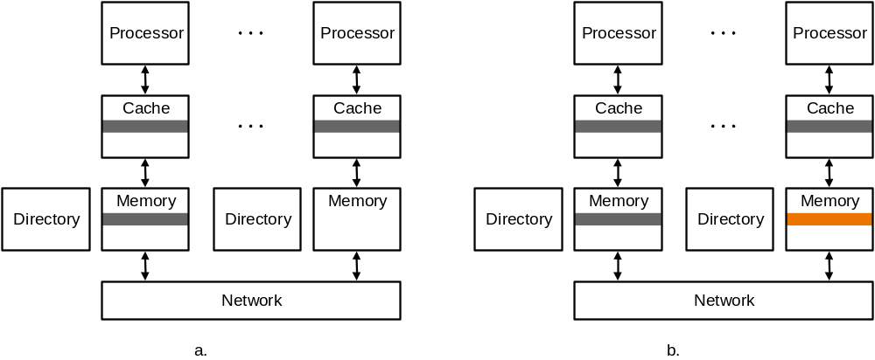
Cache Coherency for DSM
Directory-based protocols
  Directory tracks state of every block in main memory (i.e. what caches have copies of what blocks)
  Directory issue explicit request command to a processor

Slide 11
Multithreaded Processors
PC
PC
PC
PC
regs
regs
regs
regs
CPU Core
CPU Core
Conventional CPU
Multithreaded CPU

Slide 12
Multiprocessors: Key Points
Network vs. Bus
Message-passing vs. Shared Memory
Shared Memory is more intuitive, but creates problems for both the programmer (memory consistency, requiring synchronization) and the architect (cache coherency).
Multithreading gives the illusion of multiprocessing (including, in many cases, the performance) with very little additional hardware.

Slide 13
Key Terms
MIMD, SIMD, SISD, multiprocessors, multithreading
Message passing, Distributed shared memory, Cache coherency, snoopy cache coherency
Uniform memory access, and non-uniform memory access

