Slide 1

CS M151B / EE M116C
Computer Systems Architecture
Pipelining
Instructor: Prof. Lei He
<LHE@ee.ucla.edu>
Some notes adopted from Glenn Reinman

Slide 2
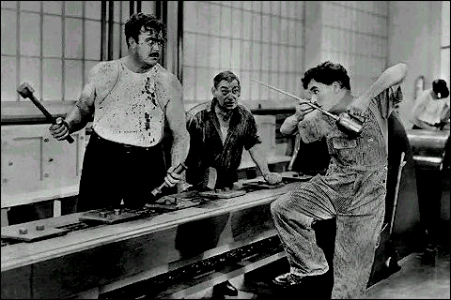
Fetch
Reg
Read
ALU
Data
Memory
Reg
Write
Slide from Prof. B Parhami at UCSB

Slide 3
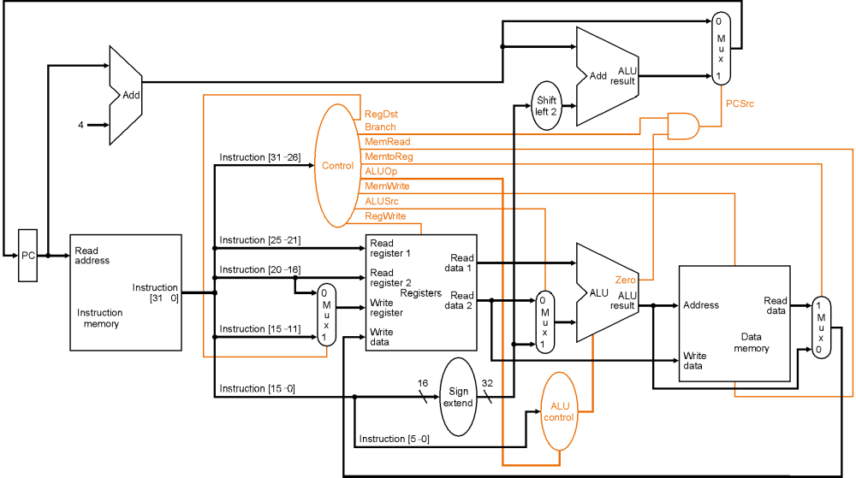
Review -- Single Cycle CPU

Slide 4
Single Cycle Datapath Partitioning
P
C
S
r
c
1
A
d
d
M
u
A
L
U
x
4
A
d
d
r
e
s
u
l
t
0
R
e
g
W
r
i
t
e
S
h
i
f
t
l
e
f
t
2
I
n
s
t
r
u
c
t
i
o
n
[
2
5
–
2
1
]
R
e
a
d
P
C
R
e
a
d
r
e
g
i
s
t
e
r
1
R
e
a
d
M
e
m
W
r
i
t
e
a
d
d
r
e
s
s
I
n
s
t
r
u
c
t
i
o
n
[
2
0
–
1
6
]
R
e
a
d
d
a
t
a
1
A
L
U
S
r
c
M
e
m
t
o
R
e
g
I
n
s
t
r
u
c
t
i
o
n
r
e
g
i
s
t
e
r
2
R
e
a
d
Z
e
r
o
[
3
1
–
0
]
1
W
r
i
t
e
d
a
t
a
2
1
A
L
U
A
L
U
R
e
a
d
M
r
e
g
i
s
t
e
r
M
r
e
s
u
l
t
A
d
d
r
e
s
s
d
a
t
a
1
I
n
s
t
r
u
c
t
i
o
n
I
n
s
t
r
u
c
t
i
o
n
[
1
5
–
1
1
]
u
u
M
m
e
m
o
r
y
x
W
r
i
t
e
R
e
g
i
s
t
e
r
s
x
u
0
d
a
t
a
0
x
W
r
i
t
e
D
a
t
a
0
R
e
g
D
s
t
1
6
d
a
t
a
m
e
m
o
r
y
I
n
s
t
r
u
c
t
i
o
n
[
1
5
–
0
]
S
i
g
n
3
2
e
x
t
e
n
d
A
L
U
M
e
m
R
e
a
d
c
o
n
t
r
o
l
I
n
s
t
r
u
c
t
i
o
n
[
5
–
0
]
A
L
U
O
p
IF
ID
EX
Mem
WB
Goal is to balance work done in each cycle - minimize cycle time!

Slide 5
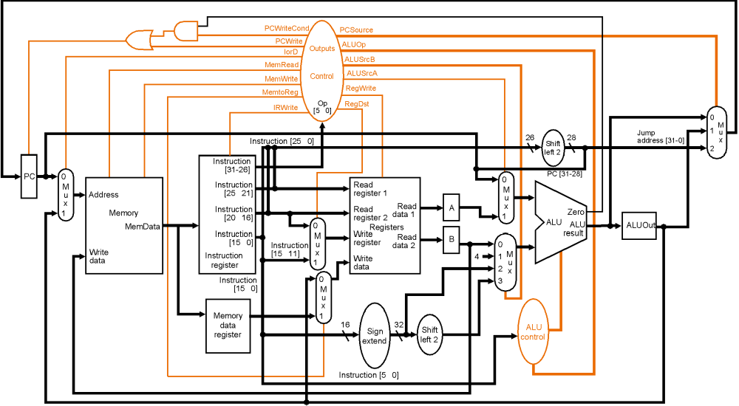
Review -- Multiple Cycle CPU

Slide 6
Review -- Instruction Latencies
Single-Cycle CPU
Load
Ifetch
Reg/Dec
Exec
Mem
Wr
Multiple Cycle CPU
Cycle 1
Cycle 2
Cycle 3
Cycle 4
Cycle 5
Load
Ifetch
Reg/Dec
Exec
Mem
Wr
Add
Ifetch
Reg/Dec
Exec
Wr

Slide 7

Getting the Best of Both Worlds
Pipelined:
Clock rate = 500 MHz
CPI ≅ 1
Single-cycle:
Clock rate = 125 MHz
CPI = 1
Multicycle:
Clock rate = 500 MHz
CPI ≅ 4
Single-cycle analogy:
Doctor appointments
scheduled for 60 min
per patient
Multicycle analogy:
Doctor appointments
scheduled in 15-min
increments
Slide from Prof. B Parhami at UCSB

Slide 8
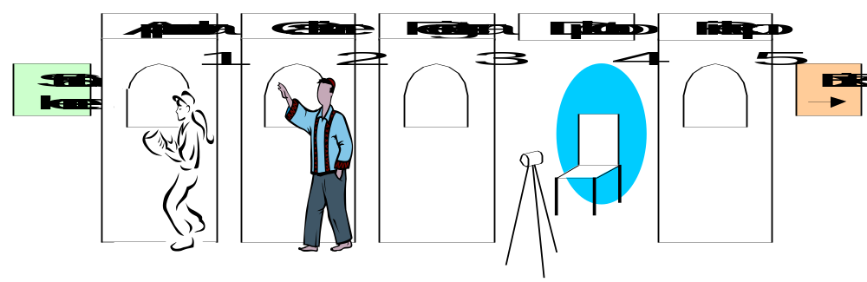
15.1 Pipelining Concepts
Strategies for improving performance
1 – Use multiple independent data paths accepting several instructions
that are read out at once: multiple-instruction-issue or superscalar
2 – Overlap execution of several instructions, starting the next instruction
before the previous one has run to completion: (super)pipelined
Fig. 15.1 Pipelining in the student registration process.
Slide from Prof. B Parhami at UCSB

Slide 9
A Pipelined Datapath
IF: Instruction fetch
ID: Instruction decode and register fetch
EX: Execution and effective address calculation
MEM: Memory access
WB: Write back
Note: These stages are often labeled with the primary structure in the stage, rather than the main function of the stage:
  IF stage = “IM” (instruction memory)
  ID stage = “Reg” (register read)
  EX stage = “ALU”
  MEM stage = “DM” (data memory)
  WB stage = “Reg”

Slide 10
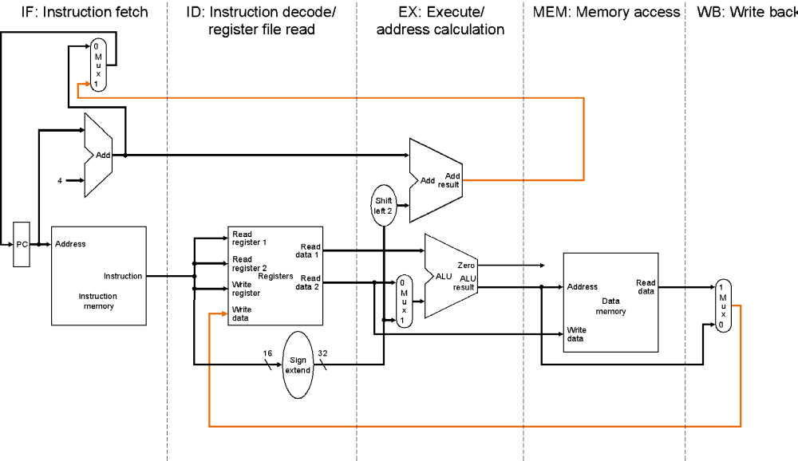
Pipelined Datapath
Warning – “write register” line is incorrect in this figure!

Slide 11
Execution in a Pipelined Datapath
CC1
CC2
CC3
CC4
CC5
CC6
CC7
CC8
CC9
IF
ID
EX
MEM
WB
lw
IM
Reg
ALU
DM
Reg
IF
ID
EX
MEM
WB
lw
IM
Reg
ALU
DM
Reg
IF
ID
EX
MEM
WB
lw
IM
Reg
ALU
DM
Reg
IF
ID
EX
MEM
WB
lw
IM
Reg
ALU
DM
Reg
IF
ID
EX
MEM
WB
lw
IM
Reg
ALU
DM
Reg
steady
state

Slide 12
Instruction Latencies and Throughput
Single-Cycle CPU
Load
IF
Dec
EX
Mem
WB
Multiple Cycle CPU
Cycle 1
Cycle 2
Cycle 3
Cycle 4
Cycle 5
Load
IF
Dec
EX
Mem
WB
Pipelined CPU
Cycle 1
Cycle 2
Cycle 3
Cycle 4
Cycle 5
Cycle 6
Cycle 7
Cycle 8
Load
IF
Dec
EX
Mem
WB
Load
IF
Dec
EX
Mem
WB
Load
IF
Dec
EX
Mem
WB
Load
IF
Dec
EX
Mem
WB

Slide 13
Pipelining Advantages
Higher maximum throughput
Higher utilization of CPU resources
But:
  more hardware needed
  perhaps complex control

Slide 14
Mixed Instructions in the Pipeline
CC1
CC2
CC3
CC4
CC5
CC6
lw
IM
Reg
ALU
DM
Reg
add
IM
Reg
ALU
Reg

Slide 15
Pipeline Principles
All instructions that share a pipeline must have the same stages in the same order.
  therefore, add does nothing during Mem stage
  sw does nothing during WB stage
All intermediate values must be latched each cycle.
There is no functional block reuse
  example: we need 2 adders and ALU (like in single-cycle)
IF ID EX MEM WB
IM
Reg
ALU
DM
Reg

Slide 16
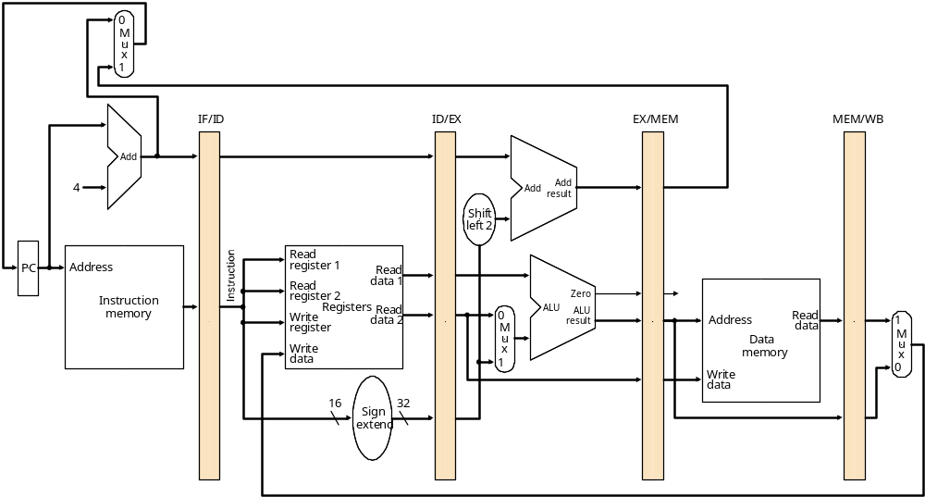
Pipelined Datapath
Instruction Fetch
Instruction Decode/
Register Fetch
Execute/
Address Calculation
Memory Access
Write Back
registers!

Slide 17
The Pipeline in Execution
add $10, $1, $2
Instruction Decode/
Register Fetch
Execute/
Address Calculation
Memory Access
Write Back

Slide 18
The Pipeline in Execution
lw $12, 1000($4)
add $10, $1, $2
Execute/
Address Calculation
Memory Access
Write Back

Slide 19
The Pipeline in Execution
sub $15, $4, $1
lw $12, 1000($4)
add $10, $1, $2
Memory Access
Write Back

Slide 20
The Pipeline in Execution
Instruction Fetch
sub $15, $4, $1
lw $12, 1000($4)
add $10, $1, $2
Write Back

Slide 21
The Pipeline in Execution
Instruction Fetch
Instruction Decode/
Register Fetch
sub $15, $4, $1
lw $12, 1000($4)
add $10, $1, $2

Slide 22
The Pipeline in Execution
Instruction Fetch
Instruction Decode/
Register Fetch
Execute/
Address Calculation
sub $15, $4, $1
lw $12, 1000($4)

Slide 23
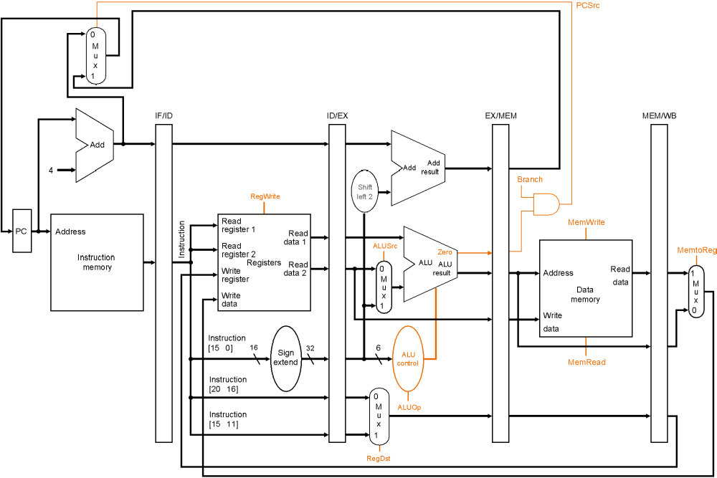
The Pipeline in Execution, with controls
(This figure has a correct Write register)

Slide 24
Pipelined Control
FSM isn’t really appropriate
Combinational Logic (like single-cycle design)!
  signals generated once in ID stage
  follow instruction through the pipeline
  get used in whatever stage they are needed
control
instruction
IF/ID
ID/EX
EX/MEM
MEM/WB

Slide 25
Pipelined Control Signals
 | Execution Stage Control Lines |  |  |  | Memory Stage Control Lines |  |  | Write Back Stage Control Lines
Instruction | RegDst | ALUOp1 | ALUOp0 | ALUSrc | Branch | MemRead | MemWrite | RegWrite | MemtoReg
R-Format | 1 | 1 | 0 | 0 | 0 | 0 | 0 | 1 | 0
lw | 0 | 0 | 0 | 1 | 0 | 1 | 0 | 1 | 1
sw | x | 0 | 0 | 1 | 0 | 0 | 1 | 0 | x
beq | x | 0 | 1 | 0 | 1 | 0 | 0 | 0 | x

Slide 26
Break
Quick survey
  Are we moving too fast, or right pace?
Review of FP
Continue on pipelining
Midterm II: likely Feb. 28th
  May be Feb. 24th

Slide 27
IEEE 754 FP Numbers
1
8
23
Single precision
representation of
(-1)^{S} 2^{E-127} (1.M)
S
E
M
sign
bit
exponent:
excess 127
binary integer
mantissa:
sign + magnitude, normalized
binary significand with hidden
integer bit: 1.M
(actual exponent
is e = E - 127)
0 = 0 00000000 00 . . . 0
-1.5 = 1 01111111 10 . . . 0
325 = 101000101 = 1.01000101 x 2⁸
= 0 10000111 01000101000000000000000
.02 = .0011001101100... = 1.1001101100... x 2⁻³
= 0 01111100 1001101100...
range of about 2 X 10⁻³⁸ to 2 X 10³⁸
always normalized (so always leading 1, never shown)
special representation of 0 (E = 00000000)
can do integer compare for greater-than, sign

Slide 28
Double Precision FP (IEEE 754)
1
11
20
32
sign
S
E
M
M
exponent:
excess 1023
binary integer
mantissa:
sign + magnitude, normalized
binary significand with hidden
integer bit: 1.M
actual exponent is e = E - 1023
S
E-1023
N = (-1) 2 (1.M)
52 (+1) bit mantissa
range of about 2 X 10⁻³⁰⁸ to 2 X 10³⁰⁸

Slide 29
Range of FP Numbers
Exponent | Fraction | Object
0 | 0 | 0
0 | ≠0 | Denormalized Number
1 to 254 | any | Normalized Number (regular floating point number)
255 | 0 | ± ∞
255 | ≠0 | NaN
Range of the floating point number:
Single precision: 2^{–126}~2¹²⁷ (10^{–38}~10³⁸)
Double Precision: 2^{–1022}~2¹⁰²³ (10^{–308}~10³⁰⁸)
Notes:
Here is a quick review of a 4-bit binary number .
The 0 to 7 representation of the number looks like this-what it is is just a binary count.
With this representation, you can perform addition just like adding decimal numbers.
For example here, I show you how to add 3 and 2 with the carry propagates from the 2nd bit to the 3rd bit.
+1 = 21 min. (Y:01)

Slide 30
Review -- Single Cycle CPU

Slide 31
Single Cycle Datapath Partitioning
P
C
S
r
c
1
A
d
d
M
u
A
L
U
x
4
A
d
d
r
e
s
u
l
t
0
R
e
g
W
r
i
t
e
S
h
i
f
t
l
e
f
t
2
I
n
s
t
r
u
c
t
i
o
n
[
2
5
–
2
1
]
R
e
a
d
P
C
R
e
a
d
r
e
g
i
s
t
e
r
1
R
e
a
d
M
e
m
W
r
i
t
e
a
d
d
r
e
s
s
I
n
s
t
r
u
c
t
i
o
n
[
2
0
–
1
6
]
R
e
a
d
d
a
t
a
1
A
L
U
S
r
c
M
e
m
t
o
R
e
g
I
n
s
t
r
u
c
t
i
o
n
r
e
g
i
s
t
e
r
2
R
e
a
d
Z
e
r
o
[
3
1
–
0
]
1
W
r
i
t
e
d
a
t
a
2
1
A
L
U
A
L
U
R
e
a
d
M
r
e
g
i
s
t
e
r
M
r
e
s
u
l
t
A
d
d
r
e
s
s
d
a
t
a
1
I
n
s
t
r
u
c
t
i
o
n
I
n
s
t
r
u
c
t
i
o
n
[
1
5
–
1
1
]
u
u
M
m
e
m
o
r
y
x
W
r
i
t
e
R
e
g
i
s
t
e
r
s
x
u
0
d
a
t
a
0
x
W
r
i
t
e
D
a
t
a
0
R
e
g
D
s
t
1
6
d
a
t
a
m
e
m
o
r
y
I
n
s
t
r
u
c
t
i
o
n
[
1
5
–
0
]
S
i
g
n
3
2
e
x
t
e
n
d
A
L
U
M
e
m
R
e
a
d
c
o
n
t
r
o
l
I
n
s
t
r
u
c
t
i
o
n
[
5
–
0
]
A
L
U
O
p
IF
ID
EX
Mem
WB
Goal is to balance work done in each cycle - minimize cycle time!

Slide 32
Review -- Multiple Cycle CPU

Slide 33
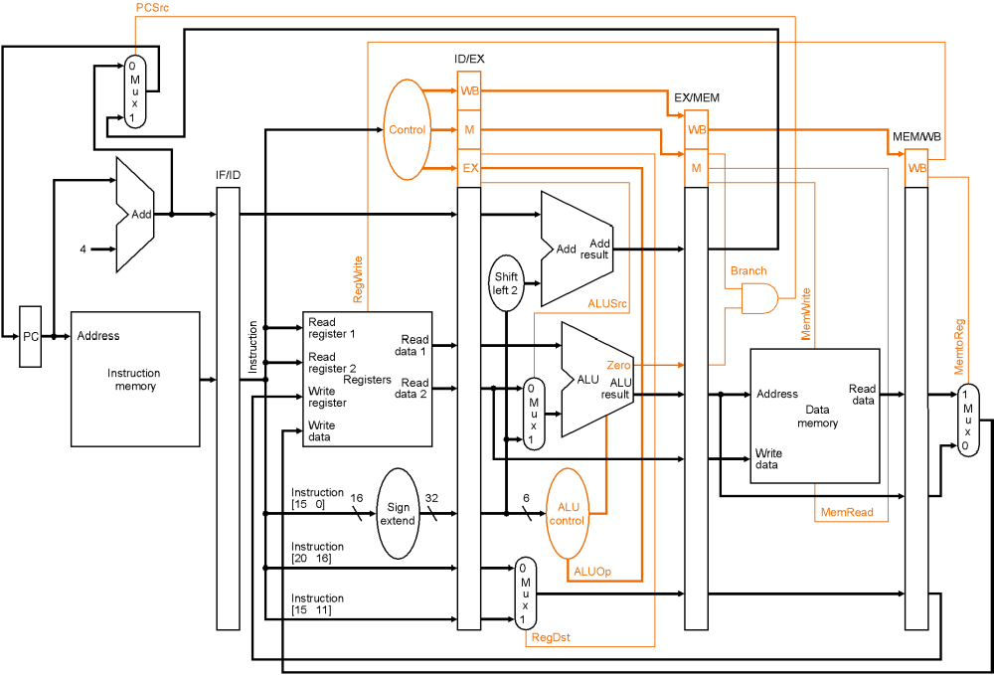
The Pipeline with Control Logic

Slide 34
Is it really that easy?
Suppose initially, register $i holds the number 2i
What happens when we see the following dynamic instruction sequence:
  add $3, $10, $11
    this should add 20 + 22, putting result 42 into $3
  lw $8, 50($3)
    this should load memory location 92 (42+50) into $8
  sub $11, $8, $7
    this should subtract 14 from that just-loaded value

Slide 35
The Pipeline in Execution
lw $8, 50($3)
add $3, $10, $11
Execute/
Address Calculation
Memory Access
Write Back
20
22

Slide 36
The Pipeline in Execution
sub $11, $8, $7
lw $8, 50($3)
add $3, $10, $11
Memory Access
Write Back
HAZARD: This should have been “42”!
But register 3 didn’t get updated yet.
6
16
20
22
42
50

Slide 37
The Pipeline in Execution
add $10, $1, $2
sub $11, $8, $7
lw $8, 50($3)
  add $3, $10, $11
Write Back
And this should be a value
from memory (which hasn’t
even been loaded yet).
Recall: this should
have been “92”
16
14
6
50
56
42

Slide 38
Data Hazards
When a result is needed in the pipeline before it is available, a “data hazard” occurs.
R2 Available
CC1
CC2
CC3
CC4
CC5
CC6
CC7
CC8
sub $2, $1, $3
IM
Reg
ALU
DM
Reg
IM
Reg
ALU
DM
Reg
and $12, $2, $5
IM
Reg
ALU
DM
Reg
or $13, $6, $2
R2 Needed
IM
Reg
ALU
DM
Reg
add $14, $2, $2
IM
Reg
ALU
DM
sw $15, 100($2)

