Slide 1

CS M151B / EE M116C
Computer Systems Architecture
Data and Control Hazards
Instructor: Prof. Lei He
<LHE@ee.ucla.edu>
Some notes adopted from Glenn Reinman

Slide 2
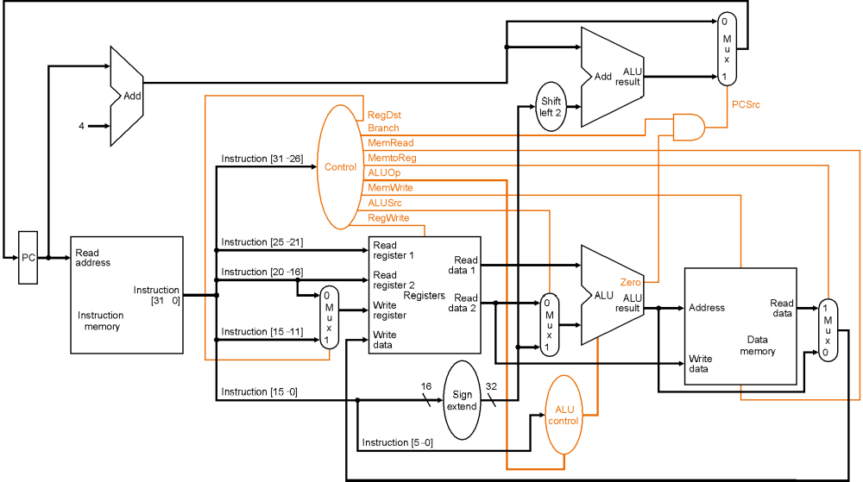
Review -- Single Cycle CPU

Slide 3
Single Cycle Datapath Partitioning
P
C
S
r
c
1
A
d
d
M
u
A
L
U
x
4
A
d
d
r
e
s
u
l
t
0
R
e
g
W
r
i
t
e
S
h
i
f
t
l
e
f
t
2
I
n
s
t
r
u
c
t
i
o
n
[
2
5
–
2
1
]
R
e
a
d
P
C
R
e
a
d
r
e
g
i
s
t
e
r
1
R
e
a
d
M
e
m
W
r
i
t
e
a
d
d
r
e
s
s
I
n
s
t
r
u
c
t
i
o
n
[
2
0
–
1
6
]
R
e
a
d
d
a
t
a
1
A
L
U
S
r
c
M
e
m
t
o
R
e
g
I
n
s
t
r
u
c
t
i
o
n
r
e
g
i
s
t
e
r
2
R
e
a
d
Z
e
r
o
[
3
1
–
0
]
1
W
r
i
t
e
d
a
t
a
2
1
A
L
U
A
L
U
R
e
a
d
M
r
e
g
i
s
t
e
r
M
r
e
s
u
l
t
A
d
d
r
e
s
s
d
a
t
a
1
I
n
s
t
r
u
c
t
i
o
n
I
n
s
t
r
u
c
t
i
o
n
[
1
5
–
1
1
]
u
u
M
m
e
m
o
r
y
x
W
r
i
t
e
R
e
g
i
s
t
e
r
s
x
u
0
d
a
t
a
0
x
W
r
i
t
e
D
a
t
a
0
R
e
g
D
s
t
1
6
d
a
t
a
m
e
m
o
r
y
I
n
s
t
r
u
c
t
i
o
n
[
1
5
–
0
]
S
i
g
n
3
2
e
x
t
e
n
d
A
L
U
M
e
m
R
e
a
d
c
o
n
t
r
o
l
I
n
s
t
r
u
c
t
i
o
n
[
5
–
0
]
A
L
U
O
p
IF
ID
EX
Mem
WB
Goal is to balance work done in each cycle - minimize cycle time!

Slide 4
Review: Dealing with Data Hazards
In Software
  insert independent instructions (or no-ops)
In Hardware
  insert bubbles (i.e. stall the pipeline)
  data forwarding

Slide 5
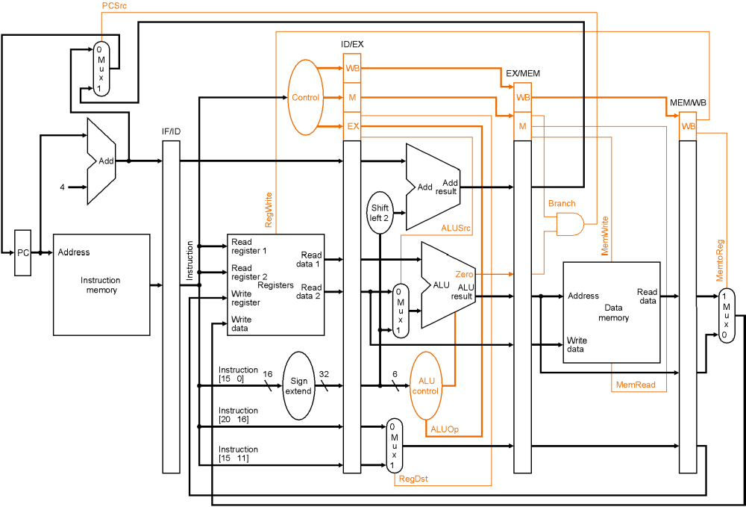
Review: Pipeline with Control Logic

Slide 6
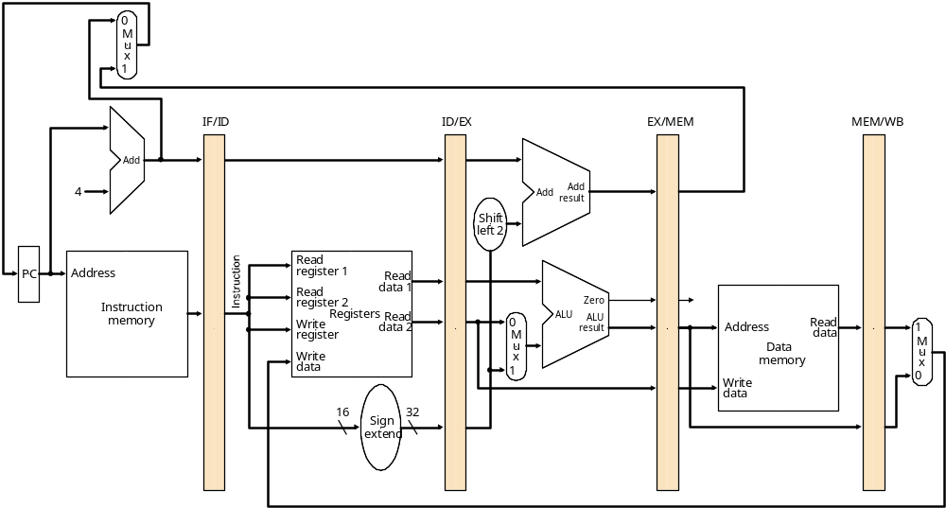
Pipelined Implementation Datapath
Instruction Fetch
Instruction Decode/
Register Fetch
Execute/
Address Calculation
Memory Access
Write Back

Slide 7
Data Hazards
When a result is needed in the pipeline before it is available, a “data hazard” occurs.
R2 Available
CC1
CC2
CC3
CC4
CC5
CC6
CC7
CC8
sub $2, $1, $3
IM
Reg
ALU
DM
Reg
IM
Reg
ALU
DM
Reg
and $12, $2, $5
IM
Reg
ALU
DM
Reg
or $13, $6, $2
R2 Needed
IM
Reg
ALU
DM
Reg
add $14, $2, $2
IM
Reg
ALU
DM
sw $15, 100($2)

Slide 8
Dealing With Data Hazards
Register file bypass eliminates one hazard.
  First half-cycle of cycle 5: register 2 written
  Second half-cycle: new value is read
CC1
CC2
CC3
CC4
CC5
CC6
CC7
CC8
sub $2, $1, $3
IM
Reg
ALU
DM
Reg
R2 Available
IM
Reg
ALU
DM
Reg
and $12, $6, $5
IM
Reg
ALU
DM
Reg
or $13, $6, $8
IM
Reg
ALU
DM
Reg
add $14, $2, $2

Slide 9
Dealing with Data Hazards
In Software
  insert independent instructions (or no-ops)
In Hardware
  insert bubbles (i.e. stall the pipeline)
  data forwarding

Slide 10
Dealing with Data Hazards in Software
CC1
CC2
CC3
CC4
CC5
CC6
CC7
CC8
sub $2, $1, $3
IM
Reg
ALU
DM
Reg
nop
IM
Reg
ALU
DM
Reg
IM
Reg
ALU
DM
Reg
nop
IM
Reg
ALU
DM
Reg
add $12, $2, $5
Insert enough no-ops (or other instructions that don’t
use register 2) so that data hazard doesn’t occur,

Slide 11
Where are No-ops needed?
sub $2, $1,$3
and $4, $2,$5
or $8, $2,$6
add $9, $4,$2
slt $1, $6,$7
Are no-ops really necessary?

Slide 12
Handling Data Hazards in Hardware
Stall the pipeline
CC1
CC2
CC3
CC4
CC5
CC6
CC7
CC8
sub $2, $1, $3
IM
Reg
DM
Reg
add $12, $2, $5
IM
Bubble
Bubble
Reg
DM
Reg
or $13, $6, $2
IM
Reg
DM
Reg
IM
Reg
DM
add $14, $2, $2

Slide 13
Handling Data Hazards in Hardware
CC1
CC2
CC3
CC4
CC5
CC6
CC7
CC8
CC9
CC10
CC11
sub $2, $1, $3
IM
Reg
DM
Reg
add $12, $3, $5
IM
Reg
DM
Reg
or $13, $6, $2
IM
Bubble
Reg
DM
Reg
add $14, $12, $2
IM
Reg
DM
Reg
sw $14, 100 ($2)
IM
Bubble
Bubble
Reg
DM

Slide 14
Pipeline Stalls
To insure proper pipeline execution in light of register dependences, we must:
  Detect the hazard
  Stall the pipeline
    prevent the IF and ID stages from making progress
      the ID stage because we can’t go on until the dependent instruction completes correctly
      the IF stage because we do not want to lose any instructions.

Slide 15
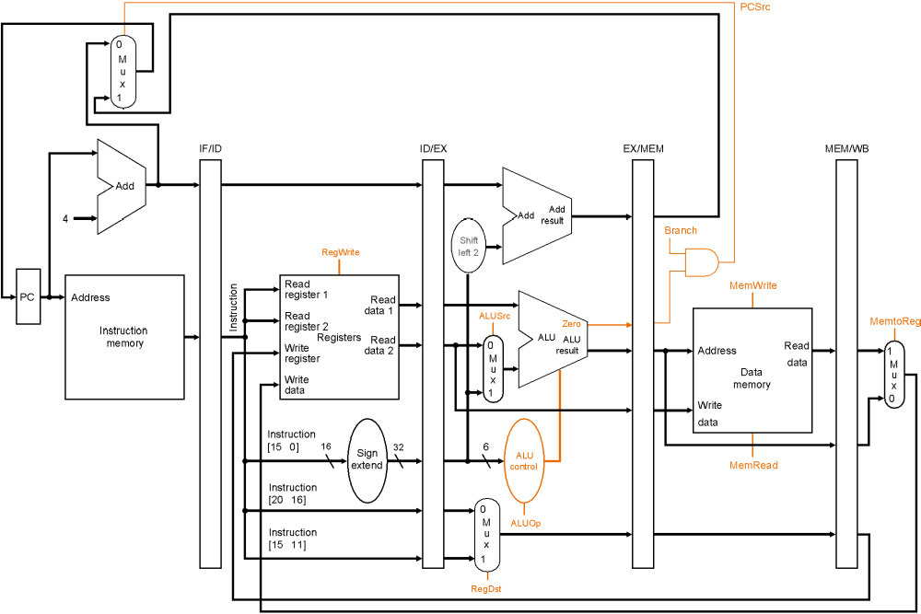
The Pipeline
What comparisons tell us when to stall?

Slide 16
Stalling the Pipeline
Prevent the IF and ID stages from proceeding
  don’t write the PC (PCWrite = 0)
  don’t rewrite IF/ID register (IF/IDWrite = 0)
Insert “nops”
  set all control signals propagating to EX/MEM/WB to zero

Slide 17
The Pipeline

Slide 18
Reducing Data Hazards Through Forwarding
add $2, $3, $4
IM
Reg
ALU
DM
Reg
or $5, $3, $2
IM
Reg
ALU
DM
Reg
ID/EX
EX/MEM
MEM/WB
Registers
ALU
Data
Memory
0
1
We could avoid stalling if we could get the ALU output from “add” to ALU input for “or”.

Slide 19
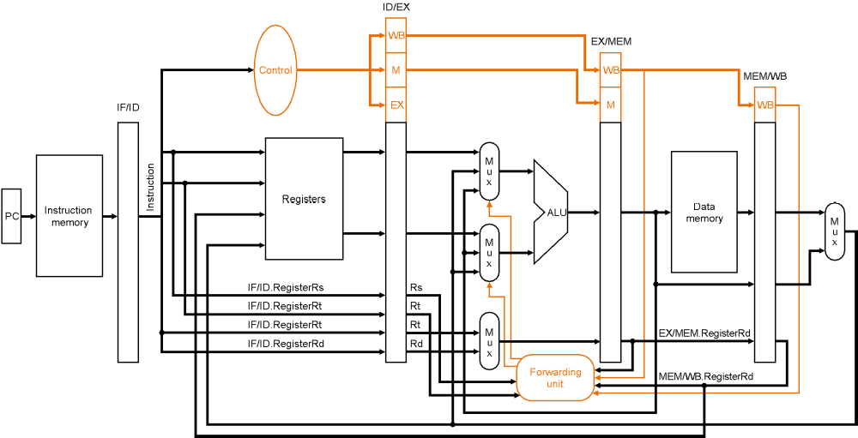
Reducing Data Hazards Through Forwarding
EX Hazard:
if (EX/MEM.RegWrite
and (EX/MEM.RegisterRd != 0)
and (EX/MEM.RegisterRd = ID/EX.RegisterRs)) ForwardA = 10
if (EX/MEM.RegWrite
and (EX/MEM.RegisterRd != 0)
and (EX/MEM.RegisterRd = ID/EX.RegisterRt)) ForwardB = 10
(similar for the MEM stage)

Slide 20
Data Forwarding
Forwarding (just shown) handles two types of data hazards
  EX hazard
  MEM hazard
We’ve already handled the third type (WB) hazard by using a transparent reg file
  if the register file is asked to read and write the same register in the same cycle, the reg file allows the write data to be forwarded to the output.

Slide 21
Eliminating Data Hazards via Forwarding
CC1
CC2
CC3
CC4
CC5
CC6
CC7
CC8
sub $2, $1, $3
IM
Reg
ALU
DM
Reg
IM
Reg
ALU
DM
Reg
and $6, $2, $5
IM
Reg
ALU
DM
Reg
or $13, $6, $2
IM
Reg
ALU
DM
Reg
add $14, $2, $2
IM
Reg
ALU
DM
sw $15, 100($2)

Slide 22
Does Forwarding Eliminate All Hazards?
CC1
CC2
CC3
CC4
CC5
CC6
CC7
CC8
lw $2, 10($1)
IM
Reg
ALU
DM
Reg
IM
Reg
ALU
DM
Reg
and $12, $2, $5
IM
Reg
ALU
DM
Reg
or $13, $6, $2
IM
Reg
ALU
DM
Reg
add $14, $2, $2
IM
Reg
ALU
DM
sw $15, 100($2)

Slide 23
You may need to stall after loads
CC1
CC2
CC3
CC4
CC5
CC6
CC7
CC8
lw $2, 10($1)
IM
Reg
ALU
DM
Reg
IM
Reg
Bubble
ALU
DM
Reg
and $12, $2, $5
IM
Reg
ALU
DM
Reg
or $13, $6, $2
Bubble
IM
Reg
ALU
DM
add $14, $2, $2
IM
Reg
ALU
sw $15, 100($2)

Slide 24
Try this one...
Show stalls and forwarding for this code
  add $3, $2, $1
  lw $4, 100($3)
  and $6, $4, $3
  sub $7, $6, $2

Slide 25
Data Hazard Key Points
Pipelining provides high throughput, but does not handle data dependences easily.
Data dependences cause data hazards.
Data hazards can be solved by:
  software (no-ops)
  hardware stalling
  hardware forwarding
Our processor, and indeed all modern processors, use a combination of forwarding and stalling.

Slide 26
Control hazards

Slide 27
Dependences
Data dependence: one instruction is dependent on another instruction to provide its operands.
Control dependence (aka branch dependences): one instructions determines whether another gets executed or not.
  particularly critical with conditional branches.
add $5, $3, $2
sub $6, $5, $2
beq $6, $7, somewhere
and $9, $3, $1
data dependences
control dependence

Slide 28
Branch Hazards
Branch dependences can result in branch hazards (aka control hazards) when they are too close to be handled correctly in the pipeline.

Slide 29
When are branches resolved?
Instruction Fetch
Instruction Decode
Execute/
Address Calculation
Memory Access
Write Back
Branch target address is put in PC during Mem stage.
Correct instruction is fetched during branch’s WB stage.

Slide 30
Branch Hazards
CC1
CC2
CC3
CC4
CC5
CC6
CC7
CC8
beq $2, $1, here
IM
Reg
ALU
DM
Reg
add ...
IM
Reg
ALU
DM
Reg
IM
Reg
ALU
DM
Reg
sub ...
These instructions
should not be executed!
IM
Reg
ALU
DM
Reg
lw ...
IM
Reg
ALU
DM
here: lw ...
the correct instruction

Slide 31
Dealing With Branch Hazards
Hardware solutions
  stall until you know which direction branch goes
  guess which direction, start executing chosen path (but be prepared to undo any mistakes!)
    static branch prediction: base guess on instruction type
    dynamic branch prediction: base guess on execution history
  reduce the branch delay
Software/hardware solution
  delayed branch: Always execute instruction after branch.
    compiler puts something useful (or a no-op) there

Slide 32
Stalling for Branch Hazards
CC1
CC2
CC3
CC4
CC5
CC6
CC7
CC8
beq $4, $0, there
IM
Reg
DM
Reg
and $12, $2, $5
Bubble
Bubble
Bubble
IM
Reg
DM
Reg
or ...
IM
Reg
DM
Reg
IM
Reg
DM
add ...
IM
Reg
sw ...

Slide 33
Stalling for Branch Hazards
All branches waste 3 cycles.
  Seems wasteful, particularly when the branch isn’t taken.
It’s better to guess branch direction
  Easiest guess is “branch is not taken”

Slide 34
Assume Branch Not Taken
works pretty well when the prediction is right
  no wasted cycles
CC1
CC2
CC3
CC4
CC5
CC6
CC7
CC8
beq $4, $0, there
IM
Reg
DM
Reg
and $12, $2, $5
IM
Reg
DM
Reg
or ...
IM
Reg
DM
Reg
IM
Reg
DM
add ...
IM
Reg
sw ...

Slide 35
Assume Branch Not Taken
same performance as stalling when you’re wrong
CC1
CC2
CC3
CC4
CC5
CC6
CC7
CC8
beq $4, $0, there
IM
Reg
DM
Reg
none of these instructions
have changed memory or
registers.
and $12, $2, $5
IM
Reg
Flush
or ...
IM
Reg
Flush
IM
Flush
add ...
IM
Reg
there: sub $12, $4, $2

Slide 36
Some other static strategies
Assume backwards branch is always taken, forward branch never is
  “backwards” = negative displacement field
  loops (which branch backwards) are usually executed multiple times.
  “if-then-else” often takes the “then” (no branch) clause.
Compiler makes educated guess
  sets “predict taken/not taken” bit in instruction

Slide 37
Reducing the Branch Delay
it’s easy to reduce stall to 2-cycles

Slide 38
Reducing the Branch Delay
it’s easy to reduce stall to 2-cycles

Slide 39
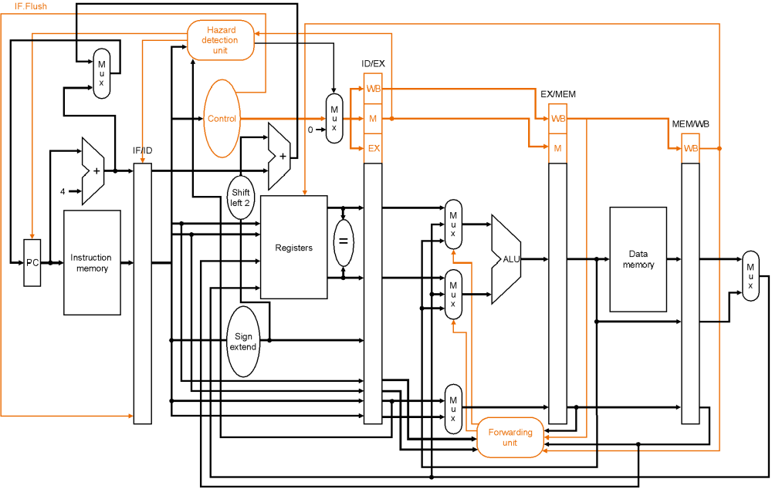
One-Cycle Branch Misprediction Penalty
Target computation & equality check in ID
  This figure also shows flushing hardware

Slide 40
Branch Hazard Stalls with ID Stage Branching
CC1
CC2
CC3
CC4
CC5
CC6
CC7
CC8
beq $4, $0, there
IM
Reg
DM
Reg
and $12, $2, $5
Bubble
IM
Reg
DM
Reg
or ...
IM
Reg
DM
Reg
IM
Reg
DM
add ...
IM
Reg
sw ...

Slide 41
Eliminating the Branch Stall
There’s no rule that says we have to branch immediately. We could wait an extra instruction before branching.
The original SPARC and MIPS processors used a branch delay slot to eliminate single-cycle stalls after branches.
The instruction after a conditional branch is always executed in those machines, whether the branch is taken or not!

Slide 42
Branch Delay Slot
CC1
CC2
CC3
CC4
CC5
CC6
CC7
CC8
beq $4, $0, there
IM
Reg
DM
Reg
and $12, $2, $5
IM
Reg
DM
Reg
there: xor ...
IM
Reg
DM
Reg
IM
Reg
DM
add ...
IM
Reg
sw ...
Branch delay slot instruction (next instruction after a branch) is
executed even if the branch is taken.

Slide 43
Filling the branch delay slot
The branch delay slot is only useful if you can find something to put there.
  Need earlier instruction that doesn’t affect the branch
If you can’t find anything, you must put a nop to ensure correctness.
Worked well for early RISC machines
  Doesn’t help recent processors much
  E.g. MIPS R10000, has a 5-cycle branch penalty, and executes 4 instructions per cycle.
Pentium 4
  20 cycle branch misprediction penalty!

Slide 44
Filling the Branch Delay Slot
a
.
F
r
o
m
b
e
f
o
r
e
b
.
F
r
o
m
t
a
r
g
e
t
c
.
F
r
o
m
f
a
l
l
t
h
r
o
u
g
h
a
d
d
$
s
1
,
$
s
2
,
$
s
3
s
u
b
$
t
4
,
$
t
5
,
$
t
6
a
d
d
$
s
1
,
$
s
2
,
$
s
3
i
f
$
s
2
=
0
t
h
e
n
…
i
f
$
s
1
=
0
t
h
e
n
a
d
d
$
s
1
,
$
s
2
,
$
s
3
D
e
l
a
y
s
l
o
t
D
e
l
a
y
s
l
o
t
i
f
$
s
1
=
0
t
h
e
n
D
e
l
a
y
s
l
o
t
s
u
b
$
t
4
,
$
t
5
,
$
t
6
B
e
c
o
m
e
s
B
e
c
o
m
e
s
B
e
c
o
m
e
s
a
d
d
$
s
1
,
$
s
2
,
$
s
3
i
f
$
s
2
=
0
t
h
e
n
i
f
$
s
1
=
0
t
h
e
n
a
d
d
$
s
1
,
$
s
2
,
$
s
3
a
d
d
$
s
1
,
$
s
2
,
$
s
3
s
u
b
$
t
4
,
$
t
5
,
$
t
6
i
f
$
s
1
=
0
t
h
e
n
s
u
b
$
t
4
,
$
t
5
,
$
t
6

Slide 45
Filling the Branch Delay Slot
  add $5, $3, $7
  sub $6, $1, $4
  and $7, $8, $2
  beq $6, $7, there
  nop /* branch delay slot */
  add $9, $1, $2
  sub $2, $9, $5
  ...
  there:
  mult $2, $10, $11

Slide 46
Branch Prediction
Static branch prediction isn’t good enough when mispredicted branches waste 10 or 20 instructions
Dynamic branch prediction keeps a brief history of what happened at each branch

Slide 47
Branch Prediction
Branch history table
program counter
1
1
for (i=0;i<10;i++) {
...
...
}
0
1
1
0
...
...
add $i, $i, #1
beq $i, #10, loop

Slide 48
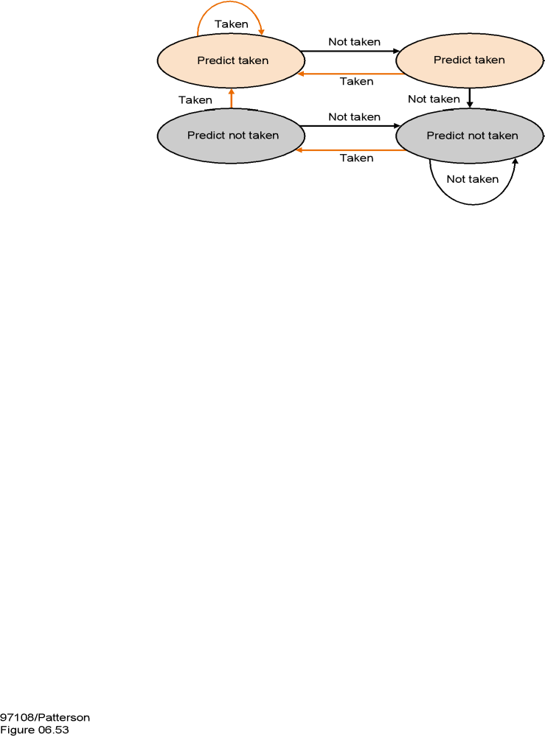
Two-bit predictors are even better
this state means, “the last
two branches at this
location were taken.”
This one means, “the
last two branches at this
location were not taken.”

Slide 49
Problems?
We know the branch direction
  what about the address?
  Branch Target Buffer (BTB)
Procedure calls and returns?
  Return Address Stack (RAS)
Indirect branches?

Slide 50
Control Hazards -- Key Points
Control (or branch) hazards arise because we must fetch the next instruction before we know if we are branching or where we are branching
Control hazards are detected in hardware
We can reduce the impact of branch hazards through:
  early detection of branch address and condition
  branch delay slots
  branch prediction – static or dynamic

