Slide 1

Amazon Sales Analysis
Emma Li, Barrett Ottenberg and Matthew Warner

Slide 2
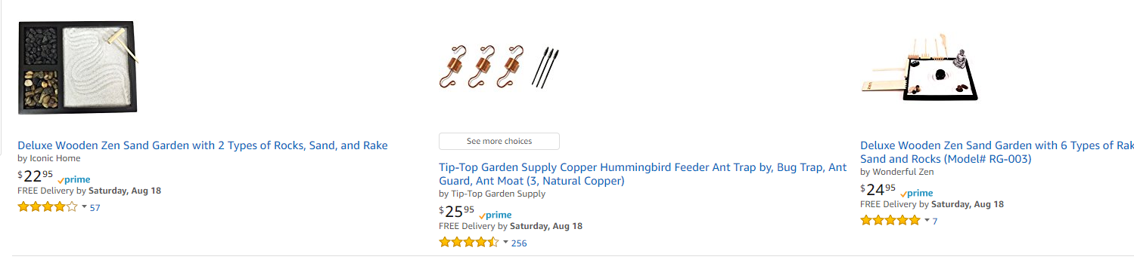
Project: Amazon Sales Analysis
Matthew has a small business and uses Amazon.com as a sales channel.
Project is to explore sales and advertising data to find trends
Migrate away from Excel
Foundation for actual business use
Data has been masked
Real Data but it has been scaled for privacy

Slide 3

4 Questions Explored
Does advertising in this dataset always increase sales?
Hypothesis: No (Matthew Warner)
Does lowering price in this dataset always increase revenue?
Hypothesis: No (Matthew Warner)
Do products used during summer sell better during warmer months.
Hypothesis: Yes (Emma Li)
Does click through rate correlate with conversion rate in this dataset?
Hypothesis: Yes (Barrett Ottenberg)

Slide 4

Raw Data
Data is from Amazon.com sales
CSVs came from Amazon.com reports
API Available but complex
Three datasets were used
Transactional sales data (26k rows)
Advertising data (3k rows)
Cost of Goods data ( 50 rows)
Data limitations
Only ~70 days worth of advertising data was used
Due to Amazon file change and to keep it simple
Missing some insightful data,
# of Reviews and Review Score
Similar competitor prices
Sales rank
Keyword rankings

Slide 5
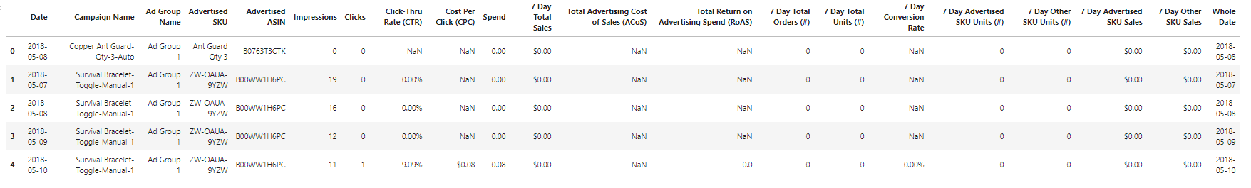
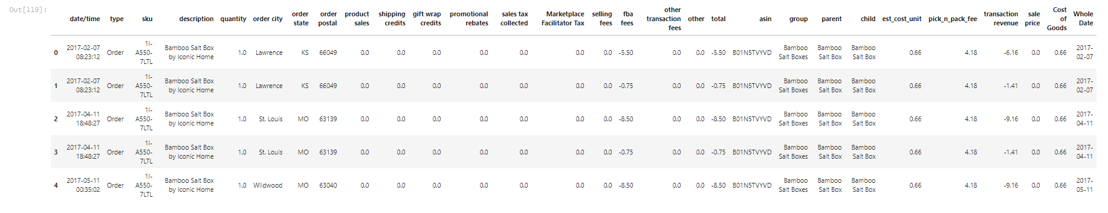
Clean Data
Transaction Data + Cost of Goods Merged
Advertising Data

Slide 6
Data Cleanup
3 CSV file types
Total of 6 CSVs
Merge into 2 master dataframes
All other queries were ran on these dfs
Convert STR to appropriate datatype (int, datetime, float etc.. )
Converting timestamps to dates was critical
A lot of data was grouped by dates
Very challenging to work with time.
Time zone aware vs naïve
Many libraries to deal with time data. (None of them great)
Convert strings with % to floats
Many times errors were not obvious until plotting steps
Caused a lot of recoding

Slide 7
Does advertising in this dataset always increase sales?
Hypothesis: No

Slide 8
Does advertising in this dataset always increase sales? Hypothesis: No
Average across entire dataset
Cost Per Click (CPC) is the cost when an ad is clicked.
Bid on keywords
Higher CPC results in more prominent ad placement. (Ie. Top of Page)

Slide 9
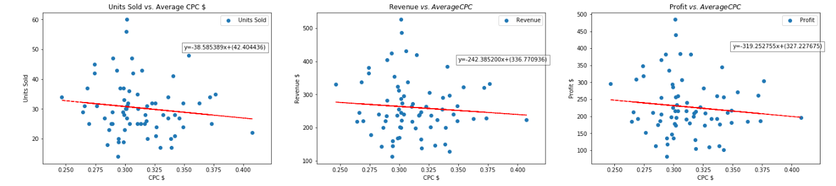
Does advertising in this dataset always increase sales? Hypothesis: No
This figure shows a negative correlation between Cost Per Click and Units Sold, Profit and Revenue.
Higher CPC results in less units sold, less revenue and less profit.
May be worth exploring Higher and Lower Average CPC costs.
Hypothesis was supported by this data.

Slide 10
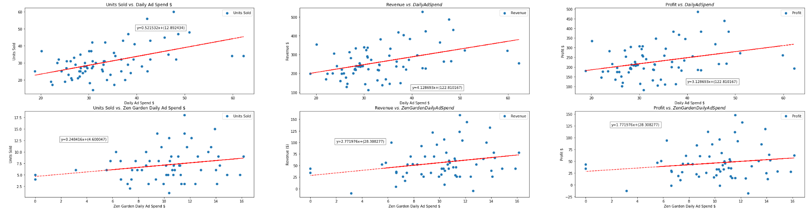
There is a positive correlation between ad spend and units sold, revenue and profit.
For both aggregate and individual graphs
This suggests higher ad spend correlates with higher sales.
May be worth exploring ad spend higher and lower than this dataset.
Hypothesis was not supported by this dataset.
Products may need to be evaluated on an individual basis.

Slide 11
Does lowering price in this dataset always increase revenue?
Hypothesis: No

Slide 12
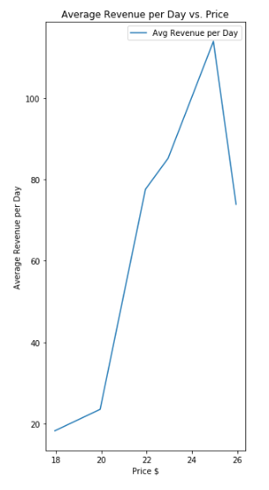
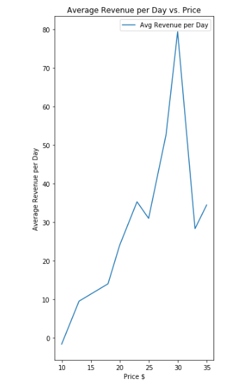
Does lowering price in this dataset always increase revenue? Hypothesis: No
For single product
There is a correlation between price and revenue.
Low price and high price yields lower revenue.
Data suggests there is an optimal price range.
Many small business aren’t doing these tests and could be losing $$$.
Hypothesis was supported.

Slide 13
Do products used during summer sell better during warmer months?
Hypothesis: Yes

Slide 14
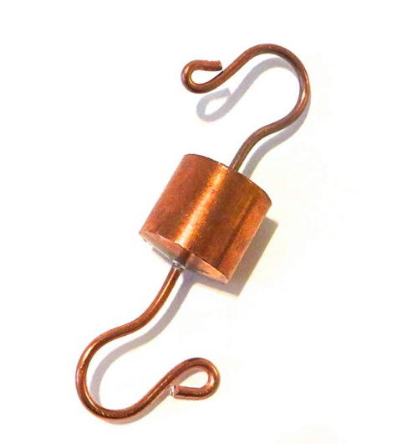
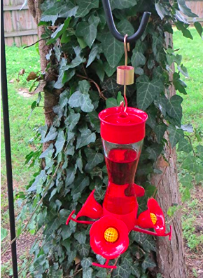
Do products used during summer sell better during warmer months? Hypothesis: Yes
What products are used during summer ?
Which months are warmer months?
Ant Guard (Qt 1, Qt2, Qt3)
Copper Hummingbird Feeder Ant Guard by Tip-Top Garden Supply
OpenWeatherMap API ??
Over 5000 zip code
Different dates
Assumption:
Warmer months= summer

Slide 15
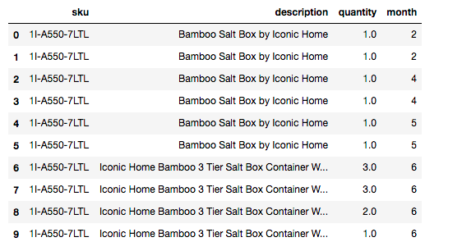
Tidy Data Again
Do products used during summer sell better during warmer months? Hypothesis: Yes
Only take the columns we need:
SKU, description , Quantity, month

Slide 16
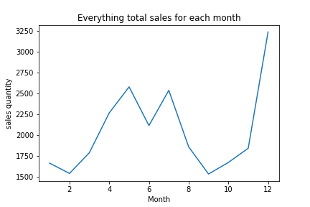
Do products used during summer sell better during warmer months? Hypothesis: Yes
Total 79 items.
3 peaks
May, July, December
December
May
July

Slide 17
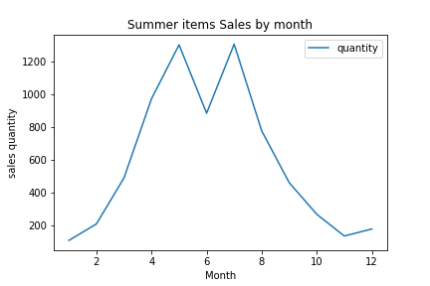
Do products used during summer sell better during warmer months? Hypothesis: Yes
Summer item:
Ant Guard (Qt 1, Qt2, Qt3)
Copper Hummingbird Feeder Ant Guard by Tip-Top Garden Supply
Go up from Feb, then go down from August.
bottom in January
2 peaks in May, and July
July
May

Slide 18
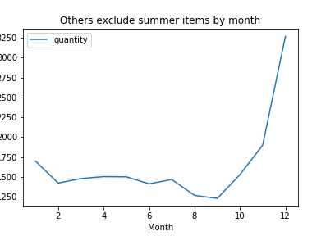
Do products used during summer sell better during warmer months? Hypothesis: Yes
Others exclude summer items sales
75 items
Go up from Oct.
Only 1 peak in December
December

Slide 19
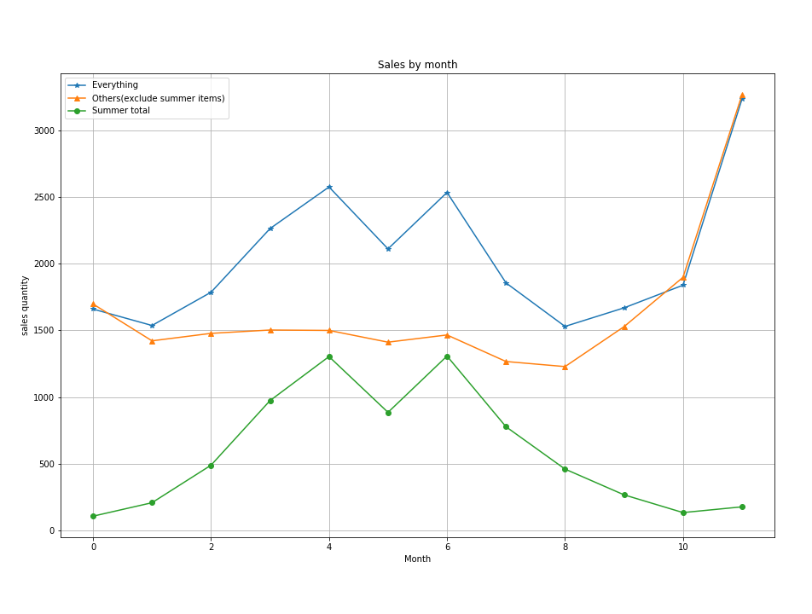
Do products used during summer sell better during warmer months? Hypothesis: Yes
There is a correlation between summer items and seasons.
Sales go high in summer and go down in winter.
The curve of non-summer items only go high in winter.
Summer

Slide 20
Do products used during summer sell better during warmer months? Hypothesis: Yes
Conclusion
we don’t need use API!!!!
Hypothesis was supported.

Slide 21
Does click through rate correlate with conversion rate in this dataset?
Hypothesis: Yes

Slide 22
Does click through rate correlate with conversion rate in this dataset? Hypothesis: Yes

Slide 23
Does click through rate correlate with conversion rate in this dataset? Hypothesis: Yes

Slide 24
Important Learns
Most likely this data has multiple variable interactions
Output is due to many inputs
Not explored with techniques used
Statistical models for each item may need to be developed
Use flexible code
Use variables and don’t hard code. Allows for easy switch to new data.
Wrap each step in a function
Allows for reuse of variable names
Makes copy and pasting code easier

Slide 25
Future Considerations
Add more data
Automated reporting through API
Automated adjustments on advertising or price
Thank You!!!

