Slide 1
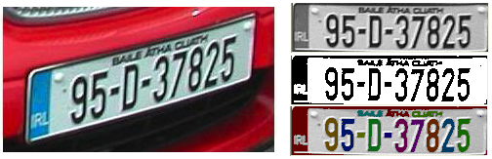
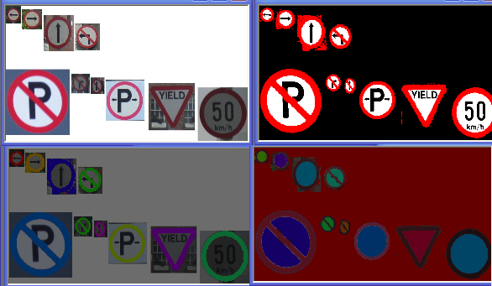
Binary
Thresholding
Threshold detection
Variations
Mathematical Morphology
Connectivity

Slide 2
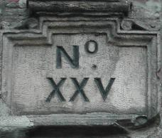
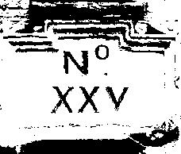
Thresholding
Binary thresholding
for all pixels
g(i,j) = 1 for f(i,j) ≥ T
= 0 for f(i,j) < T
Simple scenes?
LUT
for all grey levels
LUT(k) = 1 for k ≥ T
= 0 for k < T
for all pixels
g(i,j) = LUT( f(i,j) )
Objects of interest vs. background
threshold(gray_image,binary_image,threshold,
255,THRESH_BINARY);

Slide 3
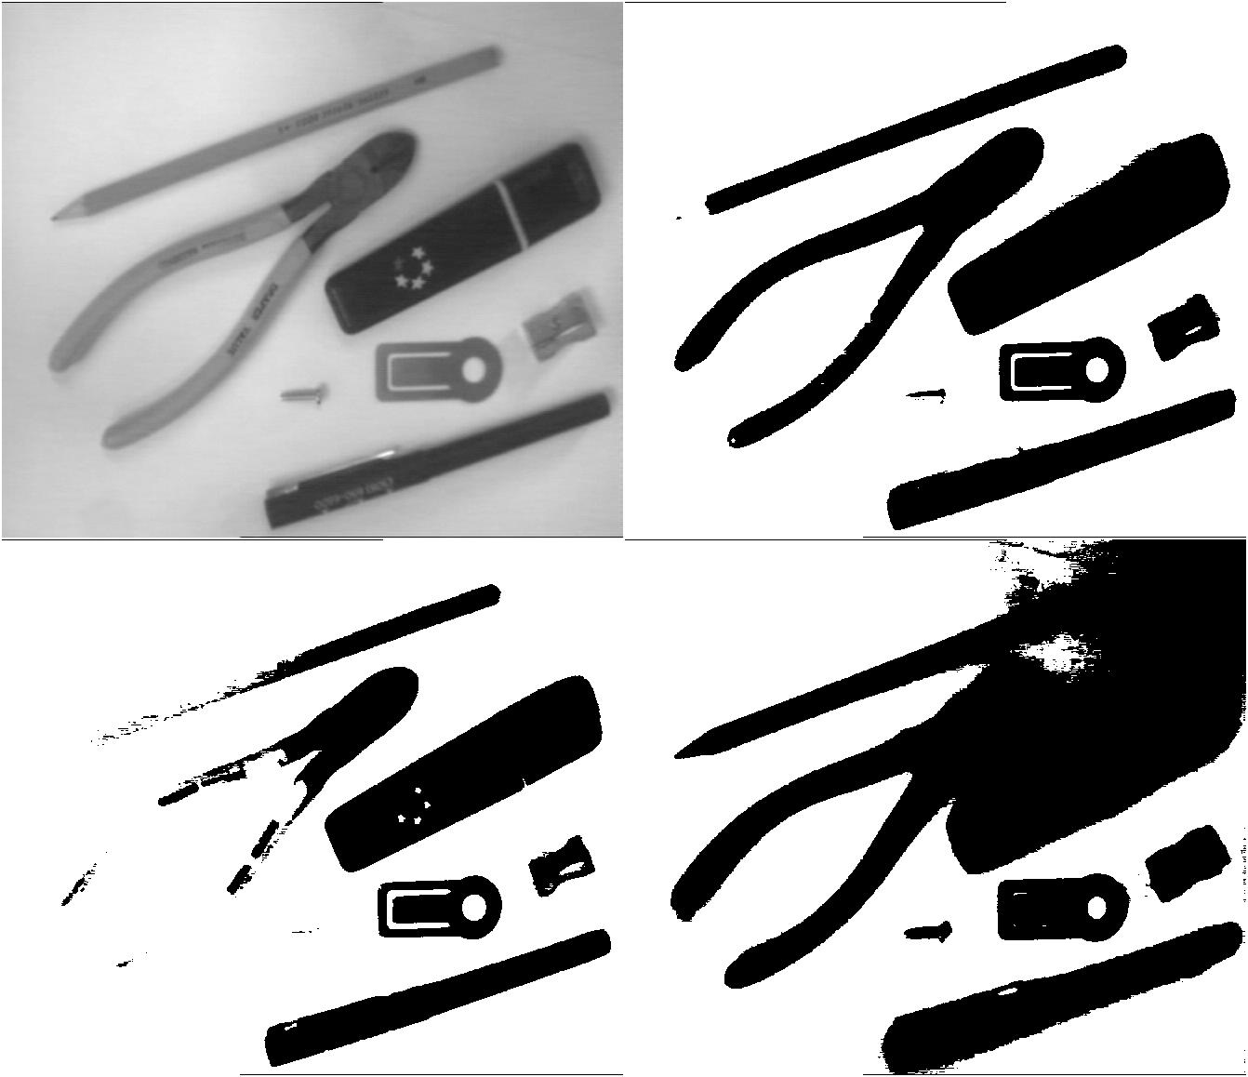
Thresholding
Distinct foreground & background needed
How do we determine the best threshold?

Slide 4
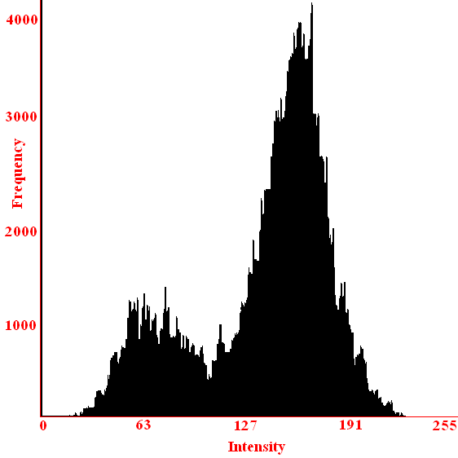
Threshold Detection
Manual Setting
Changing lighting
Need to determine automatically
For the techniques which follow:
Image – f(i,j)
Histogram – h(g)
Probability Distribution – p(g) = h(g) / Σ_{g}h(g)

Slide 5
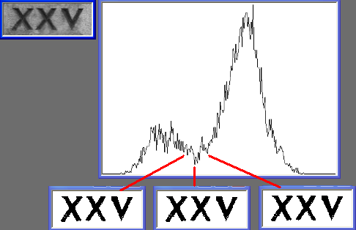
Threshold Detection – Bimodal Histogram Analysis
Histogram Analysis
Bi-modal histogram…
Anti-mode
Smooth histogram?
Correct segmentation?
Alternatives
Ignore high gradients
Only consider high gradients

Slide 6
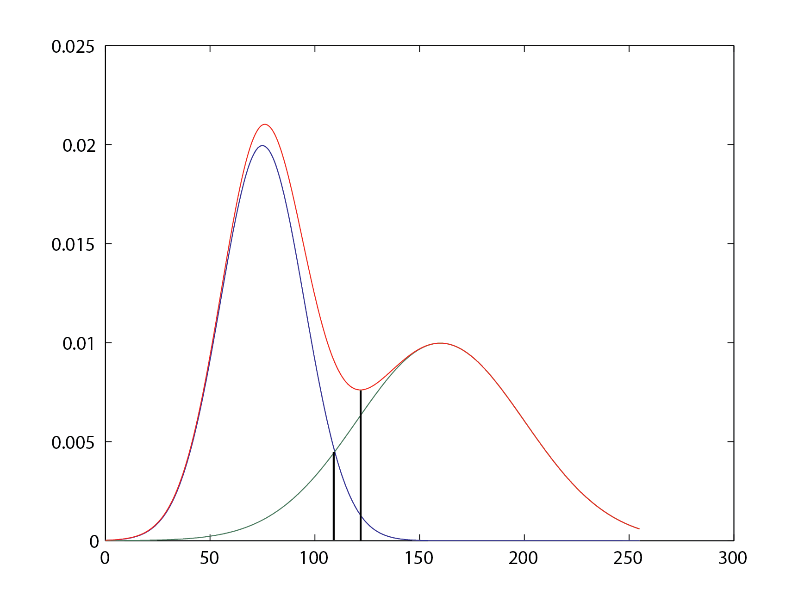
Threshold Detection – Optimal Thresholding
Model as two normal distributions
What if they overlap?

Slide 7
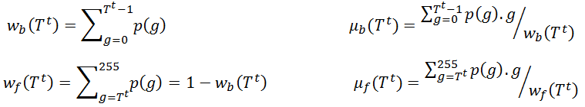
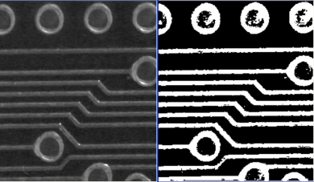
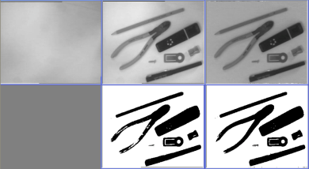
Threshold Detection – Optimal Thresholding
Set T⁽⁰⁾ = <some initial value>, t = 0
Compute µ^{t}_{B} and µ^{t}_{O} using T^{(t)}
Update the threshold:
Set T^{(t+1)} = (µ^{t}_{B} + µ^{t}_{O}) / 2
Increment t
Go back to 2 until:
T^{(t+1)} = T^{(t)}

Slide 8
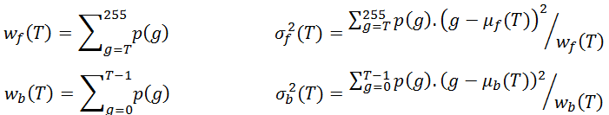

Threshold Detection – Otsu Thresholding
What if its not two normal distributions?
Minimize the spread of the pixels…
Smallest within class variance
Largest between class variance

Slide 9
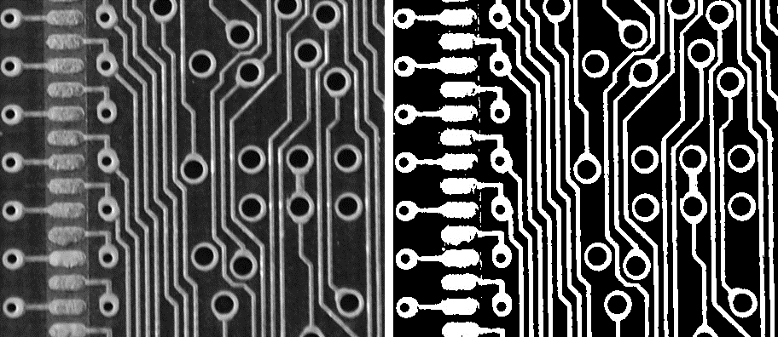
Threshold Detection – Otsu Thresholding
threshold( gray_image, binary_image, threshold,
255, THRESH_BINARY | THRESH_OTSU );

Slide 10
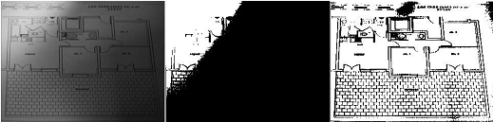
Variations – Adaptive Thresholding
The adaptive thresholding algorithm is
Divide the image into sub-images,
Compute thresholds for all sub-images,
Interpolate thresholds for every point using bilinear interpolation.

Slide 11
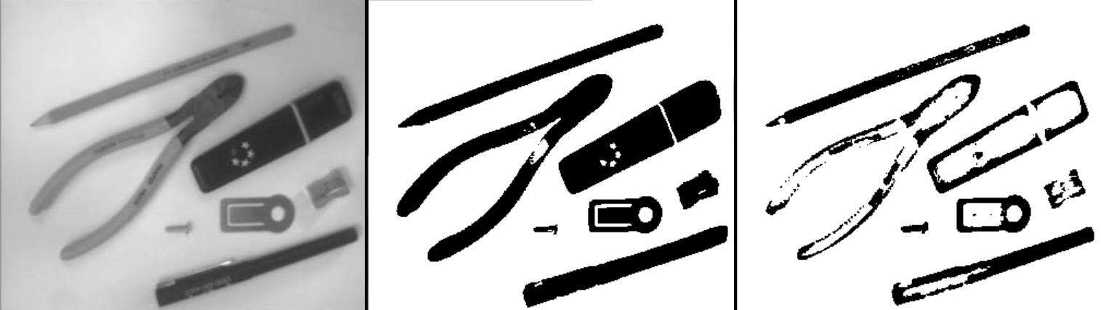
Variations – Adaptive Thresholding
OpenCV version:
if ((f(i,j) – (Σ_{a=-m..m, b=-m..m} f(i+a,j+b) / (2m+1)²)) > offset)
g(i,j) = 255
else g(i,j) = 0
adaptiveThreshold( gray_image,binary_image,output_value,
ADAPTIVE_THRESH_MEAN_C,THRESH_BINARY,
block_size,offset );

Slide 12
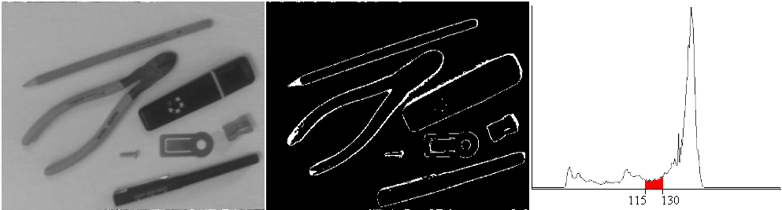
Variations – Band Thresholding
Band thresholding
g(i,j) = 1 for f(i,j) ≥ T₁ and f(i,j) ≤ T₂
= 0 otherwise
Border detector?
threshold( image, binary1, low_threshold, 255, THRESH_BINARY );
threshold( image, binary2, high_threshold, 255, THRESH_BINARY_INV );
bitwise_and( binary_image1, binary_image2, band_thresholded_image );

Slide 13
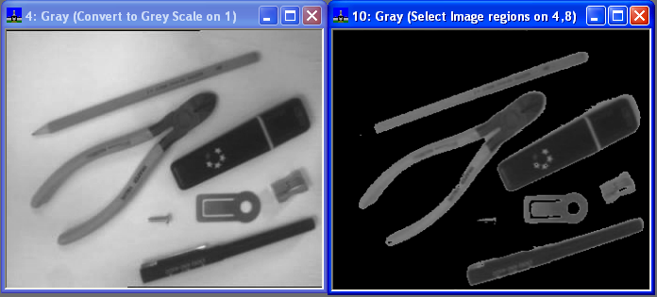
Variations – Semi Thresholding
Semi-thresholding
g(i,j) = f(i,j) for f(i,j) ≥ T
= 0 otherwise
threshold( gray_image, binary_image, threshold, 255, THRESH_BINARY );
bitwise_and( gray_image, binary_image, semi_thresholded_image );

Slide 14
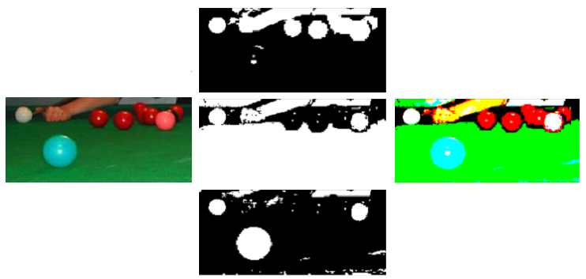
Variations – Multi-Level Thresholding
Threshold separately and combine?

Slide 15
Mathematical Morphology – Introduction
Based on algebra of non-linear operators operating on object shape
Performs many tasks better and more quickly than standard approaches
Separate part of image analysis
Operates with points sets, their connectivity and shape
Main uses:
Pre-processing
Object structure enhancement
Segmentation
Description of objects

Slide 16
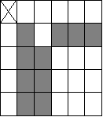
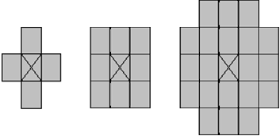
Mathematical Morphology – Sets
Consider images as point sets...
Images (Z², Z³, Z³)
Z²: Binary images
X = { (1,1), (1,3), (1,4), (1,5), (2,1), (2,2), (3,1), (3,2), (4,1), (4,2) }
Z³: Grey scale images
Z³: Voxels.
Morphological Transformation Ψ(X)
Structuring Element
Local origin
Normally symmetric
Applied at all locations in X
Dual: Ψ(X) = [Ψ*(X^{c})]^{c}

Slide 17
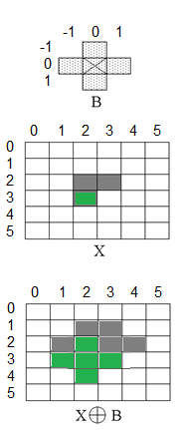
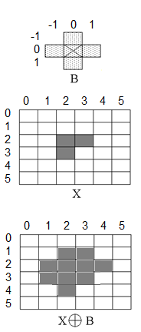
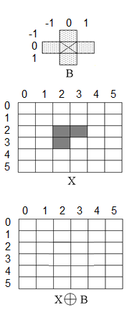
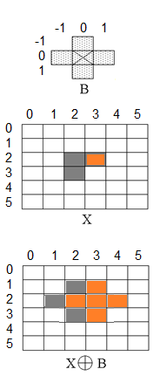
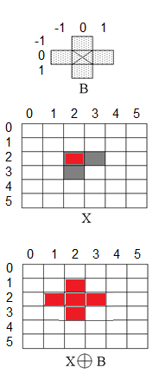
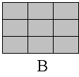
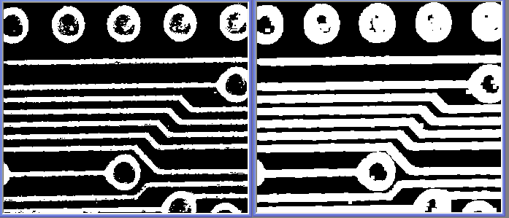
Mathematical Morphology – Dilation
Minkowski set addition:
X ⊕ B = { p ∈ ε²; p = x+b, x ∈ X and b ∈ B }
Fills small holes & gulfs
‘Normal’ dilation ?
Add all bordering pixels

Slide 18
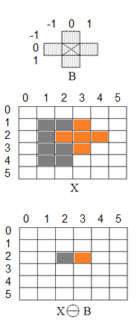
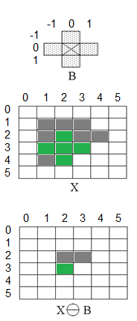
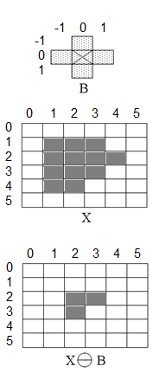
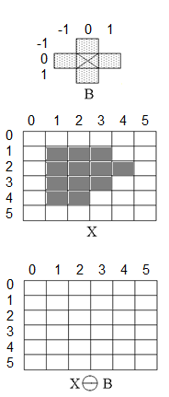
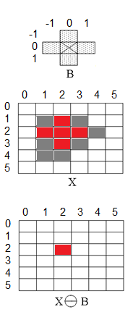
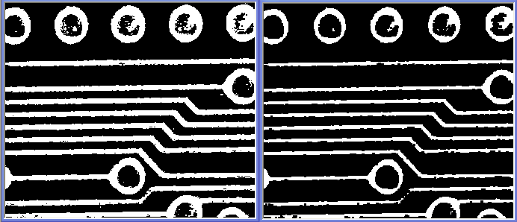
Mathematical Morphology – Erosion
Minkowski set subtraction:
X Θ B = { p ∈ ε²; p+b ∈ X for every b ∈ B }
Removes noise
‘Normal’ erosion ?
Remove all border pixels

Slide 19
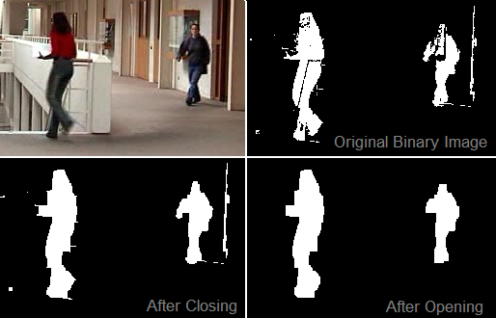
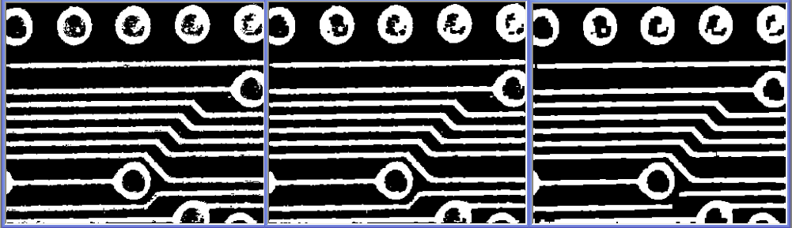
Mathematical Morphology –
Opening:
X Ο D = (X Θ D) ⊕ D
Closing:
X • D = (X ⊕ D) Θ D
Isotropic structuring element:
Eliminates small image details
Properties
X Ο D = (X Ο D) Ο D and X • D = (X • D) • D

Slide 20
Mathematical Morphology – OpenCV Code
dilate( binary_image, dilated_image, Mat());;
Mat structuring_element( 5, 5, CV_8U, Scalar(1) );
dilate( binary_image, dilated_image, structuring_element);
erode( binary_image, eroded_image, Mat());
Mat structuring_element( 5, 5, CV_8U, Scalar(1) );
erode( binary_image, eroded_image, structuring_element);
Mat five_by_five_element( 5, 5, CV_8U, Scalar(1) );
morphologyEx( binary_image, opened_image,
MORPH_OPEN, five_by_five_element );
morphologyEx( binary_image, closed_image,
MORPH_CLOSE, five_by_five_element );

Slide 21
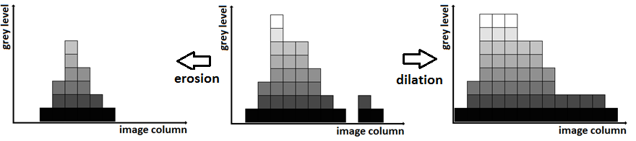
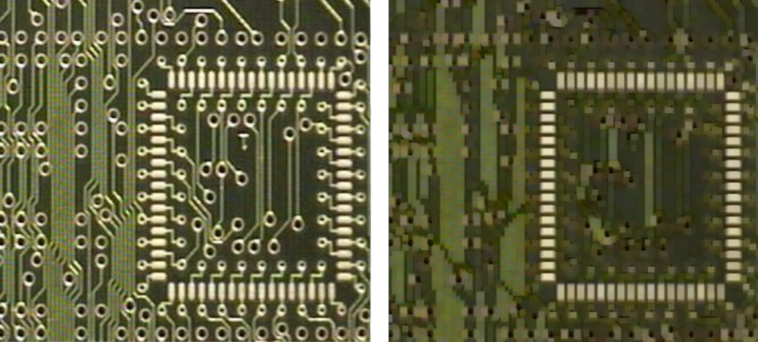
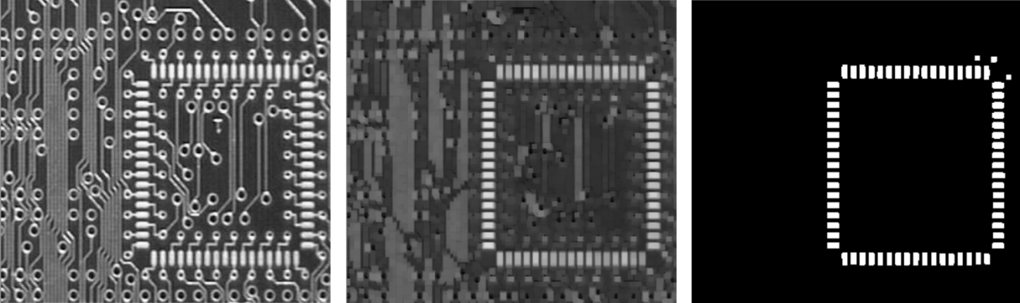
Mathematical Morphology – Greyscale / Colour
One set per grey level (g)
All points >= g…

Slide 22
Mathematical Morphology – Local maxima
Can be used to locate local maxima and minima
Mat dilated, thresholded_input, local_maxima, thresholded_8bit;
dilate( input, dilated, Mat());
compare( input, dilated, local_maxima, CMP_EQ );
threshold( input, thresholded_input, threshold, 255,
THRESH_BINARY );
thresholded_input.convertTo( thresholded_8bit, CV_8U );
bitwise_and( local_maxima, thresholded_8bit, local_maxima );

Slide 23
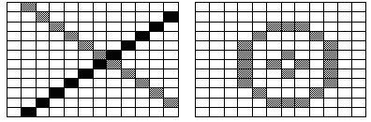
Connectivity – Paradoxes
Use pixel Adjacency to build contiguous regions
Objects
Background
Holes

Slide 24
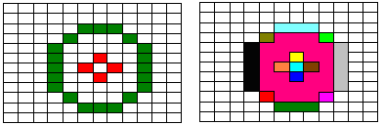
Connectivity – 4 adjacency & 8 adjacency
Have to use either 4-adjacency or 8-adjacency
Label each non-zero pixel…

Slide 25
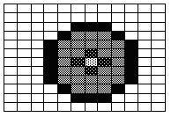
Connectivity –
What do we actually want?
One possibility
Treat background using 4-adjacency
Treat object using 8-adjacency
Treat holes using 4-adjacency
Treat objects in holes using 8-adjacency
…

Slide 26
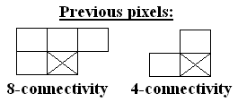
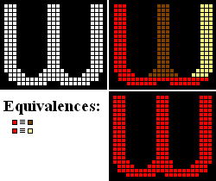
Connectivity – Connected Components Analysis
Search image row by row
Label each non-zero pixel
If previous pixels are all background
Assign New Label
Otherwise
Pick any label from the previous pixels
If any of the other previous pixels have a different label
Note equivalence
Relabel equivalent labels.

Slide 27
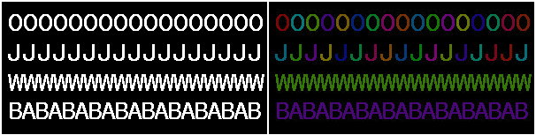
Connectivity – Extracting regions
vector<vector<Point>> contours;
vector<Vec4i> hierarchy;
findContours( binary_image, contours, hierarchy,
CV_RETR_TREE, CV_CHAIN_APPROX_NONE );

Slide 28
Connectivity – Labelling regions
for (int contour=0; (contour < contours.size()); contour++)
{
Scalar colour( rand()&0xFF,rand()&0xFF,rand()&0xFF );
drawContours( contours_image, contours, contour, colour,
CV_FILLED, 8, hierarchy );
}

