Slide 1




AICUP: Orchid Species Identification and Classification Contest
資工111 劉子弘
資工111 饒旻書
資工111 黃瀚

Slide 2
Agenda
01
02
03
04
Competitions
&Data
Model design
Result
Future work

Slide 3
01
Competitions &Data

Slide 4

Competitions
AICUP
Orchid Species Identification and Classification Contest
32W award 750 teams

Slide 5
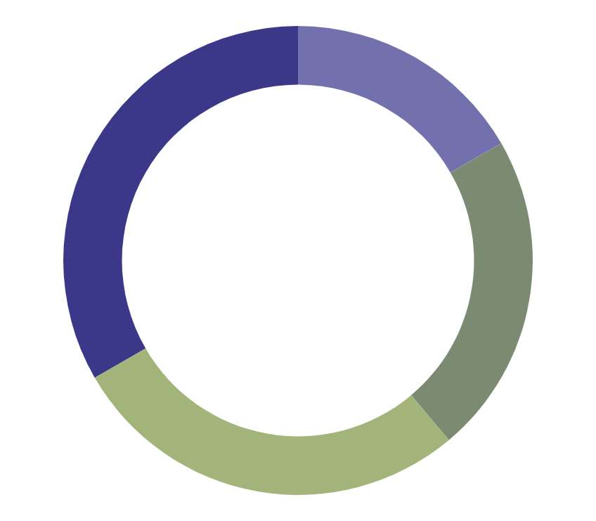
Data
100 Mb images data
220 category
10 images per category
42000 images orchid_private_set

Slide 6
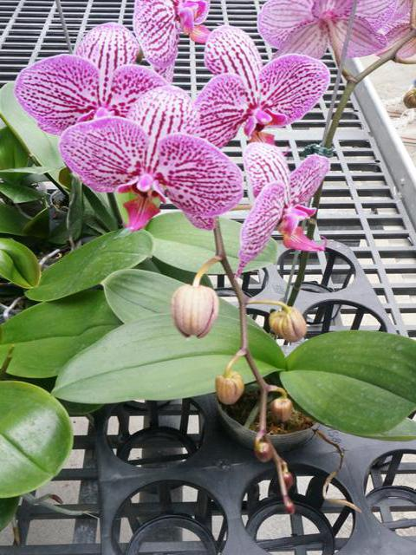
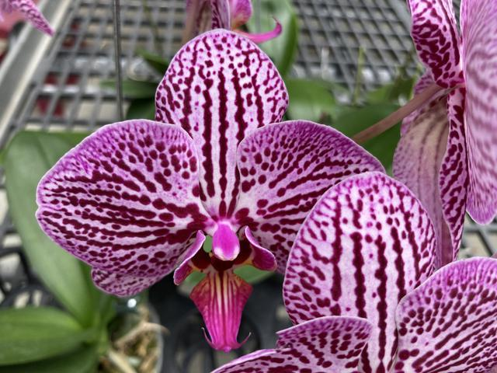

Slide 7
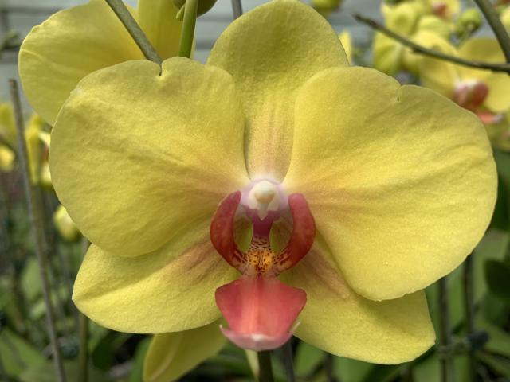
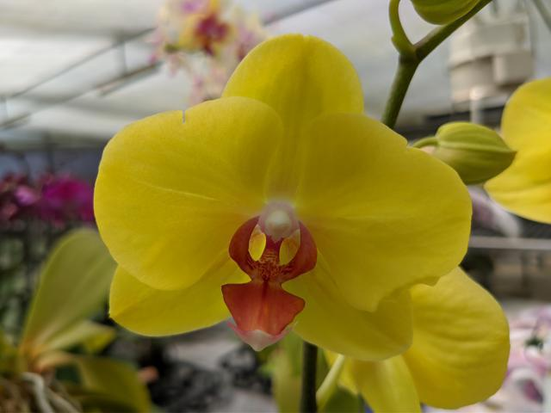

Slide 8
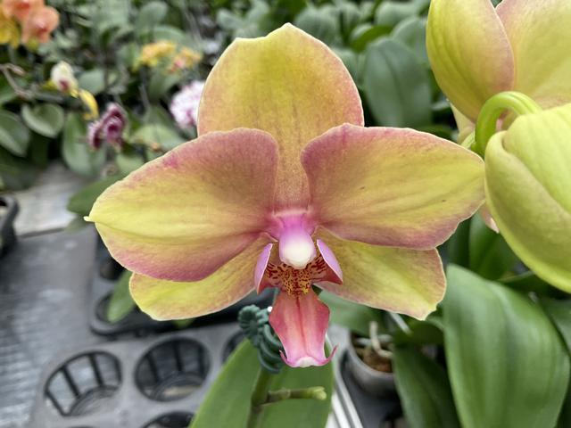
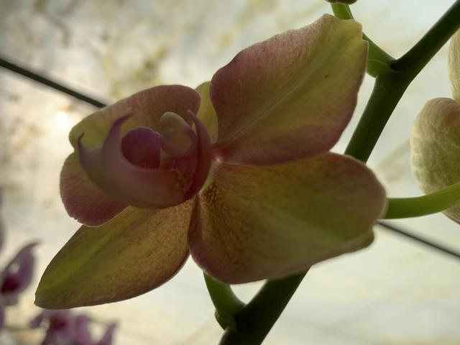

Slide 9
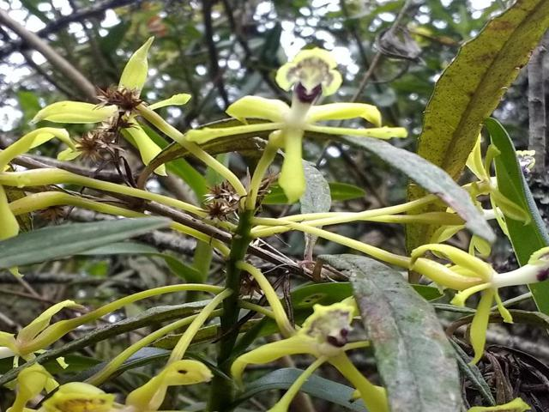
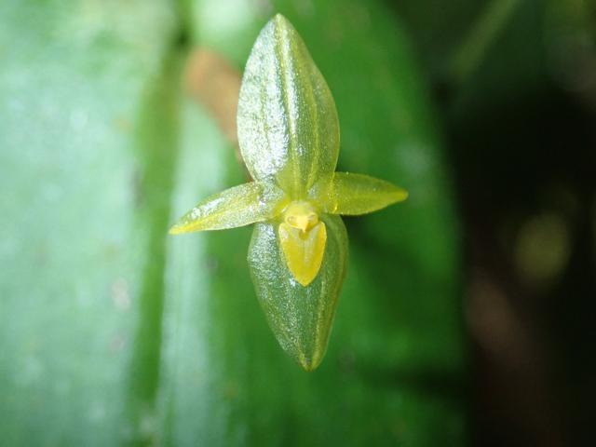
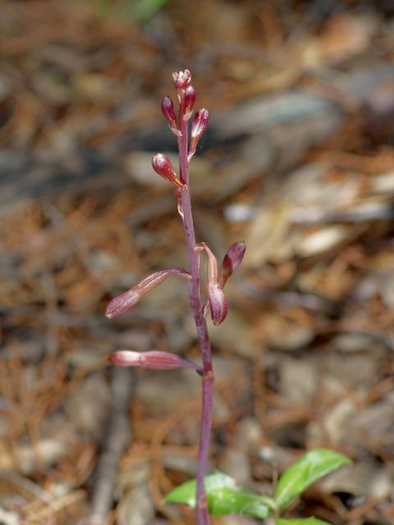
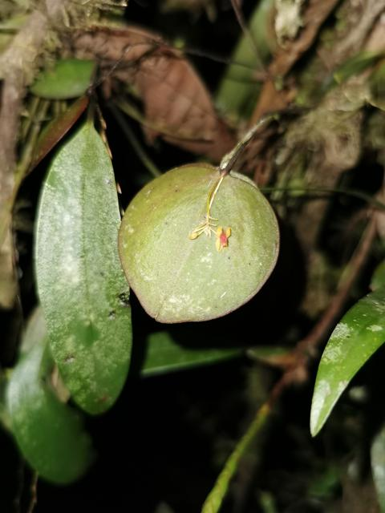
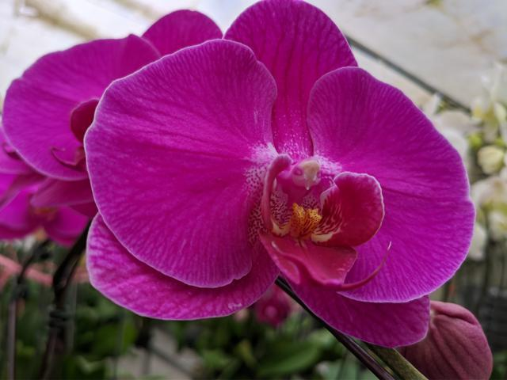

Slide 10
02
Model design

Slide 11
Approach
Python tensorflow2
Convolutional Neural Network
Geforce GTX 1050ti

Slide 12
Model structure
tf.placeholder
Convolution layer
filters 20,kernel_size 5,activation by tf.nn.relu
max_poolingConvolution layer
filters 20,kernel_size 5,activation by tf.nn.relu
max_pooling
pool_size 2x2 , strides 2x2
Flatten
Fully Connected Layer
400 units, activation=tf.nn.relu
Dropout by 0.25
Fully Connected Layer to 220 categories

Slide 13
Setting
Data preprocessing
Parameter
Resize 32*32
Epoch 1000
Dropout 0.25
Train_test split=0.8

Slide 14
03
Result

Slide 15
Training loss

Slide 16
Result
Epoch : 300
Time cost : 20s
Loss : 0.017949
Accuracy : 0.41

Slide 17
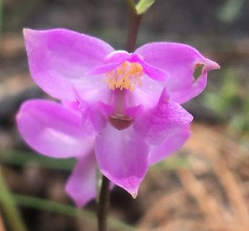
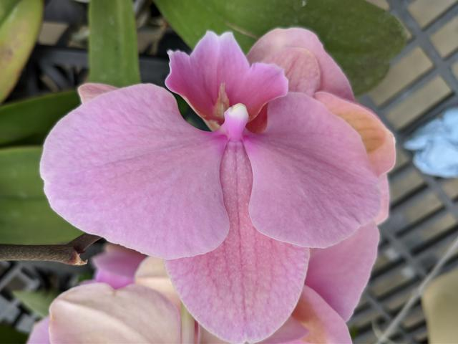
Wrong prediction

Slide 18
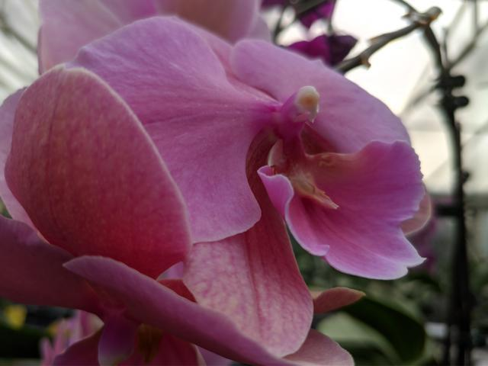
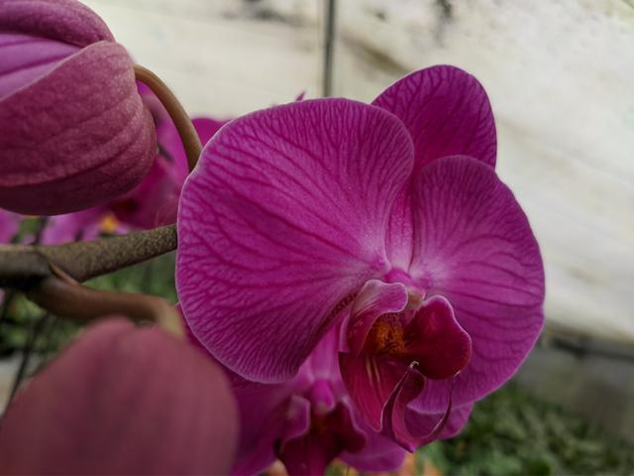
Wrong prediction

Slide 19
04
Future work

Slide 20
Future
Low loss
Well convergence
Object detection
More
object detection
More powerful model

Slide 21


Thanks for listening

