Slide 1
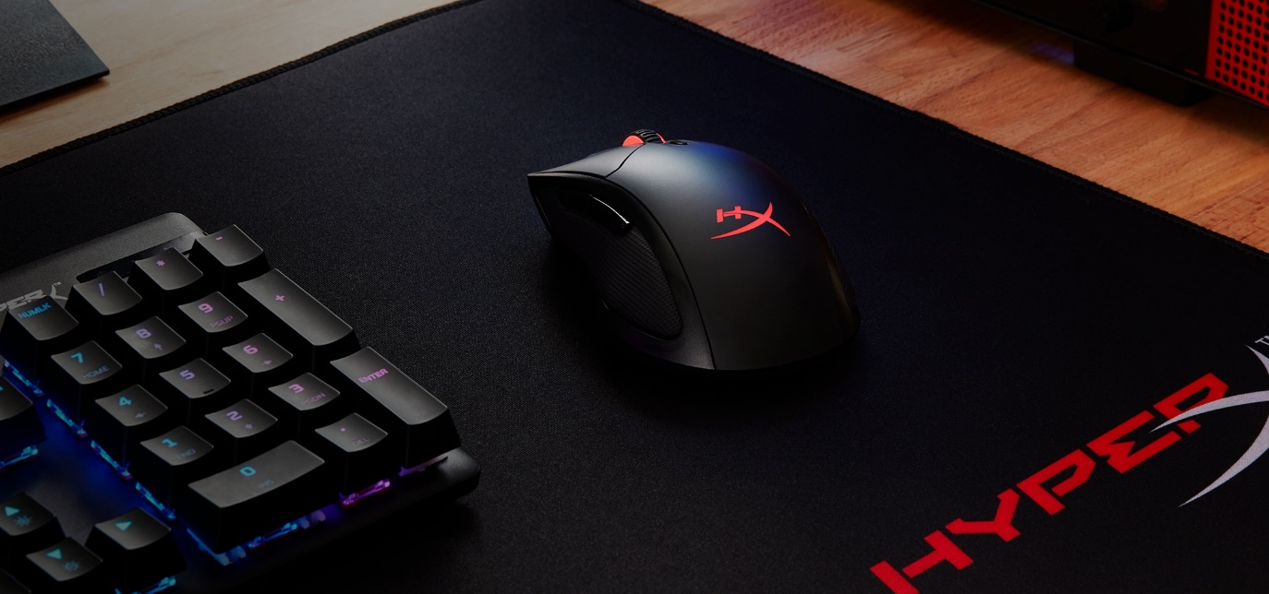
Home
Desktop components
Laptop components
Tools
About us
Login/cart
Welcome to the tech market
<
>
Here at the tech market, we sell the best components, for the cheapest of prices
V

Slide 2
Home
Desktop components
Laptop components
Tools
About us
Login/cart
video
video
video
-----------------------------------------------------------------------------------------------------------
Product
Product
Product

Slide 3
Home
Desktop components
Laptop components
Tools
About us
Login/cart
video
video
video
-----------------------------------------------------------------------------------------------------------
Product
Product
Product

Slide 4
Home
Desktop components
Laptop components
Tools
About us
Login/cart
video
video
video
-----------------------------------------------------------------------------------------------------------
Product
Product
Product

Slide 5
Home
Desktop components
Laptop components
Tools
About us
Login/cart
Who are we?
According to all known laws of aviation, there is no way that a bee should be able to fly. Its wings are too small to get its fat little body off the ground. The bee, of course, flies anyway. Because bees don’t care what humans think is impossible.” SEQ. 75 - “INTRO TO BARRY” INT. BENSON HOUSE - DAY ANGLE ON: Sneakers on the ground. Camera PANS UP to reveal BARRY BENSON’S BEDROOM ANGLE ON: Barry’s hand flipping through different sweaters in his closet. BARRY Yellow black, yellow
Contact us!
Email
Phone
Other

