Slide 1
Posit Cloud - R on the Web
ABS Network, May 13, 2026

Slide 2
Posit Cloud
Posit Cloud allows you to run RStudio projects completely on the web, with no local installations needed. You can upload and download files and data sets to and from your local computer.
You can also share projects with others, which allows collaboration, and makes teaching classes far easier. The students can start with the same setup, saving setup time.

Slide 3
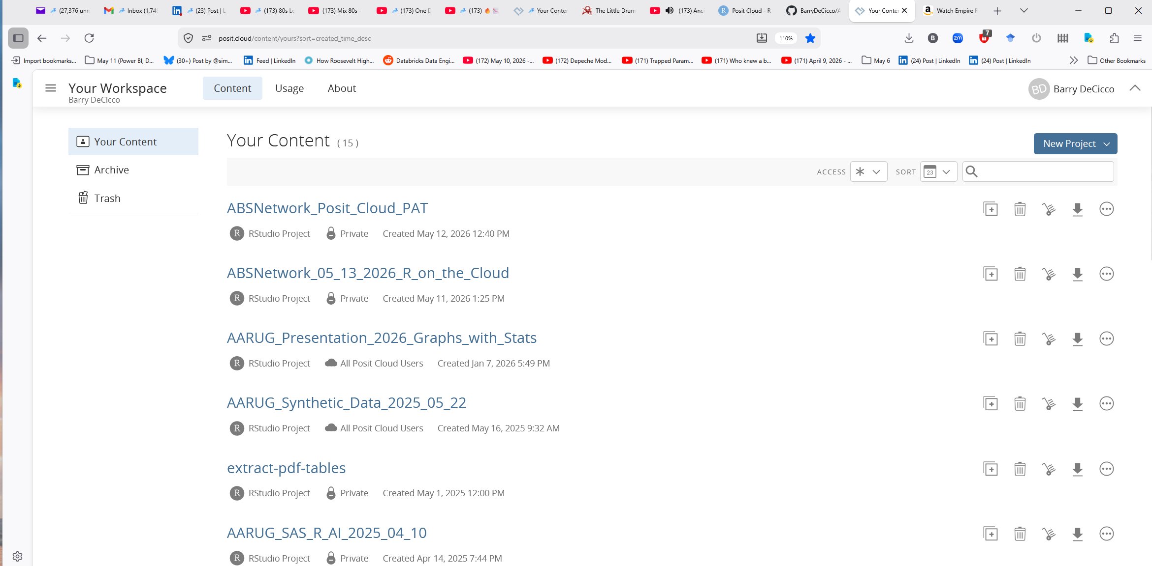
Getting Posit Cloud
Go to Posit.cloud
Sign up for a free account.
You will see your workspace (mine is full; yours will be empty):

Slide 4
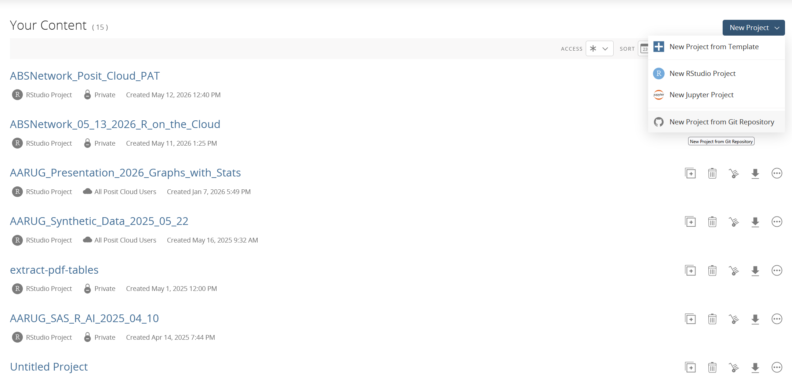
Creating a Project from Github
You can create a project from a Github repository, to get all of the advantages of Github in addition to those of Posit Cloud:

Slide 5
Connecting to Github - SSH and PAT
It’s good to be able to push changes to the repository. I have included documentation of two methods of connecting which allow the user to push changes (they will be made available later):
Connecting_Posit_Cloud_to_GitHub_SSH.docx
Connecting_Posit_Cloud_to_GitHub_Using_PAT.docx

Slide 6
Navigating the interface:
The interface is very much like the desktop version of RStudio, with a few changes:
The lower right panel has commands to upload and export files.
The session is running on a Linux box somewhere, and not your PC; you can issue the command ‘uname -a’ to see information about this linux box. Also, the path is ‘/cloud/project’,

Slide 7
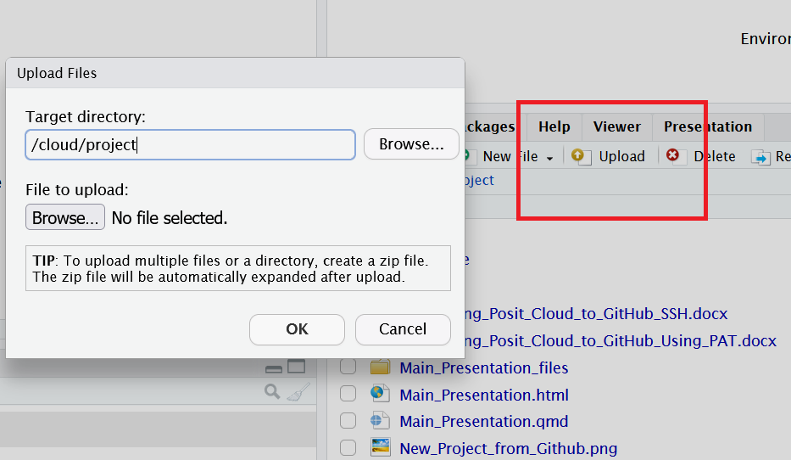
Importing files:
To get files from your PC to the project, use the ‘Upload’ button, and select your file:

Slide 8
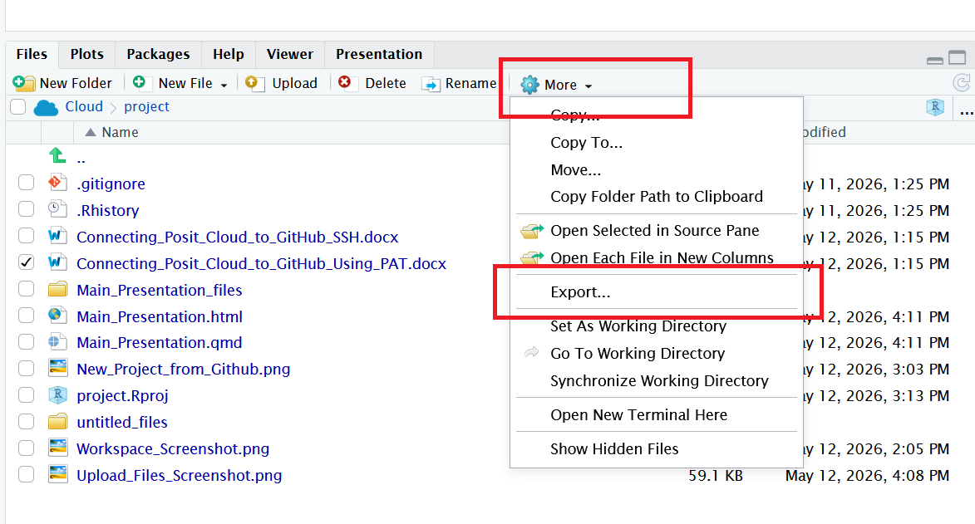
Exporting files:
To get files from your PC to the project, use the ‘Upload’ button, and select your file:

Slide 9
References:
Posit Cloud Documentation contains sections:
Get Started with Posit Cloud
Explore the Posit Cloud Guide
See What’s New on Posit Cloud
Sample Recipes on Posit Cloud
Peek at Cheatsheets for Your Posit Cloud Projects
Join the Posit Cloud Community
AI: I used Claude AI for much of this presentation (‘how do I xxx in …?’)

Slide 10
References (continued):
Connecting to Github:
Connecting_Posit_Cloud_to_GitHub_SSH.docx
Connecting_Posit_Cloud_to_GitHub_Using_PAT.docx

Slide 11
Source:
This presentation is in a public Github repository:
ABSNetwork_05_13_2026_R_on_the_Cloud

