Slide 1
First Attempt at PowerPoint
Barry DeCicco

Slide 2
## -- Attaching packages -------------------------------------------- tidyverse 1.3.0 -- ## v ggplot2 3.3.0 v purrr 0.3.3 ## v tibble 2.1.3 v dplyr 0.8.4 ## v tidyr 1.0.2 v stringr 1.4.0 ## v readr 1.3.1 v forcats 0.4.0 ## Warning: package 'ggplot2' was built under R version 3.6.3 ## -- Conflicts ----------------------------------------------- tidyverse_conflicts() -- ## x ggplot2::%+%() masks psych::%+%() ## x ggplot2::alpha() masks psych::alpha() ## x dplyr::filter() masks stats::filter() ## x dplyr::lag() masks stats::lag() ## Warning: package 'pastecs' was built under R version 3.6.3 ## ## Attaching package: 'pastecs' ## The following objects are masked from 'package:dplyr': ## ## first, last ## The following object is masked from 'package:tidyr': ## ## extract ## Registered S3 method overwritten by 'pryr': ## method from ## print.bytes Rcpp ## For best results, restart R session and update pander using devtools:: or remotes::install_github('rapporter/pander') ## ## Attaching package: 'summarytools' ## The following object is masked from 'package:tibble': ## ## view ## Loading required package: lattice ## Loading required package: survival ## Loading required package: Formula ## ## Attaching package: 'Hmisc' ## The following objects are masked from 'package:summarytools': ## ## label, label<- ## The following objects are masked from 'package:dplyr': ## ## src, summarize ## The following object is masked from 'package:psych': ## ## describe ## The following objects are masked from 'package:base': ## ## format.pval, units ## ## Attaching package: 'janitor' ## The following objects are masked from 'package:stats': ## ## chisq.test, fisher.test ## Warning: package 'kableExtra' was built under R version 3.6.3 ## ## Attaching package: 'kableExtra' ## The following object is masked from 'package:dplyr': ## ## group_rows

Slide 3
R Markdown
This is an R Markdown presentation. Markdown is a simple formatting syntax for authoring HTML, PDF, and MS Word documents. For more details on using R Markdown see http://rmarkdown.rstudio.com.
When you click the Knit button a document will be generated that includes both content as well as the output of any embedded R code chunks within the document.

Slide 4
Slide with Bullets
Bullet 1
Bullet 2
Bullet 3

Slide 5
Slide with R Output
summary(cars)
## speed dist ## Min. : 4.0 Min. : 2.00 ## 1st Qu.:12.0 1st Qu.: 26.00 ## Median :15.0 Median : 36.00 ## Mean :15.4 Mean : 42.98 ## 3rd Qu.:19.0 3rd Qu.: 56.00 ## Max. :25.0 Max. :120.00

Slide 6
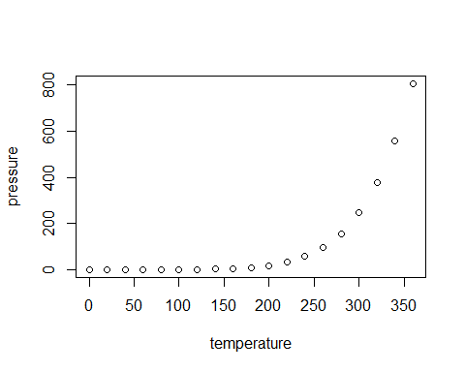
Slide with Plot

