Slide 1

A Brief Introduction to ASP.NET MVC 5
using C# and the Razor view engine

Slide 2
So what Is MVC?
Model View Controller (MVC) is a popular development pattern adopted by many frameworks and languages.
This pattern encourages the separation of concerns between the major components of an application into 3 layers – Models, Views, Controllers.
Its purpose is to simplify the development of GUI driven applications by providing an elegant means of separating concerns within your applications design.
For this, MVC applies itself really well to the development of web applications.

Slide 3
What are Models Views and Controllers?
Models: A set of classes that describe the domain specific data we are working with, as well as business rules for how the data can be changed and manipulated within your application
Views: Defines how the application’s user interface will be displayed and often use models to present specific data - typically our HTML and Razor pages
Controllers: A set of classes that handles the communication (requests/responses) with the client, overall application flow, and application-specific logic

Slide 4
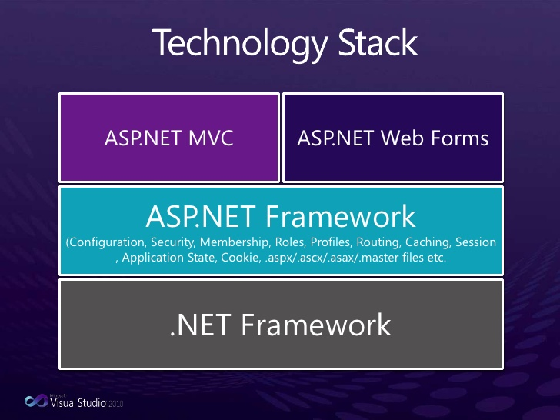
How this fits with the Microsoft web stack
ASP.NET MVC is a framework developed by Microsoft for building web applications in our familiar ASP.NET environment.
It applies the general MVC pattern to ASP.NET by providing a set of libraries and conventions that encourage the MVC pattern in our applications design.

Slide 5
What this means for us..
Design our web applications using Microsoft’s implementation of the MVC design pattern
Continue to use familiar tools such as the Razor view engine and ASP.NET
Take advantage of some of the useful features and neat conventions the MVC framework offers
Transition to an MVC based architecture relatively easily because we already understand core concepts
Lets take a first look at the basics of ASP.NET MVC..

Slide 6
Basic overview of traditional MVC routing
For now lets take it for granted that incoming requests are directed to controllers(classes) and within the controller, actions(methods) - based on the structure of the URL.
A typical MVC URL might look something like www.domainname.com/home/index
Where ‘home’ is the name of the controller and ‘index’ is the name of the Index() Action Method that is defined in the HomeController class.
This is the traditional approach to routing and the one we will use in our examples and demos.
-Routes and URL paths are fully customisable and you can specify your own route patterns.

Slide 7
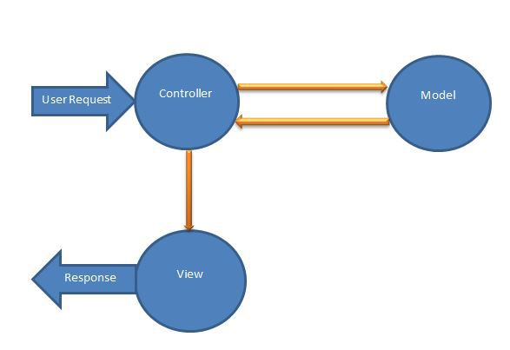
Basic request life cycle flow
0. Routing – controller is instantiated
A request is received by the controller
The appropriate action method on the controller is invoked, request processing begins, calls to other resources such as database or application specific logic, creates models etc..
the view receives from the action method any models it requires for displaying and begins rendering the specified razor page
A response is returned to the client in the form of pure html or other formats.

Slide 8
MVC Controllers
Provide a set of useful properties and behaviours inherited from the base class ‘Controller’
Contain our ‘Action Methods’ which process requests, any data that has been packaged with a request and generate or call appropriate responses.
Action Methods are invoked and our request/response processing begins by making calls to external resources such as database and other domain specific logic.
Controllers Group together related Action Methods
Action Methods pass models and other data to the appropriate views or generate other response types

Slide 9
More on Models
These classes represent data and behaviours of our domain specific objects in the form of regular C# classes
Often store data retrieved from a database
Have no dependency on the controllers or views
Easy to package data and process them in either a view response or other ActionResult types.

Slide 10
Razor Views
Represent our UI and are typically our ‘.cshtml’ file that use the Razor view engine to render dynamic mark up
Views have a dependency on models and are responsible for displaying these to the user
Views do not usually contain business specific or request processing logic
Collect and submit data from user inputs to a controller action method in the form of http requests

Slide 11
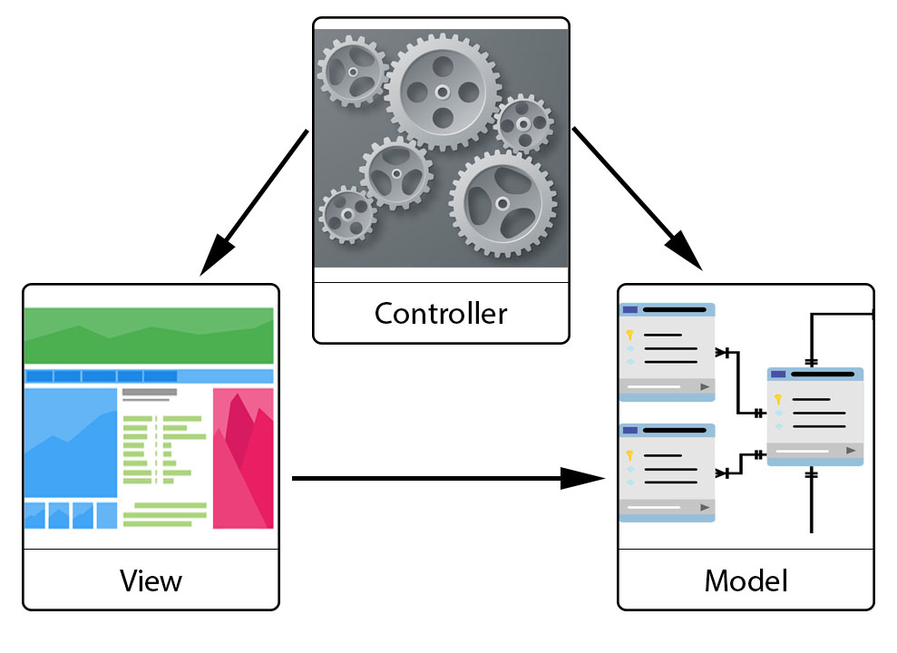
Basic MVC dependency diagram
Controllers have a dependency on both views and models because all the processing is done here
Views have a dependency on models, because they display the data carried by models
Models point to neither, they have no dependency on the other two MVC components.

Slide 12
What we have learnt so far about MVC
A design pattern often used in the development of web applications
Encourages the separation of concerns between the major server side components into 3 layers – Models, Views, Controllers
Helps us to develop a clean and maintainable code base
Controllers do all of the request processing and manage overall application flow
Models represent domain specific entities or data
Views display the data to the user

