Slide 1

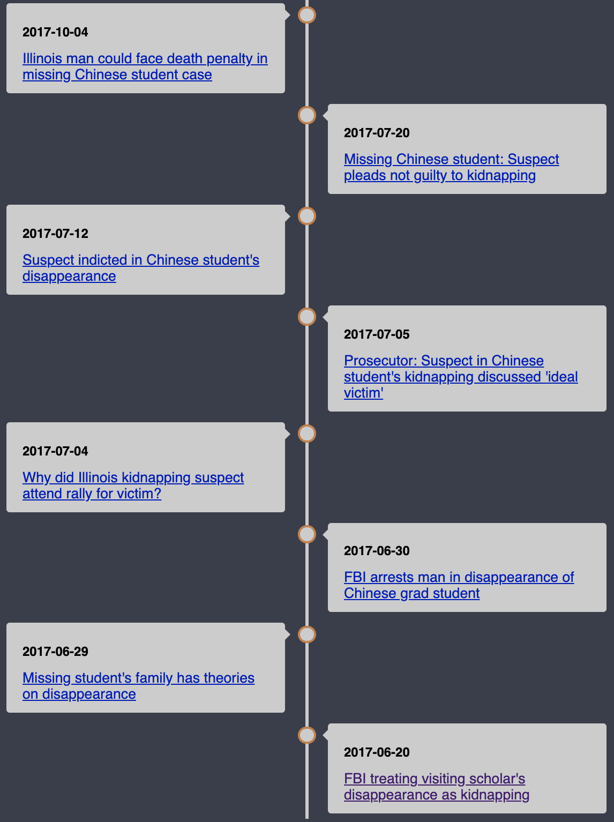



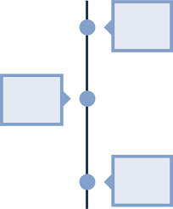
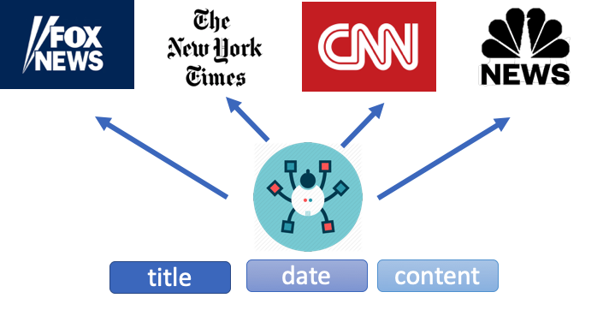
32. Building Timeline for Social Events
Guyi Chen, Zhiming Ruan, Yichen Yang, Qiyue Yao, Zhen Yu
EECS, University of Michigan, Ann Arbor, MI.
Introduction
Methods
Results
People are often interested in knowing the development of the news event when they search certain event keywords online or when they browse through their newsfeed such as CNN, FOX, etc.
However, most search engines only return a series of most relevant results and organize them into a hierarchical structure, and there is no development organization of these retrieved results.
Our project is interested in identifying news events from news stories and model the development or evolution among these news events as a timeline.
We get each previous historical event recursively to generate the development.
Retrieve all the relevant news articles related to the input query keywords.
Extract keywords [1] of related documents into keyword pool.
Embed [2] and calculate similarity between query keywords and keywords pool.
Use least relevant words as next query which is most likely to be retrieve previous event.
Feedback to the pipeline recursively.
Key components of this project:
1.An retrieval system 2.Keyword extraction model
3.Word embedding model 4.Recursive searching model
Output Timeline
Previous Related News
Insert Top Relevant Docs into Timeline
Query Keyword
Retrieval
Relevant Documents
Extract Keywords
New Keyword Pool
Input
Embed and
Calc. Similarity
Figure 1. General Idea
Data
Relevant Words As Next New Query
Figure 4. Visualized Timeline
Apply as Next Query
Acknowledgements
Constructed dataset:
Original preprocessed news dataset from Kaggle contains has scattered distribution of news events. So we constructed our own dataset by crawling news websites.
During the implementation of the project, knowledge learned from EECS 486 Information Retrieval is applied. We appreciate the help from Professor Rada Mihalcea, GSIs Yumou Wei, Yiting Shen, Hengjia Zhang, and IAs RJ Duquette, Yuanhang Roy Luo throughout the semester.
Figure 3. Prototype Flow Diagram
Discussion and Conclusion
Example runs of our pipeline demonstrate relatively human-understandable news development in general. Simple event queries generated highly reasonable timelines; complex event queries generated timelines with deviation but still reasonable to some extent.
Performance is better for one targeted person query, around whom there is only one simple event development. In this case, we generated timeline from clustered news articles.
For more broadly effective events like “Iraq War”, the performance is influenced by the recursive searching model where deviation is accumulated. The complex causes of the event also provides larger possibilities to be included in a simple timeline.
References
[1] Rose, Stuart & Engel, Dave & Cramer, Nick & Cowley, Wendy. (2010). Automatic Keyword Extraction from Individual Documents.10.ch1.
[2] Jeffrey Pennington, Richard Socher, and Christopher D. Manning. 2014. GloVe: Global Vectors for Word Representation.
Figure 2. Data Collection Method
[EECS 486]

