Slide 1


Slide 3
Prepare
Install GIT https://git-scm.com/downloads

Slide 4
What is GIT
Git (/ɡɪt/^{[7]}) is a version control system for tracking changes in computer files and coordinating work on those files among multiple people. It is primarily used for source code management in software development,^{[8]} but it can be used to keep track of changes in any set of files. As a distributed revision control system it is aimed at speed,^{[9]} data integrity,^{[10]} and support for distributed, non-linear workflows.^{[11]}
Git was created by Linus Torvalds in 2005 for development of the Linux kernel, with other kernel developers contributing to its initial development.^{[12]} Its current maintainer since 2005 is Junio Hamano.

Slide 5
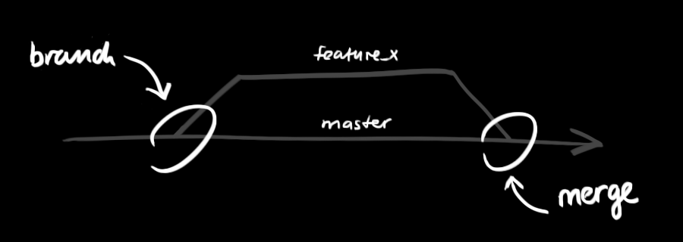
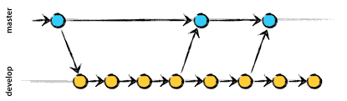
Branches

Slide 6
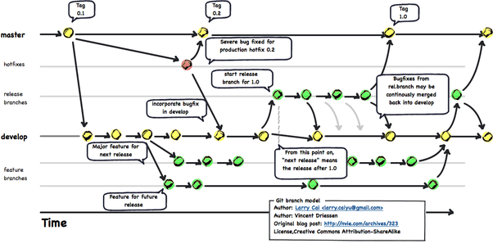
Branches

Slide 7
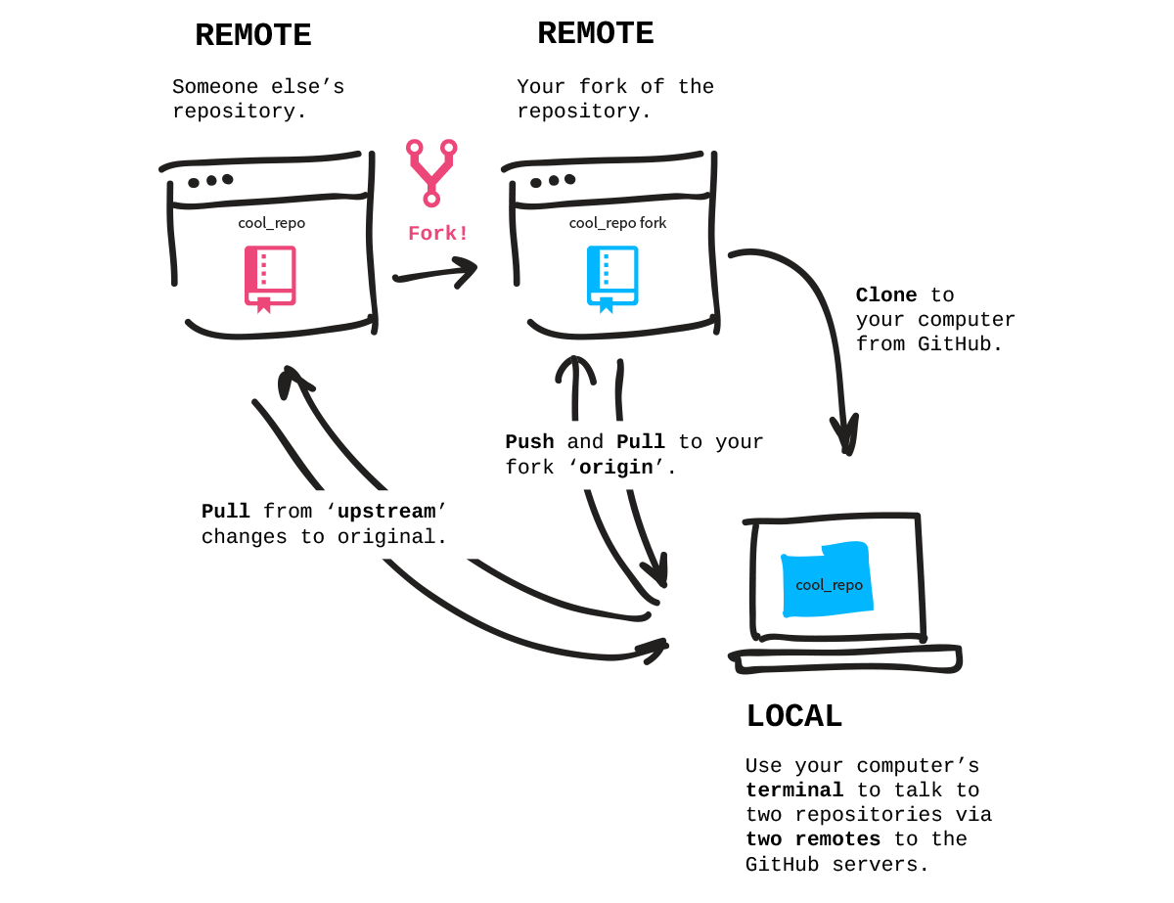
Fork

Slide 8
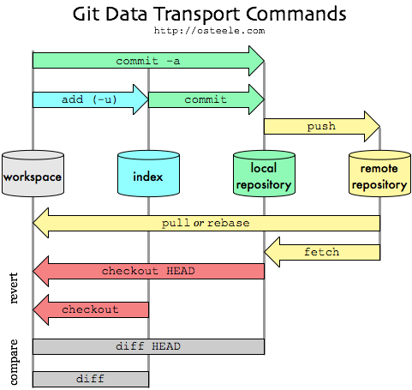
Commit vs Push

Slide 9
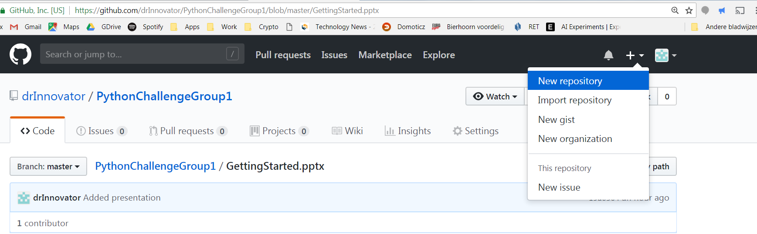
Create a new GitHub project

Slide 10
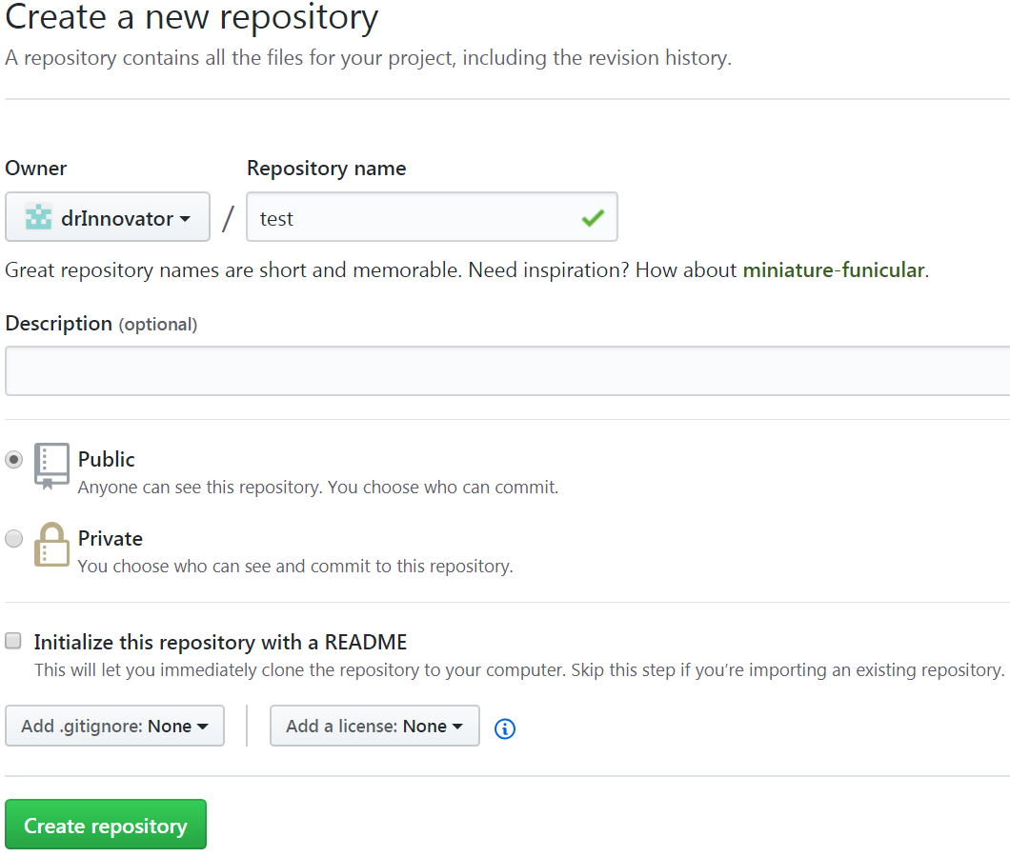
Create a new GitHub project

Slide 11
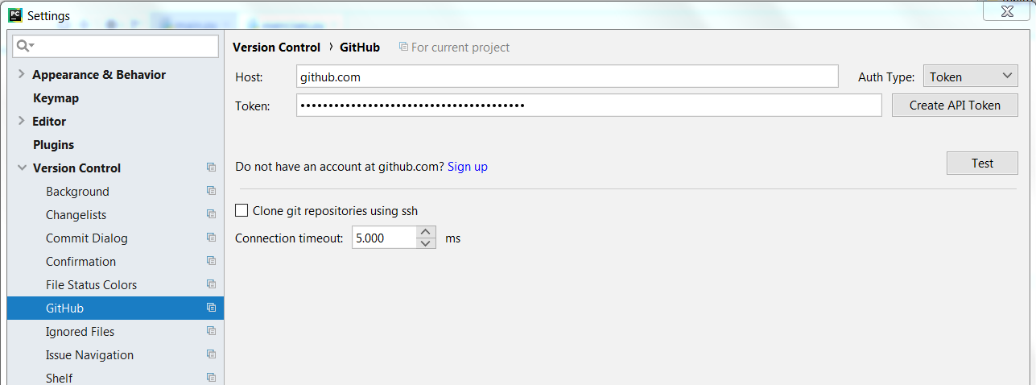
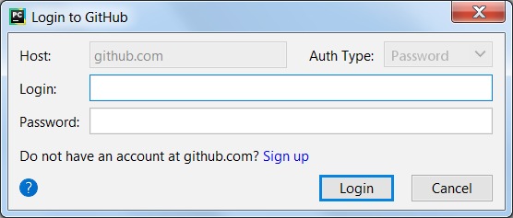
Setting up GitHub in PyCharm
File->Settings

Slide 12
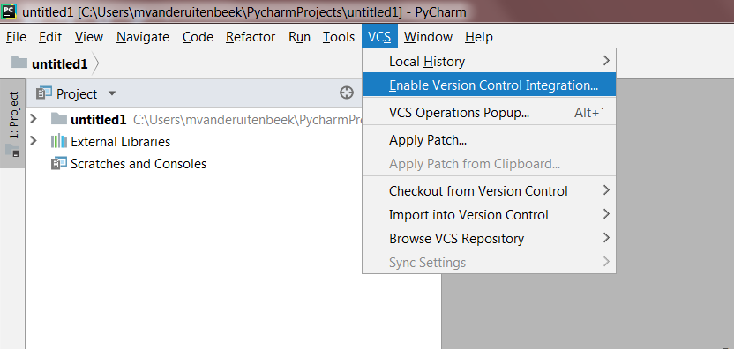
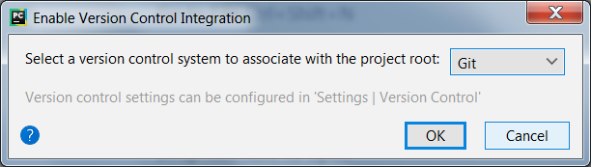
Enable VCS in your project

Slide 13
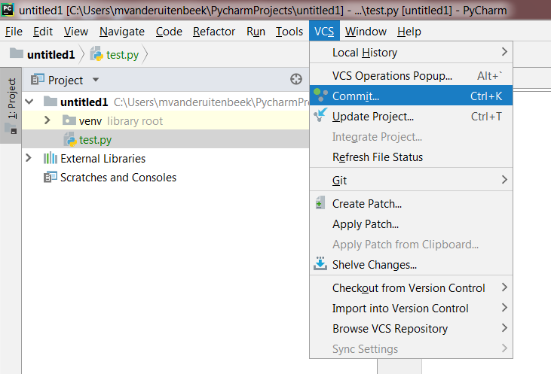
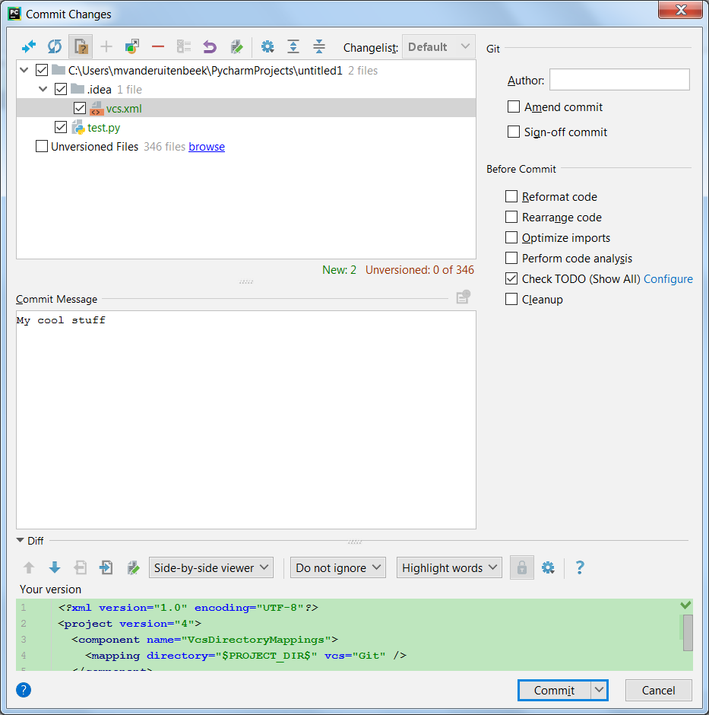
Commit your project

Slide 14
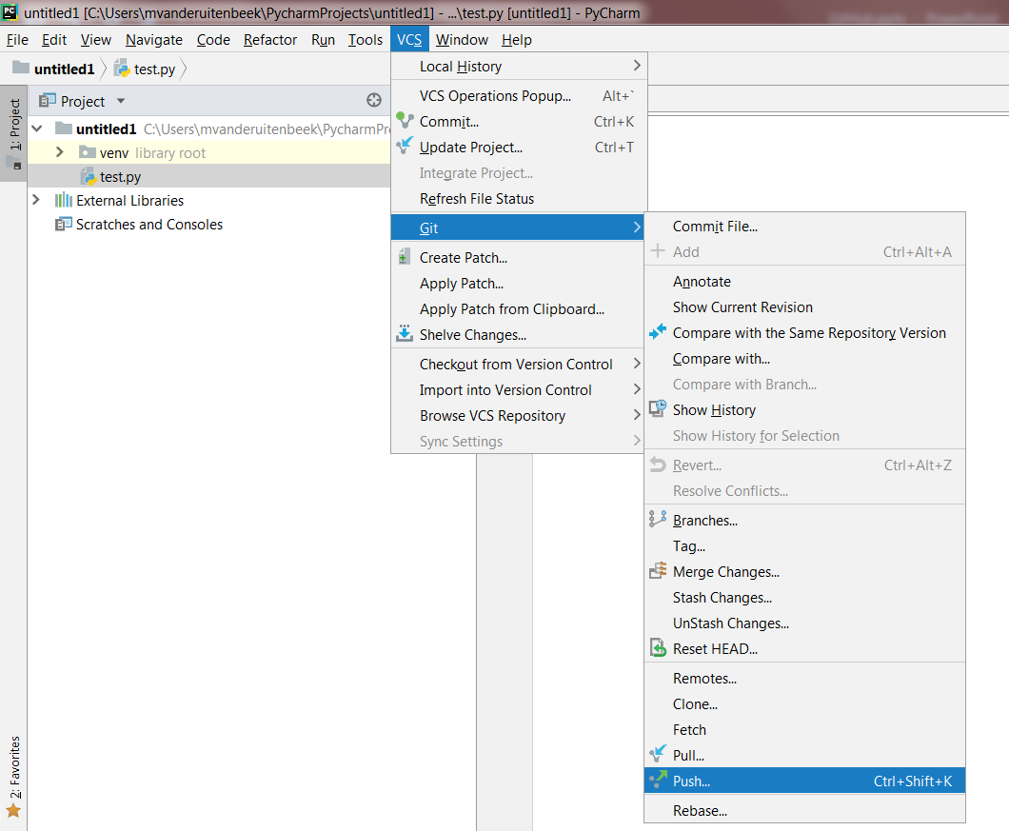
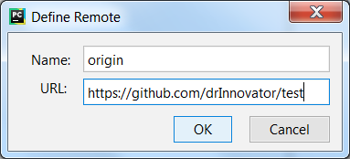
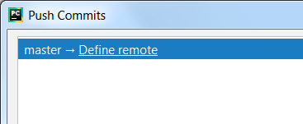
Push your project

Slide 15
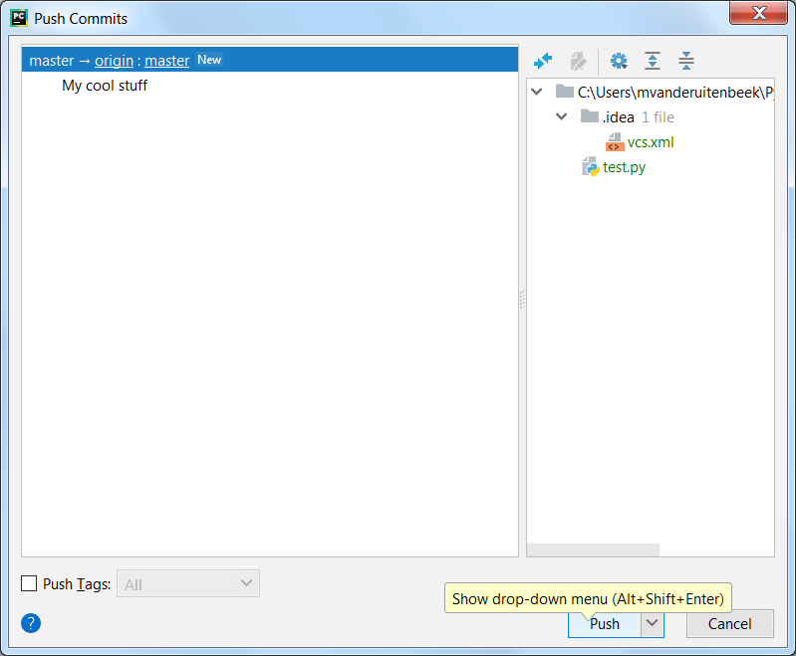
Push commits to remote

