Slide 1
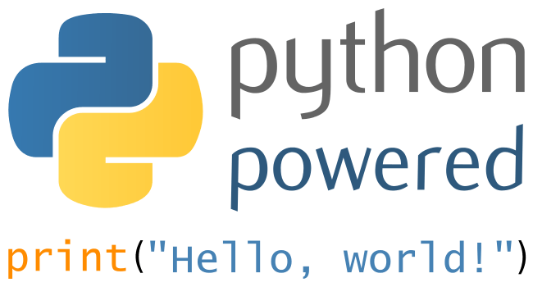


Slide 3
Get the software
Install latest Python https://www.python.org/downloads/
Install latest PyCharm https://www.jetbrains.com/pycharm/download/
Install Git & Get a GitHub or GitLab or BitBucket account https://gitforwindows.org/ https://github.com/
Get the examples code & presentation here (exercises.py and GettingStarted.pptx): https://github.com/drInnovator/PythonChallengeGroup1

Slide 4
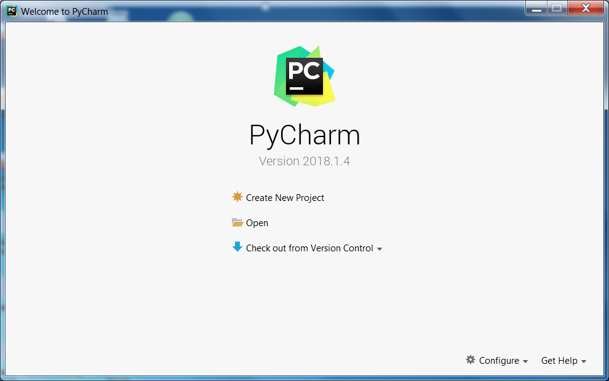

Slide 5
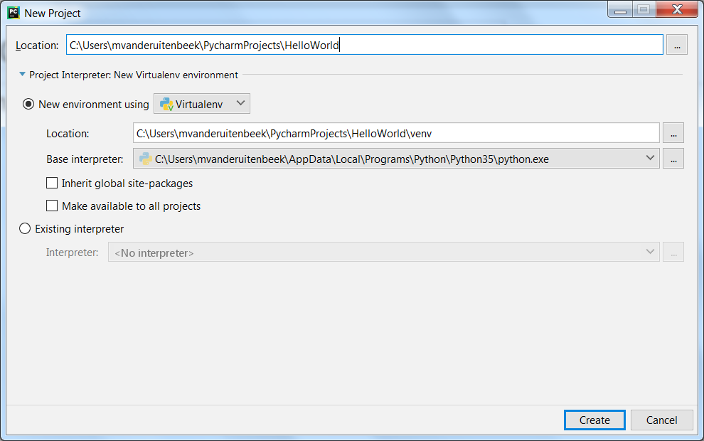

Slide 6
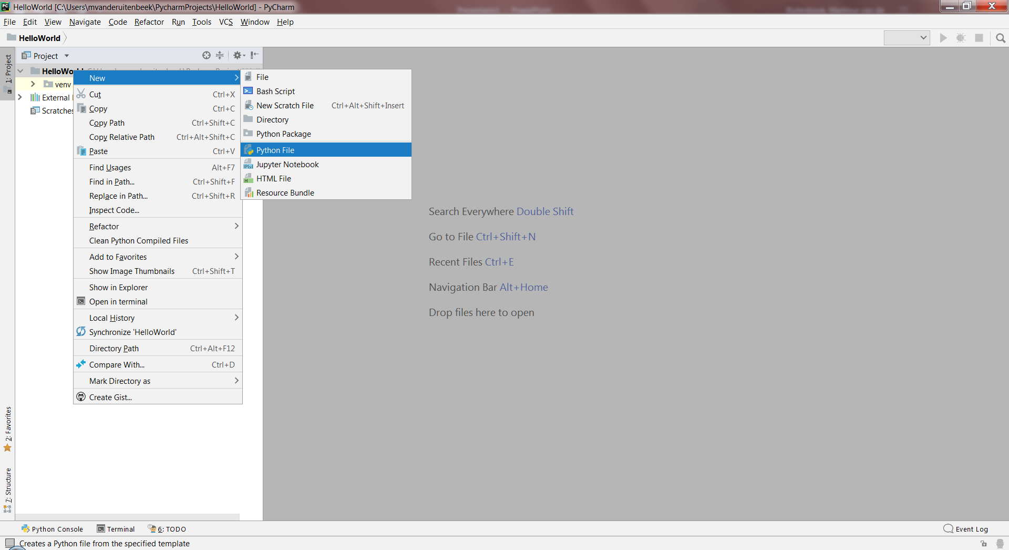
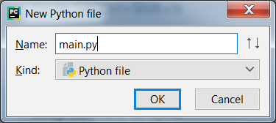

Slide 7
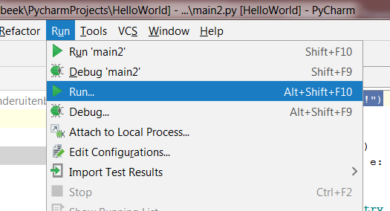
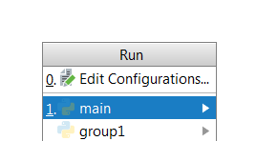
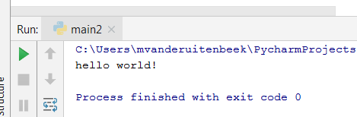
print ("hello world!")
Press Shift + F10 to run again quickly

Slide 8
Your first Variable
a = 5 print(a)
a = 5 print(a) a += 3 # this is the equivalent for a = a + 3 print(a) b = 5 print(a + b)

Slide 9

Your first If statement
if (1 > 2): print("wow that's nice!")
a = int(input("How much?")) if (a > 2): print("wow that's nice!")
a = int(input("How much?")) if (a >= 2): print("wow that's nice!") elif (a < 2 and a >= 0): print("better improve on it") else: print ("oh whatever")

Slide 10
Your first While statement
a = 50 while a > 10: a -= 1 # this is equivalent to: a = a-1 print(a)
print ("end result: " + str(a))
a = int(input("How much?")) while a > 10: print ("That is invalid. Try again") a = int(input("How much?")) print("Good job! End result: " + str(a))

Slide 11
Your first For loop
for i in range (0, 100): print (i)
for i in range (0, 100, 3): # each third value in the range print (i)
fruits = [“pear", "banana", "cherry“, “orange”] for x in fruits: if x == “cherry": break if x == “pear": continue print(x)

Slide 12
Your first Method Organize your code in reusable chunks
import math def calculate_distance(x1, y1, x2, y2): """This method calculates the distance between two points""" dx = x2 - x1 dy = y2 - y1 result = math.sqrt(dx ** 2 + dy ** 2) # dx ** 2 is dx to the power of 2 return result # now reuse the method multiple times print(calculate_distance(0, 0, 3, 4)) # result is 5, the famous 3, 4, 5 triangle print(calculate_distance(0, 0, 6, 8)) # result is 10, the famous 6, 8, 10 triangle print(calculate_distance(1, 10, 6, 22)) # result is 13, the famous 5, 12, 13 triangle

Slide 13
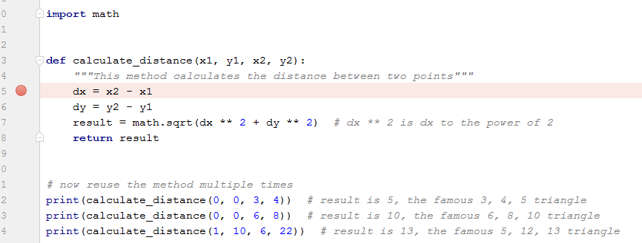
Debug your code. This is your BEssssssT friend in coding!!
1: Click here to set a breakpoint
2: Press Run->Debug (or shift+F9). Program stops at breakpoint.
3: Inspect your variables
3: Press Run-> Step Over (F8) to proceed one step. Or F9 to resume.

Slide 14
Your first Error Handler
divide_by = int(input("Divide by?")) result = 0 try: result = 15 / divide_by except Exception as e: print("Something is wrong with your calculation. Reverting to the default result: ") result = 15 / 2 finally: print(result)

Slide 15
Clean your code This is your second BEssssssT friend in coding
import math def calculate_distance(x1,y1,x2,y2): """This method calculates the distance between two points""" dx = x2 -x1 dy=y2- y1 result= math.sqrt(dx**2+dy** 2) # dx ** 2 is dx to the power of 2 return result
CTRL+ALT+L (Code->Reformat code)
import math def calculate_distance(x1, y1, x2, y2): """This method calculates the distance between two points""" dx = x2 - x1 dy = y2 - y1 result = math.sqrt(dx ** 2 + dy ** 2) # dx ** 2 is dx to the power of 2 return result

Slide 16
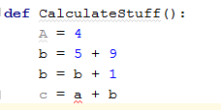
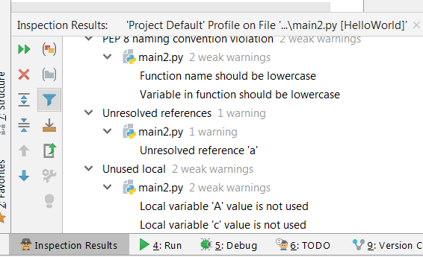
Inspect your code
Code->Inspect

Slide 17
Play a little

Slide 18
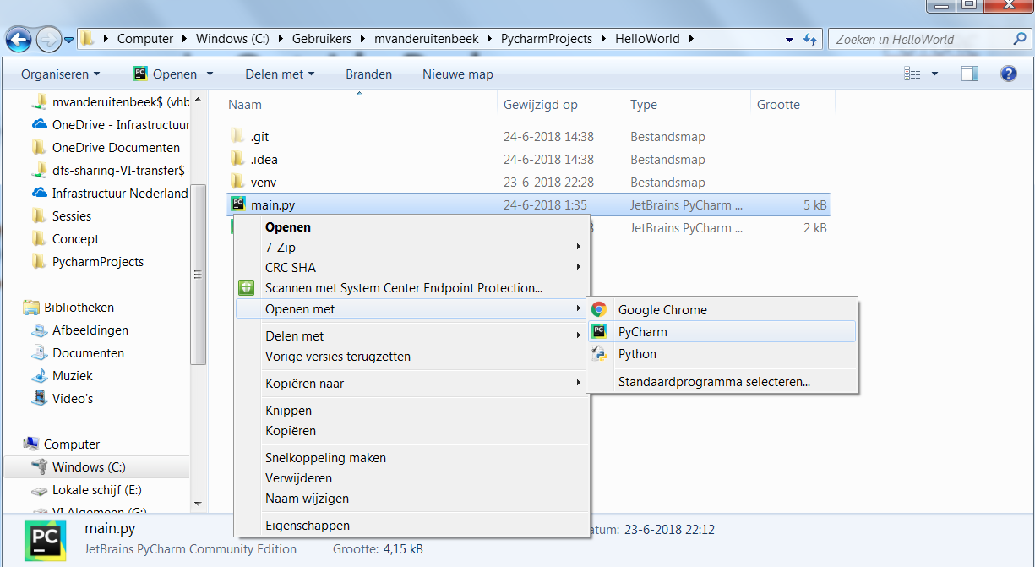
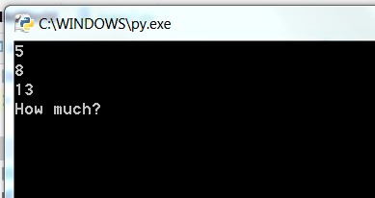
Run your code Outside Pycharm

Slide 19

Your first Class A class is a Blueprint, a Template, a Definition
class Car: color = "red" max_speed = 300 # in km/h velocity = 0 # in km/h heading = 0 # in degrees
Create 2 actual cars from this template:
car1 = Car() car1.color = "blue" car1.velocity = 50 car1.heading = 10 car2 = Car() car2.color = "green" car2.velocity = 130 car1.heading = 180
print(car1.color) print(car2.color)

Slide 20
Your first slightly advanced Class
import random class Car: color = "red" max_speed = 0 # in km/h velocity = 0 # in km/h heading = 0 # in degrees traveltime = 0 # in seconds def __init__(self): """When this class is instantiated, generate some interesting actual random values""" self.color = random.choice(["green", "yellow", "white", "blue"]) self.heading = random.randint(0, 360) self.max_speed = random.randint(0, 400) self.velocity = random.randint(0, self.max_speed) self.traveltime = random.randint(0, 1000) def traveled_distance(self): """calculates the distance this car traveled given the time and velocity""" result = self.velocity * (self.traveltime / 3600) # in km return result def print_properties(self): print(self.color + " " + str(self.velocity) + "km/h " + str( self.heading) + "deg " + str(self.traveled_distance()) + "km") car1 = Car() car2 = Car() car1.print_properties() car2.print_properties()
All car logic in one place
(Waardestroom ☺)

Slide 21
Your first List A list can hold things like numbers and classes
fruits = ["pear", "banana", "cherry", "orange"] print(fruits) fruits.append("seafruit") fruits.insert(0, "guava") # list count starts at 0 fruits.remove("cherry") print(fruits) fruits.sort() fruits.reverse() print(fruits) print(fruits[3]) # this is the fourth element in the list fruits.append("guava") print((fruits.count("guava")))

Slide 22
Your first List with cars
cars = [] # create emty list cars.append(car1) # add a car to it cars.append(car2) # add another car etc print(cars.__len__()) # amount of cars in the list
# smart way to add a lot of cars cars = [] # create emty list while cars.__len__() < 100: new_car = Car() new_car.print_properties() cars.append(new_car) print(cars.__len__()) # amount of cars in the list

Slide 23
Create your first Visualisation
root = Tk() # main dimensions width = root.winfo_screenwidth() height = root.winfo_screenheight() # canvas is a white piece of paper on which you can draw canvas = Canvas(root, width=width, height=height, bg="black") canvas.pack() # draw a green rectangle canvas.create_rectangle(width / 3, height / 3, width * 2 / 3, height * 2 / 3, fill='green') # must be the last line before exit for TKinter root.mainloop()

Slide 24
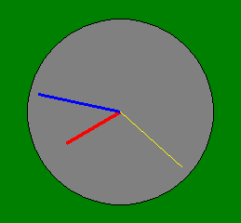
Create your first Clock
import datetime as datetime import math import time from tkinter import Tk from turtle import Canvas root = Tk() # main dimensions screen_width = root.winfo_screenwidth() screen_height = root.winfo_screenheight() # canvas is a white piece of paper on which you can draw canvas = Canvas(root, width=screen_width, height=screen_height, bg="black") canvas.pack() def draw_hand(angle, someradius, some_thinkness, some_color): # this function draws a hand with a certain angle and radius canvas.create_line(screen_width / 2, # x1 screen_height / 2, # y1 screen_width / 2 + math.cos(angle) * someradius, # x2 screen_height / 2 + math.sin(angle) * someradius, # y2 width=some_thinkness, # line thickness fill=some_color) # line color def draw_clock(): # draw a clock background canvas.create_rectangle(screen_width / 3, screen_height / 3, screen_width * 2 / 3, screen_height * 2 / 3, fill='green') # draw the clock itself radius = screen_height / 4 canvas.create_oval(screen_width / 2 - 100, screen_height / 2 - 100, screen_width / 2 + 100, screen_height / 2 + 100, fill="gray") # draw all hands now = datetime.datetime.now() hour_angle = 2 * math.pi * now.hour / 12 - math.pi / 2 # clock zero angle starts at top draw_hand(hour_angle, radius / 4, 4, "red") minute_angle = 2 * math.pi * now.minute / 60 - math.pi / 2 # clock zero angle starts at top draw_hand(minute_angle, radius / 3, 3, "blue") seconds_angle = 2 * math.pi * now.second / 60 - math.pi / 2 # clock zero angle starts at top draw_hand(seconds_angle, radius / 3, 1, "yellow") while (1 < 2): # loop forever canvas.delete("all") draw_clock() canvas.update() time.sleep(0.01) # must be the last line before exit for TKinter root.mainloop()

Slide 25
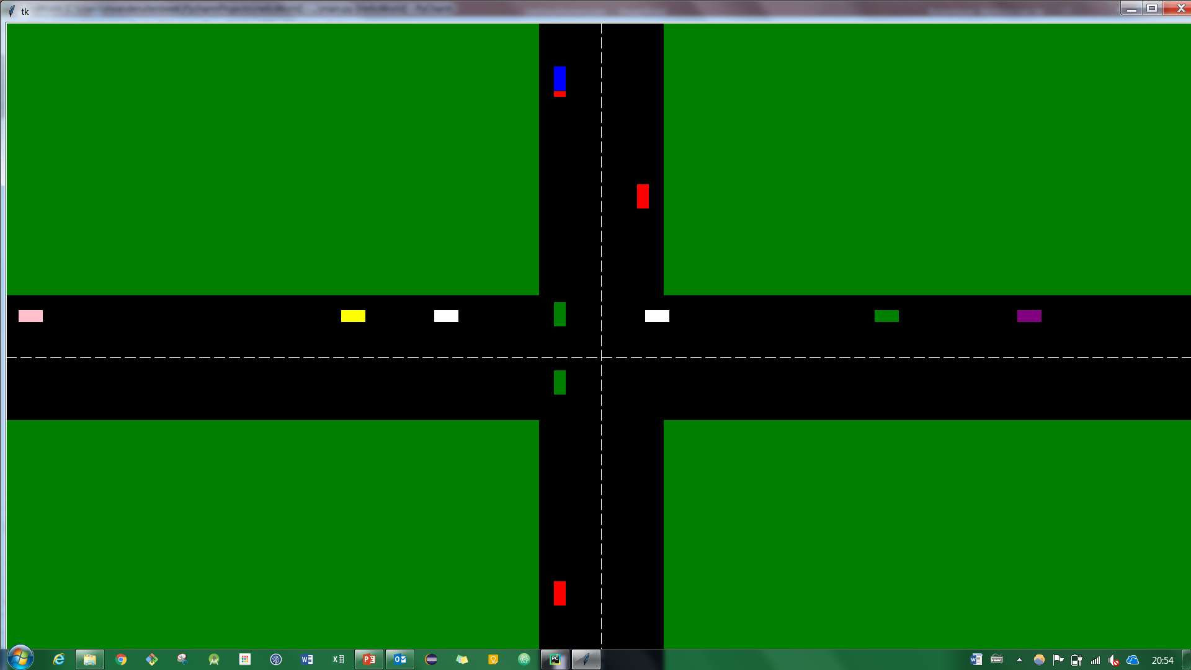
Create your first Traffic mess
# Create window import random import time from tkinter import Tk from turtle import Canvas import math class Car(): # car properties pos_x = 100 # initial position pos_y = 100 heading = 0 # car direction in rad speed = 10 # car speed in pixels / step size = 10 # car size in pixels color = "red" def __init__(self): """ generate a valid heading and corresponding start position eac time a new car is generated """ self.heading = random.choice([0, math.pi / 2, math.pi, math.pi * 1.5]) if (self.heading == 0): # car heading right self.pos_x = 0 self.pos_y = height / 2 + roadWidth / 3 elif (self.heading == math.pi / 2): # car heading down self.pos_x = width / 2 - roadWidth / 3 self.pos_y = 0 elif (self.heading == math.pi): # car heading left self.pos_x = width self.pos_y = height / 2 - roadWidth / 3 elif (self.heading == math.pi * 1.5): # car heading up self.pos_x = width / 2 + roadWidth / 3 self.pos_y = height self.color = random.choice(["blue", "green", "red", "yellow", "black", "white", "purple", "pink"]) def turn(self): directionTurn = random.choice(["left", "right", "none"]) if directionTurn == "left": # do something self.heading = self.heading + math.pi / 2 def move(self): """ calculate new car position given speed and heading """ self.pos_x = self.pos_x + math.cos(self.heading) * self.speed self.pos_y = self.pos_y + math.sin(self.heading) * self.speed def draw(self): # draw the car. Depending on direction, turn the car if (self.heading == 0 or self.heading == math.pi): # going left or right canvas.create_rectangle(self.pos_x - 2 * self.size, self.pos_y - self.size, self.pos_x + 2 * self.size, self.pos_y + self.size, fill=self.color) else: # going up or down canvas.create_rectangle(self.pos_x - self.size, self.pos_y - 2 * self.size, self.pos_x + self.size, self.pos_y + 2 * self.size, fill=self.color) def draw_scene(): """Clear the current scene and build it up again""" # first entirely clear the canvas canvas.delete("all") # draw the green parks canvas.create_rectangle(0, 0, (width - roadWidth) / 2, (height - roadWidth) / 2, fill="green") canvas.create_rectangle(0, (height + roadWidth) / 2, (width - roadWidth) / 2, height, fill="green") canvas.create_rectangle((width + roadWidth) / 2, 0, width, (height - roadWidth) / 2, fill="green") canvas.create_rectangle((width + roadWidth) / 2, (height + roadWidth) / 2, width, height, fill="green") # draw the dashed lines on the road canvas.create_line(0, height / 2, width, height / 2, fill="white", dash=(20, 20)) canvas.create_line(width / 2, 0, width / 2, height, fill="white", dash=(20, 20)) def simulate_cars(): """ iterate forever through cars and draw them """ while (1 == 1): # draw the park scene on the canvas draw_scene() # add a new car every now and then if random.randint(0, 9) > 8: newCar = Car(); cars.append(newCar) # draw all cars in the scene for car in cars: car.move() car.draw() # remove cars that drove out of the scene if (car.pos_x < 0 or car.pos_x > width or car.pos_y < 0 or car.pos_y > height): cars.remove(car) canvas.update() time.sleep(0.01) if __name__ == '__main__': root = Tk() # main global variables width = root.winfo_screenwidth() height = root.winfo_screenheight() roadWidth = 200 # canvas is a white piece of paper on which you can draw canvas = Canvas(root, width=width, height=height, bg="black") canvas.pack() # list of cars in the scene cars = [] # run the simulation simulate_cars() # must be the last line before exit for TKinter root.mainloop()

