Slide 1
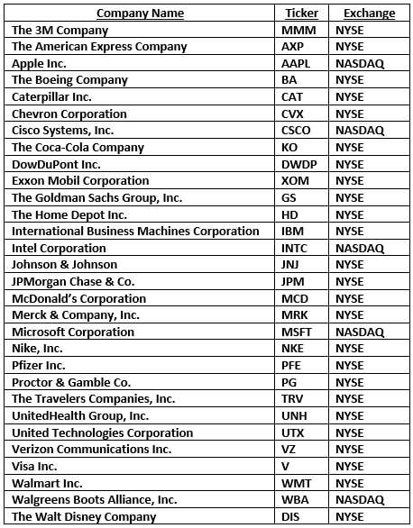
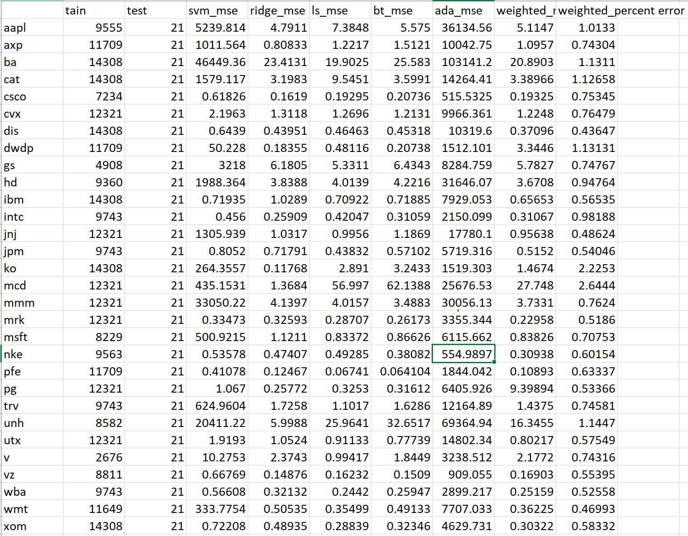
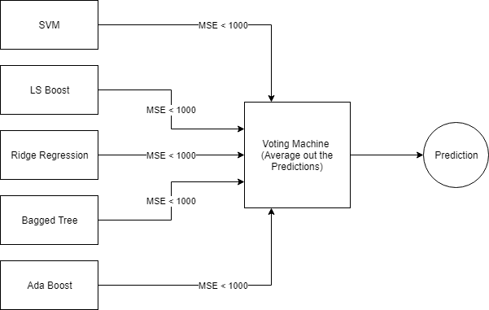
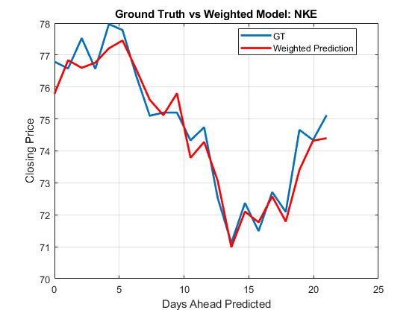
Stock Market Prediction Using a Weighted Machine Learning Model for DowJones Industrial Average Companies
Abstract
Investments into the stock market can either make one a powerful elite in a nation or a person with no value. This gamble for wealth is unpredictable as the stock market is highly volatile. Those who succeed in the stock market will be glorified for their fame and fortune. Examples of these people include Warren Buffet (CEO of Berkshire Hathaway) and Winklevoss Twins (investors of Bitcoins). Although many try to emulate these investor’s investment strategies, some have begun using machine learning models to help make smart investment choices. Many of these models follow general machine learning models such as support vector machines (SVM), regressions, and trees. However, the accuracies for these models are not high enough guarantee large profits. In this research, many machine learning models will be used to predict monthly stock values for companies inside the DowJones Industrial Average. These predictions will be weighted together. The goal of this experiment is to show that weighted amounts of machine learning algorithms can improve the performance of SVMs.
Models Used
This project is inspired by the SRA (Support Vector Machine, Random Forest, Ada Boost) Voting Model from Shanghai. This model takes the predicted results the named models and do a weighted average. The results of this research showed that a weighted ensemble model has better accuracies than an SVM model. The model does fail when predicting long periods of time, so this model is best for predicting a month ahead. From doing research on other markets, Bagged Tree was a better model for the India stock market. For the New York Stock Exchange, LS Boost and ridge regression were methods with great accuracies.
https://www.investopedia.com/terms/d/djia.asp
Results
The result of this experiment shows that the voting model does improve the SVM models. The best experiment can be seen in Nike as it uses all 5 models. The average of all 5 models reduced the MSE. When comparing this model to the other models, the voting model was more accurate.
Barry Wu
RIT Computer Engineering
CMPE-677 Machine Intelligence
Fall 2018

