Slide 1
Health Monitoring System for Docker Containers
Cloud Computing - Project Report
Barsanti Nicola
Casu Pereira de Sousa Bruno Augusto
Fregosi Frederico
Lemmi Laura
Martino Giuseppe

Slide 2
Summary
System Architecture
The Manager submodule
The Controller submodule
System Communication
Service Optimization
System Testing
Conclusions and Outlook

Slide 3

Architecture

Slide 4
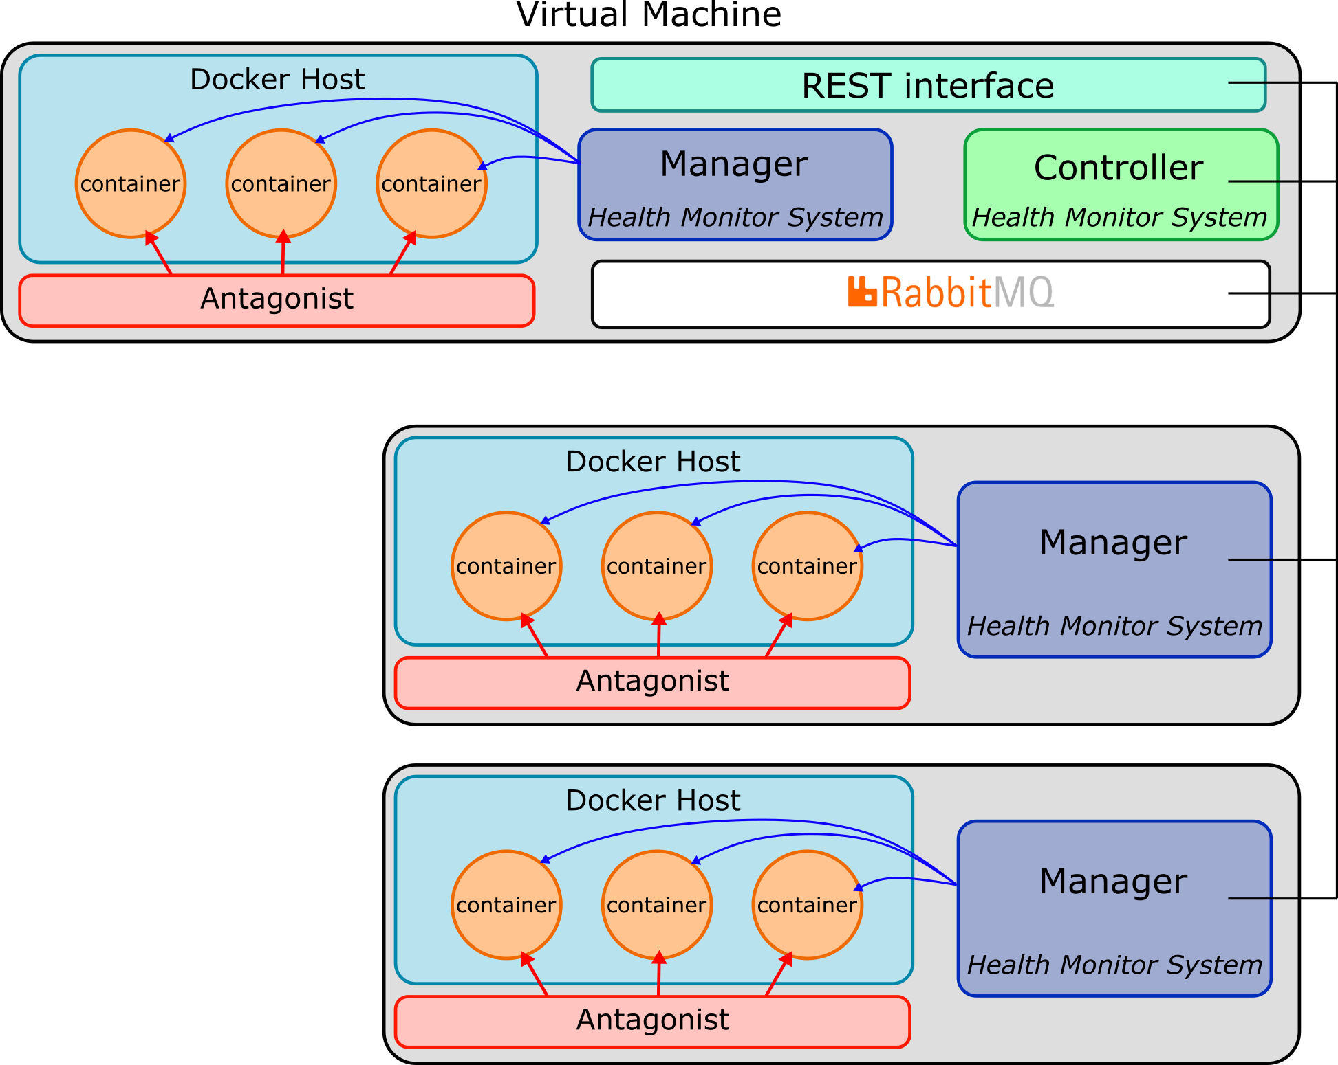
System Architecture
Health Monitoring System (HMS) architecture
Objective: Monitor the containers deployed in the VMs platform
Manager: a local submodule will check the containers status and act when a fault is detected
Controller: an overseer will manage the transmission of monitoring logs and commands in the system
Communication: the submodules exchange information a developed message queue system based in RabbitMQ

Slide 5

System Architecture
From the designed REST interface, the user will be able to verify the status of the containers and issue commands for the Managers configuration (pkt loss threshold and ignored IDs)
REST interface
User/admin
HMS Controller
Configuration
Monitoring log
HMS Manager
container
container
Docker Host

Slide 6
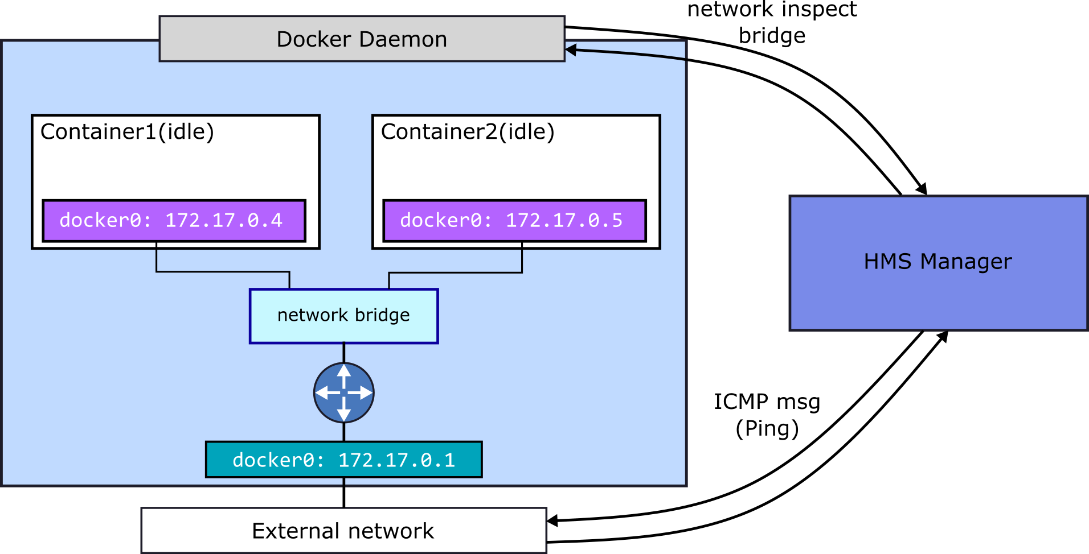
The Manager submodule
Each Manager deployed in the platform will interact with the local Docker Host daemon, retrieving a list of running containers and their status
The Manager will also interact with the docker network bridge, and will periodically send ICMP messages (Ping) to the listed containers, checking for the packet loss

Slide 7
The Manager submodule
Manager monitoring Algorithm
Get containers list
After the monitoring process, the Manager sends and update to the Controller if any container was restarted
Check if ID is in ignored List
True
False
Go to next ID
Check status
“exited”
“running”
Is container restarting?
Ping
Threshold
exceeded
False
Container OK
Restart container
Save monitoring log
Go to next ID

Slide 8
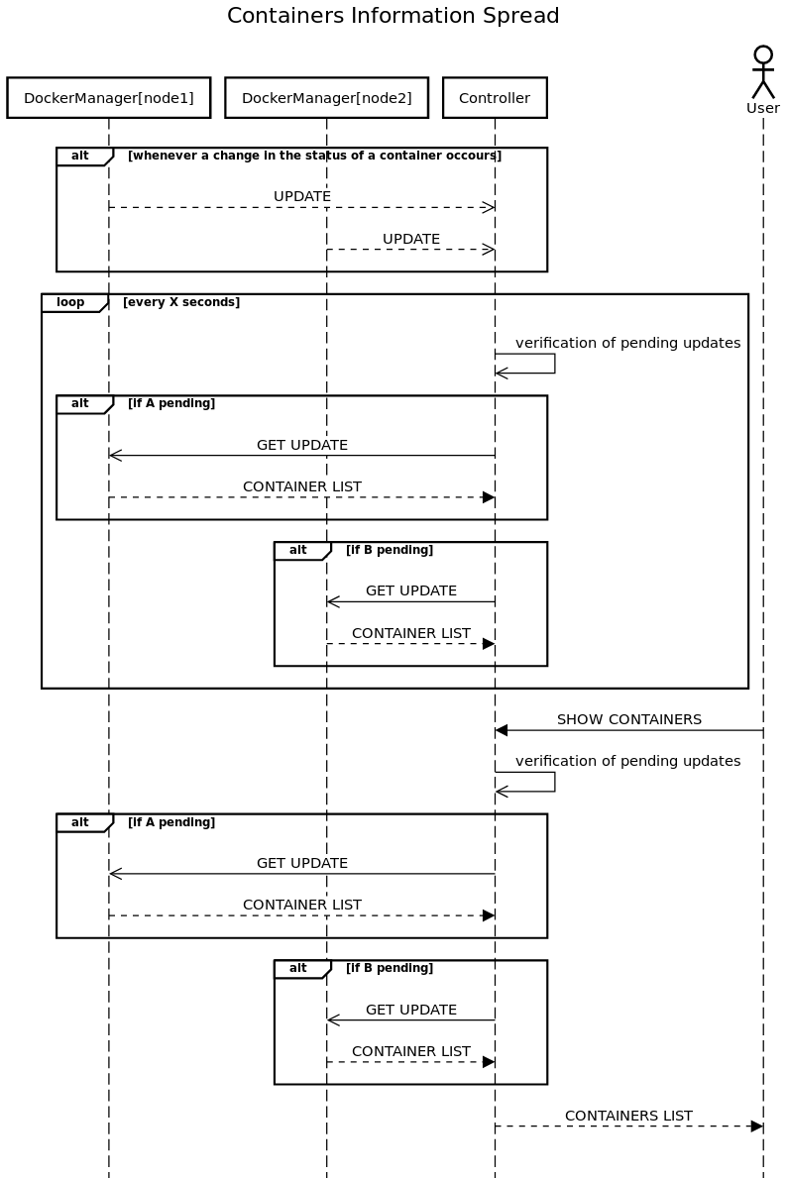
The Controller submodule
For the overall supervision of the platform, the Controller submodule was developed to manage the information exchange in the HMS
Updates will be sent by the Managers
The Controller tracks the Managers with pending updates
After a defined period, the Controller requests the monitoring log
The Controller updates the REST interface
with the container list and info

Slide 9
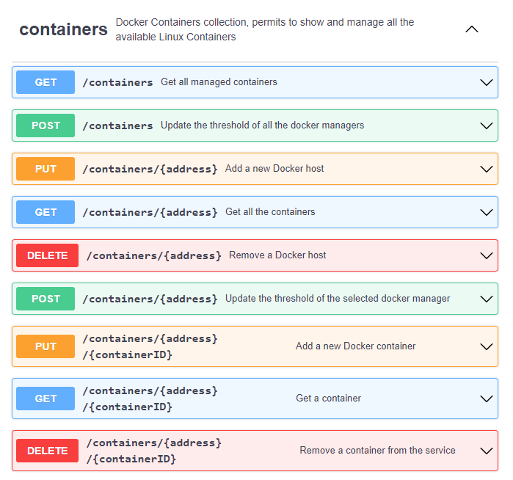
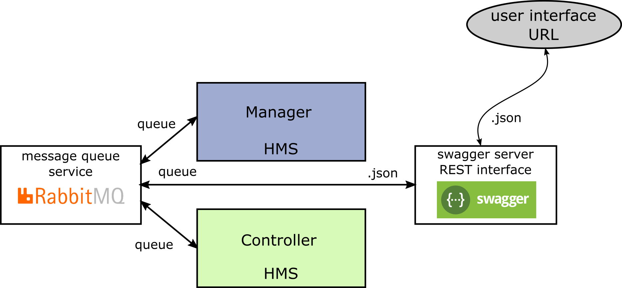
The Interface submodule
Health Monitoring System (HMS) user interface
From the developed REST interface, the user can obtain the list of running container and their status
Also, from, the available commands, the user may set the parameters for the system monitoring, such as the packet loss threshold and the ignored containers
All this information is passed through the Controller and is transmitted using the message queue system

Slide 10

Communications

Slide 11
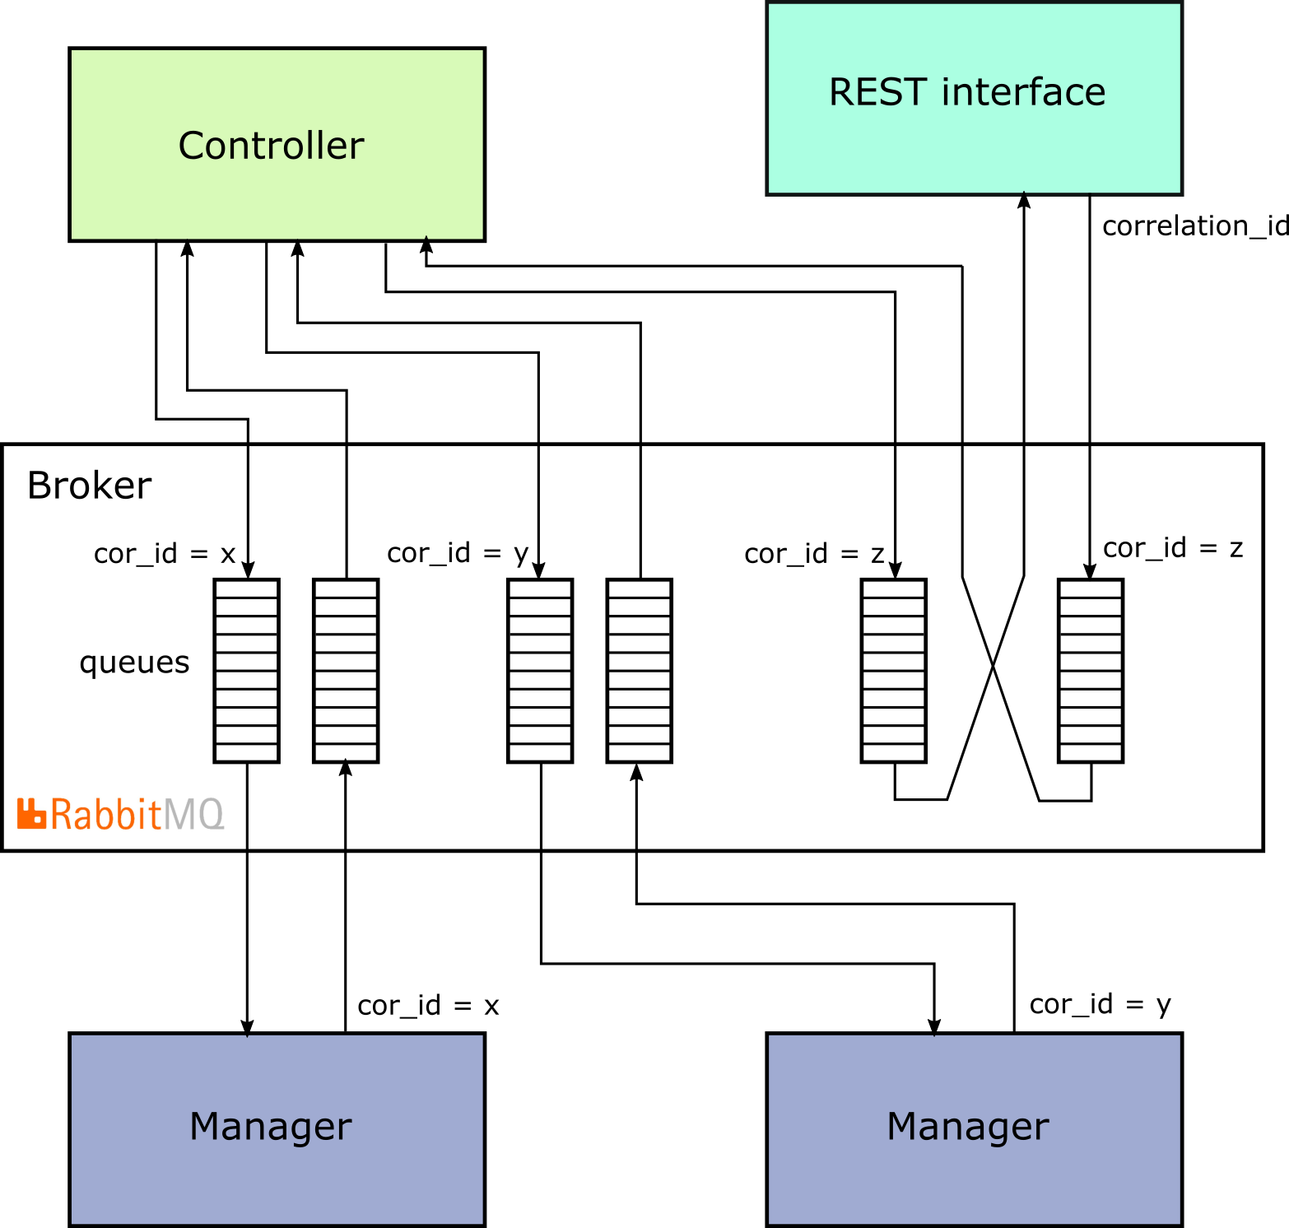
Communications Overall
For the communication we have used a RabbitMQ message broker
Each RabbitMQ client consists of two different queues, one to receive the requests from the other modules and the other the receive replies to the module requests
Communication between the module can be asynchronous or synchronous

Slide 12
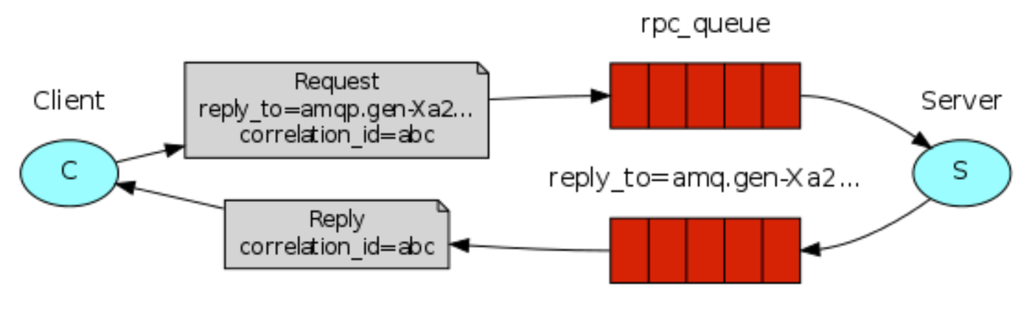
Synchronized Messaging
To implement the synchronous communications we have used a mechanism based on a callback channel
The callback channel is used to receive the reply to a request
Each request and reply have a correlation id associated which is used from the client to identify the origin request and forward the response to the correct thread

Slide 13

Optimizations

Slide 14
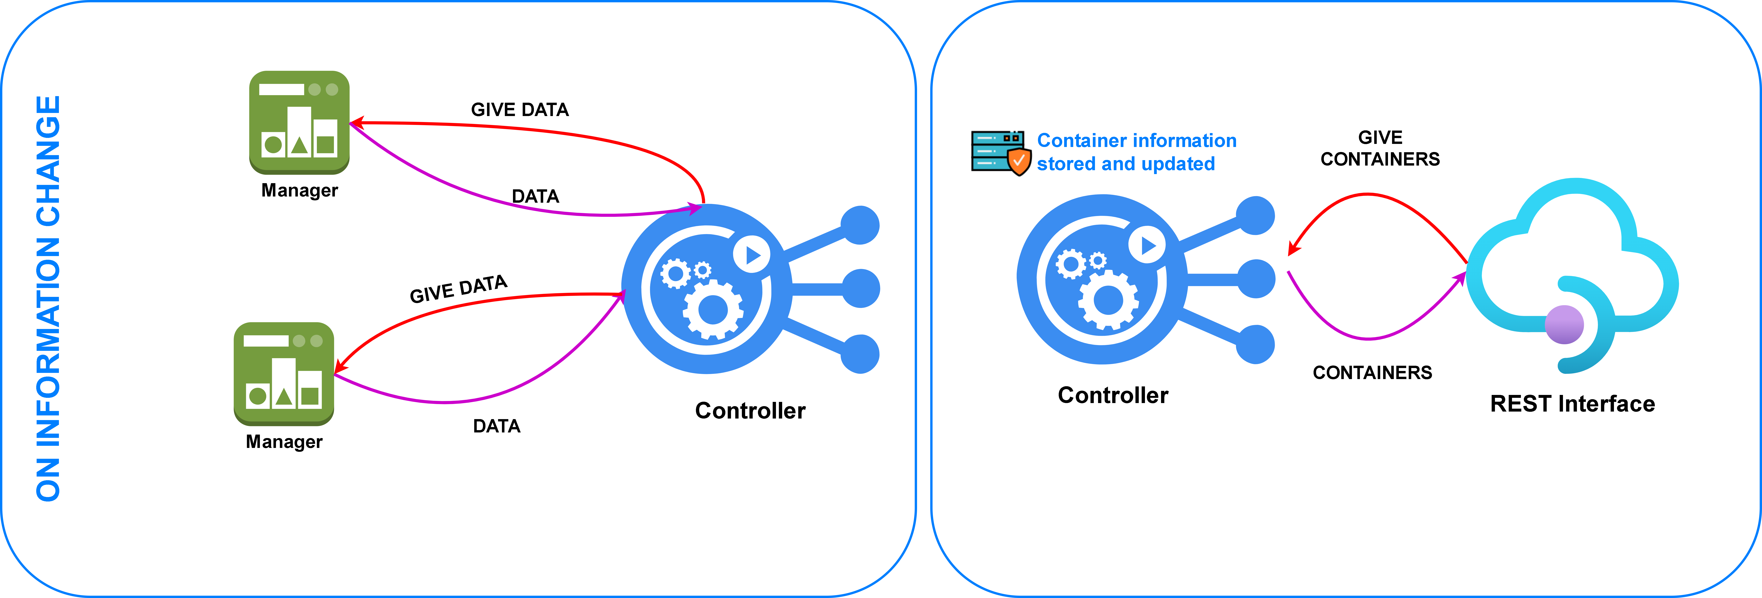
Asynchronous Information Update
To increase system performance it is important to avoid involving as many components as possible
For the containers information we have introduced a caching mechanism, in this way the controller can respond directly to a request without get the data from all the managers
The controller is responsible for keeping an up-to-date copy of all container information

Slide 15
Update Management
For testing purpose we have decided to implement an aggregation mechanism for the updates management
Updates will be sent by the Managers
The Controller tracks the Managers with pending updates
After a defined period, the Controller requests the monitoring log
The Controller updates the REST interface
with the container list and info

Slide 16

Testing

