Slide 1
IP Addresses:
Classless Addressing
Objectives
Upon completion you will be able to:
Understand the concept of classless addressing
Be able to find the first and last address given an IP address
Be able to find the network address given a classless IP address
Be able to create subnets from a block of classless IP addresses
Understand address allocation and address aggregation

Slide 2
5.1 VARIABLE-LENGTH BLOCKS
In classless addressing variable-length blocks are assigned that belong to no class. In this architecture, the entire address space (2³² addresses) is divided into blocks of different sizes.

Slide 3
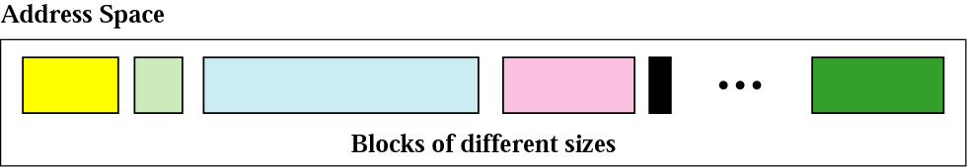
Variable-length blocks

Slide 4
Number of Addresses
Number of Addresses in a Block
There is only one condition on the number of addresses in a block; it must be a power of 2 (2, 4, 8, . . .).
A household may be given a block of 2 addresses.
A small business may be given 16 addresses.
A large organization may be given 1024 addresses.

Slide 5
Beginning Address
Beginning Address
The beginning address must be evenly divisible by the number of addresses.
For example, if a block contains 4 addresses, the beginning address must be divisible by 4.
Note: If the block has less than 256 addresses, we need to check only the rightmost byte. If it has less than 65,536 addresses, we need to check only the two rightmost bytes, and so on.

Slide 6
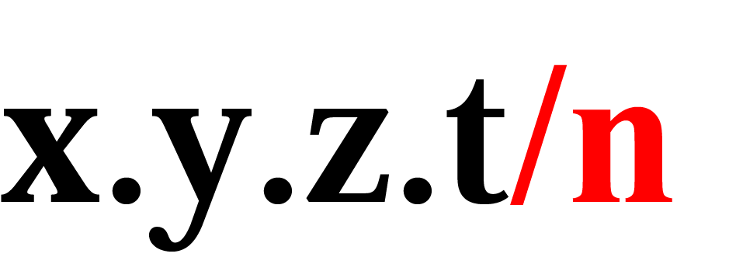
Format of classless addressing address
Prefix ->name for the common part of the address range(similar to netid)
  Prefix length->length of the prefix /n
Suffix->varying part(similar to hostid)
  Suffix length->length of the suffix (32-n) in CIDR notation

Slide 7
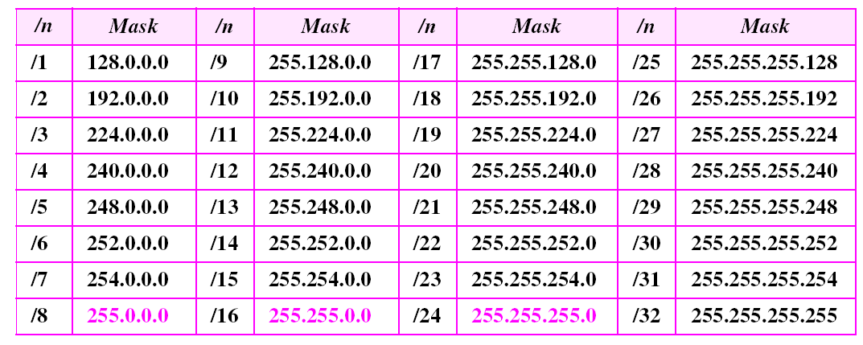
Prefix lengths

Slide 8
Problem Finding the Block
Finding the block given the classless address
  Finding the first address.
  Finding number of addresses
  Finding the last address

Slide 9
Network Addresses
In IPv4 addressing, a block of addresses can be defined as x.y.z.t /n,in which x.y.z.t defines one of the addresses and the /n defines the mask.
The first address in the block can be found by setting the rightmost 32 − n bits to 0s.
The last address in the block can be found by setting the rightmost 32 − n bits to 1s.

Slide 10
Example 3
A block of addresses is granted to a small organization. We know that one of the addresses is 205.16.37.39/28. What is the first address in the block?
Solution
The binary representation of the given address is
11001101 00010000 00100101 00100111
If we set 32−28 rightmost bits to 0, we get
11001101 00010000 00100101 00100000
or
205.16.37.32.
This is actually the block shown in Figure

Slide 11
Example 4
A block of addresses is granted to a small organization.
We know that one of the addresses is 205.16.37.39/28.
What is the last address in the block?
Solution
The binary representation of the given address is
11001101 00010000 00100101 00100111
If we set 32 − 28 rightmost bits to 1, we get
11001101 00010000 00100101 00101111
or
205.16.37.47
This is actually the block shown in Figure.

Slide 12
The number of addresses in the block can be found by using the formula 2³²−n.
Example 5
A block of addresses is granted to a small organization. We know that one of the addresses is 205.16.37.39/28.Find the total number of address in the block.
Solution
The value of n is 28, which means that number
of addresses is 2 ³²⁻²⁸ or 16.

Slide 13
Example 6
Another way to find the first address, the last address, and the number of addresses is to represent the mask as a 32-bit binary (or 8-digit hexadecimal) number. This is particularly useful when we are writing a program to find these pieces of information. In Example 3 the /28 can be represented as
11111111 11111111 11111111 11110000
(twenty-eight 1s and four 0s).
Find
a. The first address
b. The last address
c. The number of addresses.

Slide 14

Example 6 (continued)
Solution
a. The first address can be found by ANDing the given
addresses with the mask. ANDing here is done bit by
bit. The result of ANDing 2 bits is 1 if both bits are 1s;
the result is 0 otherwise.

Slide 15

Example 6 (continued)
b. The last address can be found by ORing the given
addresses with the complement of the mask. ORing
here is done bit by bit. The result of ORing 2 bits is 0 if
both bits are 0s; the result is 1 otherwise. The
complement of a number is found by changing each 1
to 0 and each 0 to 1.

Slide 16
Example 6 (continued)
c. The number of addresses can be found by
complementing the mask, interpreting it as a decimal
number, and adding 1 to it.

Slide 17

Note:
In classless addressing, the first address is used as network address and the last address is kept as a special address(limited broadcast address)

Slide 18
Note:
In classless addressing, the last address in the block does not necessarily end in 255.

Slide 19
Note:
In CIDR notation, the block granted is defined by the first address and the prefix length.

Slide 20
SUBNETTING
When an organization is granted a block of addresses, it can create subnets to meet its needs.
The prefix length increases to define the subnet prefix length.
Number of extra 1s in prefix length = log₂ s
or
Number of Subnets(s)=2number of extra 1s in prefix length

Slide 21
Note:
In fixed-length subnetting, the number of subnets is a power of 2.

Slide 22
Example 12
An organization is granted the block 130.34.12.64/26. The organization needs 4 subnets. What is the subnet prefix length?
Solution
We need 4 subnets, which means we need to add two more 1s (log₂ 4 = 2) to the site prefix. The subnet prefix is then /28.

Slide 23
Example 13
What are the subnet addresses and the range of addresses for each subnet if the address of the block is 130.34.12.64/26?
Solution
Figure shows one configuration.
See Next Slide

Slide 24
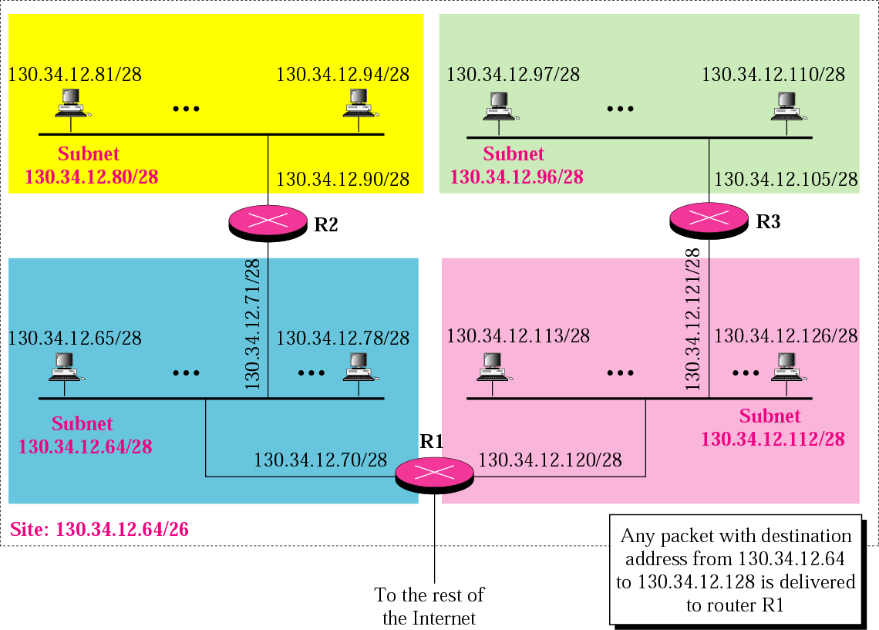
Example 13

Slide 25
Example 13 (Continued)
The site has 2³²⁻²⁶ = 64 addresses. Each subnet has 2^{32–28} = 16 addresses. Now let us find the first and last address in each subnet.
1. The first address in the first subnet is 130.34.12.64/28, using the procedure we showed in the previous examples. Note that the first address of the first subnet is the first address of the block. The last address of the subnet can be found by adding 15 (16 −1) to the first address. The last address is 130.34.12.79/28.
See Next Slide

Slide 26
Example 13 (Continued)
2.The first address in the second subnet is 130.34.12.80/28; it is found by adding 1 to the last address of the previous subnet. Again adding 15 to the first address, we obtain the last address, 130.34.12.95/28.
3. Similarly, we find the first address of the third subnet to be 130.34.12.96/28 and the last to be 130.34.12.111/28.
4. Similarly, we find the first address of the fourth subnet to be 130.34.12.112/28 and the last to be 130.34.12.127/28.

Slide 27
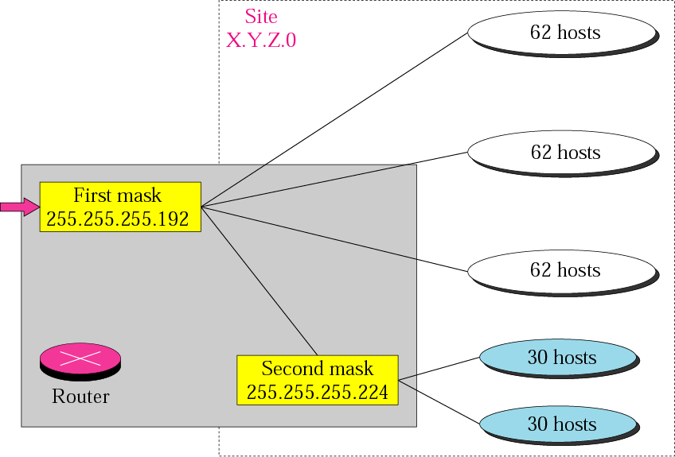
Figure 5-10
Variable-length subnetting

Slide 28
Example 14
An organization is granted a block of addresses with the beginning address 14.24.74.0/24. There are 2³²⁻²⁴= 256 addresses in this block. The organization needs to have 11 subnets as shown below:
a. two subnets, each with 64 addresses.
b. two subnets, each with 32 addresses.
c. three subnets, each with 16 addresses.
d. four subnets, each with 4 addresses.
Design the subnets.
See Next Slide For One Solution

Slide 29
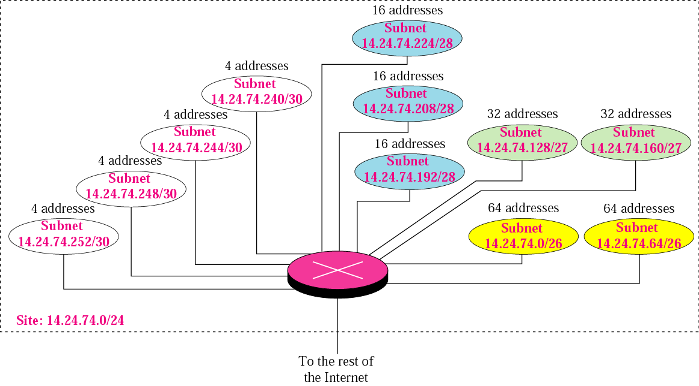
Example 14

Slide 30
Example 14 (Continuted)
1. We use the first 128 addresses for the first two subnets, each with 64 addresses. Note that the mask for each network is /26. The subnet address for each subnet is given in the figure.
2. We use the next 64 addresses for the next two subnets, each with 32 addresses. Note that the mask for each network is /27. The subnet address for each subnet is given in the figure.
See Next Slide

Slide 31
Example 14 (Continuted)
3. We use the next 48 addresses for the next three subnets, each with 16 addresses. Note that the mask for each network is /28. The subnet address for each subnet is given in the figure.
4. We use the last 16 addresses for the last four subnets, each with 4 addresses. Note that the mask for each network is /30. The subnet address for each subnet is given in the figure.

Slide 32
Example 15
As another example, assume a company has three offices: Central, East, and West. The Central office is connected to the East and West offices via private, point-to-point WAN lines. The company is granted a block of 64 addresses with the beginning address 70.12.100.128/26. The management has decided to allocate 32 addresses for the Central office and divides the rest of addresses between the two offices. Figure 5.8 shows the configuration designed by the management.
See Next Slide

Slide 33
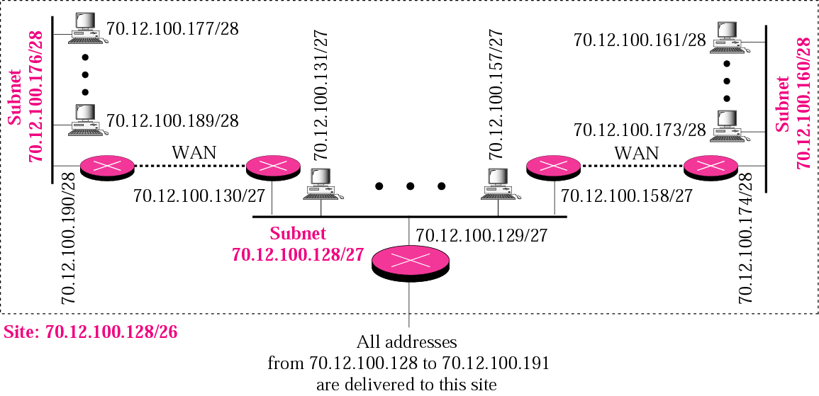
Example 15

Slide 34
Example 15 (Continued)
The company will have three subnets, one at Central, one at East, and one at West. The following lists the subblocks allocated for each network:
a. The Central office uses the network address 70.12.100.128/27. This is the first address, and the mask /27 shows that there are 32 addresses in this network. Note that three of these addresses are used for the routers and the company has reserved the last address in the sub-block. The addresses in this subnet are 70.12.100.128/27 to 70.12.100.159/27. Note that the interface of the router that connects the Central subnet to the WAN needs no address because it is a point-to-point connection.
See Next Slide

Slide 35
Example 15 (Continued)
b. The West office uses the network address 70.12.100.160/28. The mask /28 shows that there are only 16 addresses in this network. Note that one of these addresses is used for the router and the company has reserved the last address in the sub-block. The addresses in this subnet are 70.12.100.160/28 to 70.12.100.175/28. Note also that the interface of the router that connects the West subnet to the WAN needs no address because it is a point-to- point connection.
See Next Slide

Slide 36
Example 15 (Continued)
c. The East office uses the network address 70.12.100.176/28. The mask /28 shows that there are only 16 addresses in this network. Note that one of these addresses is used for the router and the company has reserved the last address in the sub-block. The addresses in. this subnet are 70.12.100.176/28 to 70.12.100.191/28. Note also that the interface of the router that connects the East subnet to the WAN needs no address because it is a point-to-point connection.

Slide 37
Example 11
A small organization is given a block with the beginning address and the prefix length 205.16.37.24/29 (in slash notation). What is the range of the block?
Solution
The beginning address is 205.16.37.24. To find the last address we keep the first 29 bits and change the last 3 bits to 1s.
Beginning:11001111 00010000 00100101 00011000
Ending : 11001111 00010000 00100101 00011111
There are only 8 addresses in this block.

Slide 38
Example 12
We can find the range of addresses in Example 11 by another method. We can argue that the length of the suffix is 32 − 29 or 3. So there are 2³ = 8 addresses in this block. If the first address is 205.16.37.24, the last address is 205.16.37.31 (24 + 7 = 31).

Slide 39
Example 13
What is the network address if one of the addresses is 167.199.170.82/27?
Solution
The prefix length is 27, which means that we must keep the first 27 bits as it is and change the remaining bits (5) to 0s. The 5 bits affect only the last byte. The last byte is 01010010. Changing the last 5 bits to 0s, we get 01000000 or 64. The network address is 167.199.170.64/27.

Slide 40
Example 14
An organization is granted the block 130.34.12.64/26. The organization needs to have four subnets. What are the subnet addresses and the range of addresses for each subnet?
Solution
The suffix length is 6. This means the total number of addresses in the block is 64 (2⁶). If we create four subnets, each subnet will have 16 addresses.

Slide 41
Solution (Continued)
Let us first find the subnet prefix (subnet mask). We need four subnets, which means we need to add two more 1s to the site prefix. The subnet prefix is then /28.
Subnet 1: 130.34.12.64/28 to 130.34.12.79/28.
Subnet 2 : 130.34.12.80/28 to 130.34.12.95/28.
Subnet 3: 130.34.12.96/28 to 130.34.12.111/28.
Subnet 4: 130.34.12.112/28 to 130.34.12.127/28.
See Figure 5.15

Slide 42
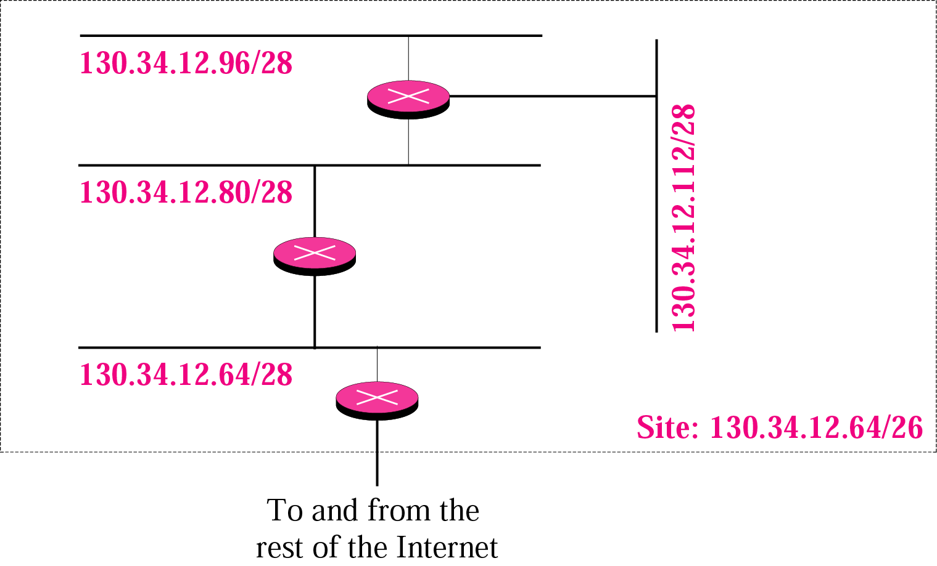
Figure 5-15
Example 14

Slide 43
ADDRESS ALLOCATION
Address allocation is the responsibility of a global authority called the Internet Corporation for Assigned Names and Addresses (ICANN). It usually assigns a large block of addresses to an ISP to be distributed to its Internet users.
Address aggregation: Many blocks of addresses are aggregated in one block and granted to one ISP

Slide 44
Example 16
An ISP is granted a block of addresses starting with 190.100.0.0/16 (65,536 addresses). The ISP needs to distribute these addresses to three groups of customers as follows:
The first group has 64 customers; each needs 256 addresses.
b. The second group has 128 customers; each needs 128 addresses
c. The third group has 128 customers; each needs 64 addresses.
Design the subblocks and find out how many addresses are still available after these allocations.
See Next Slide

Slide 45
Example 16 (Continued)
Design the subblocks and find out how many addresses are still available after these allocations.
Solution
Figure 5.9 shows the situation.
See Next Slide

Slide 46
Example 16 (Continued)
Group 1
For this group, each customer needs 256 addresses. This means the suffix length is 8 (2⁸ =256). The prefix length is then 32 − 8 = 24. The addresses are:
1st Customer 190.100.0.0/24 190.100.0.255/24
2nd Customer 190.100.1.0/24 190.100.1.255/24
. . .
64th Customer 190.100.63.0/24 190.100.63.255/24
Total = 64 × 256 = 16,384
See Next Slide

Slide 47
Example 16 (Continued)
Group 2
For this group, each customer needs 128 addresses. This means the suffix length is 7 (2⁷ =128). The prefix length is then 32 − 7 = 25. The addresses are:
1st Customer 190.100.64.0/25 190.100.64.127/25
2nd Customer 190.100.64.128/25 190.100.64.255/25
· · ·
128th Customer 190.100.127.128/25 190.100.127.255/25
Total = 128 × 128 = 16,384
See Next Slide

Slide 48
Example 16 (continued)
Group 3
For this group, each customer needs 64 addresses. This means the suffix length is 6 (26 = 64). The prefix length is then 32 − 6 = 26. The addresses are:
1st Customer 190.100.128.0/26 190.100.128.63/26
2nd Customer 190.100.128.64/26 190.100.128.127/26
· · ·
128th Customer 190.100.159.192/26 190.100.159.255/26
Total = 128 × 64 = 8,192
See Next Slide

Slide 49
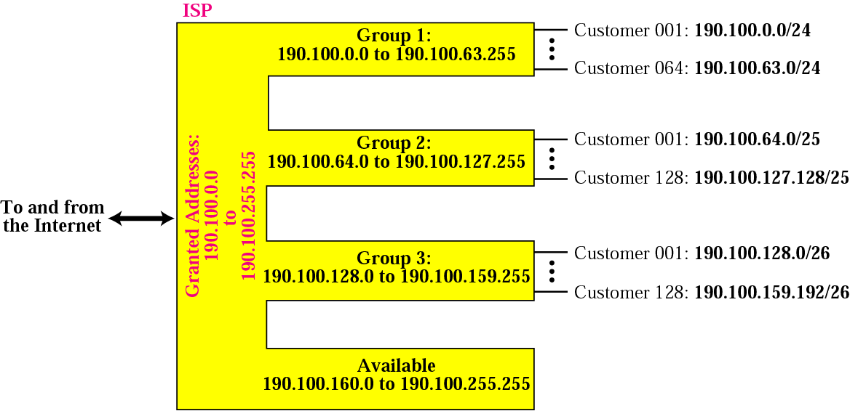
Example 16 (continued)
Number of granted addresses to the ISP: 65,536
Number of allocated addresses by the ISP: 40,960
Number of available addresses: 24,576

Slide 50
An ISP is granted a block of addresses starting with 50.80.0.0/16.
The ISP needs to distribute these blocks to 1000 customers as
follows:
-The first group has 200 medium-sized businesses; each needs
128 addresses.
-The second group has 400 small businesses; each needs 16
addresses.
-The third group has 2000 households; each needs 4
addresses.
Design the subblocks and give the slash notation for each subblock.Find out how many addresses are still available after these allocations.

