Slide 1
NETWORK TYPES

Slide 2
NETWORK TYPES
Local Area Network
Wide Area Network
Switching
The Internet
Accessing the Internet

Slide 3
NETWORK TYPES
Different types of networks.
Criteria to distinguishing one type of network from another are
Size
Geographical coverage
Ownership

Slide 4
1. Local Area Network (LAN)
Privately owned.
Links devices in the same office, building, or campus.
Ex: Simple LAN: 2 PCs & 1 printer in home or office
Each host has an identifier, an address, that uniquely defines
the host.
Packet carries both source and destination host’s addresses.
Size is limited to a few kilometers.
Allow resources to be shared (hardware, software, or data).
It does not define the minimum or maximum number of hosts.
It use either a common cable or a switch.

Slide 5
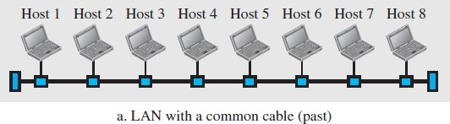
1. Local Area Network (LAN) cont..
LAN with a common cable
All hosts were connected through a common cable.
A packet was received by all hosts.
Intended recipient kept the packet.
Others dropped the packet.

Slide 6
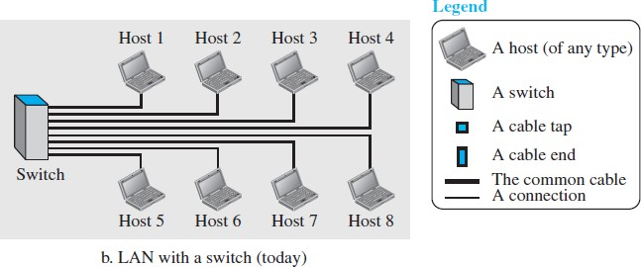
1. Local Area Network (LAN) cont..
2. LANs with a Switch
Switch
It is able to recognize the destination address.
Guide the packet to its destination without sending it to all.
It alleviates the traffic in the LAN.
It allows more than one pair to communicate with each other at the same time if there is no common source and destination among them.

Slide 7
2. Wide Area Network (WAN)
It is an interconnection of devices capable of communication.
LAN | WAN
Limited in size. | It has a wider geographical span.
Spanning an office, a building, or a campus. | Spanning a town, a state, a country, or even the world.
Interconnects hosts | Interconnects connecting devices such as switches, routers, or modems.
Privately owned by organization that uses it. | Normally created and run by communication companies and leased by an organization that uses it.
 | Examples: Point-to-point WANs and Switched WAN .

Slide 8
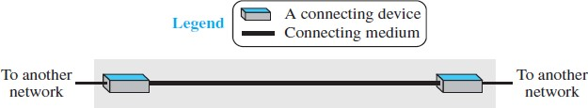
2.1 Point-to-Point WAN
Connects two communicating devices through a transmission
media (cable or air).

Slide 9
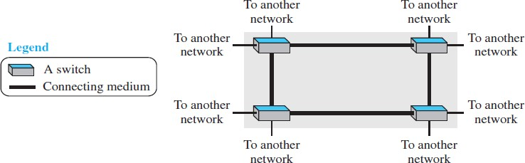
2.2 Switched WAN
Network with more than two ends.
Used in the backbone of global communication.
Combination of several point-to-point WANs that are connected by switches.

Slide 10
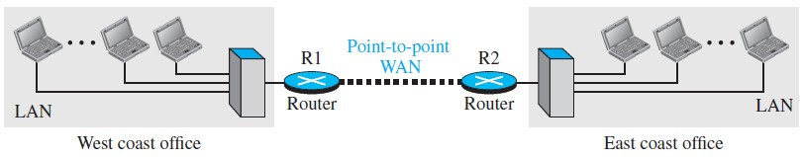
3. Internetwork
When two or more networks are connected, they make an
internetwork, or internet.
Ex: Organization has two offices.
Each office has a LAN that allows all employees to
communicate with each other.
To make communication between offices, management leases a
point-to-point dedicated WAN from a service provider, such as a
telephone company, and connects the two LANs.
Now, company has an internetwork, or a private internet.

Slide 11
3. Internetwork cont..
When a host sends a message to another host in same office, router blocks message, but switch directs message to destination.
When a host sends a message to a host on another office, router R1 routes packet to router R2, and packet reaches destination.

Slide 12
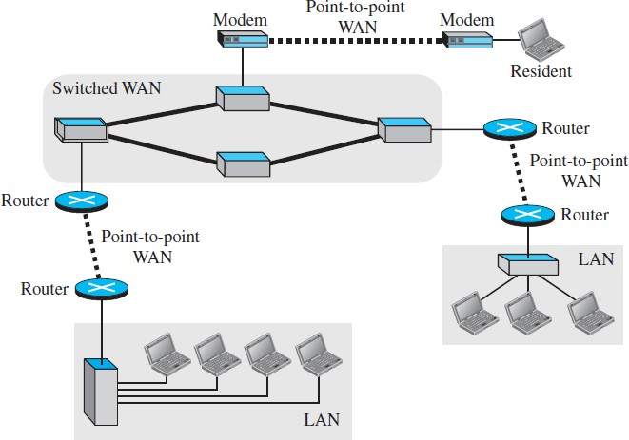
internet with several LANs and switched WANs

Slide 13
3. Switching
Switched network
In which a switch connects at least two links together.
A switch needs to forward data from a network to another network when required.
Two most common types
Circuit-switched networks
Packet-switched networks.

Slide 14
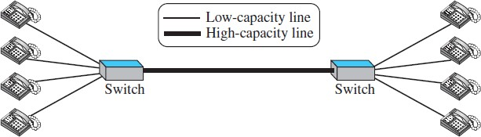
3.1 Circuit-Switched Network
A dedicated connection, called a circuit, is always available between two end systems.
Switch can only make the circuit active or inactive.
Ex: Switch connects a telephone set at one side to a telephone set at the other side.
High-capacity communication line
Connect two switches
Handle four voice communications at the same time.
Capacity - shared between all pairs of telephone sets.
Used to forwarding tasks but no storing capability.

Slide 15
3.1 Circuit-Switched Network cont..
All telephone sets are busy - capacity of thick line is fully
used.
Only one telephone at one side is connected to a telephone set at the other side - only one-fourth of the capacity of thick line is used.
Advantage:
It is efficient only when it is working at its full capacity.
Disadvantage:
It is inefficient because most of the it is working at partial capacity.

Slide 16
3.2 Packet-Switched Network
In a computer network, communication can be performed by
exchange of individual data packets between the two computers.
Source of the message sends the packets one by one.
Destination of the message receives the packets one by one.
Destination waits for all packets belonging to the same message to
arrive before delivering the message to the upper layer.
Connecting devices need to decide how to route the packets to the
final destination.
Two different approaches to route the packets:
Datagram approach
Virtual circuit approach(connection-oriented switching)

Slide 17
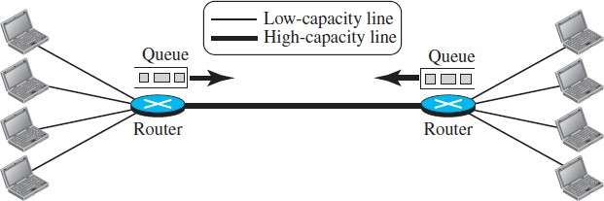
3.2 Packet-Switched Network cont..
Ex: Connection of four computers at one site to four
computers at the other site.
A router has a queue that can store and forward the packet.
It is more efficient than a circuit switched network, but packets may encounter some delays.

Slide 18
4. The Internet
Internet
– It is composed of thousands of interconnected networks.

Slide 19
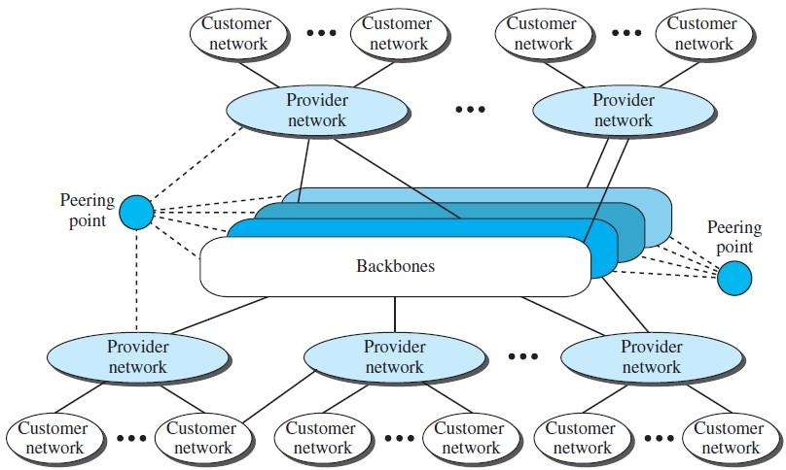
The Internet
It actually use the services provided by the Internet.
Pay fees to provider networks for receiving
services.
Large networks.
Owned by some communication companies such as Sprint, Verizon (MCI), AT&T, and NTT.
Often referred as international ISPs.
Complex switching system
Connect Backbones networks
Smaller networks
Use - services of backbones
for a fee.
Connected to backbones and sometimes to other provider networks.
Often referred as national or
regional ISPs.
Dr.C.

Slide 20
5. Accessing the Internet
Internet is an internetwork that allows any user to become part
of it.
User needs to be physically connected to an ISP.
Physical connection is done through a point-to-point WAN.
Using Telephone Networks
Using Cable Networks
Using Wireless Networks
Direct Connection to the Internet

Slide 21
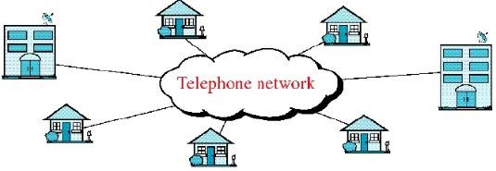
5.1 Using Telephone Networks
To connect to the Internet
– Change the voice line between residence or business and telephone center to a point-to-point WAN.
This can be done in two ways.
Dial-up service
2. DSL Service
Most telephone networks have connected to the Internet.
Most residences and small businesses are connected to a telephone network to get telephone service.

Slide 22
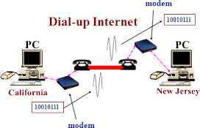
5.1.1 Dial-up service
A modem is added to telephone line that converts data to voice.
Software installed on the computer dials the ISP and imitates making a telephone connection.
Disadvantage:
Line cannot be used for telephone (voice) connection if it is
used for Internet connection.
Only useful for small residences.
It is very slow.

Slide 23
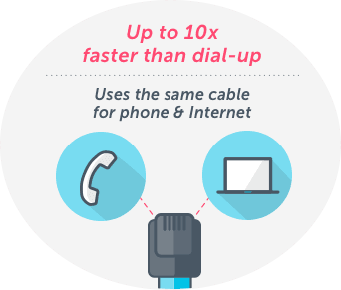
5.1.2 DSL Service
Digital Subscriber Line
Telephone companies developed DSL technology to provide higher speed Internet services to residences or small businesses.
Line can be used simultaneously for voice and data
communication.
List of DSL Internet Providers
AT&T - DSL speeds up to 5–100 Mbps
CenturyLink - 1-100 Mbps
Frontier - 6–115 Mbps
Verizon - 0.5–15 Mbps
Windstream - 25–100 Mbps

Slide 24
5.2 Using Cable Networks
To receive TV broadcasting, more residents using cable TV
services.
Cable companies connecting their cable networks and to the Internet.
A residence or a small business can be connected to the Internet by using this service.
It provides a higher speed connection, but the speed varies
depending on number of neighbors that use the same cable.

Slide 25
5.3 Using Wireless Networks
With the growing wireless WAN access, a household or a small business can be connected to the Internet through a wireless WAN.

Slide 26
5.4 Direct Connection to the Internet
A large organization or a large corporation can itself become a
local ISP and be connected to the Internet.
This can be done if the organization or the corporation leases a high-speed WAN from a carrier provider and connects itself to a regional ISP.
Ex: A large university with several campuses can create an internetwork and then connect the internetwork to the Internet.

