Slide 1
Cloud Computing Service Architectures
V. Arun
College of Computer Science
University of Massachusetts Amherst

Slide 2
Common cloud computing models
Service models:
IaaS: Infrastructure as a Service
e.g., Amazon EC2, Microsoft Azure, Google Compute Engine
PaaS: Platform as a Service
e.g., Google AppEngine, Heroku, Apache Stratos
SaaS: Software as a Service
Microsoft Office365, Amazon DynamoDB, gmail

Slide 3
Cloud infrastructure management
Management models:
Public clouds
Utility model
Shared hardware
No control of hardware,
Self-managed (e.g., AWS, Azure, GCE)
Private clouds:
More isolated (secure?),
Federal compliance friendly
Customizable hardware and hardware sharing
Example: OpenStack, an open source platform for virtualized clouds

Slide 4
Virtualization: key to cloud boom
Physical machine virtualization
Full virtualization: masking as physical machine to guest
Para-virtualization: Semi-transparent to guest
Virtualization goes well beyond CPU or physical machines
Virtualized I/O (Elastic Block Storage)
Virtual private networks
Containers (e.g., AWS or Google Container Service)
Virtual switches/routers with software-defined networking (SDN)
Network function virtualization (NFV) forwarding-plane services

Slide 5
Cloud pricing models
Market-driven: variety of pricing models for each of IaaS, PaaS, SaaS service models
Let’s ask some questions:
How much does an hour of computing on a commodity core cost today?
How much does transferring 1GB of data over a wide-area network cost today?
How much does 1GB of storage for a month cost today?
Let’s find out what the market looks like today!

Slide 6
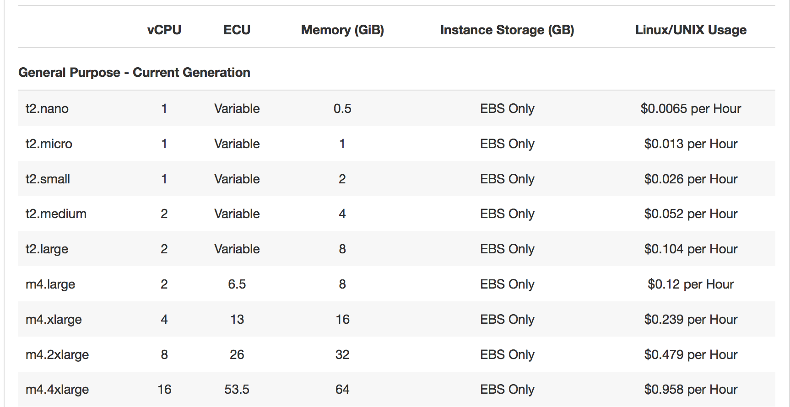
EC2 compute pricing
Do these numbers match our intuition based on market prices for computers and peripherals?

Slide 7
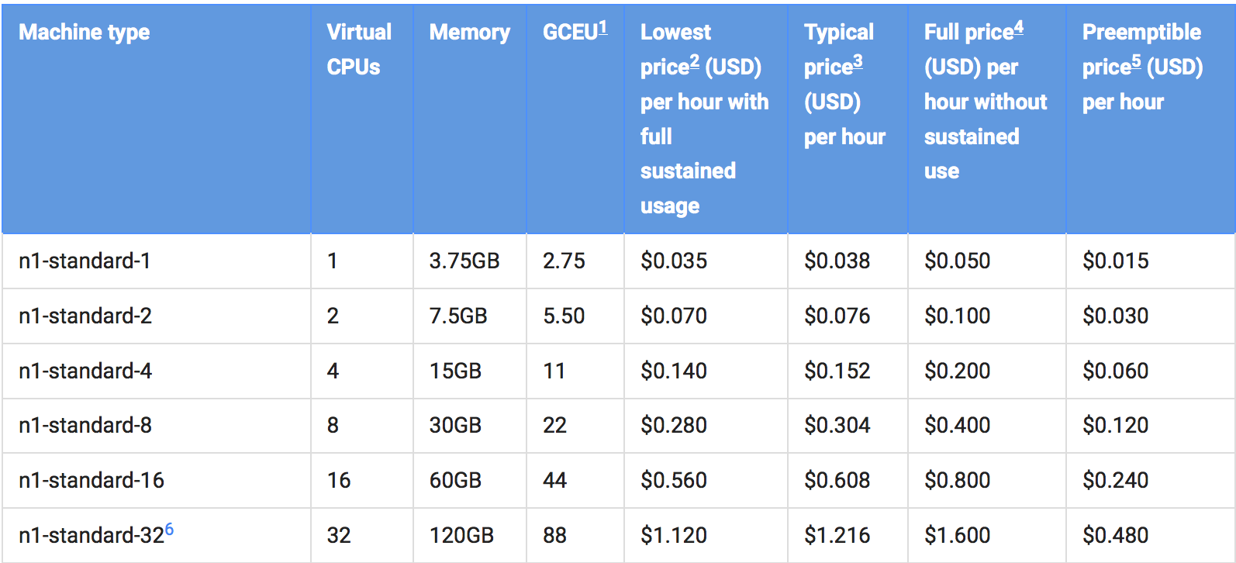
Google Cloud compute pricing

Slide 8
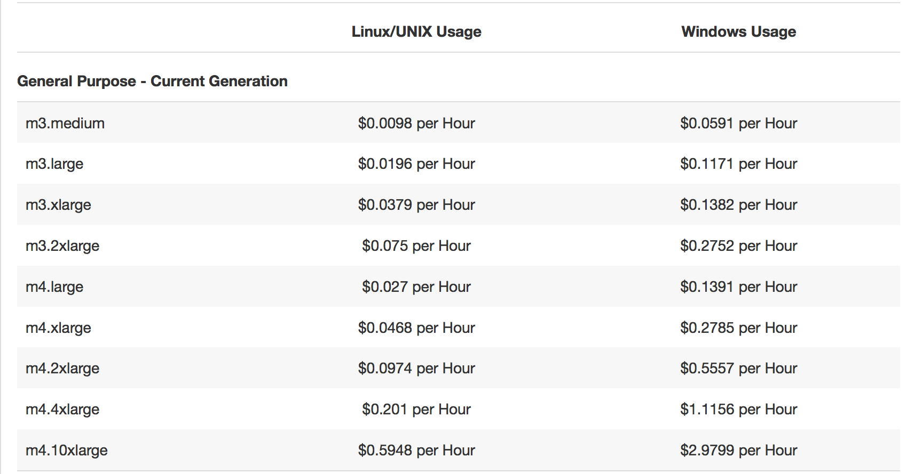
Spot pricing: market inside a cloud

