Slide 1
Transaction Management

Slide 2
What is a Transaction?
A logical unit of work on a database
  An entire program
  A portion of a program
  A single command
The entire series of steps necessary to accomplish a logical unit of work
Successful transactions change the database from one CONSISTENT STATE to another
(One where all data integrity constraints are satisfied)

Slide 3
Transaction (Cont..)
What is a transaction?
A transaction is an executing program that forms a logical
unit of database processing.
insert/update/delete/retrieval – are transactions
Only retrievals – read-only transaction
Otherwise, read-write transaction
Transaction can be Embedded in application program OR
Can be Specified interactively by SQL (or other high level
query language)

Slide 4
Transactions ….
Single-User System:
  At most one user at a time can use the system.
Multiuser System:
  Many users can access the system concurrently.
Concurrency
  Interleaved processing:
    Concurrent execution of processes is interleaved in a single CPU
  Parallel processing:
    Processes are concurrently executed in multiple CPUs.

Slide 5
Example of Transaction processing system
Airline reservation system,
Railway reservation system,
Banking system,
Credit card processing system,
Online retail purchasing system,
Stock markets database system,
Supermarket checkouts system &
the likes

Slide 6
Example of a Transaction
Updating a Record
  Locate the Record on Disk
  Bring record into Buffer
  Update Data in the Buffer
  Writing Data Back to Disk

Slide 7
Features & Requirements of
Transaction processing system
Features
Large database &
Hundreds of concurrent users!
Requirements
High availability &
Fast response time

Slide 8
Transaction on a bank database
Transaction T₁
Transfer Rs.50000/- from a/c no. 1259 to a/c no 3245.
Transaction T₂
Checking balance in a/c no. 3245.
Transaction T₃
Deposit Rs.70000/- into a/c no. 3245.

Slide 9
Transactions on university database
Transaction T₄
Register courses for the next semester
Transaction T₅
View attendance status
Transaction T₆
View semester results
Transaction T₇
Withdraw from a course

Slide 10
4 Properties of a Transaction
Atomic – All or Nothing
All parts of the transaction must be completed and committed or it must be aborted and rolled back
Maintained by Transaction Management Component
Consistency
Each user is responsible to ensure that their transaction (if executed by itself) would leave the database in a consistent state
Responsibility of Application Programmer

Slide 11
4 Properties of a Transaction
Isolation
It indicates that action performed by a transaction will be hidden from outside the transaction until the transaction terminates.
Managed by Concurrency Control Manager
Durability
If a transaction has been committed, the DBMS must ensure that its effects are permanently recorded in the database (even if the system crashes)
Responsibility of Recovery Manager
(ACID properties of transaction)

Slide 12
Transaction Management with SQL
SQL Statements → Commit / Rollback
When a transaction sequence is initiated it must continue through all succeeding SQL statements until:
  A Commit Statement is Reached
  A Rollback Statement is Reached
  The End of the Program is Reached (Commit)
  The Program is Abnormally Terminated (Rollback)

Slide 13
Transaction Log
Keeps track of all transactions that update the database
  Record for the beginning of the transaction
  Type of operation (insert / update / delete)
  Names of objects/tables affected by the transaction
  Before and After Values for Updated Fields
  Pointers to Previous and Next Transaction Log Entries for the same transaction
  The Ending of the Transaction (Commit)
Used for recovery in case of a Rollback
Notes:
A transaction log is a database – therefore it is managed by the DBMS like any other database. It is subject to database dangers like disk crashes. The transaction log contains some of the most critical data in a DBMS – attempts to reduce the risk of system failure should be implemented.

Slide 14
Data model used in transaction processing
A database is looked upon as a collection of named data items.
A data item can be
  a database record,
  value of an attribute in a database record,
  an entire table,
  the entire database,
  a disk block (disk page).
Size of data item is called granularity of data item.
Data item is also called database item.

Slide 15
Basic database access operation
read_item(X)
Reads database item named X into the program variable X.
write_item(X)
Write the value of the program variable X into the database item named X.

Slide 16
Transaction States
Because failures occurs, transaction are broken up into states to handle various situation.
Active : The initial state; the transaction stays in this state until while it is still executing.
Partially Committed : After the final statement has been executed
Failed : after the discovery that normal execution can no longer proceed
Committed : after successful completion.
Aborted : after the transaction has been rolled back the database has been restored to its state prior to the start of the transaction.

Slide 17

State diagram of a transaction

Slide 18
Representation of a transaction in terms of read and write
Transaction T₁
Transfer Rs.50000/- from a/c no. 1259 to a/c no 3245.
read_item(X);
X := X – 50000;
write_item(X);
read_item(Y);
Y:= Y + 50000;
write_item(Y);

Slide 19
System log
System maintains a log (a sequential, append only
file kept on disk).
A part of the log (last portions) reside in DBMS
cache & this part of DBMS cache is called log buffer
Records of log file look like:
[start_transaction, T]
[write_item, T, X, old_value, new_value]
[read_item, T, X]
[commit, T]
[abort, T]

Slide 20
Schedules
Schedules – sequences that indicate the chronological order in which instructions of concurrent transactions are executed
  a schedule for a set of transactions must consist of all instructions of those transactions
  must preserve the order in which the instructions appear in each individual transaction.

Slide 21

Example Schedules
Let T₁ transfer $50 from A to B, and T₂ transfer 10% of the balance from A to B. The following is a serial schedule (Schedule 1 in the text), in which T₁ is followed by T₂.

Slide 22

Cont.
Let T₁ and T₂ be the transactions defined previously. The following schedule is not a serial schedule, but it is equivalent to Schedule 1.

Slide 23

Cont.
The following concurrent schedule does not preserve the value of the the sum A + B.

Slide 24
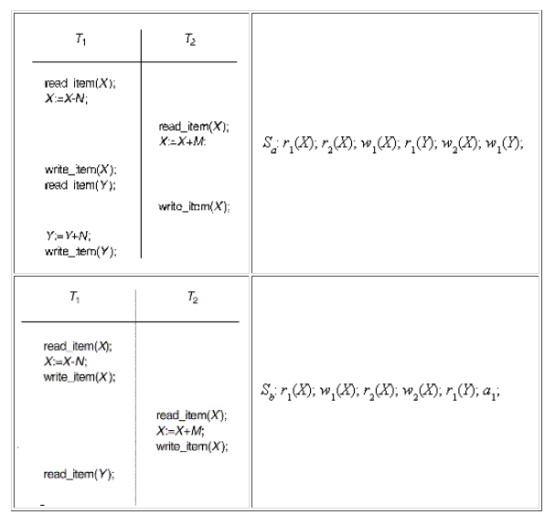

Slide 25
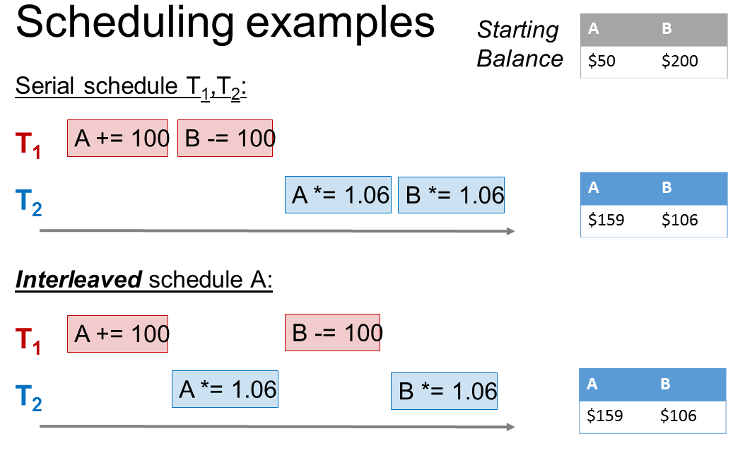

Slide 26
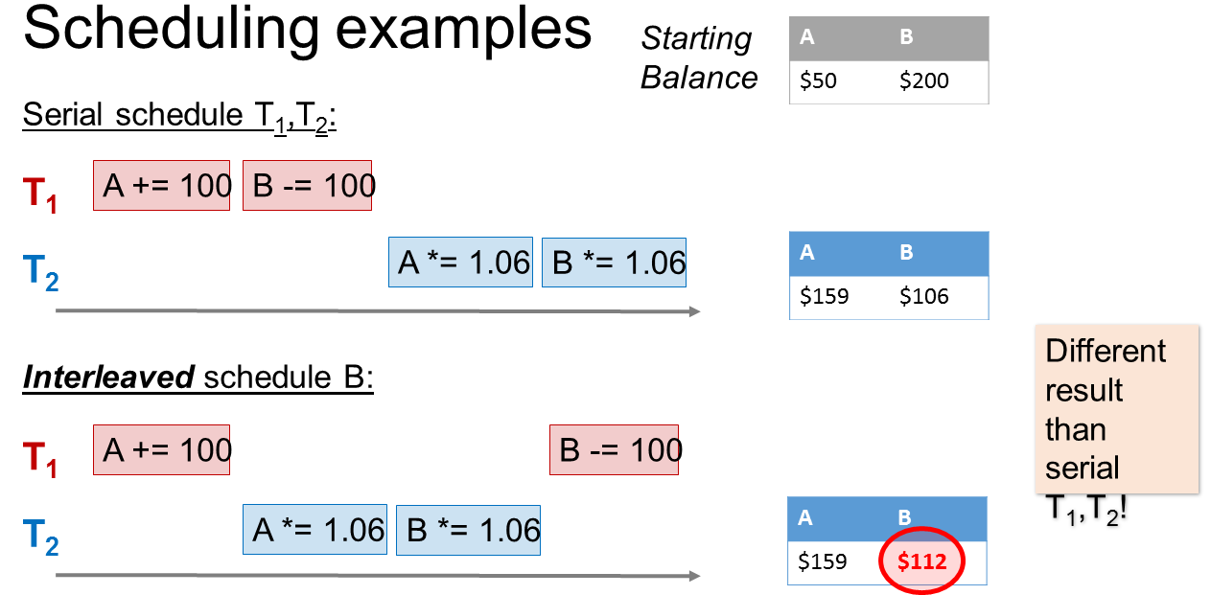

Slide 27
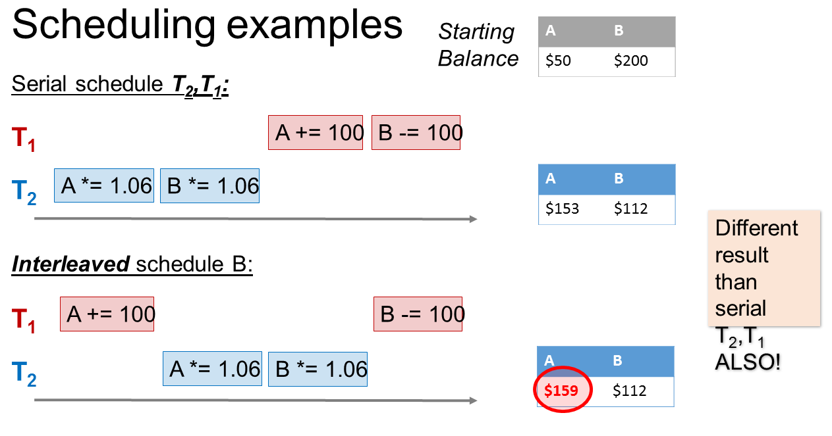

Slide 28
Concurrency Control
Coordination of simultaneous transaction execution in a multiprocessing database system
Ensure transaction serializability in a multi-user database
Lack of Concurrency Control can create data integrity and consistency problems:
  Lost Updates
  Uncommitted Data
  Inconsistent Retrievals

Slide 29
Lost Updates
Time | Jack’s Trans | Jill’s Trans | Balance
T1 | Begin
T2 | Read Balance | Begin | 1000
T3 |  | Read Balance | 1000
T4 | Bal = Bal – 50 (950) |  | 1000
T5 | Write Bal (950) | Bal = Bal + 100 (1100) | 950
T6 | Commit |  | 950
T7 |  | Write Bal (1100) | 1100
T8 |  | Commit | 1100

Slide 30
Uncommitted Data
Time | Deposit | Interest | Bal
T1 | Begin Transaction |  | 1000
T2 | Read Bal (1000) |  | 1000
T3 | Bal = Bal + 1000 (2000) |  | 1000
T4 | Write Bal (2000) | Begin Transaction | 2000
T5 |  | Read Bal (2000) | 2000
T6 |  | Bal = Bal*1.05 (2100) | 2000
T7 | Rollback |  | 1000
T8 |  | Write Bal (2100) | 2100
T9 |  | Commit | 2100

Slide 31
Serializability
Basic Assumption – Each transaction preserves database consistency.
Thus serial execution of a set of transactions preserves database consistency.
A (possibly concurrent) schedule is serializable if it is equivalent to a serial schedule.

Slide 32
Conflict Serializability
Instructions l_{i} and l_{j} of transactions T_{i} and T_{j} respectively, conflict if and only if there exists some item Q accessed by both l_{i} and l_{j}, and at least one of these instructions wrote Q.
1. l_{i} = read(Q), l_{j} = read(Q). l_{i} and l_{j} don’t conflict.
2. l_{i} = read(Q), l_{j} = write(Q). They conflict.
3. l_{i} = write(Q), l_{j} = read(Q). They conflict
4. l_{i} = write(Q), l_{j} = write(Q). They conflict

Slide 33
Conflict (conflicting operations)
Two operations in a schedule are said to conflict if they
satisfy all the three conditions viz.
Operations belong to different transactions.
Operations operate on the same data item.
At least one of the operations is a write operation.
r₁(X);w₂(X) read-write conflict,
w₁(X);w₂(X) write-write conflict
w₁(X);r₂(X) write-read conflict
Intuitively, two operations are conflicting if changing their
order may result in a different outcome.

Slide 34

Conflict Serializability (Cont.)
Schedule 3 below can be transformed into Schedule 1, a serial schedule where T₂ follows T₁, by series of swaps of non-conflicting instructions. Therefore Schedule 3 is conflict serializable.

Slide 35
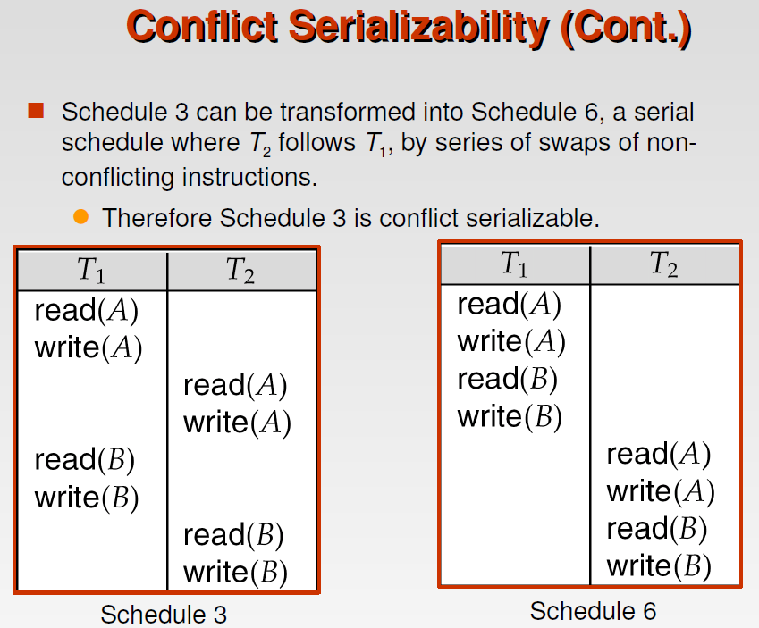

Slide 36
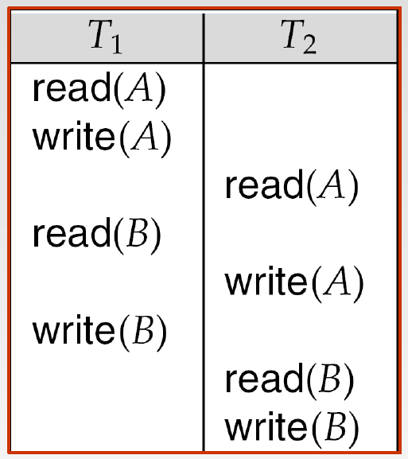
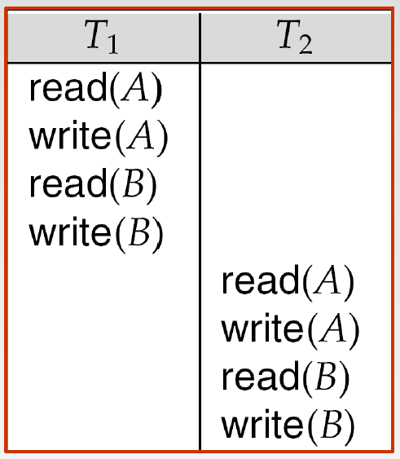

Slide 37
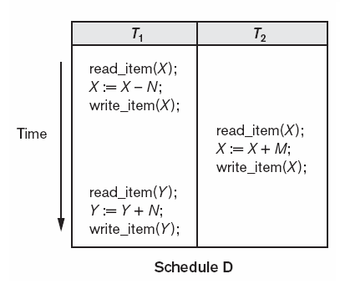
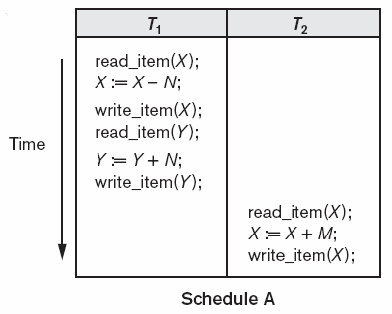
Conflict serializable schedule
A schedule is conflict serializable, if it is conflict equivalent to
a serial schedule
S_{d}:r₁(X);w₁(X);r₂(X);w₂(X);r₁(Y);w₁(Y);
S_{d} is Conflict serializable to S_{a}

Slide 38
Algorithm to test conflict serializability
1. For each transaction T_{i} participating in schedule S, create a node labeled T_{i} in the precedence graph.
2. For each case in S, where T_{i} executes a read_item(X) before T_{j} executes a write_item(X), create an edge
(T_{i} → T_{j}) in the precedence graph.
3. For each case in S, where T_{i} executes a write_item(X) before T_{j} executes a read_item(X), create an edge
(T_{i} → T_{j}) in the precedence graph.
4. For each case in S where T_{i} executes a write_item(X) before T_{j} executes a write_item(X), create an edge
(T_{i} → T_{j}) in the precedence graph.
5. The schedule S is serializable if and only if the
precedence graph has no cycle.

Slide 39
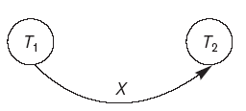
Testing conflict serializability of schedule
S_{d}:r₁(X);w₁(X);r₂(X);w₂(X);r₁(Y);w₁(Y);
r₁(X);w₂(X)
w₁(X);r₂(X)
w₁(X);w₂(X)
S_{d} is conflict serializable
Precedence graph is also called Serialization graph
Precedence graph of S_{d}

Slide 40
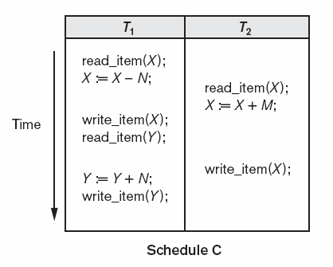
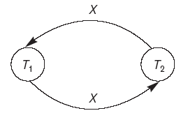
Testing conflict serializability of schedule
S_{c}:r₁(X);r₂(X);w₁(X);r₁(Y);w₂(X);w₂(Y);
r₁(X);w₂(X)
r₂(X);w₁(X)
w₁(X);w₂(X)
Precedence graph of S_{c}

Slide 41

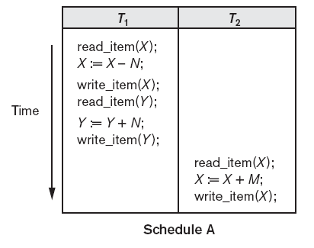
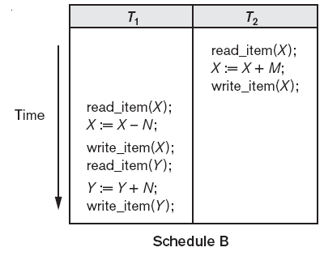
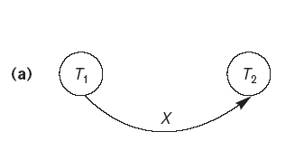
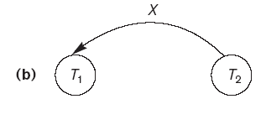

Slide 42
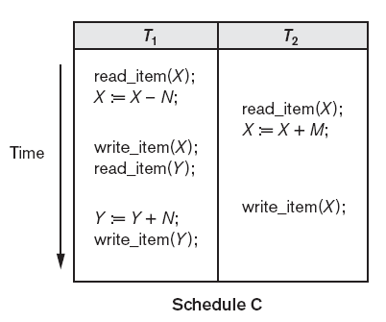
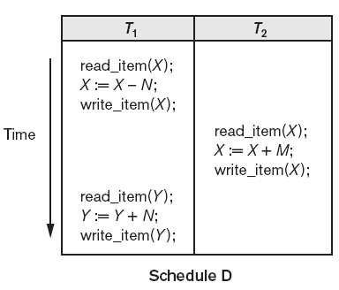
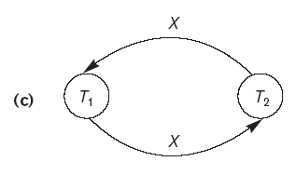
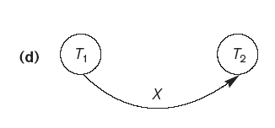

Slide 43
Locking
Lock guarantees exclusive use of data item to current transaction
Prevents reading Inconsistent Data
Lock Manager is responsible for assigning and policing the locks used by the transaction
Notes:
Most DBMS’s automatically initiate and enforce locking procedures through the lock manager

Slide 44
Locking Granularity
Indicates the level of lock use
Database Level – Entire Database is Locked
Table Level – Entire Table is Locked
Page Level – Locks an Entire Diskpage
(Most Frequently Used)
Row Level – Locks Single Row of Table
Field Level – Locks a Single Attribute of a Single Row (Rarely Done)
Notes:
Database Level – Good for batch processing, bad for multiuser databases
Table Level – the table is locked, no access to any rows in table with another transaction is using table. Caused problems with many transactions are waiting to access the same table – again not suitable for multi-user databases
Page Level – A diskpage (page) / diskblock is a directly addressable section of a disk. A page has a fixed size (4K, 8K, etc) A table can span several pages, a page can contains several rows from one or more tables.
Row Level – Much less restrictive, allows concurrent transactions to access different rows of same table → However, HIGH OVERHEAD COST because a lock must exist for every row in every table of the database
Field Level – Allows access to the same row as long as accessing different attributes. MOST flexible, HIGHEST overhead

Slide 45
Types of Locks:
Binary
Binary Locks – Lock with 2 States
  Locked – No other transaction can use that object
  Unlocked – Any transaction can lock and use object
  All Transactions require a Lock and Unlock Operation for Each
  Object Accessed (Handled by DBMS)
  Eliminates Lost Updates
  Too Restrictive to Yield Optimal Concurrency Conditions

Slide 46
Types of Locks:
Shared / Exclusive Locks
Indicates the Nature of the Lock
Shared Lock – Concurrent Transactions are granted READ access on the basis of a common lock
Exclusive Lock – Access is reserved for the transaction that locked the object
3 States: Unlocked, Shared (Read), Exclusive (Write)
More Efficient Data Access Solution
More Overhead for Lock Manager
  Type of lock needed must be known
  3 Operations:
    Read_Lock – Check to see the type of lock
    Write_Lock – Issue a Lock
    Unlock – Release a Lock
  Allow Upgrading / Downgrading of Locks

Slide 47
Problems with Locking
Transaction Schedule May Not be Serializable
  Can be solved with 2-Phase Locking
May Cause Deadlocks
  A deadlock is caused when 2 transactions wait for each other to unlock data

Slide 48
Locking Techniques for Concurrency Control
The concept of locking data items is one of the main techniques used for controlling the concurrent execution of transactions.
A lock is a variable associated with a data item in the database. Generally there is a lock for each data item in the database.
A lock describes the status of the data item with respect to possible operations that can be applied to that item. It is used for synchronising the access by concurrent transactions to the database items.
A transaction locks an object before using it.
When an object is locked by another transaction, the requesting transaction must wait.

Slide 49
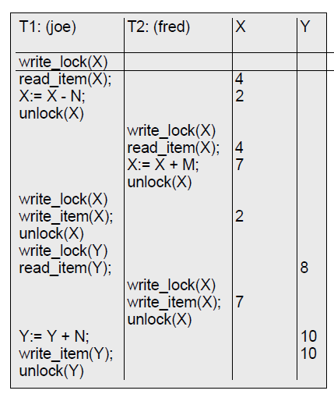
Locks don’t guarantee serialisability: Lost Update

Slide 50
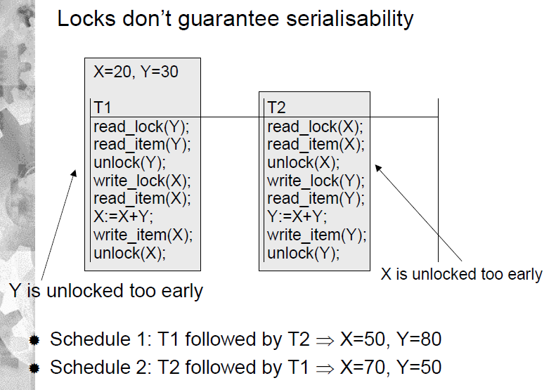

Slide 51
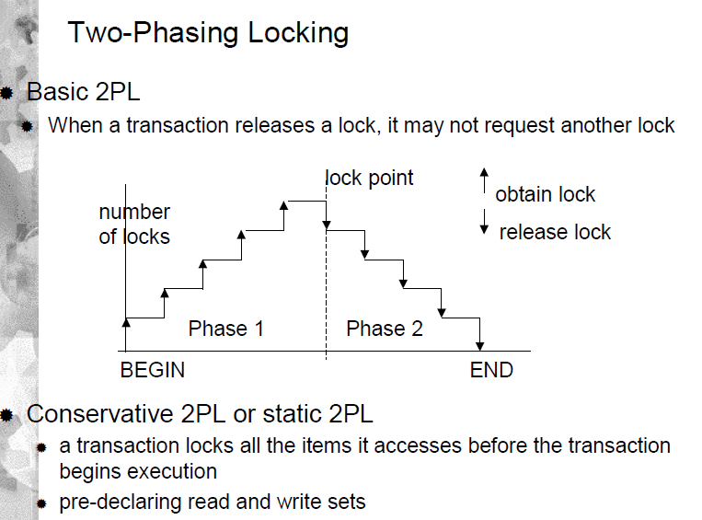

Slide 52
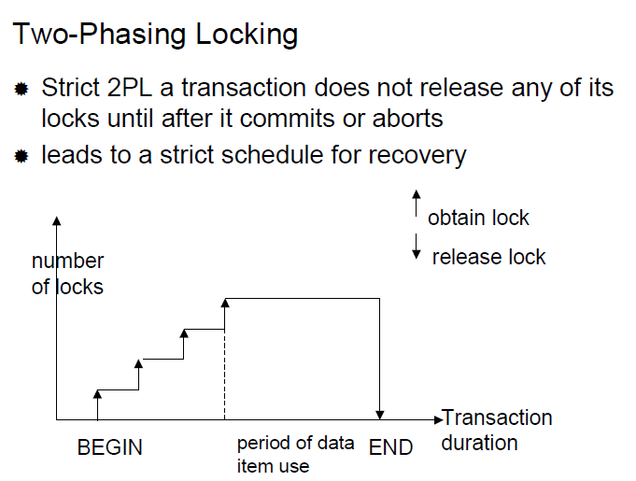

Slide 53
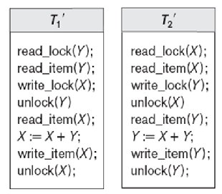
Do T’₁ & T’₂ follow C2PL?
T₁’ & T₂’ do not follow C2PL
Solution?
Swap read_item(Y) &
write_lock(X) operations in T₁’
Swap read_item(X) &
write_lock(Y) operations in T₂’
commit;
commit;

Slide 54
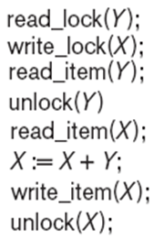
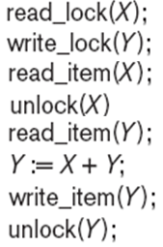
T₁’ & T₂’ modified to follow C2PL protocol
T₁’’
T₂’’

Slide 55
Two Phase Locking
Defines how transactions Acquire and Relinquish Locks
Growing Phase – The transaction acquires all locks (doesn’t unlock any data)
Shrinking Phase – The transaction releases locks (doesn’t lock any additional data)
Transactions acquire all locks it needs until it reaches locked point
When locked, data is modified and locks are released
Notes:
2 Transactions cannot have conflicting locks
No unlock operation can precede a lock operation in the same transaction
No data is modified until all locks are obtained.

Slide 56
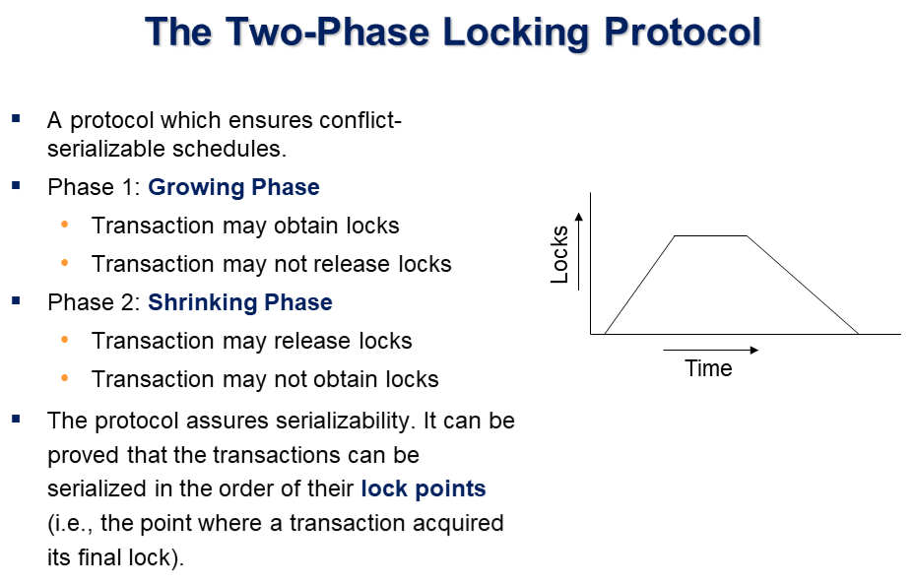

Slide 57
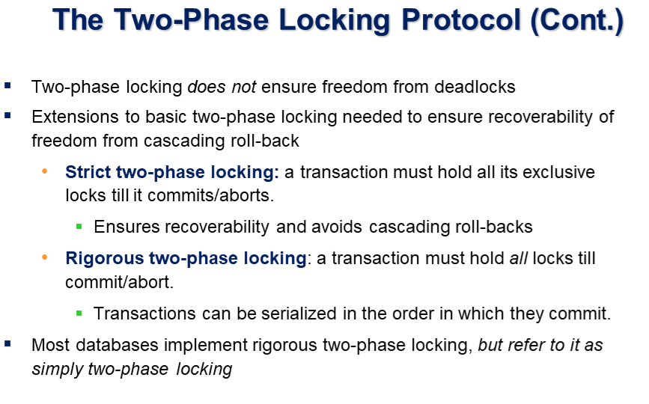

Slide 58
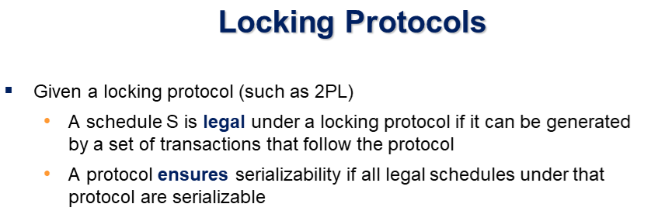

Slide 59
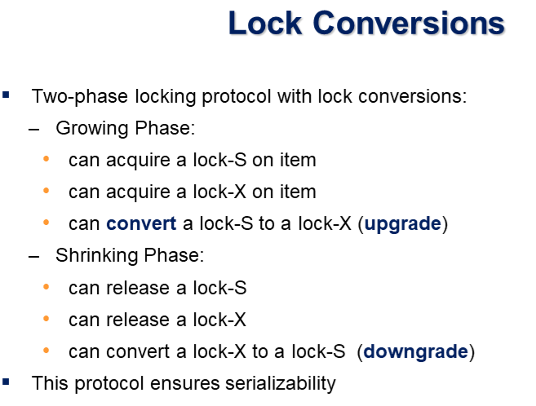

Slide 60
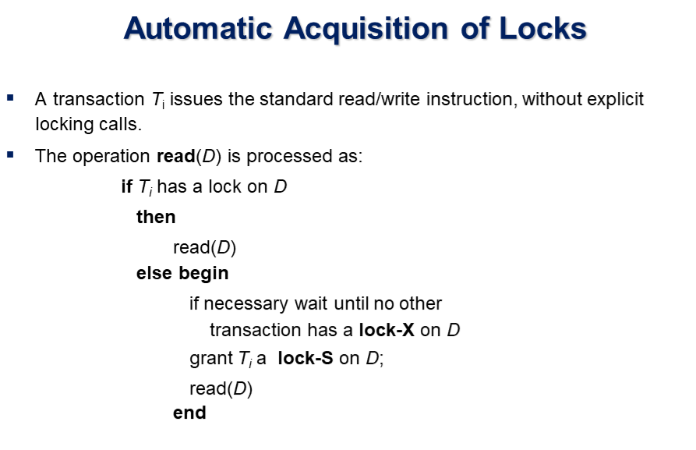

Slide 61
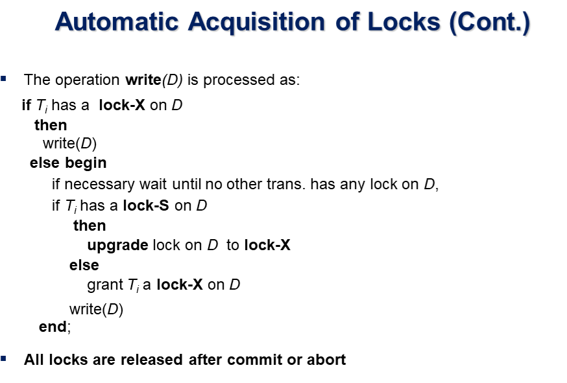

Slide 62
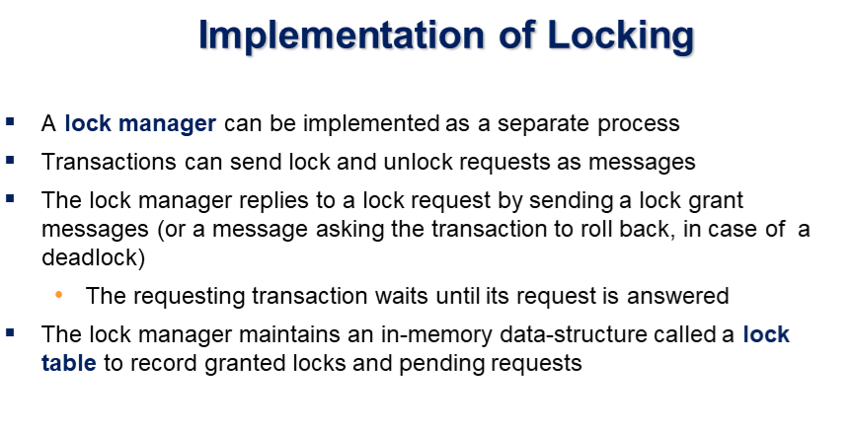

Slide 63

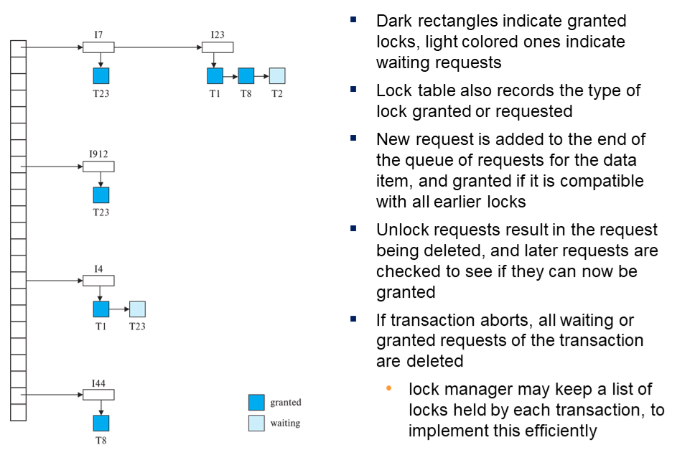

Slide 64
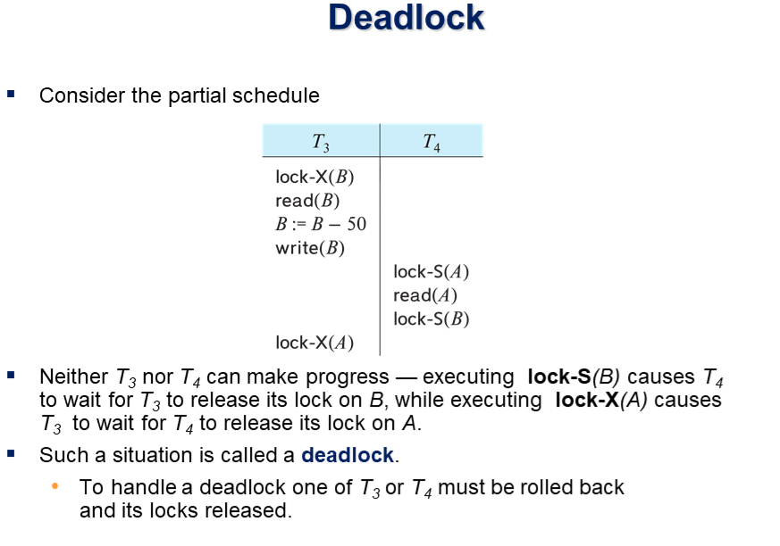

Slide 65
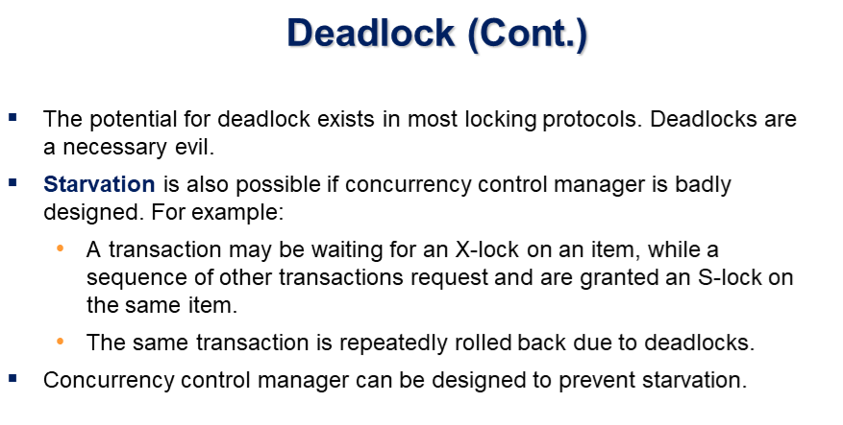

Slide 66
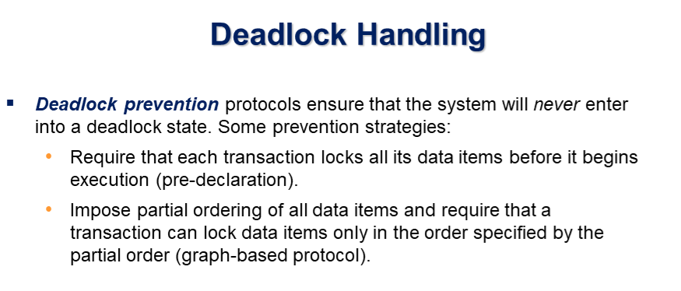

Slide 67
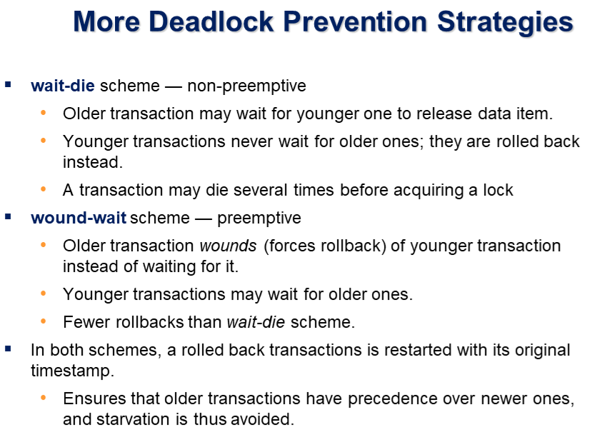

Slide 68
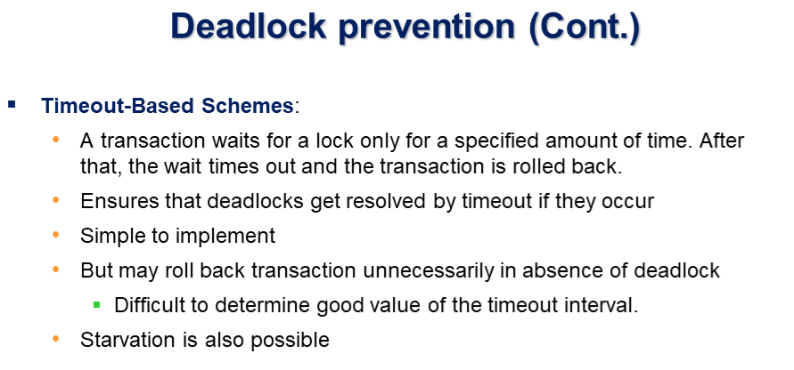

Slide 69
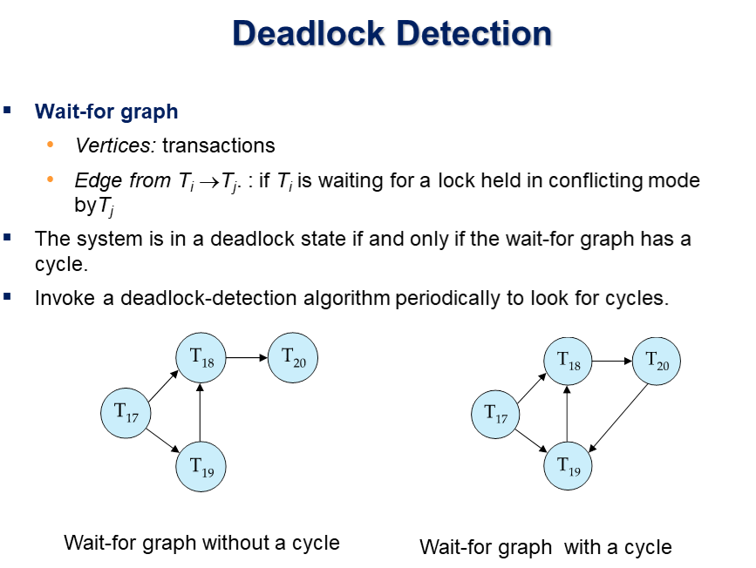

Slide 70
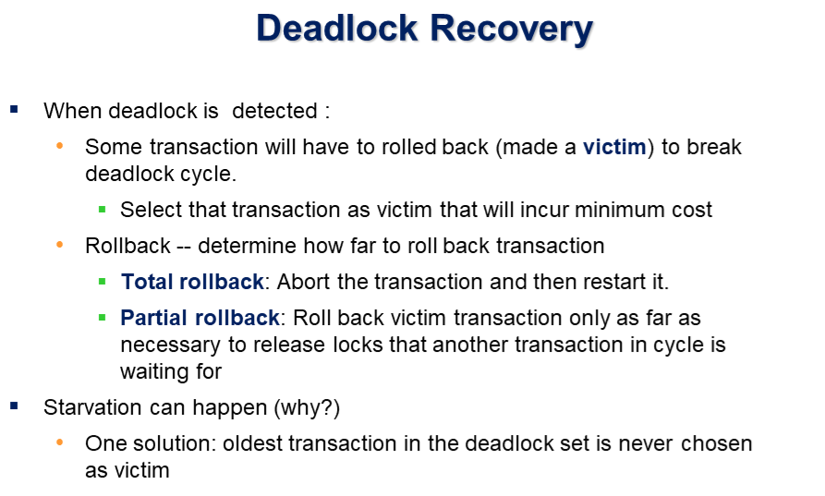

Slide 71
Two-Phase Commit Protocol
Distributed databases make it possible for a transaction to access data at several sites
Final COMMIT must not be issued until all sites have committed their parts of the transaction
Two-phase commit protocol requires each individual DP’s transaction log entry be written before the database fragment is actually updated

Slide 72
Two-Phase Commit Protocol
DO-UNDO-REDO protocol is used by the DP to roll back and/or roll forward transactions with the help of the system’s transaction log entries
  DO performs the operation and records the “before” and “after” values in the transaction log
  UNDO reverses an operation, using the log entries written by the DO portion of the sequence
  REDO redoes an operation, using the log entries written by the DO portion of the sequence
  To ensure that the DO,UNDO and REDO operations can survive a system crash while they are being executed, a write-ahead protocol is used
    This forces the log entry to be written to permanent storage before the actual operation takes place

Slide 73
Two-Phase Commit Protocol
The two-phase commit protocol defines the operations between two types of nodes – the coordinator and one or more subordinates
Phase I: Preparation
  The coordinator sends a PREPARE TO COMMIT message to its subordinates
  The subordinates receive the message, write the transaction log using the write-ahead protocol, and send an acknowledgement (YES/PREPARED TO COMMIT or NO/NOT PREPARED) message to the coordinator
  The coordinator makes sure that all nodes are ready to commit or it aborts the action

Slide 74
Two-Phase Commit Protocol
Phase II: The Final COMMIT
  The coordinator broadcasts a COMMIT message to all subordinates and waits for replies
  Each subordinate receives the COMMIT message, then updates the database using the DO protocol
  The subordinates reply with a COMMITTED or NOT COMMITTED message to the coordinator
  If one or more subordinates did not commit, the coordinator sends an ABORT message, forcing them to UNDO all changes
    The information necessary to recover the database is in the transaction log and the database can be recovered with the DO-UNDO-REDO protocol

Slide 75
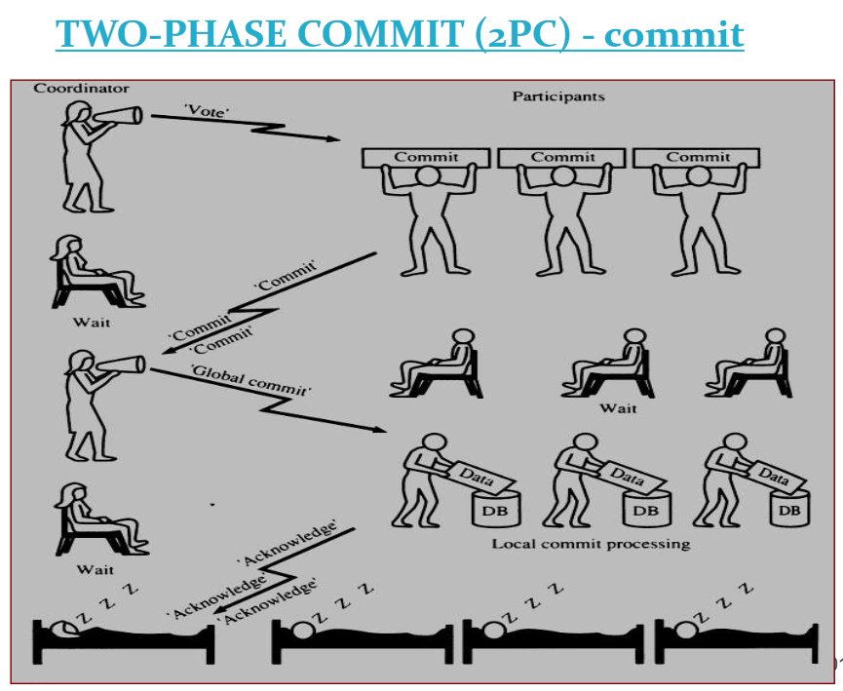

Slide 76
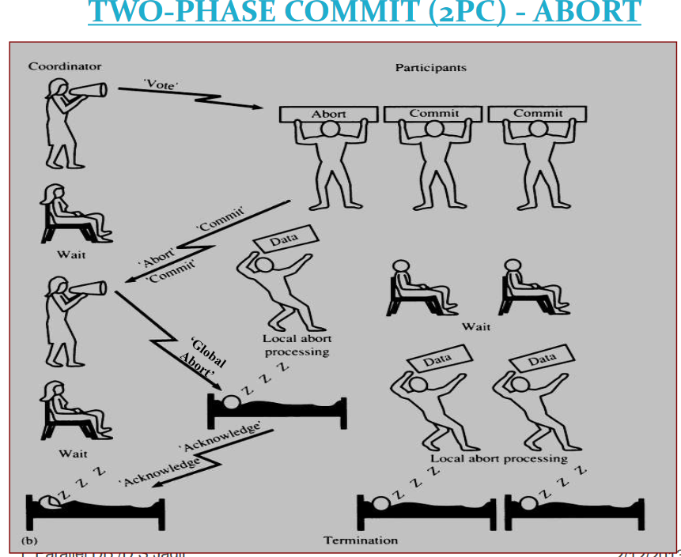

Slide 77
Deadlocks
Occur when 2 transactions exist in the following mode:
T1 = access data item X and Y
T2 = Access data items Y and X
If T1 does not unlock Y, T2 cannot begin
If T2 does not unlock X, T1 cannot continue
T1 & T2 wait indefinitely for each other to unlock data
Deadlocks are only possible if a transactions wants an Exclusive Lock (No Deadlocks on Shared Locks)

Slide 78
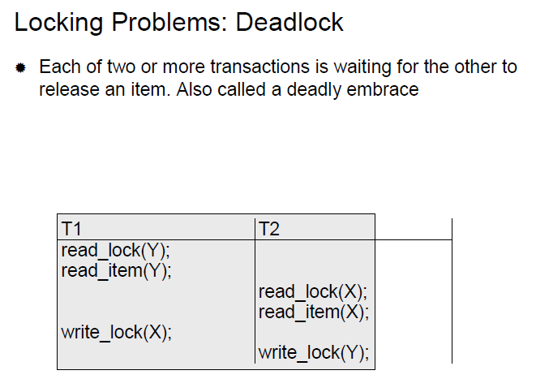

Slide 79
Controlling Deadlocks
Prevention – A transaction requesting a new lock is aborted if there is the possibility of a deadlock – Transaction is rolled back, Locks are released, Transaction is rescheduled
Detection – Periodically test the database for deadlocks. If a deadlock is found, abort / rollback one of the transactions
Avoidance – Requires a transaction to obtain all locks needed before it can execute – requires locks to be obtained in succession
Notes:
Choice of best method depends on the needs and probability of deadlocks within the database

Slide 80
Database Recovery
Restore a database from a given state to a previous consistent state
Atomic Transaction Property (All or None)
Backup Levels:
  Full Backup
  Differential Backup
  Transaction Log Backup
Database / System Failures:
  Software (O.S., DBMS, Application Programs, Viruses)
  Hardware (Memory Chips, Disk Crashes, Bad Sectors)
  Programming Exemption (Application Program rollbacks)
  Transaction (Aborting transactions due to deadlock detection)
  External (Fire, Flood, etc)

Slide 81
Transaction Recovery
Recover Database by using data in the Transaction Log
Write-Ahead-Log – Transaction logs need to be written before any database data is updated
Redundant Transaction Logs – Several copies of log on different devices
Database Buffers – Buffers are used to increase processing time on updates instead of accessing data on disk
Database Checkpoints – Process of writing all updated buffers to disk → While this is taking place, all other requests are not executes
  Scheduled several times per hour
  Checkpoints are registered in the transaction log

