Slide 1
4NF and 5NF

Slide 2
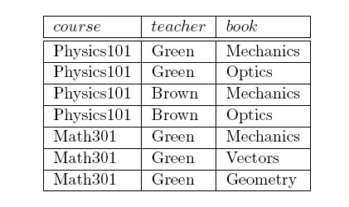
A BCNF table with data redundancy
K = {course, teacher, book}
An all key relation.
Schema is in BCNF but
it has data redundancy.

Slide 3
Multi-valued dependency
Course Teacher
Course Book
Whenever two one to many (1:N) relationships are combined into a single table, you encounter
multi-valued functional dependency.

Slide 4
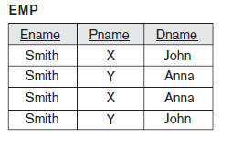
EPD table
Ename →→ Pname
Ename →→ Dname

Slide 5
Multi-valued dependency
Let R be a relation schema and X and Y are
subsets of R and Z = R – (X U Y) then
if there exists a set of values of Y for every
value of X and if Z and Y be independent of each
other then we say that X →→ Y.

Slide 6
Formal definition of MVD
If X and Y are subsets of R and Z = R – (X U Y) then
X →→ Y (read as X multi determines Y), if t₁, t₂ are
any two tuples of any state r of R such that
t₁[X] = t₂[X] then there should exist another two
tuples t₃ and t₄ such that
i) t₄[X] = t₃[X] = t₁[X] = t₂[X],
ii) t₁[Y] = t₃[Y], t₂[Y] = t₄[Y],
iii) t₁[Z] = t₄[Z], t₂[Z] = t₃[Z]
R | X | Y | Z
t₁ | a | b₁ | c₁
t₂ | a | b₂ | c₂
t₃ | a | b₁ | c₂
t₄ | a | b₂ | c₁

Slide 7
Multi-valued dependency
Let R be a relation schema and X and Y are subsets of R
and if Z = R – (X U Y) then
if X →→ Y then X →→ Z.
So we write X →→ Y | Z
A MVD X →→ Y is called a trivial MVD, if
either X is a super set of Y or X U Y = R.
A MVD which is not trivial, is called a non-trivial MVD.
If X → Y then X →→ Y. i.e. Every FD is a MVFD.

Slide 8
Fourth normal form (4NF)
A relation schema R is said to be in fourth normal form if for every non-trivial MVD
X →→ Y that holds good on R,
X is a super key of R.

Slide 9
Conversion into 4NF
If a relation schema R has a multi-valued functional dependency X →→ Y that violates 4NF requirement then replace R by two schemas
R₁(X, Y) and R₂ = R – Y

Slide 10
CTB table
CTB(Course, Teacher, Book)
Course →→ Teacher
Course →→ Book
Since Course →→ Teacher is a non-trivial MVD with its left hand side not being a super key of the schema CTB hence replace CTB by
R₁(Course, Teacher) & R₂(Course, Book)

Slide 11
CTB
R₂
R₁
course | book
Physics101 | Mechanics
Physics101 | Optics
Math301 | Mechanics
Math301 | Vector
Math301 | Geometry
course | teacher
Physics101 | Green
Physics101 | Brown
Math301 | Green

Slide 12
EMP table
EMP(Ename, Pname, Dname)
Ename →→ Pname
Ename →→ Dname
Since Ename →→ Pname is a non-trivial MVD with its left hand side not being a super key of the schema EPD hence replace EPD by
EP(Ename, Pname) & ED(Ename, Dname)

Slide 13
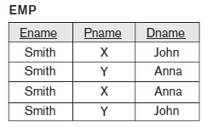
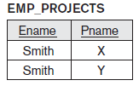
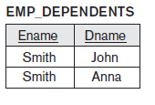
Decomposition

Slide 14
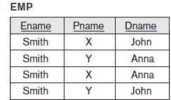
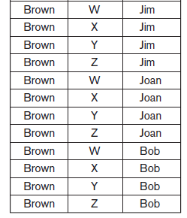
Insertion Anomaly because of multi-valued dependency
Ename = ‘Brown’
Pname = {W, X, Y, Z}
Dname = {Jim, Joan, Bob}

Slide 15
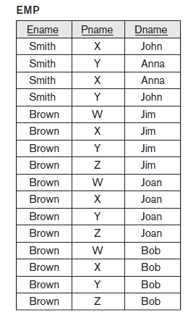
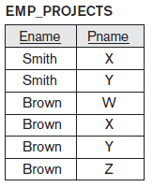
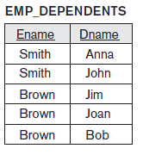
Avoid insertion anomaly through decomposition

Slide 16
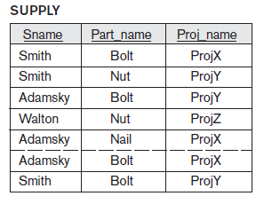
Join dependency & Fifth normal form
The SUPPLY table is in 4NF.
But there is data redundancy.

Slide 17
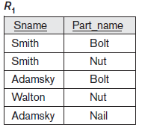
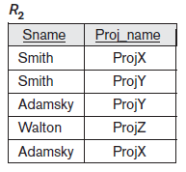
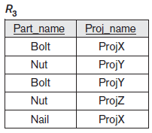
Join dependency & Fifth normal form

Slide 18
r₁ * r₂
Sname | Part_name | Proj_name
Smith | Bolt | ProjX
Smith | Bolt | ProjY
Smith | Nut | ProjX
Smith | Nut | ProjY
Adamsky | Bolt | ProjY
Adamsky | Bolt | ProjX
Watson | Nut | ProjZ
Adamsky | Nail | ProjY
Adamsky | Nail | ProjX
Tuples marked in red are spurious (invalid) tuples

Slide 19
Join dependency
We say that a join dependency denoted by JD(R₁, R₂) holds good on a relation schema R if for any state of the relation r of R r₁*r₂ = r.
We say that a join dependency denoted by JD(R₁, R₂, R₃, R₄) holds good on a relation schema R if for any state of the relation r of R
r₁*r₂*r₃*r₄ = r

Slide 20
Trivial & non-trivial join dependency
A join dependency JD(R₁, R₂, … R_{m}) on a relation schema R is called a trivial join dependency if there exists at least one R_{i} (i = 1, 2, …,m) such
that R = R_{i}.
A join dependency which is not trivial is called a non-trivial join dependency.

Slide 21
Fifth normal form
A relation schema R is in fifth normal form if for every non-trivial join dependency
JD(R₁, R₂, … R_{m}) that holds good on R,
R_{i} is a super key of R.

