Slide 1
What is Database Recovery
Restoring a database to the most recent legal state
after failure (crash) is called Database Recovery.
Recovery is necessary to preserve Atomicity &
Durability of a transaction.
The module of a DBMS responsible for database
recovery is called Recovery Manager.

Slide 2
Recovery System
Failure Classification
Storage Structure
Recovery and Atomicity
Log-Based Recovery
Shadow Paging

Slide 3
Failure Classification
Transaction failure :
  Logical errors: transaction cannot complete due to some internal error condition
  System errors: the database system must terminate an active transaction due to an error condition (e.g., deadlock)
System crash: a power failure or other hardware or software failure causes the system to crash.
  Fail-stop assumption: non-volatile storage contents are assumed to not be corrupted by system crash
    Database systems have numerous integrity checks to prevent corruption of disk data
Disk failure: a head crash or similar disk failure destroys all or part of disk storage
  Destruction is assumed to be detectable: disk drives use checksums to detect failures

Slide 4
Transaction failure
A transaction may fail because of
incorrect input (e.g. wrong OTP),
deadlock,
schedule is not serializable.

Slide 5
System failure
System may fail because of
Addressing error,
Application error,
Operating system fault,
RAM failure,
Network failure

Slide 6
Disk failure
Disk block may lose data because of
malfunction of read/write head
read/write head crash

Slide 7
Catastrophic failure
Power failure
Air conditioning failure
Fire
Theft
Sabotage
Overwriting disk
Mounting a wrong tape
Tsunami
Hurricane

Slide 8
Recovery Algorithms
Recovery algorithms are techniques to ensure database consistency and transaction atomicity and durability despite failures
Recovery algorithms have two parts
  Actions taken during normal transaction processing to ensure enough information exists to recover from failures
  Actions taken after a failure to recover the database contents to a state that ensures atomicity, consistency and durability

Slide 9
Storage Structure
Volatile storage:
  does not survive system crashes
  examples: main memory, cache memory
Nonvolatile storage:
  survives system crashes
  examples: disk, tape, flash memory,
  non-volatile (battery backed up) RAM
Stable storage:
  a mythical form of storage that survives all failures
  approximated by maintaining multiple copies on distinct nonvolatile media

Slide 10
Stable-Storage Implementation
Maintain multiple copies of each block on separate disks
  copies can be at remote sites to protect against disasters such as fire or flooding.
Failure during data transfer can still result in inconsistent copies: Block transfer can result in
  Successful completion
  Partial failure: destination block has incorrect information
  Total failure: destination block was never updated
Protecting storage media from failure during data transfer (one solution):
  Execute output operation as follows (assuming two copies of each block):
    Write the information onto the first physical block.
    When the first write successfully completes, write the same information onto the second physical block.
    The output is completed only after the second write successfully completes.

Slide 11
Stable-Storage Implementation (Cont.)
Protecting storage media from failure during data transfer (cont.):
Copies of a block may differ due to failure during output operation. To recover from failure:
  First find inconsistent blocks:
    Expensive solution: Compare the two copies of every disk block.
    Better solution:
      Record in-progress disk writes on non-volatile storage (Non-volatile RAM or special area of disk).
      Use this information during recovery to find blocks that may be inconsistent, and only compare copies of these.
      Used in hardware RAID systems
  If either copy of an inconsistent block is detected to have an error (bad checksum), overwrite it by the other copy. If both have no error, but are different, overwrite the second block by the first block.

Slide 12
Data Access
Physical blocks are those blocks residing on the disk.
Buffer blocks are the blocks residing temporarily in main memory.
Block movements between disk and main memory are initiated through the following two operations:
  input(B) transfers the physical block B to main memory.
  output(B) transfers the buffer block B to the disk, and replaces the appropriate physical block there.
Each transaction T_{i} has its private work-area in which local copies of all data items accessed and updated by it are kept.
  T_{i}'s local copy of a data item X is called x_{i}.
We assume, for simplicity, that each data item fits in, and is stored inside, a single block.

Slide 13
Example of Data Access
buffer
Buffer Block A
input(A)
x
Buffer Block B
A
Y
output(B)
B
read(X)
write(Y)
x₂
disk
x₁
y₁
work area
of T₁
work area
of T₂
memory

Slide 14
Recovery and Atomicity
Modifying the database without ensuring that the transaction will commit may leave the database in an inconsistent state.
Consider transaction T_{i} that transfers $50 from account A to account B; goal is either to perform all database modifications made by T_{i} or none at all.
Several output operations may be required for T_{i} (to output A and B). A failure may occur after one of these modifications have been made but before all of them are made.
To ensure atomicity despite failures, we first output information describing the modifications to stable storage without modifying the database itself.
We study two approaches:
  log-based recovery, and
  shadow-paging
We assume (initially) that transactions run serially, that is, one after the other.

Slide 15
Log-Based Recovery
A log is kept on stable storage.
  The log is a sequence of log records, and maintains a record of update activities on the database.
When transaction T_{i} starts, it registers itself by writing a
<T_{i} start>log record
Before T_{i} executes write(X), a log record <T_{i}, X, V₁, V₂> is written, where V₁ is the value of X before the write, and V₂ is the value to be written to X.
  Log record notes that T_{i} has performed a write on data item X_{j} X_{j} had value V₁ before the write, and will have value V₂ after the write.
When T_{i} finishes it last statement, the log record <T_{i} commit> is written.
We assume for now that log records are written directly to stable storage (that is, they are not buffered)
Two approaches using logs
  Deferred database modification
  Immediate database modification

Slide 16
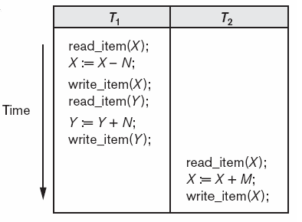
System log (an example)
[start_transaction, T₁]
[read_item, T₁, X]
[write_item, T₁, X, 12000, 7000]
[read_item, T₁, Y]
[write_item, T₁, Y, 20000, 25000]
[commit, T₁]
[start_transaction, T₂]
[read_item, T₂, X]
[write_item, T₂, X, 7000, 16000]
[commit, T₂]

Slide 17
Deferred Database Modification
The deferred database modification scheme records all modifications to the log, but defers all the writes to after partial commit.
Assume that transactions execute serially
Transaction starts by writing <T_{i} start> record to log.
A write(X) operation results in a log record <T_{i}, X, V> being written, where V is the new value for X
  Note: old value is not needed for this scheme
The write is not performed on X at this time, but is deferred.
When T_{i} partially commits, <T_{i} commit> is written to the log
Finally, the log records are read and used to actually execute the previously deferred writes.

Slide 18
Deferred Database Modification (Cont.)
During recovery after a crash, a transaction needs to be redone if and only if both <T_{i} start> and<T_{i} commit> are there in the log.
Redoing a transaction T_{i} ( redoT_{i}) sets the value of all data items updated by the transaction to the new values.
Crashes can occur while
  the transaction is executing the original updates, or
  while recovery action is being taken
example transactions T₀ and T₁ (T₀ executes before T₁):
T₀: read (A) T₁ : read (C)
A: - A - 50 C:- C- 100
Write (A) write (C)
read (B)
B:- B + 50
write (B)

Slide 19

Deferred Database Modification (Cont.)
Below we show the log as it appears at three instances of time.
If log on stable storage at time of crash is as in case:
(a) No redo actions need to be taken
(b) redo(T₀) must be performed since <T₀ commit> is present
(c) redo(T₀) must be performed followed by redo(T₁) since
<T₀ commit> and <T_{i} commit> are present

Slide 20
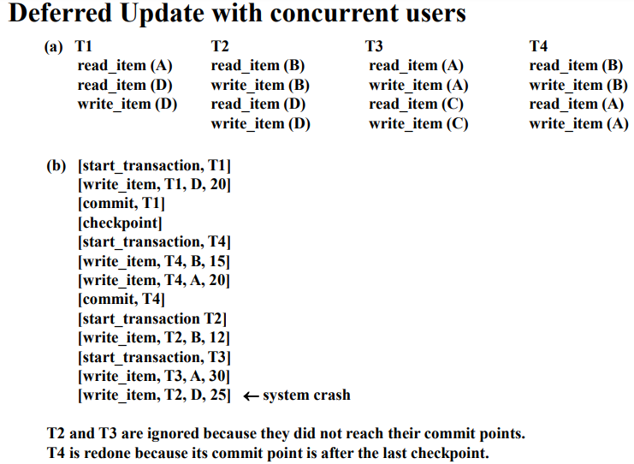

Slide 21
Immediate Database Modification
The immediate database modification scheme allows database updates of an uncommitted transaction to be made as the writes are issued
  since undoing may be needed, update logs must have both old value and new value
Update log record must be written before database item is written
  We assume that the log record is output directly to stable storage
  Can be extended to postpone log record output, so long as prior to execution of an output(B) operation for a data block B, all log records corresponding to items B must be flushed to stable storage
Output of updated blocks can take place at any time before or after transaction commit
Order in which blocks are output can be different from the order in which they are written.

Slide 22

Immediate DB Modification Recovery Example
Below we show the log as it appears at three instances of time.
Recovery actions in each case above are:
(a) undo (T₀): B is restored to 2000 and A to 1000.
(b) undo (T₁) and redo (T₀): C is restored to 700, and then A and B are
set to 950 and 2050 respectively.
(c) redo (T₀) and redo (T₁): A and B are set to 950 and 2050
respectively. Then C is set to 600

Slide 23
Checkpoints
Problems in recovery procedure as discussed earlier :
  searching the entire log is time-consuming
  we might unnecessarily redo transactions which have already
  output their updates to the database.
Streamline recovery procedure by periodically performing checkpointing
  Output all log records currently residing in main memory onto stable storage.
  Output all modified buffer blocks to the disk.
  Write a log record < checkpoint> onto stable storage.

Slide 24
Checkpoints (Cont.)
During recovery we need to consider only the most recent transaction T_{i} that started before the checkpoint, and transactions that started after T_{i}.
  Scan backwards from end of log to find the most recent <checkpoint> record
  Continue scanning backwards till a record <T_{i} start> is found.
  Need only consider the part of log following above start record. Earlier part of log can be ignored during recovery, and can be erased whenever desired.
  For all transactions (starting from T_{i} or later) with no <T_{i} commit>, execute undo(T_{i}). (Done only in case of immediate modification.)
  Scanning forward in the log, for all transactions starting from T_{i} or later with a <T_{i} commit>, execute redo(T_{i}).

Slide 25
Example of Checkpoints
T_{c}
T_{f}
T₁ can be ignored (updates already output to disk due to checkpoint)
T₂ and T₃ redone.
T₄ undone
T₁
T₂
T₃
T₄
checkpoint
system failure

Slide 26
Recovery from failure: Two phases
  Redo phase: replay updates of all transactions, whether they committed, aborted, or are incomplete
  Undo phase: undo all incomplete transactions
Redo phase:
  1. Find last <checkpoint L> record, and set undo-list to L.
  2. Scan forward from above <checkpoint L> record
    Whenever a record <T_{i}, X_{j}, V₁, V₂> or <T_{i}, X_{j}, V₂> is found, redo it by writing V₂ to X_{j}
    Whenever a log record <T_{i} start> is found, add T_{i} to undo-list
    Whenever a log record <T_{i} commit> or <T_{i} abort> is found, remove T_{i} from undo-list

Slide 27
Undo phase:
  1. Scan log backwards from end
    Whenever a log record <T_{i}, X_{j}, V₁, V₂> is found where T_{i} is in undo-list perform same actions as for transaction rollback:
      perform undo by writing V₁ to X_{j}.
      write a log record <T_{i} , X_{j}, V₁>
    Whenever a log record <T_{i} start> is found where T_{i} is in undo-list,
      Write a log record <T_{i} abort>
      Remove T_{i} from undo-list
    Stop when undo-list is empty
      1. i.e., <T_{i} start> has been found for every transaction in undo-list
After undo phase completes, normal transaction processing can commence

Slide 28
Shadow Paging
Shadow paging is an alternative to log-based recovery; this scheme is useful if transactions execute serially
Idea: maintain two page tables during the lifetime of a transaction –the current page table, and the shadow page table
Store the shadow page table in nonvolatile storage, such that state of the database prior to transaction execution may be recovered.
  Shadow page table is never modified during execution
To start with, both the page tables are identical. Only current page table is used for data item accesses during execution of the transaction.
Whenever any page is about to be written for the first time
  A copy of this page is made onto an unused page.
  The current page table is then made to point to the copy
  The update is performed on the copy

Slide 29

Sample Page Table

Slide 30

Example of Shadow Paging

Slide 31
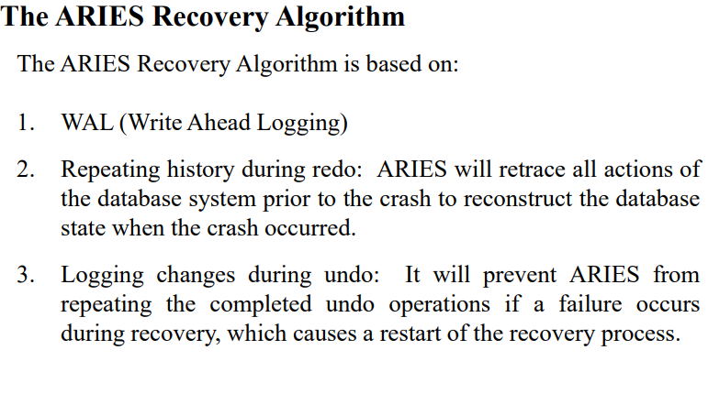

Slide 32
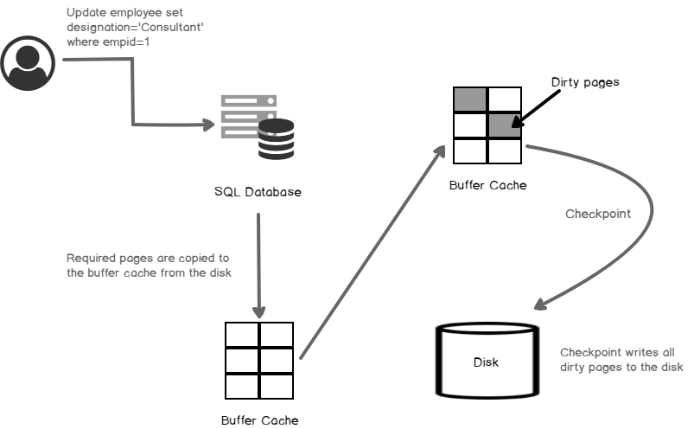

Slide 33
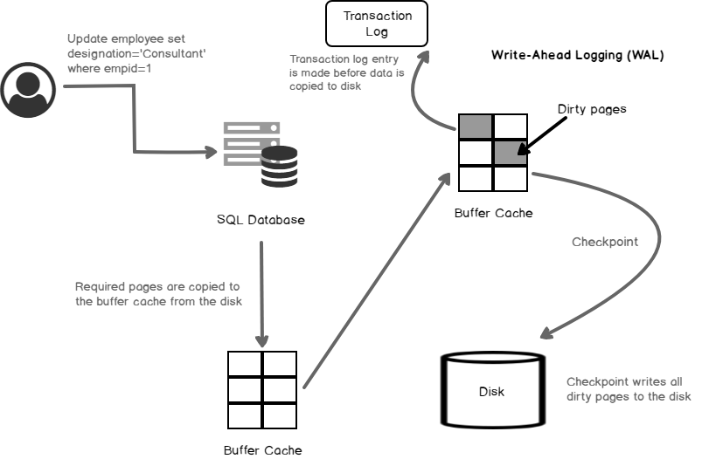

Slide 34
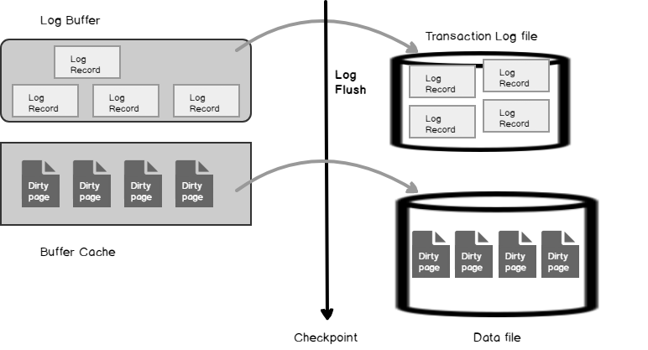

Slide 35
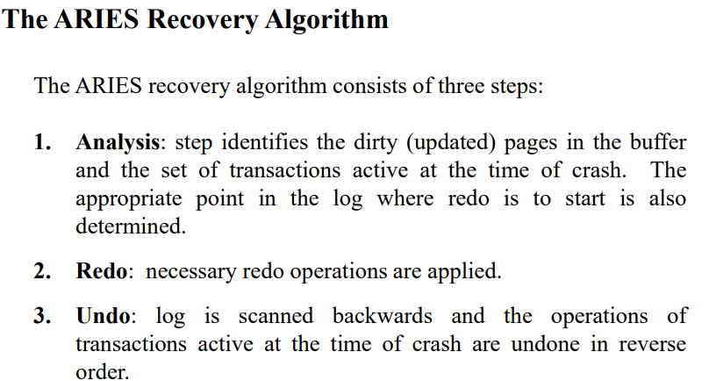

Slide 36
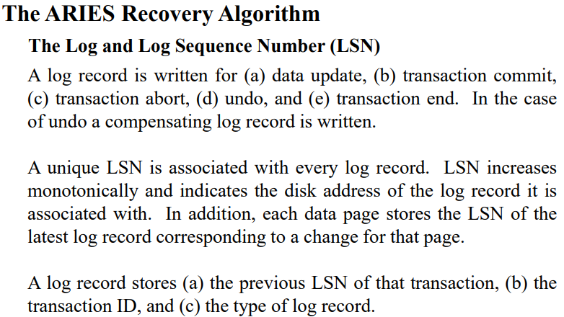

Slide 37
