Slide 1
SUBQUERIES

Slide 2
SUBQUERY
Subqueries enable you to write queries that select data rows for criteria that are actually developed while the query is executing at run time.

Slide 3
Subquery
Subquery or Inner query or Nested query is a query in a query.
A subquery is usually added in the WHERE Clause of the sql statement.
Most of the time, a subquery is used when you know how to search for a value using a SELECT statement, but do not know the exact value.
Subqueries are an alternate way of returning data from multiple tables.

Slide 4
What Is a Subquery?
A subquery is a SELECT statement embedded in a clause of another SQL statement.
Main
Query
SELECT . . .
FROM . . .
WHERE . . .
(SELECT . . .
FROM . . .
WHERE . . .)
Subquery
Notes:
What Is a Subquery?
A subquery is a SELECT statement that is embedded in the clause of another SQL statement.
The subquery (inner query) returns a value that is used by the main query (outer query). Using a subquery is equivalent to performing two sequential queries, and using the result of the first query as the search value in the second query.
Subqueries can be used for the following purposes:
To provide values for conditions in WHERE, HAVING, and START WITH clauses of SELECT, UPDATE, and DELETE statements
To define the set of rows to be inserted into the target table of an INSERT or CREATE TABLE statement
To define the set of rows to be included in a view or snapshot in a CREATE VIEW or CREATE SNAPSHOT statement
To define one or more values to be assigned to existing rows in an UPDATE statement
To define a table to be operated on by a containing query. You do this by placing the subquery in the FROM clause. This can be done in INSERT, UPDATE, and DELETE statements as well.
Note: A subquery is evaluated once for the entire parent statement.

Slide 5
For(i=0;i<3;i++)
{
For(j=1;j<3;j++)
{
Print (I, j);
}
Bordoloi and Bock

Slide 6
Sub-Query Syntax
  The subquery (inner query) executes once before the main query.
  The result of the subquery is used by the main query (outer query).
SELECT select_list
FROM table
WHERE expr operator (SELECT select_list
FROM table);
Notes:
Subqueries
You can build powerful statements out of simple ones by using subqueries. They can be very useful when you need to select rows from a table with a condition that depends on the data in the table itself.
In the syntax:
operator includes a comparison operator such as >, =, or IN.
Note: Comparison operators fall into two classes: single-row operators (>, =, >=, <, <>, <=) and multiple-row operators (IN, ANY, ALL).
The subquery is often referred to as a nested SELECT, sub-SELECT, or inner SELECT statement.

Slide 7
Problem - 1
Employee
NAME | SSN | SALARY | S_SSN | DEP_NO
SAM | 112 | 40000 | 112 | 111
RAM | 113 | 5000 | 113 | 222
TOM | 114 | 6000 | 112 | 111
JEFF | 115 | 5000 | 113 | 222
Display the names of all the employees who have got a salary lesser than Sam’s salary

Slide 8
Solution - 1
SQL> SELECT name
2 FROM employee
3 WHERE salary <=
4 (SELECT salary
5 FROM employee
6 WHERE ssn = 112);
40000
NAME
----------
Ram
Tom
Jeff
Notes:
Using a Subquery
In the slide, the inner query returns the salary of employee 7566. The outer query takes the result of the inner query and uses this result to display the names of all the employees who earn more than this amount.
Subqueries are very useful for writing SQL statements that need values based on an unknown conditional value.
Examples
Create a duplicate of the DEPT table.
Display all employees who make less than the average salary in the company.
Class Management Note
Execute the subquery (inner query) on its own first to show the value that the subquery returns. Then execute the outer query using the result returned by the inner query. Finally, execute the entire query (containing the subquery) and show that the result is the same.
SQL> CREATE TABLE dept_copy(deptno, dname, loc)
2 AS SELECT deptno, dname, loc
3 FROM dept;
SQL> SELECT ename, job, sal
2 FROM emp
3 WHERE sal < (SELECT AVG(sal)
4 FROM emp);

Slide 9
Problem - 2
Select names of all employees in the employee table whose salary is equal to the minimum salary received by employees in the table.
SQL> select name from employee where salary = (select min(salary) from employee);
Aggregate Function in SQL
MAX
Min
Sum
Avg
Count

Slide 10
SUBQUERIES AND THE IN Operator
Subqueries that are introduced with the keyword IN take the general form:
  WHERE expression [NOT] IN (subquery)
The only difference in the use of the IN operator with subqueries is that the list does not consist of hard-coded values.

Slide 11
Select ename from emp where salary (select salary from emp where age=40);
Bordoloi and Bock

Slide 12
Problem - 3
SQL> select * from employee;
NAME SSN SALARY S_SSN D_NO AGE
---------- ---------- ---------- ---------- ---------- ----------
sam 112 40000 112 123 52
ram 113 20000 112 123 52
tom 114 59999 113 124 42
jeff 117 30000 112 126 34
SQL> select * from department;
NAME D_NO M_SSN D_DATE
---------- ---------- ---------- ---------
finance 123 113 15-AUG-12
research 124 112 11-SEP-12
Print the name ,ssn,d_no of all employees who have a valid department number in the department table.

Slide 13
Solution – 3
SQL> select name,ssn,d_no from employee
where d_no in (select d_no from department);
NAME SSN D_NO
---------- ---------- ----------
sam 112 123
ram 113 123
tom 114 124

Slide 14
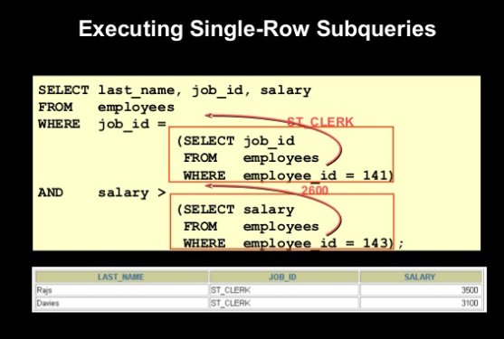

Slide 15
The NOT IN Operator
Like the IN operator, the NOT IN operator can take the result of a subquery as the operator object.
SQL> select name,ssn,d_no from employee where d_no not in (select d_no from department);
NAME SSN D_NO
---------- ---------- ----------
jeff 117 126

Slide 16
SUBQUERIES AND COMPARISON OPERATORS
The general form of the WHERE clause with a comparison operator is similar to that used thus far in the text.
Note that the subquery is again enclosed by parentheses.
    WHERE <expression> <comparison_operator> (subquery)

Slide 17
SUBQUERIES AND COMPARISON OPERATORS
The most important point to remember when using a subquery with a comparison operator is that the subquery can only return a single or scalar value.
This is also termed a scalar subquery because a single column of a single row is returned by the subquery.
If a subquery returns more than one value, the Oracle Server will generate the “ ORA-01427: single-row subquery returns more than one row ” error message, and the query will fail to execute.

Slide 18
SUBQUERIES AND COMPARISON OPERATORS
Let's examine a subquery that will not execute because it violates the "single value" rule.
The query shown below returns multiple values for the emp_salary column.
SQL> select * from employee where salary > (select salary from employee where salary >5000);

Slide 19
Aggregate Functions and Comparison Operators
The aggregate functions (AVG, SUM, MAX, MIN, and COUNT) always return a scalar result table.
Thus, a subquery with an aggregate function as the object of a comparison operator will always execute provided you have formulated the query properly.

Slide 20
Aggregate Functions and Comparison Operators
  SELECT emp_last_name "Last Name",
  emp_first_name "First Name",
  emp_salary "Salary"
  FROM employee
  WHERE emp_salary >
  (SELECT AVG(emp_salary)
  FROM employee);
  Last Name First Name Salary
  --------------- --------------- ----------
  Bordoloi Bijoy $55,000
  Joyner Suzanne $43,000
  Zhu Waiman $43,000
  Joshi Dinesh $38,000

Slide 21
Comparison Operators Modified with the ALL or ANY Keywords
  The ALL and ANY keywords can modify a comparison operator to allow an outer query to accept multiple values from a subquery.
  The general form of the WHERE clause for this type of query is shown here.
  WHERE <expression> <comparison_operator> [ALL | ANY] (subquery)
  Subqueries that use these keywords may also include GROUP BY and HAVING clauses.

Slide 22
The ALL Keyword
  The ALL keyword modifies the greater than comparison operator to mean greater than all values.
      SELECT emp_last_name "Last Name",
      emp_first_name "First Name",
      emp_salary "Salary"
      FROM employee
      WHERE emp_salary > ALL
      (SELECT emp_salary
      FROM employee
      WHERE emp_dpt_number = 7);
      Last Name First Name Salary
      --------------- --------------- --------
      Bordoloi Bijoy $55,000

Slide 23
The ANY Keyword
  The ANY keyword is not as restrictive as the ALL keyword.
  When used with the greater than comparison operator, "> ANY" means greater than some value.

Slide 24
SQL> SELECT * FROM EMPLOYEE WHERE SALARY > ALL (SELECT SALARY FROM EMPLOYEE
2 WHERE D_NO=126);
NAME SSN SALARY S_SSN D_NO DOB
---------- ---------- ---------- ---------- ---------- ---------
sam 112 40000 112 123 11-JUL-71
tom 114 59999 113 124 11-OCT-70
harini 118 88888 112 123 15-MAR-89

Slide 25
SQL> select * from employee where d_no = any (select d_no from department);
NAME SSN SALARY S_SSN D_NO AGE
---------- ---------- ---------- ---------- ---------- ----------
sam 112 40000 112 123 52
ram 113 20000 112 123 52
tom 114 59999 113 124 42

Slide 26
Example
  SELECT emp_last_name "Last Name",
  emp_first_name "First Name",
  emp_salary "Salary"
  FROM employee
  WHERE emp_salary > ANY
  (SELECT emp_salary
  FROM employee
  WHERE emp_salary > 30000);
  Last Name First Name Salary
  --------------- --------------- --------
  Bordoloi Bijoy $55,000
  Joyner Suzanne $43,000
  Zhu Waiman $43,000

Slide 27
An "= ANY" (Equal Any) Example
The "= ANY" operator is exactly equivalent to the IN operator.
For example, to find the names of employees that have male dependents, you can use either IN or "= ANY" – both of the queries shown below will produce an identical result table.
    SELECT emp_last_name "Last Name", emp_first_name "First Name"
    FROM employee
    WHERE emp_ssn IN
    (SELECT dep_emp_ssn
    FROM dependent
    WHERE dep_gender = 'M');
    SELECT emp_last_name "Last Name", emp_first_name "First Name"
    FROM employee
    WHERE emp_ssn = ANY
    (SELECT dep_emp_ssn
    FROM dependent
    WHERE dep_gender = 'M');

Slide 28
An "= ANY" (Equal Any) Example
OUTPUT
      Last Name First Name
      --------------- ---------------
      Bock Douglas
      Zhu Waiman
      Joyner Suzanne

Slide 29
A "!= ANY" (Not Equal Any) Example
The "= ANY" is identical to the IN operator.
However, the "!= ANY" (not equal any) is not equivalent to the NOT IN operator.
If a subquery of employee salaries produces an intermediate result table with the salaries $38,000, $43,000, and $55,000, then the WHERE clause shown here means "NOT $38,000" AND "NOT $43,000" AND "NOT $55,000".
WHERE NOT IN (38000, 43000, 55000);
However, the "!= ANY" comparison operator and keyword combination shown in this next WHERE clause means "NOT $38,000" OR "NOT $43,000" OR "NOT $55,000".

Slide 30
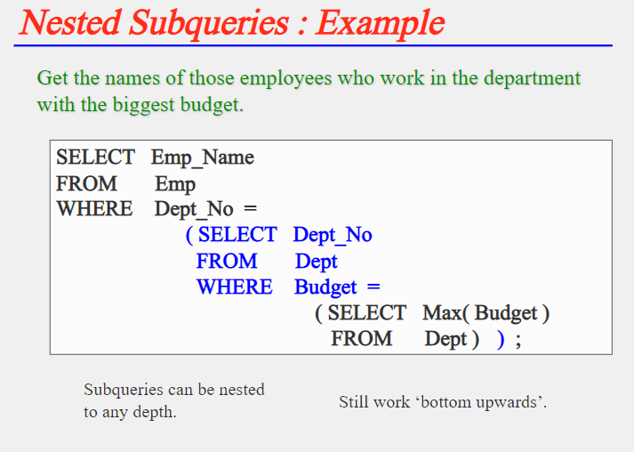

Slide 31
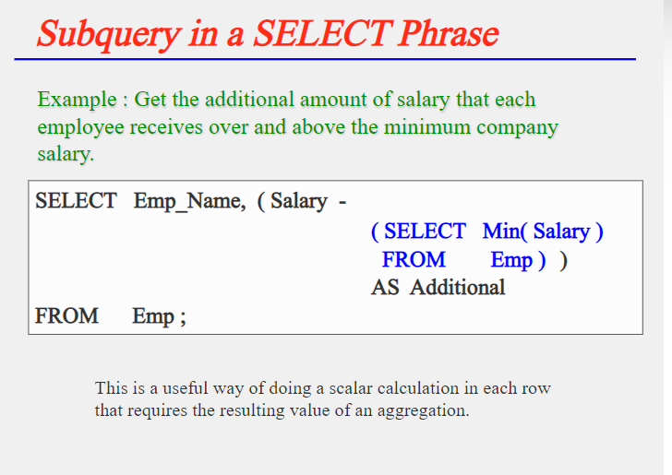

Slide 32
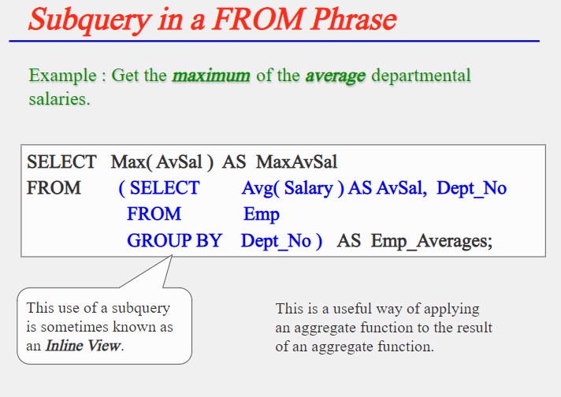

Slide 33
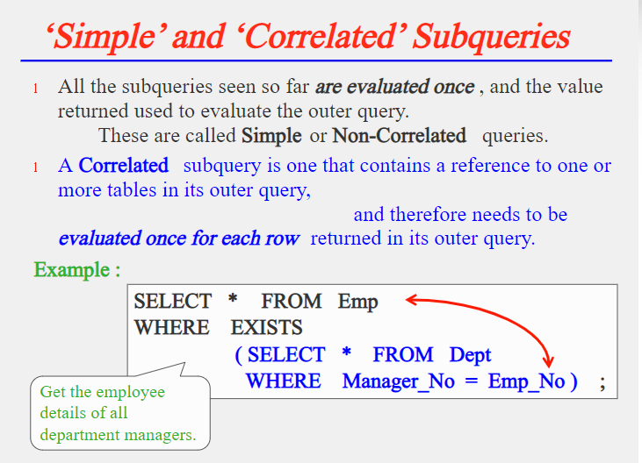

Slide 34
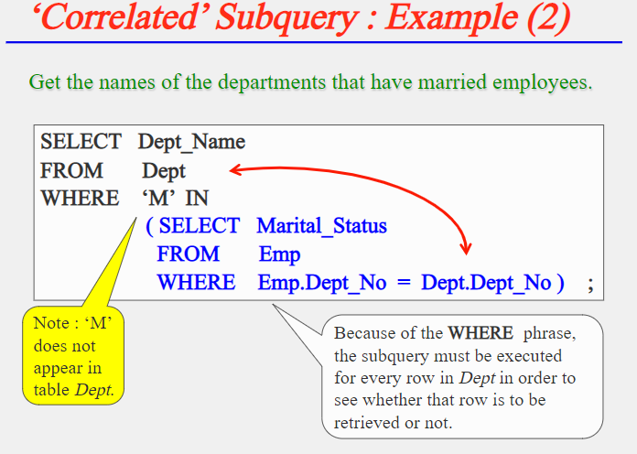

Slide 35
University Database
Department(dept_name, building, budget)
Course(course_id, title, dept_name. credits)
Instructor(id, name, dept_name, salary)
Section(course_id, sec_id, semester,year, building, room_number, time_slot_id)
Teaches(id, course_id, sec_id, semester, year)

Slide 36
Deletion
Delete from instructor where dept_name in (select dept_name from department where building=‘SJT’);
Delete from instructor where salary < (select avg(salary) from instructor);

Slide 37
Insertion
Insert into instructor select id, name, dept_name, 10000 from student where dept_name=‘CA’

Slide 38
Update
Update instructor set salary =salary * 1.05 where salary <(select avg(salary) from instructor);

Slide 39
Find all the courses taught in the Fall 2009 semester but not in the spring 2010 semester
Select distinct (course_id) from section where semester=‘Fall’ and year=2009 and course_id not in (select course_id from section where semester=‘Spring’ and year = 2010);

Slide 40
Find the names of all instructors whose salary is greater than at least one instructor in the Biology department
Select name from instructor where salary > some (select salary from instructor where dept_name=‘Biology’);
Note: SQL allows < some, <= some, >= some, =some and <> some.
=some is identical to IN operator
<> some is not same as NOT IN.

Slide 41
Find the names of all instructors that have a salary value greater than that of each instructor in the Biology department.
Select name from instructor where salary > ALL (select salary from instructor where dept_name=‘Biology’);

Slide 42
Find all courses taught in both the Fall 2009 semester and in the Spring 2010 semester
Select course_id from section as S where semester =‘Fall’ and year=2009 and exists (select * from section as T where semester =‘Spring’ and year=2010 and S.course_id=T.course_id);

Slide 43
Find all courses that were offered at most once in 2009
Select T.course_id from course as T where unique (select R.course_id from section as R where T.course_id=R.course_id and R.year-2009);

Slide 44
Find all courses that were offered at least twice in 2009
Select T.course_id from course as T where not unique (select R.course_id from section as R where T.course_id=R.course_id and R.year-2009);

Slide 45
List all departments along with the number of instructors in each department
Select dept_name, (select count(*) from instructor where department.dept_name=instructor.dept_name) as num_instructors from department;

