Slide 1
PL/SQL

Slide 2
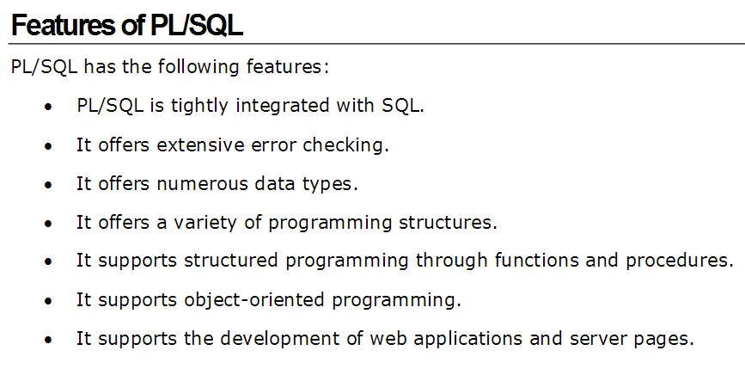

Slide 3
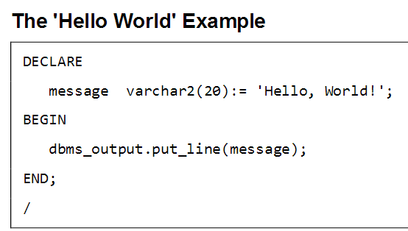

Slide 4
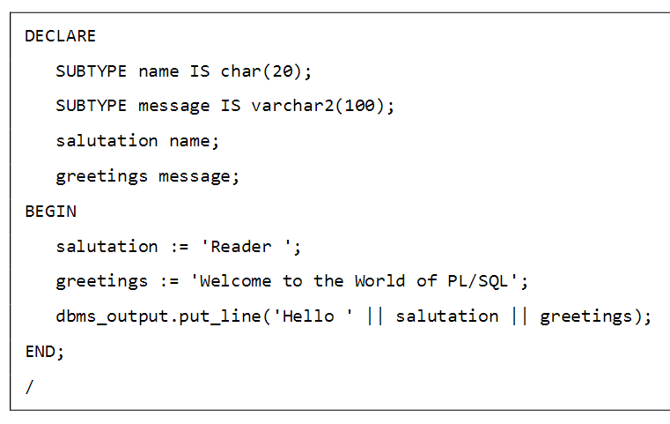
SUBTYPE

Slide 5
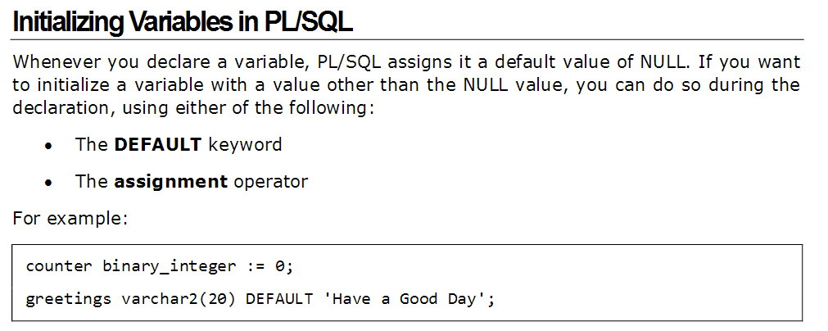

Slide 6
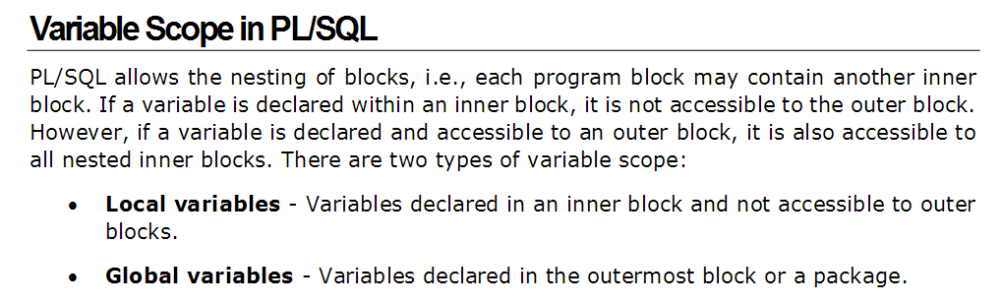
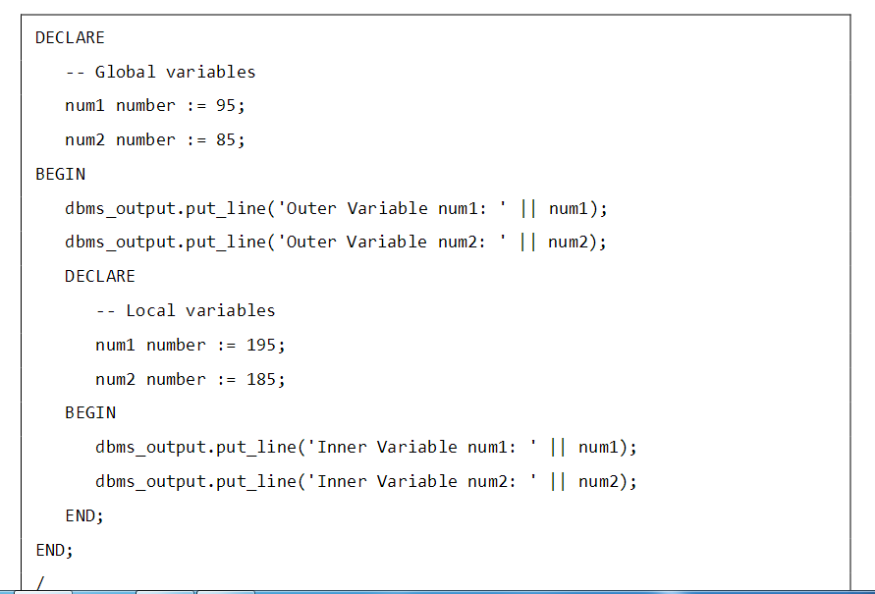

Slide 7
Declaring a constant
A constant is declared using the CONSTANT keyword. It requires an initial value and does not allow that value to be changed. For example,
PI CONSTANT NUMBER := 3.141592654;

Slide 8
Assigning SQL Query Results to PL/SQL Variables
DECLARE
c_id customers.id%type := 1;
c_name customers.name%type;
c_addr customers.address%type;
c_sal customers.salary%type;
BEGIN
SELECT name, address, salary INTO c_name, c_addr, c_sal FROM customers WHERE id = c_id;
dbms_output.put_line ('Customer ' ||c_name || ' from ' || c_addr || ' earns ' || c_sal);
END

Slide 9
BETWEEN Operator
DECLARE
x number(2) := 10;
BEGIN
IF (x between 5 and 20) THEN
dbms_output.put_line('True');
ELSE
dbms_output.put_line('False');
END IF;
IF (x BETWEEN 5 AND 10) THEN
dbms_output.put_line('True');
ELSE
dbms_output.put_line('False');
END IF;
IF (x BETWEEN 11 AND 20) THEN
dbms_output.put_line('True');
ELSE
dbms_output.put_line('False');
END IF;
END;
/

Slide 10
IN and IS NULL Operators
DECLARE
letter varchar2(1) := 'm';
BEGIN
IF (letter in ('a', 'b', 'c')) THEN
dbms_output.put_line('True');
ELSE
dbms_output.put_line('False');
END IF;
IF (letter in ('m', 'n', 'o')) THEN
dbms_output.put_line('True');
ELSE
dbms_output.put_line('False');
END IF;
IF (letter is null) THEN
dbms_output.put_line('True');
ELSE
dbms_output.put_line('False');
END IF;
END;

Slide 11
If Clause example
DECLARE
c_id customers.id%type := 1;
c_sal customers.salary%type;
BEGIN
SELECT salary INTO c_sal FROM customers WHERE id = c_id;
IF (c_sal <= 2000) THEN
UPDATE customers SET salary = salary + 1000
WHERE id = c_id;
dbms_output.put_line ('Salary updated');
END IF;
END;

Slide 12
Elseif Ladder
DECLARE
a number(3) := 100;
BEGIN
IF ( a = 10 ) THEN
dbms_output.put_line('Value of a is 10' );
ELSIF ( a = 20 ) THEN
dbms_output.put_line('Value of a is 20' );
ELSIF ( a = 30 ) THEN
dbms_output.put_line('Value of a is 30' );
ELSE
dbms_output.put_line('None of the values is matching');
END IF;
dbms_output.put_line('Exact value of a is: '|| a );
END;
/

Slide 13
CASE Statement
DECLARE
grade char(1) := 'A';
BEGIN
CASE grade
when 'A' then dbms_output.put_line('Excellent');
when 'B' then dbms_output.put_line('Very good');
when 'C' then dbms_output.put_line('Well done');
when 'D' then dbms_output.put_line('You passed');
when 'F' then dbms_output.put_line('Better try again');
else
dbms_output.put_line('No such grade');
END CASE;
END;

Slide 14
Basic Looping
DECLARE
x number := 10;
BEGIN
LOOP
dbms_output.put_line(x);
x := x + 10;
IF x > 50 THEN
exit;
END IF;
END LOOP;
dbms_output.put_line('After Exit x is: ' || x);
END;
/

Slide 15
EXIT WHEN
DECLARE
x number := 10;
BEGIN
LOOP
dbms_output.put_line(x);
x := x + 10;
exit WHEN x > 50;
END LOOP;
dbms_output.put_line('After Exit x is: ' || x);
END;
/

Slide 16
WHILE Loop
DECLARE
a number(2) := 10;
BEGIN
WHILE a < 20 LOOP
dbms_output.put_line('value of a: ' || a);
a := a + 1;
END LOOP;
END;
/

Slide 17
FOR Loop
DECLARE
a number(2);
BEGIN
FOR a in 10 .. 20 LOOP
dbms_output.put_line('value of a: ' || a);
END LOOP;
END;
/

Slide 18
REVERSE Loop
DECLARE
a number(2) ;
BEGIN
FOR a IN REVERSE 10 .. 20 LOOP
dbms_output.put_line('value of a: ' || a);
END LOOP;
END;
/

Slide 19
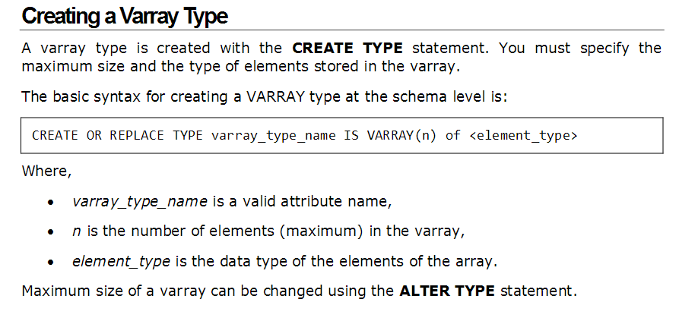
PL/SQL - Arrays
The PL/SQL programming language provides a data structure called the VARRAY , which can store a fixed - size sequential collection of elements of the same type. A varray is used to store an ordered collection of data, however it is often better to think of an array as a collection of variables of the same type.

Slide 20
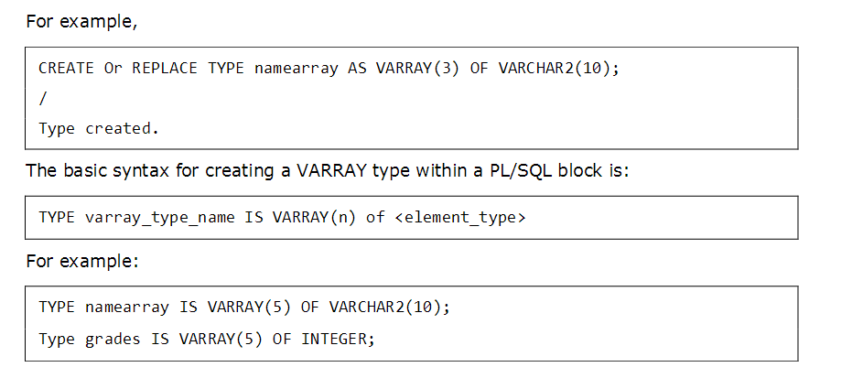

Slide 21
Example
DECLARE
type namesarray IS VARRAY(5) OF VARCHAR2(10);
type grades IS VARRAY(5) OF INTEGER;
names namesarray;
marks grades;
total integer;
BEGIN
names := namesarray('Kavita', 'Pritam', 'Ayan', 'Rishav', 'Aziz');
marks:= grades(98,97, 78, 87, 92);
total := names.count;
dbms_output.put_line('Total '|| total || ' Students');
FOR i in 1 .. total LOOP
dbms_output.put_line('Student: ' || names(i) || 'Marks: ' || marks(i));
END LOOP;
END;

Slide 22
PL/SQL block can be nested
<<outer>>
declare
birthdate date := '21-Aug-2002';
begin
declare -- inner block starts here
birthdate date;
begin
birthdate := '29-Sep-1998';
if birthdate = outer.birthdate then
dbms_output.put_line('Same Birthday');
else dbms_output.put_line('Different Birthday');
end if;
end; -- inner block ends here
end;

Slide 23
Cursors
Oracle creates a memory area, known as the context area, for processing an SQL statement, which contains all the information needed for processing the statement; for example, the number of rows processed, etc.
A cursor is a pointer to this context area. PL/SQL controls the context area through a cursor. A cursor holds the rows (one or more) returned by a SQL statement. The set of rows the cursor holds is referred to as the active set.
There are two types of cursors:
Implicit cursors
Explicit cursors
Whenever a DML statement (INSERT, UPDATE and DELETE) is issued, an implicit cursor is associated with this statement. For INSERT operations, the cursor holds the data that needs to be inserted. For UPDATE and DELETE operations, the cursor identifies the rows that would be affected.

Slide 24
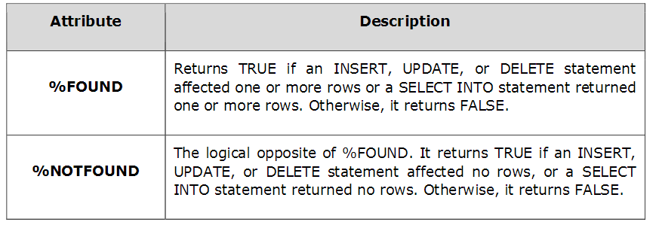
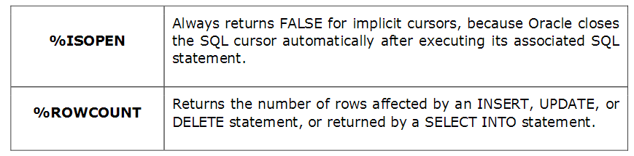

Slide 25
use the SQL%ROWCOUNT attribute to determine the number of rows affected:
DECLARE
total_rows number(2);
BEGIN
UPDATE customers SET salary = salary + 500;
IF sql%notfound THEN
dbms_output.put_line('no customers selected');
ELSIF sql%found THEN
total_rows := sql%rowcount;
End if
End

Slide 26
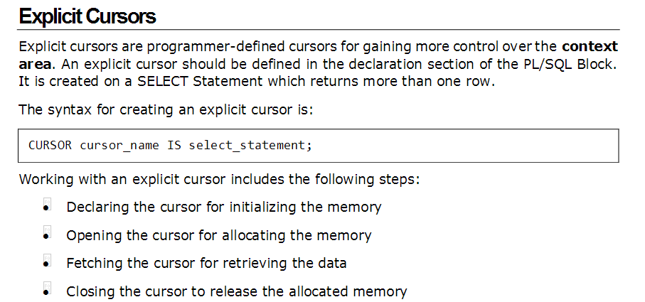

Slide 27
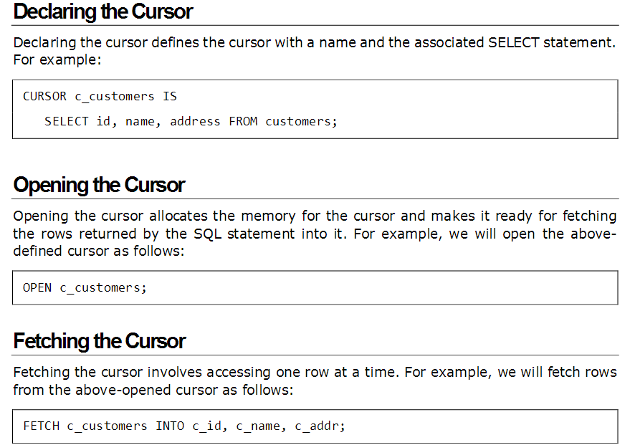

Slide 28
DECLARE
c_id customers.id%type;
c_name customers.name%type;
c_addr customers.address%type;
CURSOR c_customers is
SELECT id, name, address FROM customers;
BEGIN
OPEN c_customers;
LOOP
FETCH c_customers into c_id, c_name, c_addr;
EXIT WHEN c_customers%notfound;
dbms_output.put_line(c_id || ' ' || c_name || ' ' || c_addr);
END LOOP;
CLOSE c_customers;
END

Slide 29
Cursor – looping using simple loop
declare
cursor emp_crs is select fname, minit, lname, salary
from employee;
emp_rec emp_crs%rowtype;
begin
open emp_crs;
loop -- simple cursor loop
fetch emp_crs into emp_rec;
exit when emp_crs%notfound;
dbms_output.put_line(emp_rec.lname || ‘ ‘ || emp_rec.salary);
end loop;
close emp_crs;
end;

Slide 30
Cursor – looping using while
declare
cursor emp_crs is select fname, minit, lname, salary
from employee;
emp_rec emp_crs%rowtype;
begin
open emp_crs;
fetch emp_crs into emp_rec;
while emp_crs%found loop -- cursor while loop
dbms_output.put_line(emp_rec.lname || ‘ ‘ || emp_rec.salary);
fetch emp_crs into emp_rec;
end loop;
close emp_crs;
end;

Slide 31
Cursor – looping using cursor for loop
declare
cursor emp_crs is select fname, minit, lname, salary
from employee;
emp_rec emp_crs%rowtype;
begin
for emp_rec in emp_crs loop -- cursor for loop
dbms_output.put_line(emp_rec.lname || ‘ ‘ || emp_rec.salary);
end loop;
end;
There is no open, no fetch, no close.
No explicit end of row detection mechanism.

Slide 32
Cursor with update
declare
ssn char(9); name varchar2(10); sal number(8,2);
cursor emp_crs is select ssn, lname, salary from employee
for update;
begin
open emp_crs;
loop
fetch emp_crs into ssn, name, sal;
exit when emp_crs%notfound;
if name = 'Smith' then
update employee set salary = salary*1.10
--where current of emp_crs;
end if;
end loop;
end;

Slide 33
System defined exceptions
zero_divide (ORA-01476)
cursor_already_open (ORA-06511)
invalid_cursor (ORA-01001, invalid cursor error occurs when you try to reference a cursor that does not yet exist, e.g. trying to access a cursor which is yet to open)
no_data_found (ORA-01403, it is raised when a select into statement returns no rows.)
too_many_rows (ORA-01422, when you select or fetch more than one row into a single record or variable.)

Slide 34
no_data_found (illustration)
declare
e_id employee.ssn%type := '234567892';
e_lname employee.lname%type;
e_addr employee.address%type;
begin
select lname, address into e_lname, e_addr from employee where ssn = e_id;
dbms_output.put_line ('name: '|| e_lname); dbms_output.put_line ('address: ' || e_addr);
exception
when no_data_found then
dbms_output.put_line('no such employee!');
when others then
dbms_output.put_line('some other error has occurred!');
end;

Slide 35
User-defined exception
too_big exception; -- inside declarations
To throw this exception forcibly use
raise too_big; -- inside executable code
To process this exception use it in the exception
handling section of PL/SQL code in the following
way:
when too_big then
raise_application_error (err_no, err_msg);
N.B. The error number should be in the range
{−20000…−20999}.

Slide 36
User-defined exception (an example)
declare
salary_too_high exception;
too_high constant number(5) := 40000;
cursor empcrs is select fname, lname, salary from employee;
emp_rec empcrs%rowtype;
begin
open empcrs;
loop
fetch empcrs into emprec;
exit when emp_crs%notfound;
if emp_rec.salary > too_high then
raise salary_too_high;
end if;
end loop;
Continued in the next slide

Slide 37
User-defined exception (an example)
exception
when salary_too_high then
raise_application_error(-20100, ‘Salary is too high’);
when others then
null;
close empcrs;
end;

Slide 38
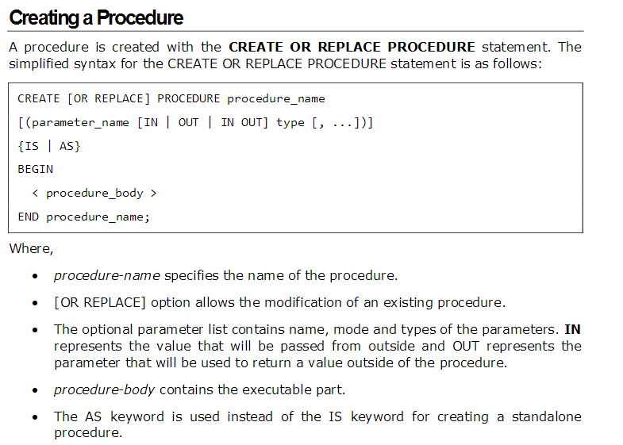

Slide 39
Example
CREATE OR REPLACE PROCEDURE greetings
AS
BEGIN
dbms_output.put_line('Hello World!');
END;
/
Standalone:
EXECUTE greetings;
The procedure can also be called from another PL/SQL block:
BEGIN
greetings;
END;
/

Slide 40
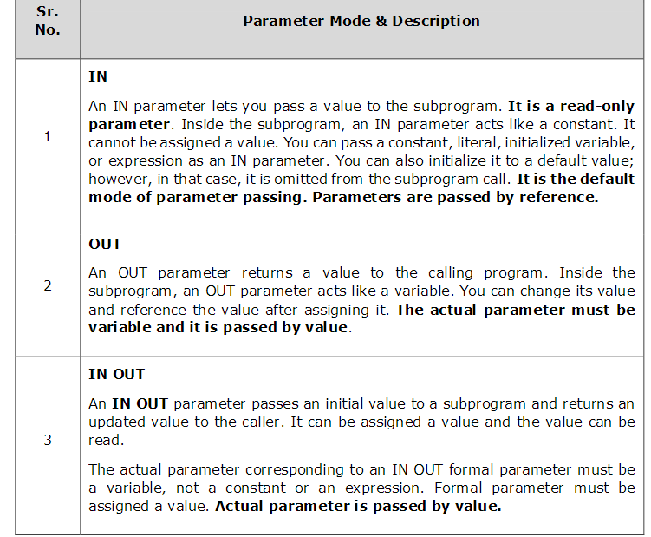

Slide 41
DECLARE
a number;
b number;
c number;
PROCEDURE findMin(x IN number, y IN number, z OUT number) IS
BEGIN
IF x < y THEN
z:= x;
ELSE
z:= y;
END IF;
END;
BEGIN
a:= 23;
b:= 45;
findMin(a, b, c);
dbms_output.put_line(' Minimum of (23, 45) : ' || c);
END;
/

Slide 42
IN & OUT Mode Example 2
This procedure computes the square of value of a passed value. This example shows how we can use the same parameter to accept a value and then return another result.
DECLARE
a number;
PROCEDURE squareNum(x IN OUT number) IS
BEGIN
x := x * x;
END;
BEGIN
a:= 23;
squareNum(a);
dbms_output.put_line(' Square of (23): ' || a);
END;
/

Slide 43
Example
CREATE OR REPLACE FUNCTION show_description
(i_course_no number)
RETURN varchar2
AS
v_description varchar2(50);
BEGIN
SELECT description
INTO v_description
FROM course
WHERE course_no = i_course_no;
RETURN v_description;
EXCEPTION
WHEN NO_DATA_FOUND
THEN
RETURN('The Course is not in the database');
WHEN OTHERS
THEN
RETURN('Error in running show_description');
END;

Slide 44
Making Use Of Functions
In a anonymous block
SET SERVEROUTPUT ON
DECLARE
v_description VARCHAR2(50);
BEGIN
v_description := show_description(&sv_cnumber);
DBMS_OUTPUT.PUT_LINE(v_description);
END;
In a SQL statement
SELECT course_no, show_description(course_no)
FROM course;

Slide 45
PL/SQL functions
create or replace function empsal(id char) return number is
sal employee.salary%type;
begin
select salary into sal from employee where ssn = id;
return sal;
end;
SQL>/
SQL> variable x number;
SQL> exec :x := f(‘123456789’);
SQL> print x;
SQL> X
----------
36720

Slide 46
Triggers

Slide 47
Creating Triggers
CREATE [OR REPLACE ] TRIGGER trigger_name
{BEFORE | AFTER | INSTEAD OF }
{INSERT [OR] | UPDATE [OR] | DELETE}
[OF col_name]
ON table_name
[REFERENCING OLD AS o NEW AS n]
[FOR EACH ROW]
WHEN (condition)
DECLARE
Declaration-statements
BEGIN
Executable-statements
EXCEPTION
Exception-handling-statements
END;

Slide 48
CREATE [OR REPLACE] TRIGGER trigger_name − Creates or replaces an existing trigger with the trigger_name.
{BEFORE | AFTER | INSTEAD OF} − This specifies when the trigger will be executed. The INSTEAD OF clause is used for creating trigger on a view.
{INSERT [OR] | UPDATE [OR] | DELETE} − This specifies the DML operation.
[OF col_name] − This specifies the column name that will be updated.
[ON table_name] − This specifies the name of the table associated with the trigger.
[REFERENCING OLD AS o NEW AS n] − This allows you to refer new and old values for various DML statements, such as INSERT, UPDATE, and DELETE.
[FOR EACH ROW] − This specifies a row-level trigger, i.e., the trigger will be executed for each row being affected. Otherwise the trigger will execute just once when the SQL statement is executed, which is called a table level trigger.
WHEN (condition) − This provides a condition for rows for which the trigger would fire. This clause is valid only for row-level triggers.

Slide 49
Example
CREATE OR REPLACE TRIGGER display_salary_changes
BEFORE DELETE OR INSERT OR UPDATE ON customers
FOR EACH ROW
WHEN (NEW.ID > 0)
DECLARE
sal_diff number;
BEGIN
sal_diff := :NEW.salary - :OLD.salary;
dbms_output.put_line('Old salary: ' || :OLD.salary);
dbms_output.put_line('New salary: ' || :NEW.salary);
dbms_output.put_line('Salary difference: ' || sal_diff);
END;
/

Slide 50
Triggering a Trigger
INSERT INTO CUSTOMERS (ID,NAME,AGE,ADDRESS,SALARY) VALUES (7, 'Kriti', 22, 'HP', 7500.00 );
When a record is created in the CUSTOMERS table, the above create trigger, display_salary_changes will be fired and it will display the following result −
Old salary:
New salary: 7500
Salary difference:
Because this is a new record, old salary is not available and the above result comes as null. Let us now perform one more DML operation on the CUSTOMERS table. The UPDATE statement will update an existing record in the table −
UPDATE customers
SET salary = salary + 500
WHERE id = 2;
When a record is updated in the CUSTOMERS table, the above create trigger, display_salary_changes will be fired and it will display the following result −
Old salary: 1500
New salary: 2000
Salary difference: 500

Slide 51
Types of Triggers in Oracle
Triggers can be classified based on the following parameters.
Classification based on the timing
BEFORE Trigger: It fires before the specified event has occurred.
AFTER Trigger: It fires after the specified event has occurred.
INSTEAD OF Trigger: A special type. You will learn more about the further topics. (only for DML )
Classification based on the level
STATEMENT level Trigger: It fires one time for the specified event statement.
ROW level Trigger: It fires for each record that got affected in the specified event. (only for DML)
Classification based on the Event
DML Trigger: It fires when the DML event is specified (INSERT/UPDATE/DELETE)
DDL Trigger: It fires when the DDL event is specified (CREATE/ALTER)
DATABASE Trigger: It fires when the database event is specified (LOGON/LOGOFF/STARTUP/SHUTDOWN)
So each trigger is the combination of above parameters.

Slide 52
:NEW and :OLD Clause
In a row level trigger, the trigger fires for each related row. And sometimes it is required to know the value before and after the DML statement.
Oracle has provided two clauses in the RECORD-level trigger to hold these values. We can use these clauses to refer to the old and new values inside the trigger body.
:NEW – It holds a new value for the columns of the base table/view during the trigger execution
:OLD – It holds old value of the columns of the base table/view during the trigger execution
This clause should be used based on the DML event. Below table will specify which clause is valid for which DML statement (INSERT/UPDATE/DELETE).

Slide 53
Trigger
A trigger defines actions that are taken by a
DBMS when an event occurs.
Events are of two types, namely
Database event & External event.
Database event {insert, update, delete,
create, alter, drop}.
External event {timing event, log on, log off, shutdown, startup, servererror}

Slide 54
Trigger
Execution of a trigger is transparent to the users.
Triggers are fired upon the occurrence of an
event.
Row level trigger fires as many times as the
number of rows affected by an event.
Statement level trigger fires only once upon the
occurrence of an event.

Slide 55
before trigger & after trigger
Triggers that fire just before the occurrence of
triggering event are called before trigger.
Triggers that fire just after the occurrence of
triggering event are called after trigger.
Triggers are also known as active rules.
Triggers implement constraint that could not be imposed on schema.
The business rules are defined using triggers.

Slide 56
Example of trigger
Consider defining a trigger that fires whenever an employee
in the company receives salary hike and as a part of action
taken by the trigger, a row is inserted into a table named
emp_audit containing employee ssn, date when the salary
was updated, the old salary and the new salary.
First, we create the table emp_audit using the following
create table statement
create table emp_audit (
ssn char(9) not null,
last_update date,
new_salary number(10, 2),
old_salary number(10, 2));

Slide 57
Trigger
create or replace trigger audit_sal1
after update of salary on emp
for each row
when (new.salary >old.salary)
begin
insert into emp_audit values (:old.ssn, sysdate, :new.salary, :old.salary);
end;
/

Slide 58
Trigger
Write a trigger to define the rule that salary of an employee
in company database cannot exceed $100000.
create or replace trigger too_high_salary
before insert or update of salary on emp
for each row
begin
if (:new.salary > 100000) then
raise_application_error(−21000, 'salary is too high');
end if;
end;

Slide 59
Trigger
In Oracle trigger the keywords new and old can
only be used with row-level triggers.

Slide 60
Statement level trigger
Statement level triggers fire only once whenever
an event happens, independent of number of rows
affected by the triggering event. To illustrate
statement level trigger, let us consider a trigger to
make an entry into a table called alog (say)
whenever any update operation (insert, update
and delete) is performed on a table (say
department table). Before we define the trigger
we create the table alog using the following create
table statement.

Slide 61
Creating the table alog
create table alog(
user_name varchar2(16),
type_of_op varchar2(20),
time_of_op date primary key);

Slide 62
Definition of a statement level trigger
create or replace trigger dept_log
after insert or update or delete on department
declare
typeop varchar2(10);
begin
if inserting then typeop := 'Insertion';
elsif deleting then typeop := 'Deletion';
elsif updating then typeop := 'Update';
end if;
insert into alog values (user, typeop, sysdate);
end;

