Slide 1
Decomposition

Slide 2
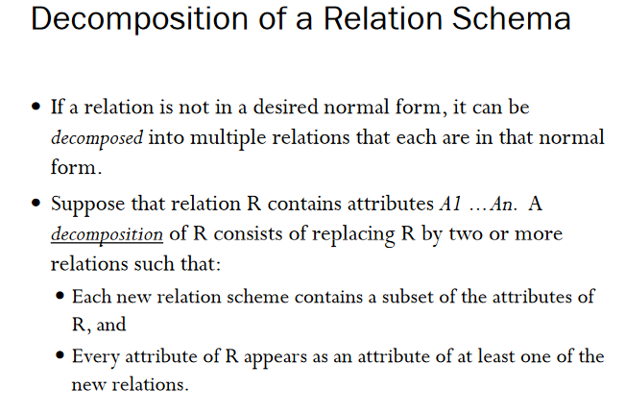

Slide 3
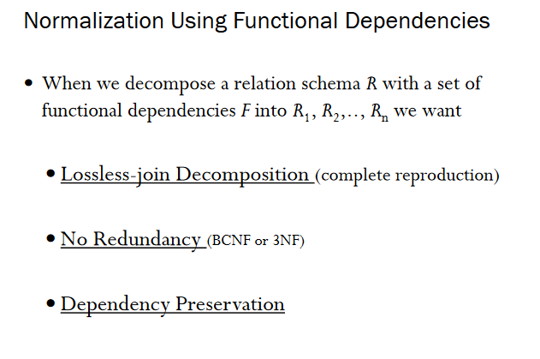

Slide 4
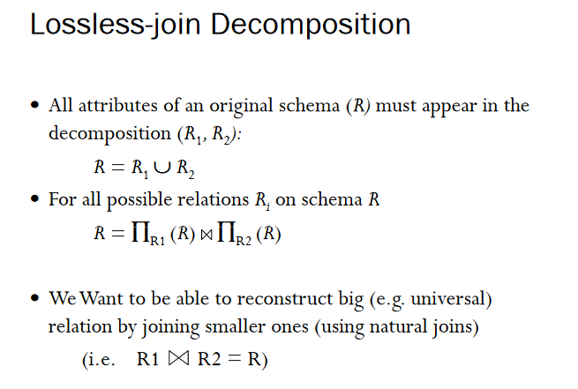

Slide 5
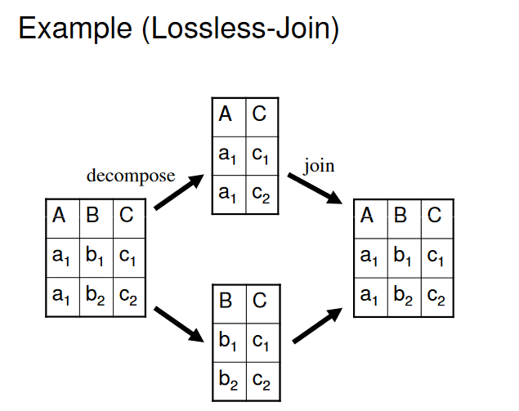

Slide 6
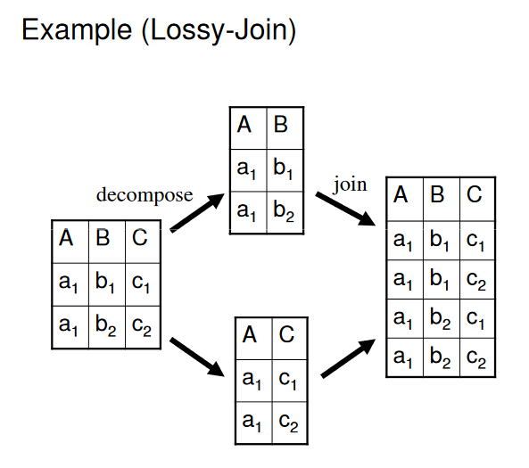

Slide 7
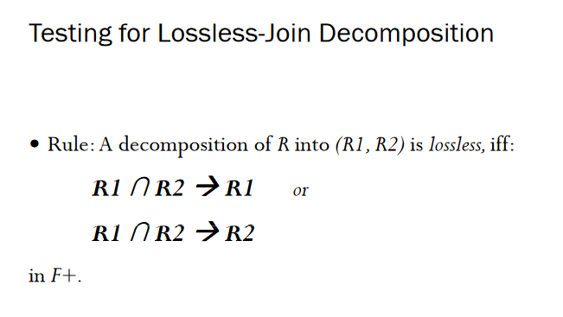

Slide 8
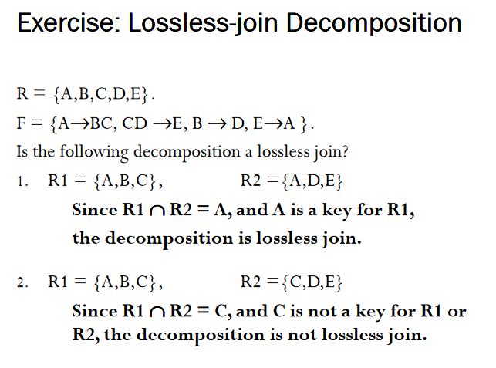

Slide 9
Algorithms
Checking lossless join decomposition
a) Create a matrix , row= no of decomposed, col=no of attributes in base
b) Fill all the rows with b
c) Taking rach row for a decomposed relation fill with a if it is present in the decomposed
d) For a FD x→ y if there is a ‘a’ in the x column make the y column as a
e) If one row contains all ‘a’ then the decomposition is lossless.

Slide 10
Example from (2NF)
Emp_Proj(SSn,pno,ename,pname,ploc,hrs)
Ssn -> ename
Pno -> pname,ploc
Ssn, pno -> hrs
E(ssn,ename)
P(pno,pname,ploc)
EP(ssn,pno,hrs)

Slide 11
Emp_Proj(SSn,pno,ename,pname,ploc,hrs)
SSN | PNO | Ename | Pname | Ploc | Hrs

Slide 12
Emp_Proj(SSn,pno,ename,pname,ploc,hrs)
SSN | PNO | Ename | Pname | Ploc | Hrs
B | B | B | B | B | B
B | B | B | B | B | B
B | B | B | B | B | B

Slide 13
E(ssn,ename)
P(pno,pname,ploc)
EP(ssn,pno,hrs)
SSN | PNO | Ename | Pname | Ploc | Hrs
A | B | A | B | B | B
B | B | B | B | B | B
B | B | B | B | B | B

Slide 14
E(ssn,ename)
P(pno,pname,ploc)
EP(ssn,pno,hrs)
SSN | PNO | Ename | Pname | Ploc | Hrs
A | B | A | B | B | B
B | A | B | A | A | B
B | B | B | B | B | B

Slide 15
E(ssn,ename)
P(pno,pname,ploc)
EP(ssn,pno,hrs)
SSN | PNO | Ename | Pname | Ploc | Hrs
A | B | A | B | B | B
B | A | B | A | A | B
A | A | B | B | B | A

Slide 16
SSN | PNO | Ename | Pname | Ploc | Hrs
A | B | A | B | B | B
B | A | B | A | A | B
A | A | B | B | B | A
A

Slide 17
SSN | PNO | Ename | Pname | Ploc | Hrs
A | B | A | B | B | B
B | A | B | A | A | B
A | A | A | B | B | A
A
A

Slide 18
SSN | PNO | Ename | Pname | Ploc | Hrs
A | B | A | B | B | B
B | A | B | A | A | B
A | A | A | A | A | A

Slide 19
SSN | PNO | Ename | Pname | Ploc | Hrs
A | B | A | B | B | B
B | A | B | A | A | B
A | A | A | A | A | A
Loss less join property is present

Slide 20
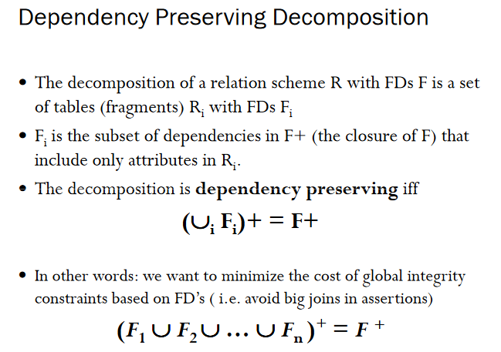

Slide 21
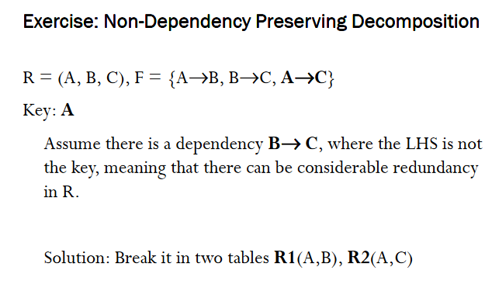

Slide 22
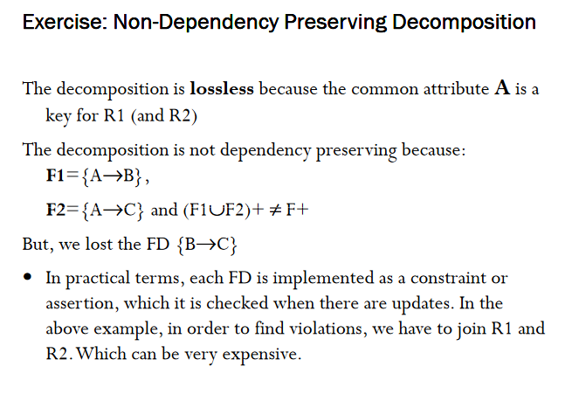

Slide 23
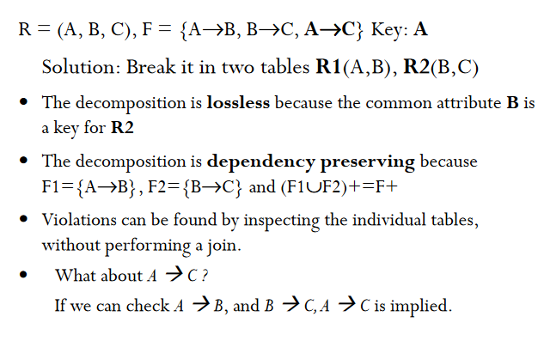

Slide 24
Decomposition into BCNF

Slide 25
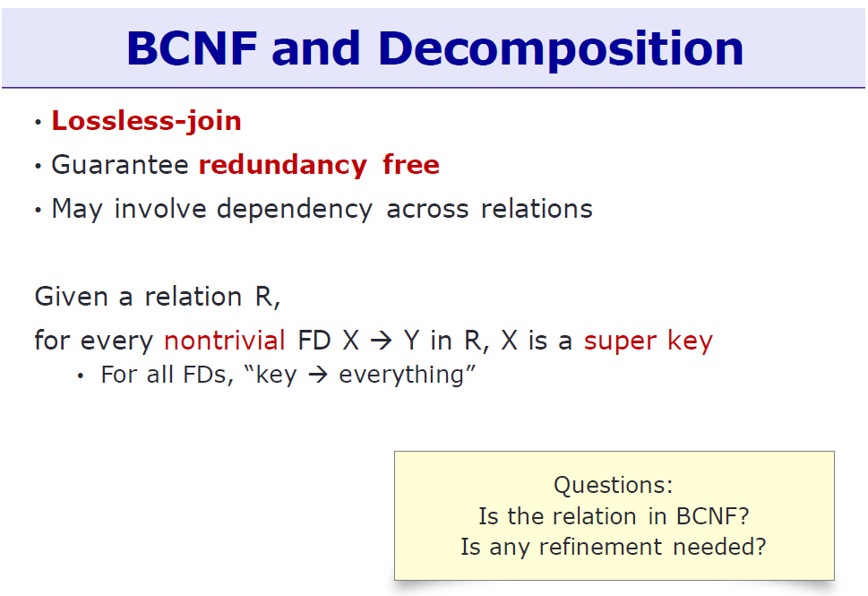

Slide 26
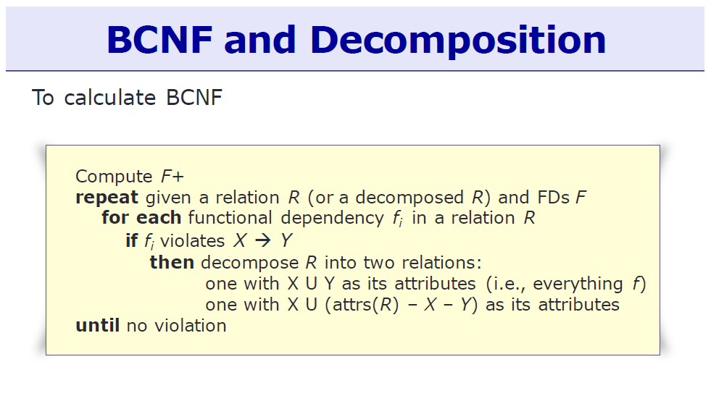

Slide 27
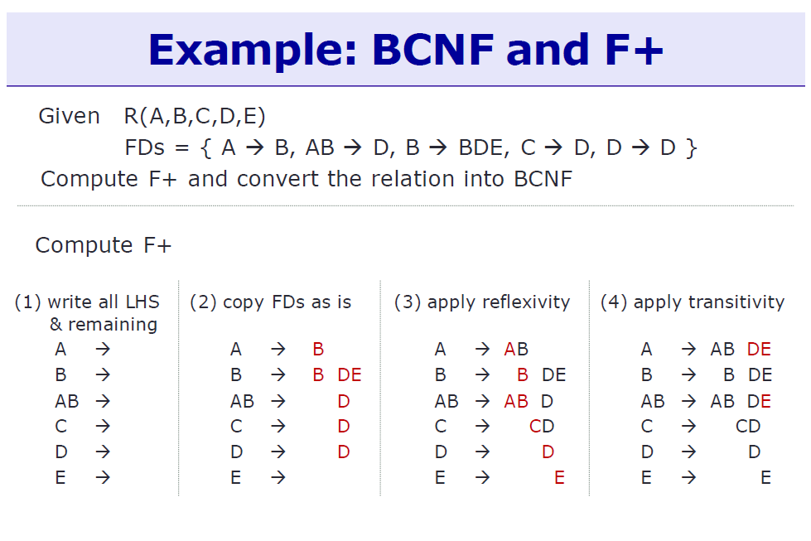

Slide 28
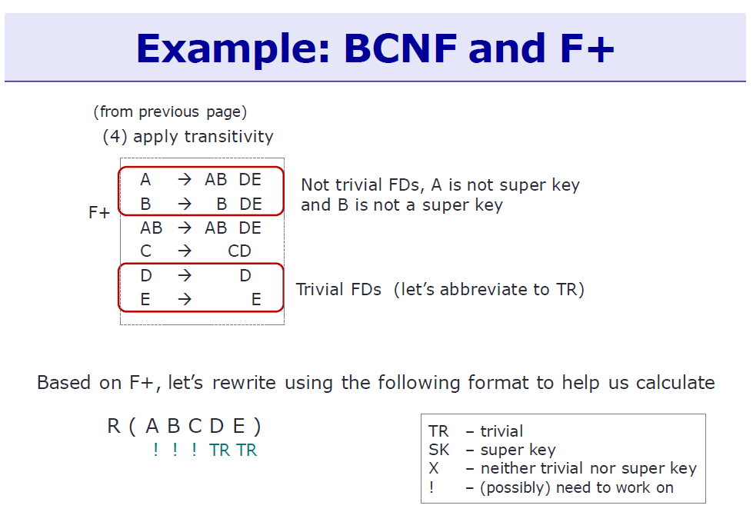

Slide 29
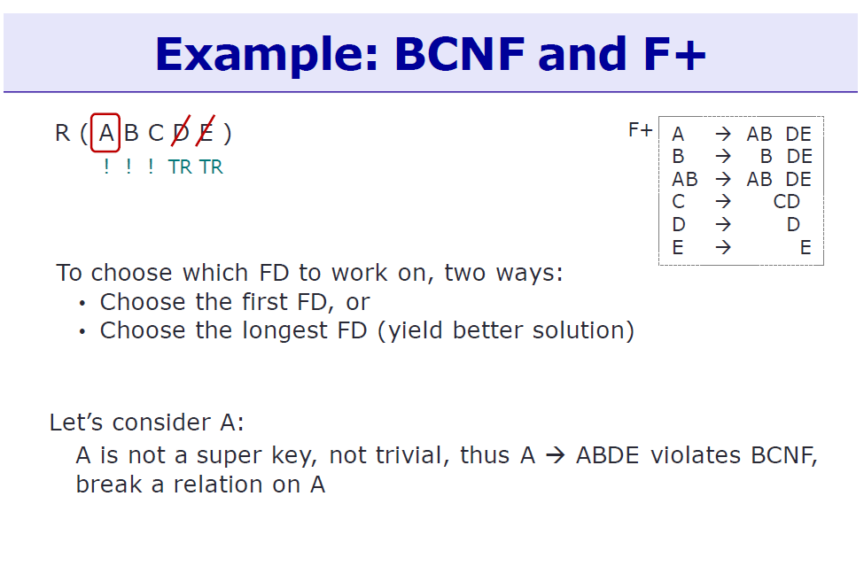

Slide 30
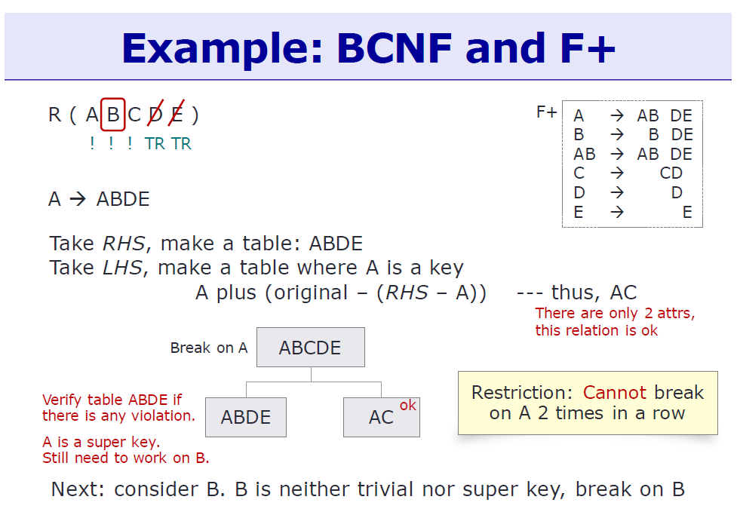

Slide 31
