Slide 1
Relational Algebra

Slide 2
Relational Algebra
Relational
algebra is the basic set of
operations for the relational model
– These operations enable a user to specify basic retrieval
requests (or queries)
The result of an operation is a new relation, which may have been formed from one or more input relations
– This
property makes the algebra “closed” (all
objects in relational algebra are relations)

Slide 3
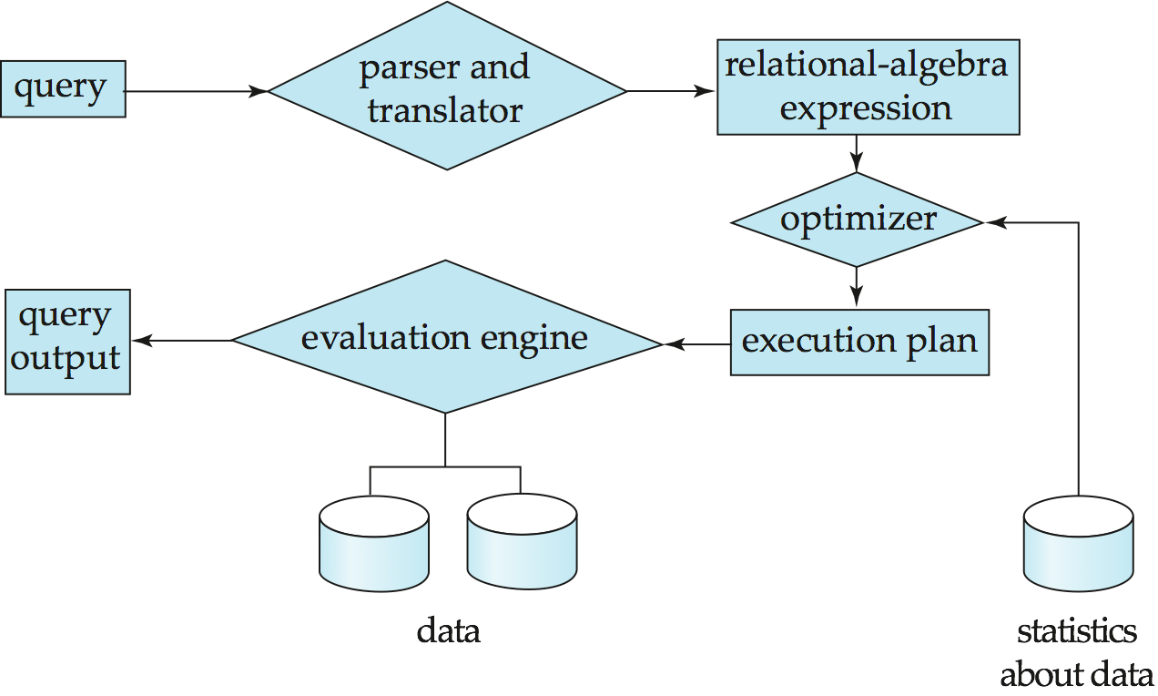

Slide 4
Relational Algebra Operations
Unary Relational Operations
Relational
Theory
Algebra Operations From Set
Binary Relational Operations
Additional Relational Operations

Slide 5
Formal Relational Query Languages
There are two mathematical Query Languages which form the basis for commercial languages (e.g. SQL)
Relational Algebra
Queries are composed of operators
Each query describes a step-by-step procedure for computing the desired answer
Very useful for representing execution plans
Relational Calculus
Queries are subsets of first-order logic
Queries describe desired answers without specifying how they will be computed
A type of non-procedural (or declarative) formal query language

Slide 6
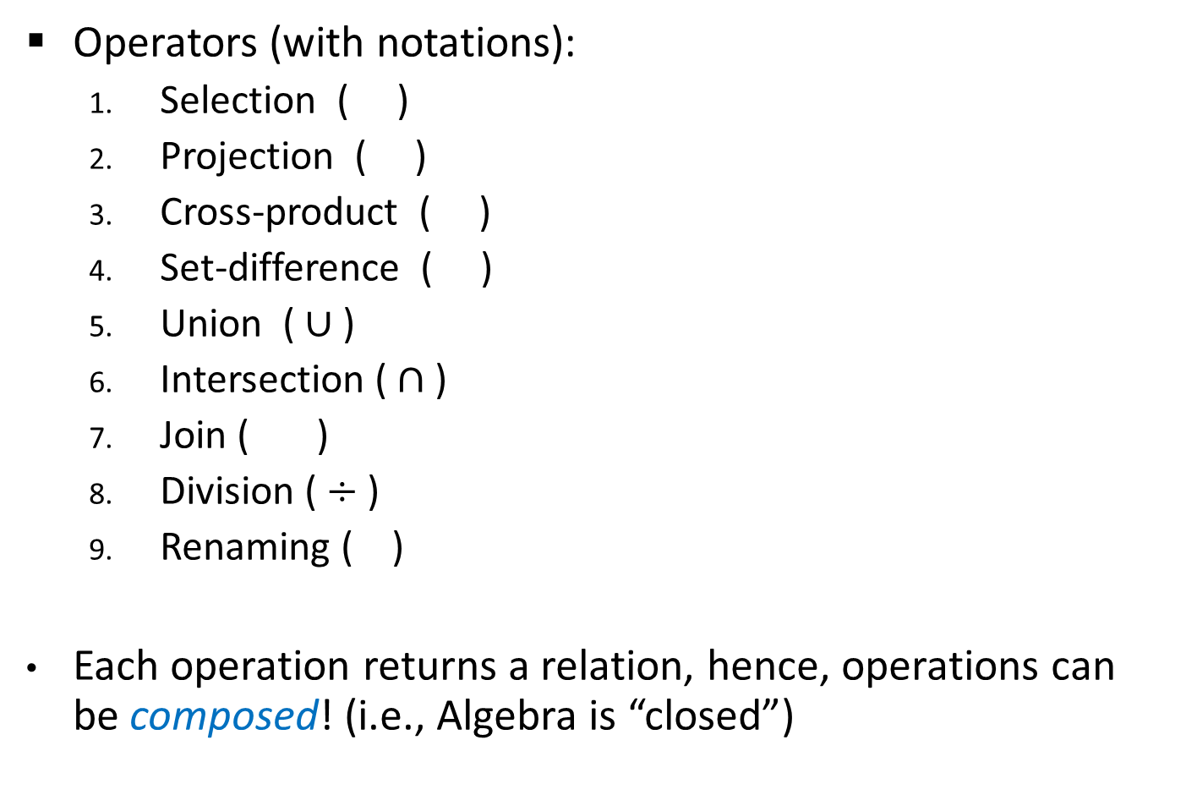
Relational Algebra
Operators (with notations):
Selection ( )
Projection ( )
Cross-product ( )
Set-difference ( )
Union ( $∪$ )
Intersection ( $∩$ )
Join ( )
Division ($÷$ )
Renaming ( )
Each operation returns a relation, hence, operations can be composed! (i.e., Algebra is “closed”)

Slide 7
Relational Algebra
Operators (with notations):
Selection ( )
Projection ( )
Cross-product ( )
Set-difference ( )
Union ( $∪$ )
Intersection ( $∩$ )
Join ( )
Division ($÷$ )
Renaming ( )
Each operation returns a relation, hence, operations can be composed! (i.e., Algebra is “closed”)
Basic
Additional, yet extremely useful!

Slide 8
The Projection Operation
Projection:
“Project out” attributes that are NOT in att-list
The schema of the output relation contains ONLY the fields in att-list, with the same names that they had in the input relation
Example 1:
Input Relation:
Output Relation:
S2

Slide 9

The Projection Operation
Example 2:
The projection operator eliminates duplicates!
Note: real DBMSs typically do not eliminate duplicates unless explicitly asked for
Input Relation:
Output Relation:
S2
Notes:
Duplicate elimination follows from the definition of a relation as a “set” of tuples.

Slide 10
The Selection Operation
Selection:
Selects rows that satisfy the selection condition
The schema of the output relation is identical to the schema of the input relation
Example:
Input Relation:
Output Relation:
S2

Slide 11
Operator Composition
The output relation can be the input for another relational algebra operation! (Operator composition)
Example:
Input Relation:
Intermediate Relation:
Final Output Relation:
S2

Slide 12
The Union Operation
Union:
The two input relations must be union-compatible
Same number of fields
`Corresponding’ fields have the same type
The output relation includes all tuples that occur “in either” R or S “or both”
The schema of the output relation is identical to the schema of R
Example:
R U S
Output Relation:
Input Relations:
S1
S2

Slide 13

The Intersection Operation
$$R∩S$$
Intersection:
The two input relations must be union-compatible
The output relation includes all tuples that occur “in both” R and S
The schema of the output relation is identical to the schema of R
Example:
Input Relations:
Output Relation:
S1
S2

Slide 14

The Set-Difference Operation
$$R−S$$
Set-Difference:
The two input relations must be union-compatible
The output relation includes all tuples that occur in R “but not” in S
The schema of the output relation is identical to the schema of R
Example:
Input Relations:
Output Relation:
S1
S2

Slide 15

The Cross-Product and Renaming Operations
$$RXS$$
Cross Product:
Each row of R is paired with each row of S
The schema of the output relation concatenates S1’s and R1’s schemas
Conflict: R and S might have the same field name
Solution: Rename fields using the “Renaming Operator”
Renaming:
Example:
Output Relation:
Input Relations:
S1
R1
Conflict: Both S1 and R1 have a field called sid

Slide 16
The Cross-Product and Renaming Operations
$$RXS$$
Cross Product:
Each row of R is paired with each row of S
The schema of the output relation concatenates S1’s and R1’s schemas
Conflict: R and S might have the same field name
Solution: Rename fields using the “Renaming Operator”
Renaming:
Example:
Output Relation:
Input Relations:
S1
R1

Slide 17
The Join Operation
(Theta) Join :
The schema of the output relation is the same as that of cross-product
It usually includes fewer tuples than cross-product
Example:
Input Relations:
Output Relation:
S1
R1
Will be redundant “if” the condition is S1.sid = R1.sid!

Slide 18
The Join Operation
Equi-Join:
A special case of theta join where the condition c contains only equalities
The schema of the output relation is the same as that of cross-product, “but only one copy of the fields for which equality is specified”
Natural Join:
Equijoin on “all” common fields
Example:
Input Relations:
Output Relation:
S1
R1
ONLY one sid column!

Slide 19
The Join Operation
Equi-Join:
A special case of theta join where the condition c contains only equalities
The schema of the output relation is the same as that of cross-product, “but only one copy of the fields for which equality is specified”
Natural Join:
Equijoin on “all” common fields
Example:
Natural Join
Input Relations:
Output Relation:
S1
R1
In this case, same as equi-join!

Slide 20
The Division Operation
Division:
Not supported as a primitive operator, but useful for expressing queries like:
Let A have 2 fields, x and y; B have only field y:
A/B contains all x tuples (sailors) such that for every y tuple (boat) in B, there is an xy tuple in A
Or: If the set of y values (boats) associated with an x value (sailor) in A contains all y values in B, then x value is in A/B
Formally: A/B =
In general, x and y can be any lists of fields; y is the list of fields in B, and x y is the list of fields in A
Find sailors who have reserved all boats

Slide 21
Examples of Divisions
B1
B3
A/B1
B2
A/B3
A
A/B2

Slide 22
Expressing A/B Using Basic Operators
Division can be derived from the fundamental operators
Idea: For A/B, compute all x values that are not `disqualified’ by some y value in B
x value is disqualified if by attaching y value from B, we obtain an xy tuple that is “not” in A
Disqualified x values:
A/B:
all disqualified tuples

Slide 23
Aggregate Functions
Summarize column information like min, max, avg, count, sum
Given by the syntax
ℱ_{<functionname>} _{<columnnanme>}(Relation)
Example:
ℱ_{MIN Salary} (EMPLOYEE)
ℱ_{SUM Salary} (EMPLOYEE)
ℱ_{COUNT eno} ( _{eno=4}(DEPENDENT))

Slide 24
Grouping with Aggregation
Grouping can be combined with Aggregate Functions
Example: For each department, retrieve the DNO, number of employees , and AVERAGE SALARY
A variation of aggregate operation ℱ allows this:
Grouping attribute placed to left of symbol
Aggregate functions to right of symbol
_{Example: DNO} ℱ_{COUNT SSN, AVERAGE Salary} (EMPLOYEE)

Slide 25
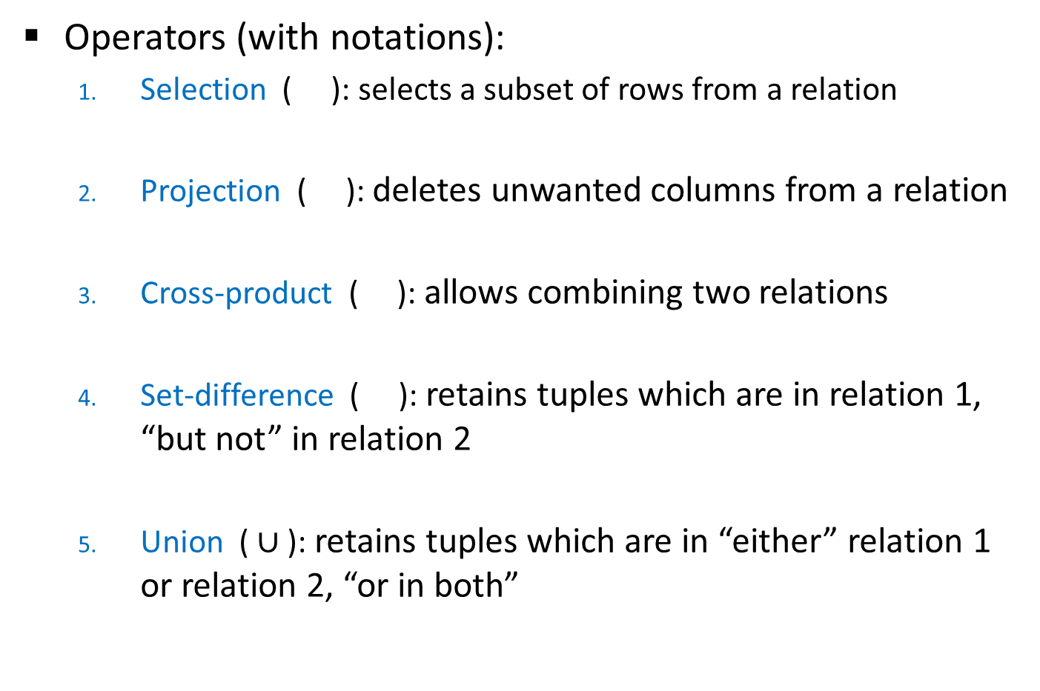
Relational Algebra: Summary
Operators (with notations):
Selection ( ): selects a subset of rows from a relation
Projection ( ): deletes unwanted columns from a relation
Cross-product ( ): allows combining two relations
Set-difference ( ): retains tuples which are in relation 1, “but not” in relation 2
Union ( $∪$ ): retains tuples which are in “either” relation 1 or relation 2, “or in both”

Slide 26
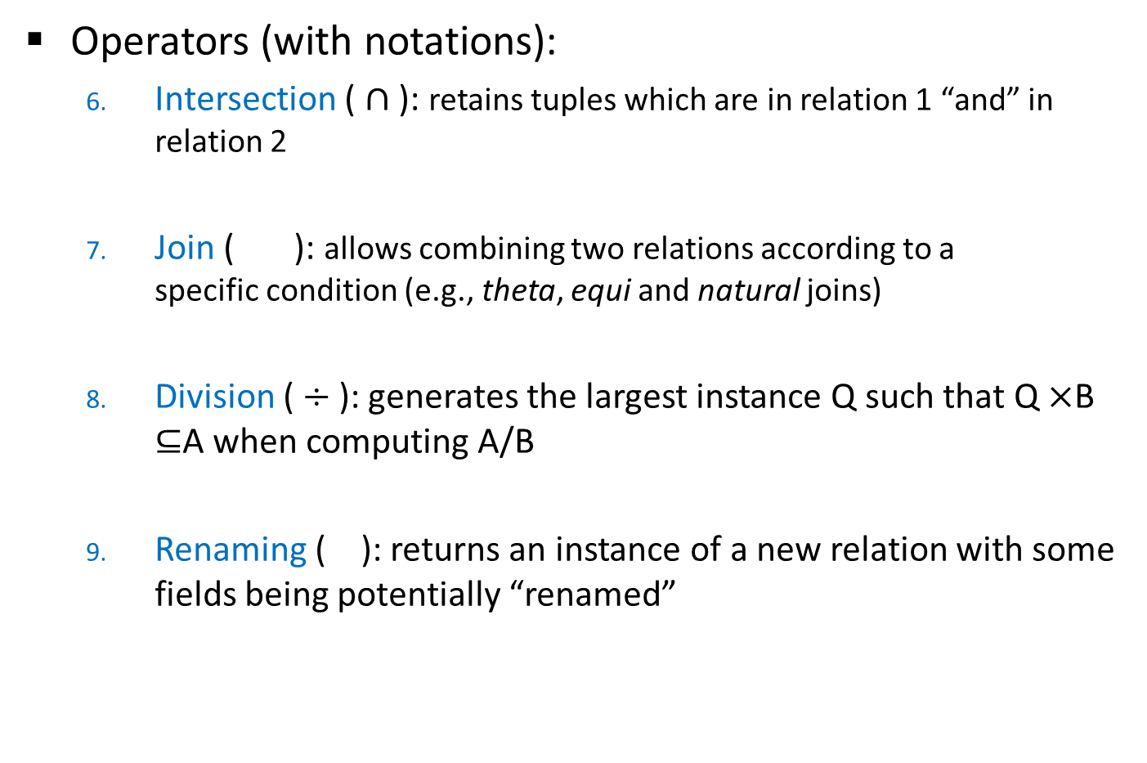
Relational Algebra: Summary
Operators (with notations):
Intersection ( $∩$ ): retains tuples which are in relation 1 “and” in relation 2
Join ( ): allows combining two relations according to a specific condition (e.g., theta, equi and natural joins)
Division ($÷$ ): generates the largest instance Q such that Q $×$B $⊆$A when computing A/B
Renaming ( ): returns an instance of a new relation with some fields being potentially “renamed”

Slide 27
Additional Examples
Q1: Find names of sailors who’ve reserved boat #103
Sid | Sname | Rating | Age
22 | Dustin | 7 | 45.0
29 | Brutus | 1 | 33.0
31 | Lubber | 8 | 55.5
32 | Andy | 8 | 25.5
58 | Rusty | 10 | 35.0
64 | Horatio | 7 | 35.0
71 | Zorba | 10 | 16.0
74 | Horatio | 9 | 35.0
85 | Art | 3 | 25.5
95 | Bob | 3 | 63.5
Sid | Bid | Day
22 | 101 | 10/10/98
22 | 102 | 10/10/98
22 | 103 | 10/8/98
22 | 104 | 10/7/98
31 | 102 | 11/10/98
31 | 103 | 11/6/98
31 | 104 | 11/12/98
64 | 101 | 9/5/98
64 | 102 | 9/8/98
74 | 103 | 9/8/98
Bid | Bname | Color
101 | Interlake | Blue
102 | Interlake | Red
103 | Clipper | Green
104 | Marine | Red
An Instance B1 of Boats
An Instance S3 of Sailors
An Instance R2 of Reserves

Slide 28
Additional Examples
Q1: Find names of sailors who’ve reserved boat #103
OR:
OR:
Which one to choose?

Slide 29
Additional Examples
Q2: Find names of sailors who’ve reserved a red boat
Sid | Sname | Rating | Age
22 | Dustin | 7 | 45.0
29 | Brutus | 1 | 33.0
31 | Lubber | 8 | 55.5
32 | Andy | 8 | 25.5
58 | Rusty | 10 | 35.0
64 | Horatio | 7 | 35.0
71 | Zorba | 10 | 16.0
74 | Horatio | 9 | 35.0
85 | Art | 3 | 25.5
95 | Bob | 3 | 63.5
Sid | Bid | Day
22 | 101 | 10/10/98
22 | 102 | 10/10/98
22 | 103 | 10/8/98
22 | 104 | 10/7/98
31 | 102 | 11/10/98
31 | 103 | 11/6/98
31 | 104 | 11/12/98
64 | 101 | 9/5/98
64 | 102 | 9/8/98
74 | 103 | 9/8/98
Bid | Bname | Color
101 | Interlake | Blue
102 | Interlake | Red
103 | Clipper | Green
104 | Marine | Red
An Instance B1 of Boats
An Instance S3 of Sailors
An Instance R2 of Reserves

Slide 30
Additional Examples
Q2: Find names of sailors who’ve reserved a red boat
OR:
A query optimizer can find the second one, given the first solution!

Slide 31
Additional Examples
Q3: Find sailors who’ve reserved a red or a green boat
Sid | Sname | Rating | Age
22 | Dustin | 7 | 45.0
29 | Brutus | 1 | 33.0
31 | Lubber | 8 | 55.5
32 | Andy | 8 | 25.5
58 | Rusty | 10 | 35.0
64 | Horatio | 7 | 35.0
71 | Zorba | 10 | 16.0
74 | Horatio | 9 | 35.0
85 | Art | 3 | 25.5
95 | Bob | 3 | 63.5
Sid | Bid | Day
22 | 101 | 10/10/98
22 | 102 | 10/10/98
22 | 103 | 10/8/98
22 | 104 | 10/7/98
31 | 102 | 11/10/98
31 | 103 | 11/6/98
31 | 104 | 11/12/98
64 | 101 | 9/5/98
64 | 102 | 9/8/98
74 | 103 | 9/8/98
Bid | Bname | Color
101 | Interlake | Blue
102 | Interlake | Red
103 | Clipper | Green
104 | Marine | Red
An Instance B1 of Boats
An Instance S3 of Sailors
An Instance R2 of Reserves

Slide 32
Additional Examples
Q3: Find sailors who’ve reserved a red or a green boat
Can we define Tempboats using union?
What happens if is replaced by ?

Slide 33
Additional Examples
Q4: Find sailors who’ve reserved a red and a green boat
Sid | Sname | Rating | Age
22 | Dustin | 7 | 45.0
29 | Brutus | 1 | 33.0
31 | Lubber | 8 | 55.5
32 | Andy | 8 | 25.5
58 | Rusty | 10 | 35.0
64 | Horatio | 7 | 35.0
71 | Zorba | 10 | 16.0
74 | Horatio | 9 | 35.0
85 | Art | 3 | 25.5
95 | Bob | 3 | 63.5
Sid | Bid | Day
22 | 101 | 10/10/98
22 | 102 | 10/10/98
22 | 103 | 10/8/98
22 | 104 | 10/7/98
31 | 102 | 11/10/98
31 | 103 | 11/6/98
31 | 104 | 11/12/98
64 | 101 | 9/5/98
64 | 102 | 9/8/98
74 | 103 | 9/8/98
Bid | Bname | Color
101 | Interlake | Blue
102 | Interlake | Red
103 | Clipper | Green
104 | Marine | Red
An Instance B1 of Boats
An Instance S3 of Sailors
An Instance R2 of Reserves

Slide 34
Additional Examples
Q4: Find sailors who’ve reserved a red and a green boat
Would the previous approach (i.e., using ∩ instead of U) work?

Slide 35
Additional Examples
Q5: Find the names of sailors who’ve reserved all boats
Sid | Sname | Rating | Age
22 | Dustin | 7 | 45.0
29 | Brutus | 1 | 33.0
31 | Lubber | 8 | 55.5
32 | Andy | 8 | 25.5
58 | Rusty | 10 | 35.0
64 | Horatio | 7 | 35.0
71 | Zorba | 10 | 16.0
74 | Horatio | 9 | 35.0
85 | Art | 3 | 25.5
95 | Bob | 3 | 63.5
Sid | Bid | Day
22 | 101 | 10/10/98
22 | 102 | 10/10/98
22 | 103 | 10/8/98
22 | 104 | 10/7/98
31 | 102 | 11/10/98
31 | 103 | 11/6/98
31 | 104 | 11/12/98
64 | 101 | 9/5/98
64 | 102 | 9/8/98
74 | 103 | 9/8/98
Bid | Bname | Color
101 | Interlake | Blue
102 | Interlake | Red
103 | Clipper | Green
104 | Marine | Red
An Instance B1 of Boats
An Instance S3 of Sailors
An Instance R2 of Reserves

Slide 36
Additional Examples
Q5: Find the names of sailors who’ve reserved all boats
How can we find sailors who’ve reserved all ‘Interlake’ boats?

Slide 37
Summary
The relational model has rigorously defined query languages that are simple and powerful
Relational algebra is operational; useful as internal representation for query evaluation plans
Several ways of expressing a given query; a query optimizer should choose the most efficient version

