Slide 1
Algorithm Analysis

Slide 2
What is algorithm analysis
Comparing the efficiency of programs in terms of time and storage space
Time complexity: amount of CPU time taken by an algorithm to run to its completion
Space complexity: amount of memory space taken by an algorithm.

Slide 3
Why algorithm analysis
For example
Sorting algorithms – produces sorted output
Why many sorting algorithms?

Slide 4
Asymptotic notation
Asymptotic Notations are languages to analyse an algorithm's running time by identifying its behaviour as the input size for the algorithm increases. This is also known as an algorithm's growth rate.
Commonly used asymptotic notations to calculate the running time complexity of an algorithm.
Big Oh- Ο Notation (actually Big Omicron)
Order at most (maximum time to execute algorithm or upper bound)
Big Omega- Ω Notation
Order at least (minimum time to execute algorithm or lower bound)
Theta- θ Notation
Order exactly

Slide 5
Big Oh O(. . .) – Formal Definition
The function f(n) is O(g(n)) iff there exists a positive real constant c and a positive integer n₀ such that f(n) ≤ cg(n) for all n > n₀.
f(n) is the function defining n
g(n) is the growth rate ( time complexity of algorithm as n grows)

Slide 6
Big Omega
The function f(n) is Ω(g(n)) iff there exists a positive real constant c and a positive integer n₀ such that f(n) ≥ cg(n) for all n > n₀.
• Ω(. . .) is complementary to O(. . .).

Slide 7
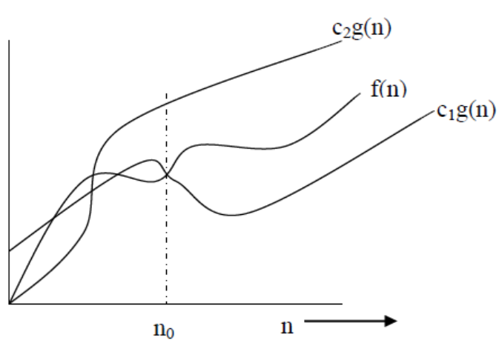
Theta
The function f(n) is Θ(g(n)) iff there exists two positive real constants c₁ and c₂ and a positive integer n₀ such that c₁g(n) ≤ f(n) ≤ c₂g(n) for all n > n₀.
• Informally, if f(n) is Θ(g(n)) then both the functions have the same rate of increase.

Slide 8
Asymptotic analysis
Asymptotic analysis is input bound i.e., if there's no input to the algorithm print (“Hello”), it is concluded to work in a constant time. Other than the "input" all other factors are considered constant.
Asymptotic analysis refers to computing the running time of any operation in mathematical units of computation.
Based on input given the time required by an algorithm falls under three types −
Best Case − Minimum time required for program execution.
Average Case − Average time required for program execution.
Worst Case − Maximum time required for program execution.

Slide 9
Some common orders of growth seen often in complexity analysis are
O(1) | constant
O(log n) | logarithmic
O(n) | linear
O(n log n) | "n logn“ (Linearithmic)
O(n²) | quadratic
O(n³) | cubic
2^{n} | exponential
NOTE: Here log means log₂ or the logarithm base 2, although the logarithm base doesn't really matter since logarithms with different bases differ by a constant factor.

Slide 10
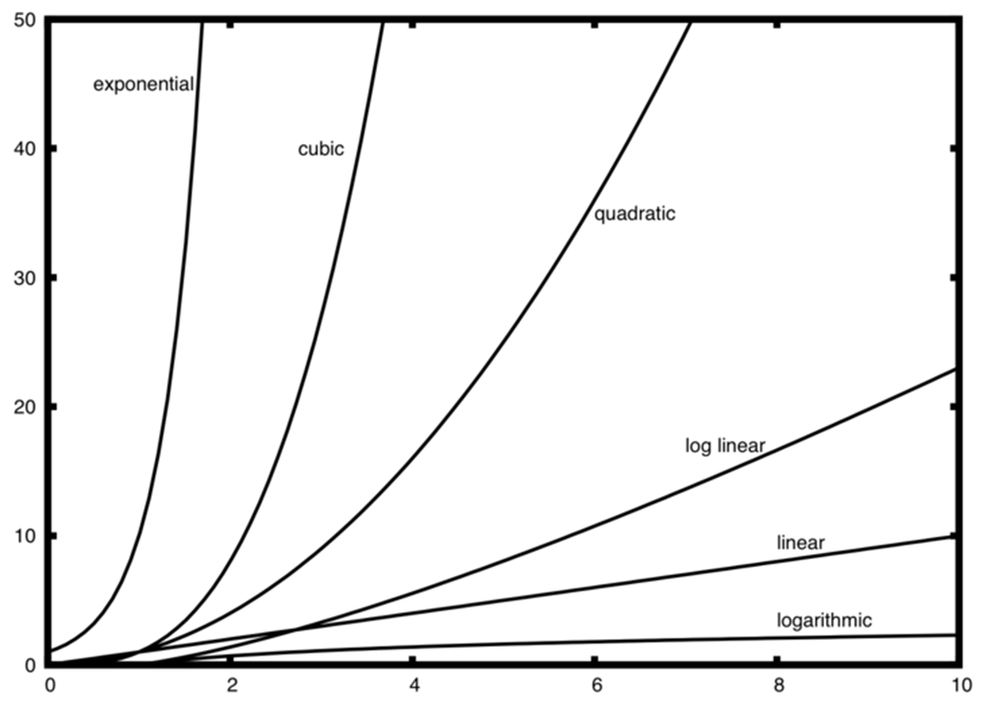
when n is small, the functions are not very well defined with respect to one another. It is hard to tell which is dominant. However, as n grows, there is a definite relationship and it is easy to see how they compare with one another.

Slide 11
Linear Loops – O(n)
for(i=0;i<n;i++)
{Stmts;} f(n)= n
for(i=0;i<n;i+=2) f(n)=n/2
{Stmts;}

Slide 12
Logarithmic Loop
for(i=0;i<n;i*=2)
{Stmts;}
f(n)=logn
for(i=0;i<n;i/=2)
{Stmts;}

Slide 13
Nested loops
Linear Logarithmic loop
for(i=0;i<10;i++) - linear
for(j=1;j<10;j*=2)-logarithmic
Stmt block;
f(n) = nlogn

Slide 14
Nested loops….
Quadratic loop
for(i=0;i<10;i++)
for(j=0;j<10;j++)
Stmt block;
f(n) = n²

Slide 15
Nested loops….
Dependent Quadratic loop O(n²)
for(i=0;i<10;i++) (n)
for(j=0;j<=i;j++) (n+1)/2 – on average
stmt block;
f(n) = n(n+1)/2

Slide 16
Common Confusion
Confusing worst case with upper bound.
Upper bound refers to a growth rate.
Worst case refers to the worst input from among the choices for possible inputs of a given size.

Slide 17
Shortcomings of asymptotic analysis
Let algorithm A be asymptotically better than algorithm B.
Implementation complexity - Algorithms with better complexity are often (much) more complicated. This can increase coding time and the constants.
Asymptotic analysis ignores small input sizes. At small input sizes, constant factors or low order terms could dominate running time, causing B to outperform A.
Worst case versus average performance If A has better worst case performance than B, but the average performance of B given the expected input is better, then B could be a better choice than A. Conversely, if the worst case performance of B is unacceptable (say for life-threatening or mission-critical reasons), A must still be used.

Slide 18
Example – O(n)
def sumOfN(n):
theSum = 0 (1)
for i in range(1,n+1):
theSum = theSum + i (n)
return theSum
print(sumOfN(10))
T(n)=1+n – as n grows large 1 becomes less and less significant. Hence time complexity of this algorithm is O(n)
T – Total no. of steps for given input

Slide 19
a=5 (1)
b=6 (1)
c=10 (1)
for i in range(n):
for j in range(n): (3n² )
x = i * i
y = j * j
z = i * j
for k in range(n): (2n)
w = a*k + 45
v = b*b
d = 33 (1)
T(n)=3+3n²+2n+1=3n²+2n+4
Upper bound – O(n²)
Lower bound – O(n)

Slide 20
void add(matrix a, matrix b, matrix c, int m, int n)
{
for (int i=0; i<=m; i++) (m+1)
for (int j=0; j<=n; j++) m(n+1)
C[i][j] =a[i][j] + b[i][j]; 1+mn
}
T(m,n)=m+1+mn+m+1+mn= 2mn+2m+2
Time Complexity = O(mn)

Slide 21
Recursion
The factorial of a number is defined as:
f(n) = n * f(n-1) → for all n >0 f(0) = 1 → for n = 0
Steps involved
if n is 0 (i.e) factorial(0)– 1comparison
T(0)=1
Factorial(n)
1 comparison
1 multiplication
1 subtraction
Time complexity for factorial(n-1)
T(n)=T(n-1)+3 or T(n)=T(n-1)+c - recurrence relation……..(1)
factorial(n):
if n is 0
return 1
return n * factorial(n-1)

Slide 22
Solving by backward substitution method
T(n-1)=T(n-2)+c
Substituting for T(n-1) in (1)
T(n)=[T(n-2)+c]+c=T(n-2)+2c…..(2)
T(n-2)=T(n-3)+c
Substituting in T(n-2) in (2)
T(n)=[T(n-3)+3]+6=T(n-3)+3c…..(3)
In general,
T(n)=T(n-k)+k.c
Now find the value of k for which n - k = 0, k = n
T(n) = T(0) + n.c , [substituting k = n and T(0)=1]
= 1 + n.c
Hence time complexity of factorial of n is O(n)

Slide 23
Recursion-Fibonacci
fib(n): if n <= 1 return 1 return fib(n - 1) + fib(n – 2)
Steps:
For n = 0 or 1, T(n)=1 (ie:T(0)=1, T(1)=1)
For n > 1: T(n) = T(n-1) + T(n-2) + 4 =T(n-1)+T(n-2)+c
Time complexity(n-1)+Time complexity (n-2)+operations(1 comparison, 2 subtractions, 1 addition)

Slide 24
Let us assume T(n-2)<=T(n-1)
Therefore T(n)=2T(n-1)+c…..(1) [T(n-2)~T(n-1)]
T(n-1)=2T(n-2)+c…..(2)
Substituting 2 in 1
T(n)=2[2T(n-2)+c]+c=4T(n-2)+3c
T(n-2)=2T(n-3)+c….(3)
Substituting 3 in 1
T(n)=8T(n-3)+7c
In general, T(n)=2^{k}T(n-k)+(2^{k} -1)c
Let's find the value of k for which: n - k = 0, k = n
T(n) = 2^{n} * T(0) + (2^{n} - 1)*c [T(0)=1]
= 2^{n} [1 + c] - c
i.e. T(n) ~ 2^{n}
Therefore time complexity of Fibonacci series using recursion is exponential.
Note: recursive call for n-2 is completed before n-1 recursive function but not beyond it. (Similar to the concept of Golden ratio)

Slide 25
Proof Example
Prove that 3n²+4n+6= O (n²)
To prove using Big-O:
Determine f(n) and g(n)
Write the equation based on the definition
Choose a c such that the equation is true
Here f(n) is 3n²+4n+6 and g(n) is n²
Using definition of Big oh - O(g(n))={f(n): if there exist positive constant c and n₀ such that 0≤f(n) ≤cg(n) for all n, n> n₀} try to find a constant and n₀ such that 3n²+4n+6<cn² for all n, n> n₀
Say if c is 4 and n₀ is 6 (n₀ could be called as threshold value) f(n)<cg(n) holds true (i.e) 3n²+4n+6<4n² for n>6 (138<144)
Therefore f(n)= O(g(n)) (i.e) 3n²+4n+6 = O (n²)

Slide 26
Let’s Practice
Generate the hierarchy of growth rate for the following growth rates.
C, N³, 2N, 3N, N! , NN, N, N log N, log N, sqrt(N)
Assume doit is O(n)=n². Determine the efficiency of following algorithm
i=1
loop(i<=n)
{j=1
loop(j<n)
{doit(..)
j=j+1}
i=i+1
}
Assume doit is O(n)=5n. Determine the efficiency of following algorithm
i=1
loop(i<n)
{doit(..)
i=i*2
}

