Slide 1
Time Complexity
Practice problems

Slide 2
Example 1:
int a = 0, b = 0;
for (i = 0; i < N; i++) {
a = a + rand();
}
for (j = 0; j < M; j++) {
b = b + rand();
}
Time Complexity : O(N+M)

Slide 3
Example 2:
int a = 0;
for (i = 0; i < N; i++) {
for (j = N; j > i; j--) {
a = a + i + j;
}
}
Time Complexity : O(N²)

Slide 4
Example 3:
int i, j, k = 0;
for (i = n / 2; i <= n; i++) {
for (j = 2; j <= n; j = j * 2) {
k = k + n / 2;
}
}
Outer loop runs for n/2 times and inner loop for logn times
=n/2*logn
Time Complexity : O(nlogn)

Slide 5
Example 4:
int a = 0, i = N;
while (i > 0) {
a += i;
i /= 2;
}
Time Complexity : O(logn)

Slide 6
Example 5:
void function(int n)
{
int i = 1, s = 1;
while (s < n) { //note: looping condition depends on s
s = s + i;
i++;
}
}
Explanation:
1+1+2+3+4+5…k [loop stops when s>=n]
1+[k(k+1)]/2=n
On solving we find the dominating term to be K²
Therefore K² =n , Thus k = sqrt(n)
Time Complexity : sqrt(n)

Slide 7
Example 6:
if(i>j){
j==0? j++ : j--;
}
Time Complexity : O(1)
[conditional staatements]

Slide 8
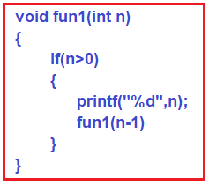
Example 7
Write the recurrence relation for the following code and derive its time complexity
T(n)=T(n-1)+1 , n>0
T(n)=1, n=0 (for comparison)

Slide 9
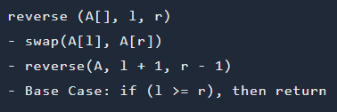
Example 8:
Write the recurrence relation for the following code and derive its time complexity
T(n)=T(n-2)+1, n>1
T(n)=0, n=0, n=1
T(n-2)- recursion happens after swapping 1st and n^{th} element

Slide 10
For reference
Big O Notation | Name | Example(s)
O(1) | Constant | # Odd or Even number, # Look-up table (on average)
O(log n) | Logarithmic | # Finding element on sorted array with binary search
O(n) | Linear | # Find max element in unsorted array, # Duplicate elements in array with Hash Map
O(n log n) | Linearithmic | # Sorting elements in array with merge sort
O(n²) | Quadratic | # Duplicate elements in array **(naïve)**, # Sorting array with bubble sort
O(n³) | Cubic | # 3 variables equation solver
O(2^{n}) | Exponential | # Find all subsets
O(n!) | Factorial | # Find all permutations of a given set/string

