Slide 1
Master’s Theorem

Slide 2
Introduction
The most useful and easy method to compute the time complexity function of recurrence relations.
Master's Theorem is applied for:
Dividing functions (Divide and Conquer technique)
Decreasing Functions (Subtract and Conquer)

Slide 3
Master’s Theorem for Dividing Functions
The Master Theorem applies to recurrences of the following form:
T (n) = aT (n/b) + f(n)
where a > 1 and b > 1 are constants and f(n) is an asymptotically positive function given as f(n) = θ(n ^{K} log ^{p} n)
Compare log_{b}​a and k to decide the final time complexity function.
K is a constant > 0
Note:
n : input size (or the size of the problem) a :count of sub problems in the dividing recursive function n/b = size of each sub problem (Assuming size of each sub problem is same)

Slide 4
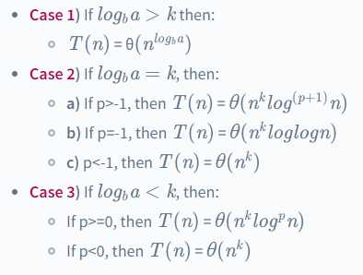
For the values log_{b}a and k
Master theorem states that

Slide 5
For dividing functions: Examples for Practice
T(n)=T(n/2)+1 …….Binary search …..case 2
T(n)=2T(n/2)+n…..Quick sort, Merge sort….case 2
T (n) = 3T (n/2)+ n² ......case 3
T (n) = 16T (n/4)+ n........case 1
T (n) = 2^{n}T (n/2) + n^{n} …..Does not apply (a is not constant)

Slide 6
Master’s Theorem for Decreasing Functions
Recurrence relation is of the form:
T(n)=aT(n−b)+f(n), where f(n) = O(n^{k})
where: n = input size (or the size of the problem) a = count of sub problems in the decreasing recursive function n-b = size of each sub problem (Assuming size of each sub problem is same)
Here a, b, and k are constants where a>0, b>0, k>=0
Case 1: If a<1 then T(n) = O(n^{k}) [T(n)=O(f(n))] Case 2: If a=1 then T(n) = O(n^{k+1}) [T(n)=O(n.f(n))] Case 3: if a>1 then T(n) = O(n^{k}a^{n/b}) [T(n)=O(f(n).a^{n/b} )]

Slide 7
Example
T(n)=T(n-1)+1
T(n)=T(n-1)+n
T(n)=T(n-1)+log₂n…….heap sort
T(n)=2T(n-1)+1 …….Fibonacci recurrence after applying approximation

