Slide 1
PMCA502L- Java Programming
Java Basics

Slide 2
Java Introduction
Java is a programming language and computing platform first released by Sun Microsystems in 1995.
Java is free to download.
Java is a general-purpose, class-based, object-oriented programming language designed for having lesser implementation dependencies. It is a computing platform for application development. Java is fast, secure, and reliable, therefore. It is widely used for developing Java applications in laptops, data centers, game consoles, scientific supercomputers, cell phones, etc.
Java Platform is a collection of programs that help programmers to develop and run Java programming applications efficiently. It includes an execution engine, a compiler, and a set of libraries in it. It is a set of computer software and specifications. James Gosling developed the Java platform at Sun Microsystems, and the Oracle Corporation later acquired it.
Vijayarani A., AP SITE, VIT, Vellore

Slide 3
Java Features
Is simple
Is object-oriented
Is distributed
Interpreted
Robust
Secure
Architecture-neutral
Portable
Performance
Multithreaded
dynamic
Vijayarani A., AP SITE, VIT, Vellore

Slide 4
Different Types of Java Platforms
Java Platform, Standard Edition (Java SE): Java SE's API offers the Java programming language's core functionality.
Java Platform, Enterprise Edition (Java EE): The Java EE platform offers an API and runtime environment for developing and running highly scalable, large-scale, multi-tiered, reliable, and secure network applications.
Java Programming Language Platform, Micro Edition (Java ME): The Java ME platform offers an API and a small-footprint virtual machine running Java programming language applications on small devices, like mobile phones.
Java FX: JavaFX is a platform for developing rich internet applications using a lightweight user-interface API.
Vijayarani A., AP SITE, VIT, Vellore

Slide 5
Components of Java
A Java Programmer writes a program in a human-readable language called Source Code. Therefore, the CPU or Chips never understand the source code written in any programming language.
These computers or chips understand only one thing, which is called machine language or code. These machine codes run at the CPU level. Therefore, it would be different machine codes for other models of CPU.
Vijayarani A., AP SITE, VIT, Vellore

Slide 6
Components of Java - JDK
Java Development Kit(JDK) is a software development environment used for making applets and Java applications.
JDK contains tools required to write Java programs and Java Run Environment (JRE) to execute them.
It includes a compiler, Java application launcher, Appletviewer, etc.
Compiler converts code written in Java into byte code.
Java application launcher opens a JRE, loads the necessary class, and executes its main method.
Vijayarani A., AP SITE, VIT, Vellore

Slide 7
Components of Java - JRE
JRE is a piece of software that is designed to run other software. It contains the class libraries, loader class, and JVM. In simple terms, if you want to run a Java program, you need JRE. If you are not a programmer, you don't need to install JDK, but just JRE to run Java programs.
Vijayarani A., AP SITE, VIT, Vellore

Slide 8
Components of Java - JVM
Java Virtual Machine (JVM) is an engine that provides a runtime environment to drive the Java Code or applications. It converts Java bytecode into machine language. JVM is a part of the JRE. In other programming languages, the compiler produces machine code for a particular system. However, the Java compiler produces code for a Virtual Machine known as Java Virtual Machine.
JVM provides a platform-independent way of executing Java source code.
It has numerous libraries, tools, and frameworks.
Once you run a Java program, you can run on any platform and save lots of time.
JVM comes with JIT (Just-in-Time) compiler that converts Java source code into low-level machine language. Hence, it runs faster than a regular application.
Vijayarani A., AP SITE, VIT, Vellore

Slide 9
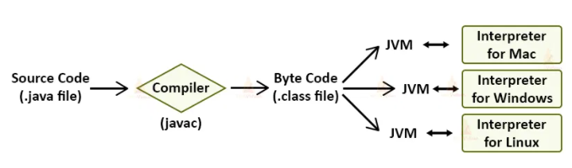
JVM - Architecture
Java programs are first compiled into Java Byte Code(Binary form) and then a special Java interpreter interprets them for a specific platform.
Java ByteCode is the machine language for Java Virtual machine(JVM). The JVM converts the compiled binary byte code into a specific machine language.
Java Virtual machine acts as a subpart of Java Runtime Environment(JRE).
Vijayarani A., AP SITE, VIT, Vellore

Slide 10
JVM Architecture
JVM(Java Virtual Machine) behaves as a run-time engine to run Java applications. JVM calls the main method present in Java code.
Java Virtual machine(JVM) is a part of the JRE(Java Runtime Environment).
Java applications are WORA (Write Once Run Anywhere). This means that we need to write the Java programs just once, which we can run on different platforms without making changes in the Java program.
When we compile a .java file, the compiler generates the .class files(contains byte-code) with the same names as that of the class present in a .java file.
When we run a .class file, it goes through various steps.
Vijayarani A., AP SITE, VIT, Vellore

Slide 11
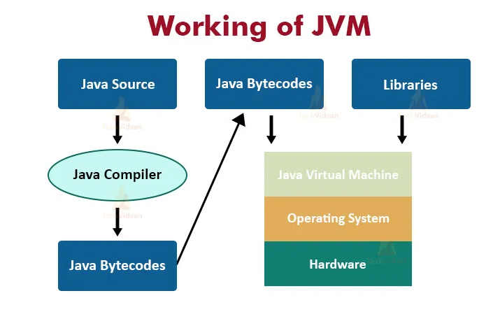
JVM – Working Scenario
Vijayarani A., AP SITE, VIT, Vellore

Slide 12
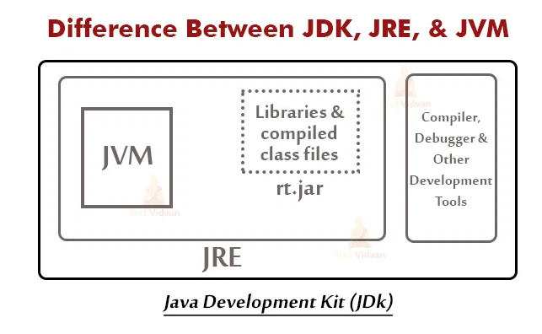
JDK, JRE and JVM
Vijayarani A., AP SITE, VIT, Vellore

Slide 13
Structure of Java Program
Documentation Section
Package Declaration
Import Statements
Interface Section
Class Definition
Class Members and Methods
Main Method Class
Methods and Behaviours
Vijayarani A., AP SITE, VIT, Vellore

Slide 14
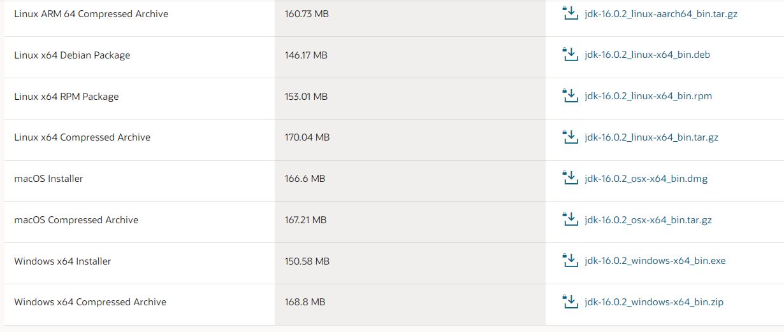
Java Installation
https://techvidvan.com/tutorials/java-installation/ - link for installation
https://www.oracle.com/java/technologies/javase-jdk16-downloads.html - link to download the software
Windows 64 bit software
Vijayarani A., AP SITE, VIT, Vellore

Slide 15
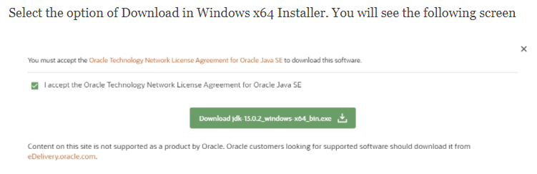
Java Introduction
Download the required software based on your system configuration. Click on the JDK Download option. After that, check the box(which is circled with red color) of the Accept License Agreement. Download the latest Java JDK for your version (32 or 64 bit) of Java for Windows.
Click this
Vijayarani A., AP SITE, VIT, Vellore

Slide 16
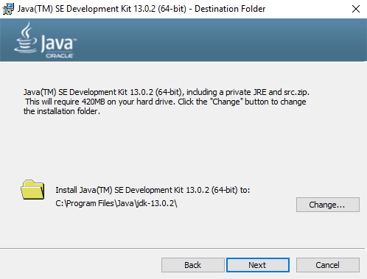
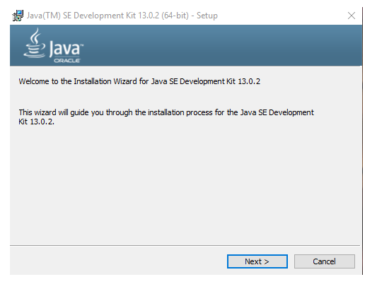
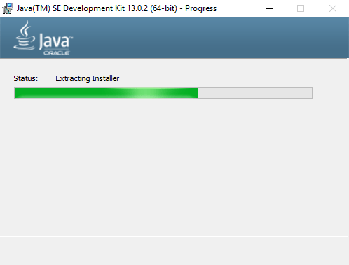
Java Installation
Once the download is complete, run the exe to install JDK on your windows machine. Click Next.
Can change the path if you wish. ‘C’ drive is the suggested path
Click this
Vijayarani A., AP SITE, VIT, Vellore

Slide 17
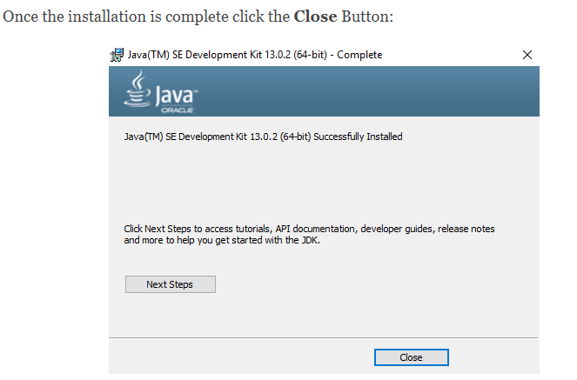
Java Installation
Click this to close the installation
Vijayarani A., AP SITE, VIT, Vellore

Slide 18
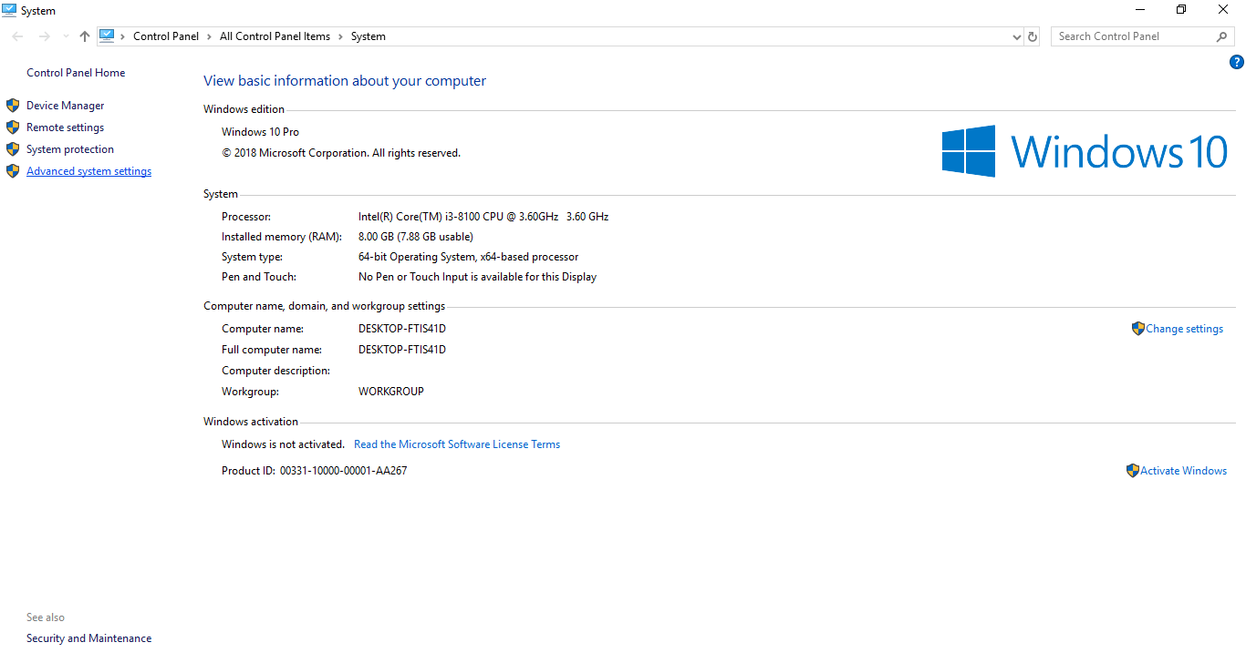
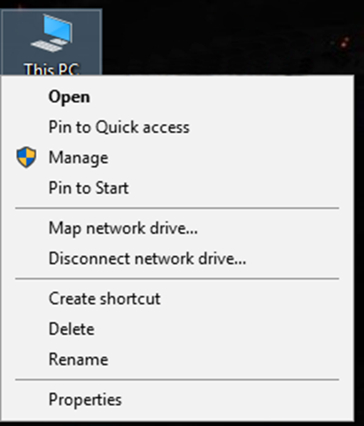

Java Installation
Setting the Environment Variables in Java: Path and Classpath
Right Click on the My Computer and Select the properties as shown below:
Click this
Vijayarani A., AP SITE, VIT, Vellore

Slide 19
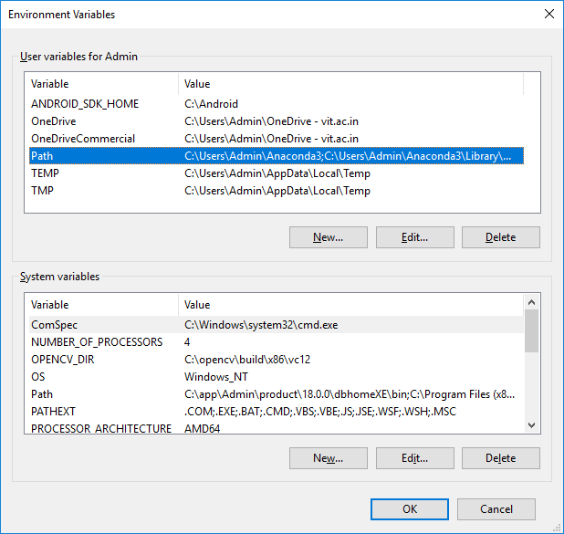
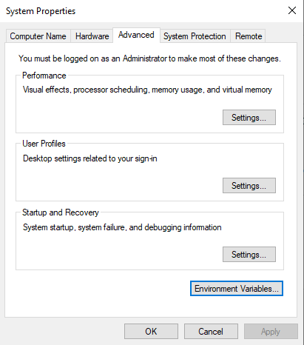
Java Installation
Click on the Environment Variables button
Click Path
Click Edit
Click this
Vijayarani A., AP SITE, VIT, Vellore

Slide 20
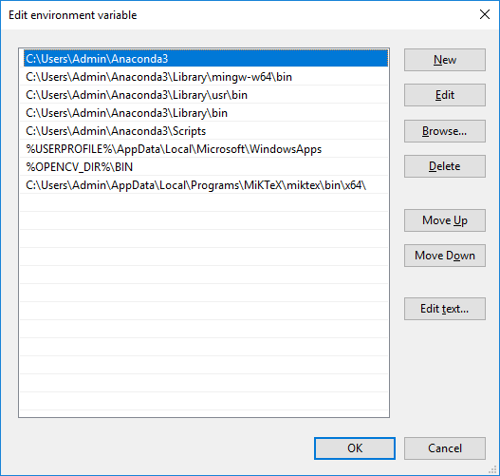
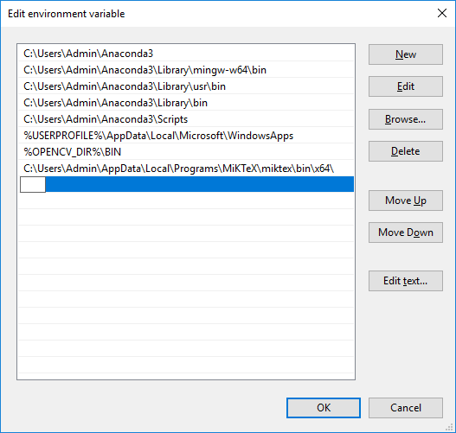
Java Installation
Click on the new button.
Click this
Click this
Vijayarani A., AP SITE, VIT, Vellore

Slide 21
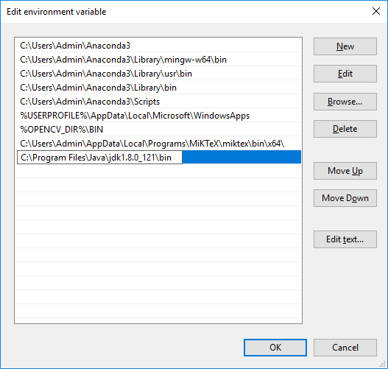
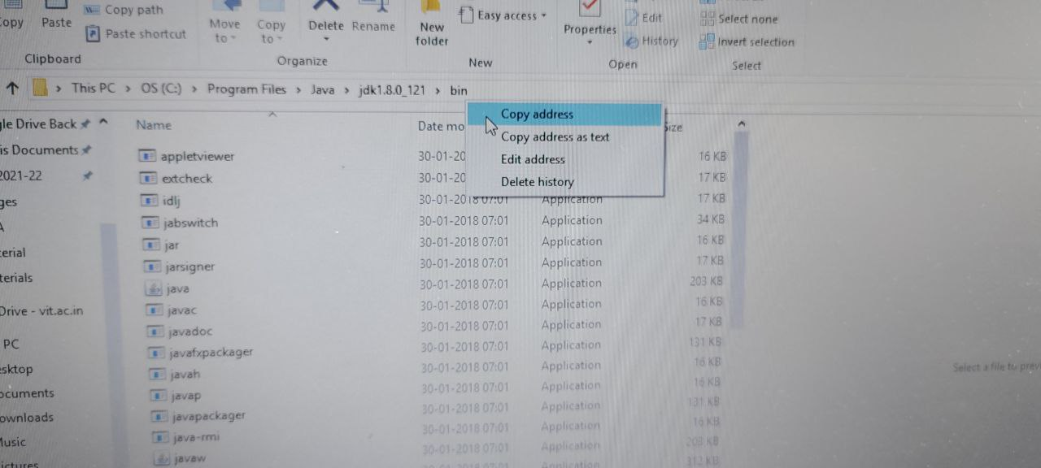
Java Installation
Now copy the address of java installation path as shown:
Paste the address
Click this
Then click rest of “OK” buttons to close the properties window
Vijayarani A., AP SITE, VIT, Vellore

Slide 22
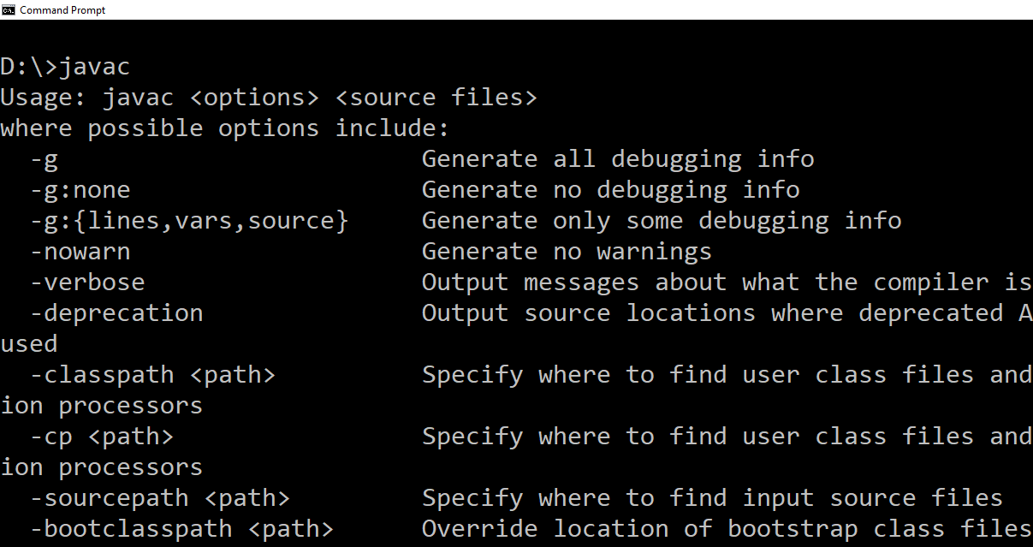
Java Installation
Go to command prompt and type the command: “javac”. If you see a screen like below, Java is installed and the path added successfully.
Vijayarani A., AP SITE, VIT, Vellore

Slide 23
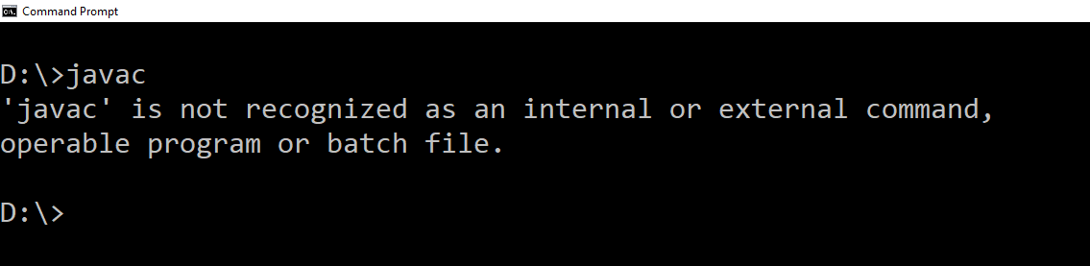
Java Installation
Suppose Java is not installed properly or the path variable not updated, you will get the following message while using the “javac” command as shown below:
Vijayarani A., AP SITE, VIT, Vellore

Slide 24
First Java Program
Let us look at a simple code that will print the words Hello World. Type the below code using simple text editor like notepad++ and save it as “MyFirstJavaProgram.java”.
Type 'javac MyFirstJavaProgram.java' and press enter to compile your code. If there are no errors in your code, the command prompt will take you to the next line.
C:\> javac MyFirstJavaProgram.java
Now, type ' java MyFirstJavaProgram ' to run your program.
C:\> java MyFirstJavaProgram
You will be able to see ' Hello World ' printed on the window.
Hello World
public class MyFirstJavaProgram {
/* This is my first java program.
* This will print 'Hello World' as the output
*/
public static void main(String []args) {
// prints Hello World
System.out.println("Hello World");
}
}
Vijayarani A., AP SITE, VIT, Vellore

Slide 25
Java Basics
About Java programs, it is very important to keep in mind the following points.
Case Sensitivity - Java is case sensitive, which means identifier Hello and hello would have different meaning in Java.
Class Names - For all class names the first letter should be in Upper Case. If several words are used to form a name of the class, each inner word's first letter should be in Upper Case.
Example: class MyFirstJavaClass
Vijayarani A., AP SITE, VIT, Vellore

Slide 26
Java Basics
Method Names - All method names should start with a Lower Case letter. If several words are used to form the name of the method, then each inner word's first letter should be in Upper Case.
Example: public void myMethodName()
Program File Name - Name of the program file should exactly match the class name.
Example: Assume 'MyFirstJavaProgram' is the class name. Then the file should be saved as 'MyFirstJavaProgram.java'
public static void main(String args[]) - Java program processing starts from the main() method which is a mandatory part of every Java program.
Vijayarani A., AP SITE, VIT, Vellore

Slide 27
Java Keywords
abstract | assert | boolean | break
byte | case | catch | char
class | const | continue | default
do | double | else | enum
extends | final | finally | float
for | goto | if | implements
import | instanceof | int | interface
long | native | new | package
private | protected | public | return
short | static | strictfp | super
switch | synchronized | this | throw
throws | transient | try | Void
volatile | while
Vijayarani A., AP SITE, VIT, Vellore

Slide 28
Data Types
Primitive
Byte
int
float
double
char
String
Boolean
Abstract
Array
ArrayList
Class
Vijayarani A., AP SITE, VIT, Vellore

Slide 29
Java Primitive Data Type
Name | Data Type | Min Value | Max Value | Example
Byte | 8-bit signed 2’s Complement integer | -2^7 | 2^7-1 | byte a=100;
Short | 16-bit signed 2’s complement integer | -2^15 | 2^15-1 | short s =-20000, p=10000
Int | 32-bit signed 2’s complement integer | -2^31 | 2^31-1 | int a = 100000, int b = -200000
Long | 64-bit signed 2’s complement integer | -2^63 | -2^63-1 | long a =1000000
Vijayarani A., AP SITE, VIT, Vellore

Slide 30
Java Primitive Data Type
Name | Data Type | Example
Float | Float datatype is a single-precision 32-bit IEEE 754 floating point. Float is mainly used to save memory in large arrays of floating point numbers | float f1 = 234.5
Double | double datatype is a double-Precision 64-bit IEEE 754 floating point This datatype is generally used as the default data type for decimal values, generally the default choice | double d1 = 123.4
Boolean | boolean datatype represents one bit of information. There are only two possible values: true and false. This datatype is used for simple flags that track true/false conditions | boolean flag=true
Char | char datatype is a single 16-bit Unicode character. Minimum value is '\u0000' (or 0). Maximum value is '\uffff' (or 65,535 inclusive). Char datatype is used to store any character. | char initial=‘a’;
Vijayarani A., AP SITE, VIT, Vellore

Slide 31
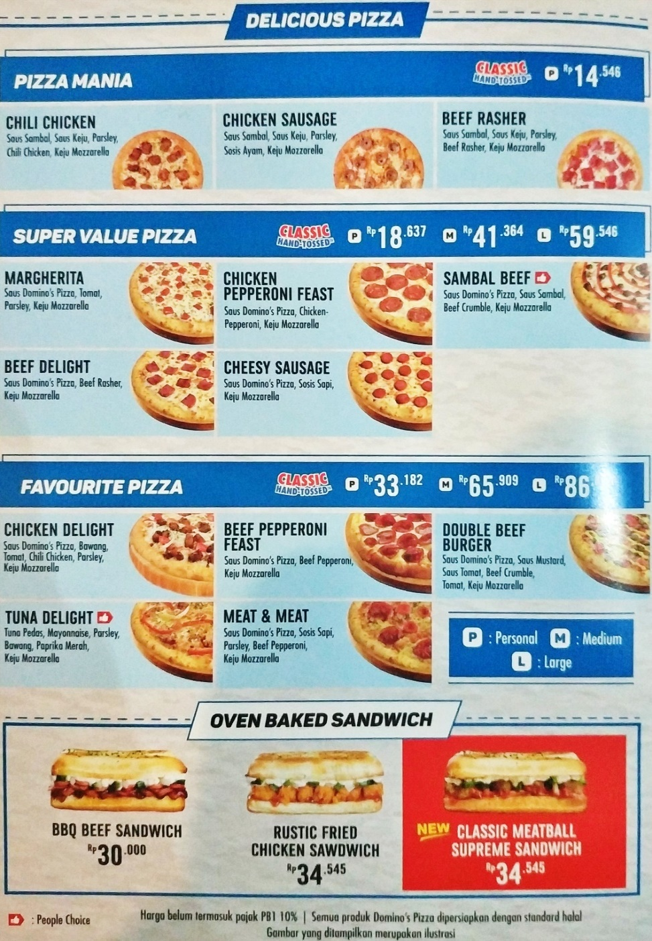
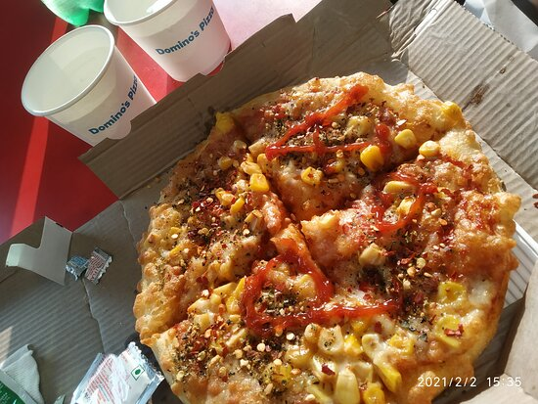


Data Type vs. Variables
a
b
c
d
Data Type -
a,c
Variables -
b,d
Vijayarani A., AP SITE, VIT, Vellore

Slide 32
Variables
Variables are nothing but reserved memory locations to store values. This means that when you create a variable you reserve some space in the memory Following are the types of variables in Java:
Local Variables
Class Variables (Static Variables)
Instance Variables (Non-static Variables)
Vijayarani A., AP SITE, VIT, Vellore

Slide 33
Variables Naming
All Java components require names. Names used for classes, variables, and methods are called identifiers.
In Java, there are several points to remember about identifiers. They are as follows:
All identifiers should begin with a letter (A to Z or a to z), currency character ($) or an underscore (_).
After the first character, identifiers can have any combination of characters and numbers.
A key word cannot be used as an identifier.
Most importantly, identifiers are case sensitive.
Examples of legal identifiers: age, $salary, _value, __1_value.
Examples of illegal identifiers: 123abc, -salary.
Vijayarani A., AP SITE, VIT, Vellore

Slide 34
Java – Operators and Literal
Java provides a rich set of operators to manipulate variables. We can divide all the Java operators into the following groups:
Arithmetic Operators => +,-,*,/,%
Relational Operators => <,<=,>,>=,==,!=
Logical Operators => &&,||,!
Assignment Operators => =,+=,-=,*=,/=,%=
Miscellaneous Operators => ?:
A literal is a source code representation of a fixed value. They are represented directly in the code without any computation. Literals can be assigned to any primitive type variable.
For example:
byte b = 68;
char c = 'A‘;
int i = 80 ;
float pi=3.14;
Vijayarani A., AP SITE, VIT, Vellore

Slide 35
Java Statements
A statement in Java forms a complete command to be executed and can include one or more expressions. In simpler terms, a Java statement is just an instruction that explains what should happen.
Java statements appear inside methods and classes; they describe all activities of a Java program. Type of statements are:
Variable declarations and assignments
Decision making and branching
If .. else
Switch
Decision making and looping
For
While
Do..while
For(array)
Vijayarani A., AP SITE, VIT, Vellore

Slide 36
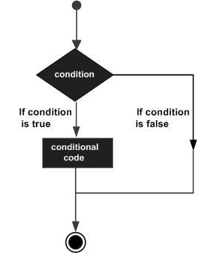
Decision Making and Branching
Decision making structures have one or more conditions to be evaluated or tested by the program, along with a statement or statements that are to be executed if the condition is determined to be true, and optionally, other statements to be executed if the condition is determined to be false.
Vijayarani A., AP SITE, VIT, Vellore

Slide 37
If Statement
if statement - An if statement consists of a boolean expression followed by one or more statements. An if statement can be followed by an optional else statement, which executes when the boolean expression is false.
Syntax
E.g.
if (<condition>)
{
code //True part
}
[else
{
code //False part
}]
if (num1 > num2)
{
max = num1;
}
else
{
max = num2;
}
Vijayarani A., AP SITE, VIT, Vellore

Slide 38
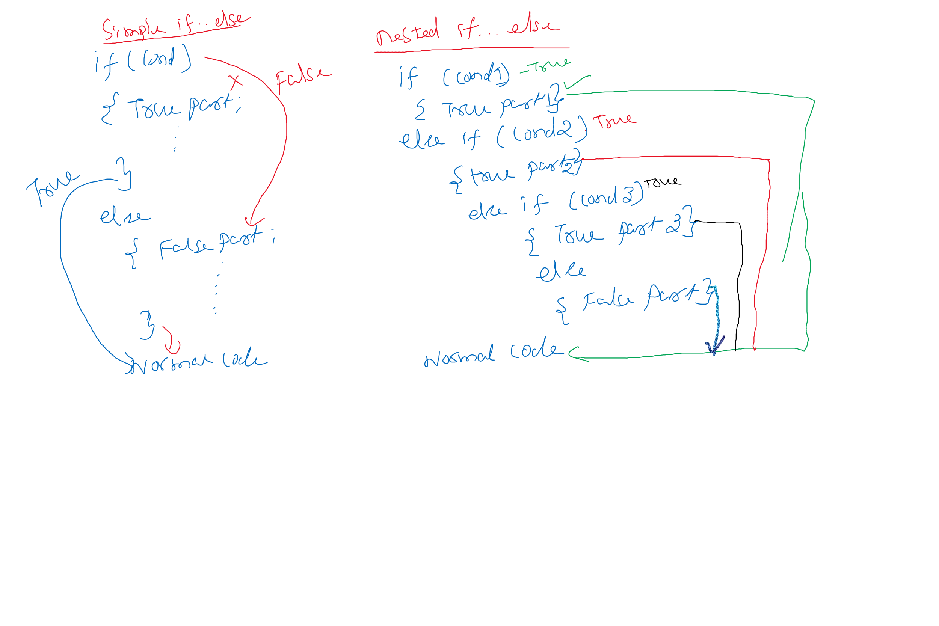
Class Board Images

Slide 39
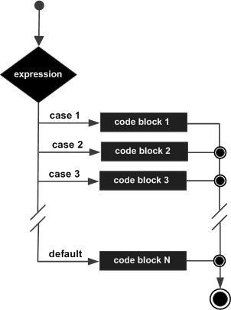
Switch Statement
A switch statement allows a variable to be tested for equality against a list of values.
Each value is called a case, and the variable being switched on is checked for each case.
Vijayarani A., AP SITE, VIT, Vellore

Slide 40
Switch Statement
Syntax
E.g.
switch (expression)
{
case value1: {stmts1; break;}
case value2: {stmts2; break;}
…………
…………
[default: stmts;]
}
switch (day)
{
case 1: {dayname= “its Sunday”; break;}
case 2: {dayname= “its Monday”; break;}
………
………
case 7: {dayname= “its Saturday”; break;}
default: {dayname= “not specified value”;}
}
Vijayarani A., AP SITE, VIT, Vellore

Slide 41
Switch Statement - Rules
The variable used in a switch statement can only be integers, convertable integers (byte, short, char), strings and enums.
You can have any number of case statements within a switch. Each case is followed by the value to be compared to and a colon.
The value for a case must be the same data type as the variable in the switch and it must be a constant or a literal.
When the variable being switched on is equal to a case, the statements following that case will execute until a break statement is reached.
When a break statement is reached, the switch terminates, and the flow of control jumps to the next line following the switch statement.
Not every case needs to contain a break. If no break appears, the flow of control will fall through to subsequent cases until a break is reached.
A switch statement can have an optional default case, which must appear at the end of the switch. The default case can be used for performing a task when none of the cases is true. No break is needed in the default case.
Vijayarani A., AP SITE, VIT, Vellore

Slide 42
If and Switch – Class Board Image
Vijayarani A., AP SITE, VIT, Vellore

Slide 43
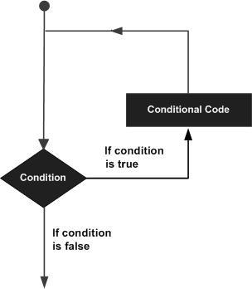
Looping Statement
A loop statement allows us to execute a statement or group of statements multiple times and following is the general form of a loop statement in most of the programming languages.
Vijayarani A., AP SITE, VIT, Vellore

Slide 44
Looping Statements
while loop - Repeats a statement or group of statements while a given condition is true. It tests the condition before executing the loop body.
for loop - Execute a sequence of statements multiple times and abbreviates the code that manages the loop variable.
do...while loop - Like a while statement, except that it tests the condition at the end of the loop body.
Vijayarani A., AP SITE, VIT, Vellore

Slide 45
While Statement
Here, statement(s) may be a single statement or a block of statements. The condition may be any expression, and true is any non zero value.
When executing, if the boolean_expression result is true, then the actions inside the loop will be executed. This will continue as long as the expression result is true.
When the condition becomes false, program control passes to the line immediately following the loop.
Syntax
E.g.
while(<condition>)
{
Statement (S);
}
// printing 1 to 10
int i=0;
while (i <= 10)
{
i=i+1;
S.o.p(“i = “+ i);
}
Vijayarani A., AP SITE, VIT, Vellore

Slide 46
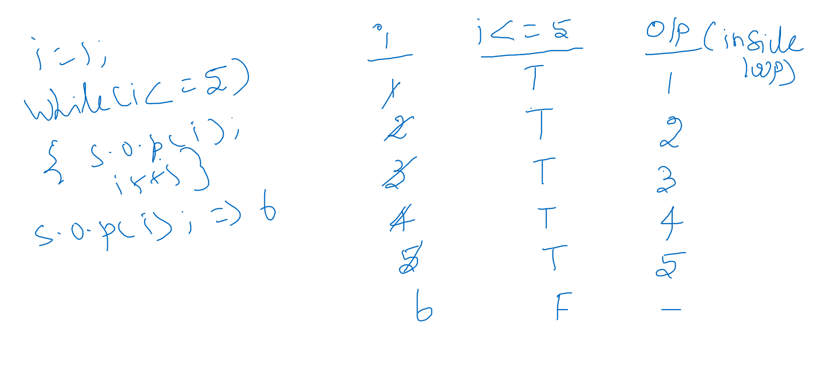
While Statement

Slide 47
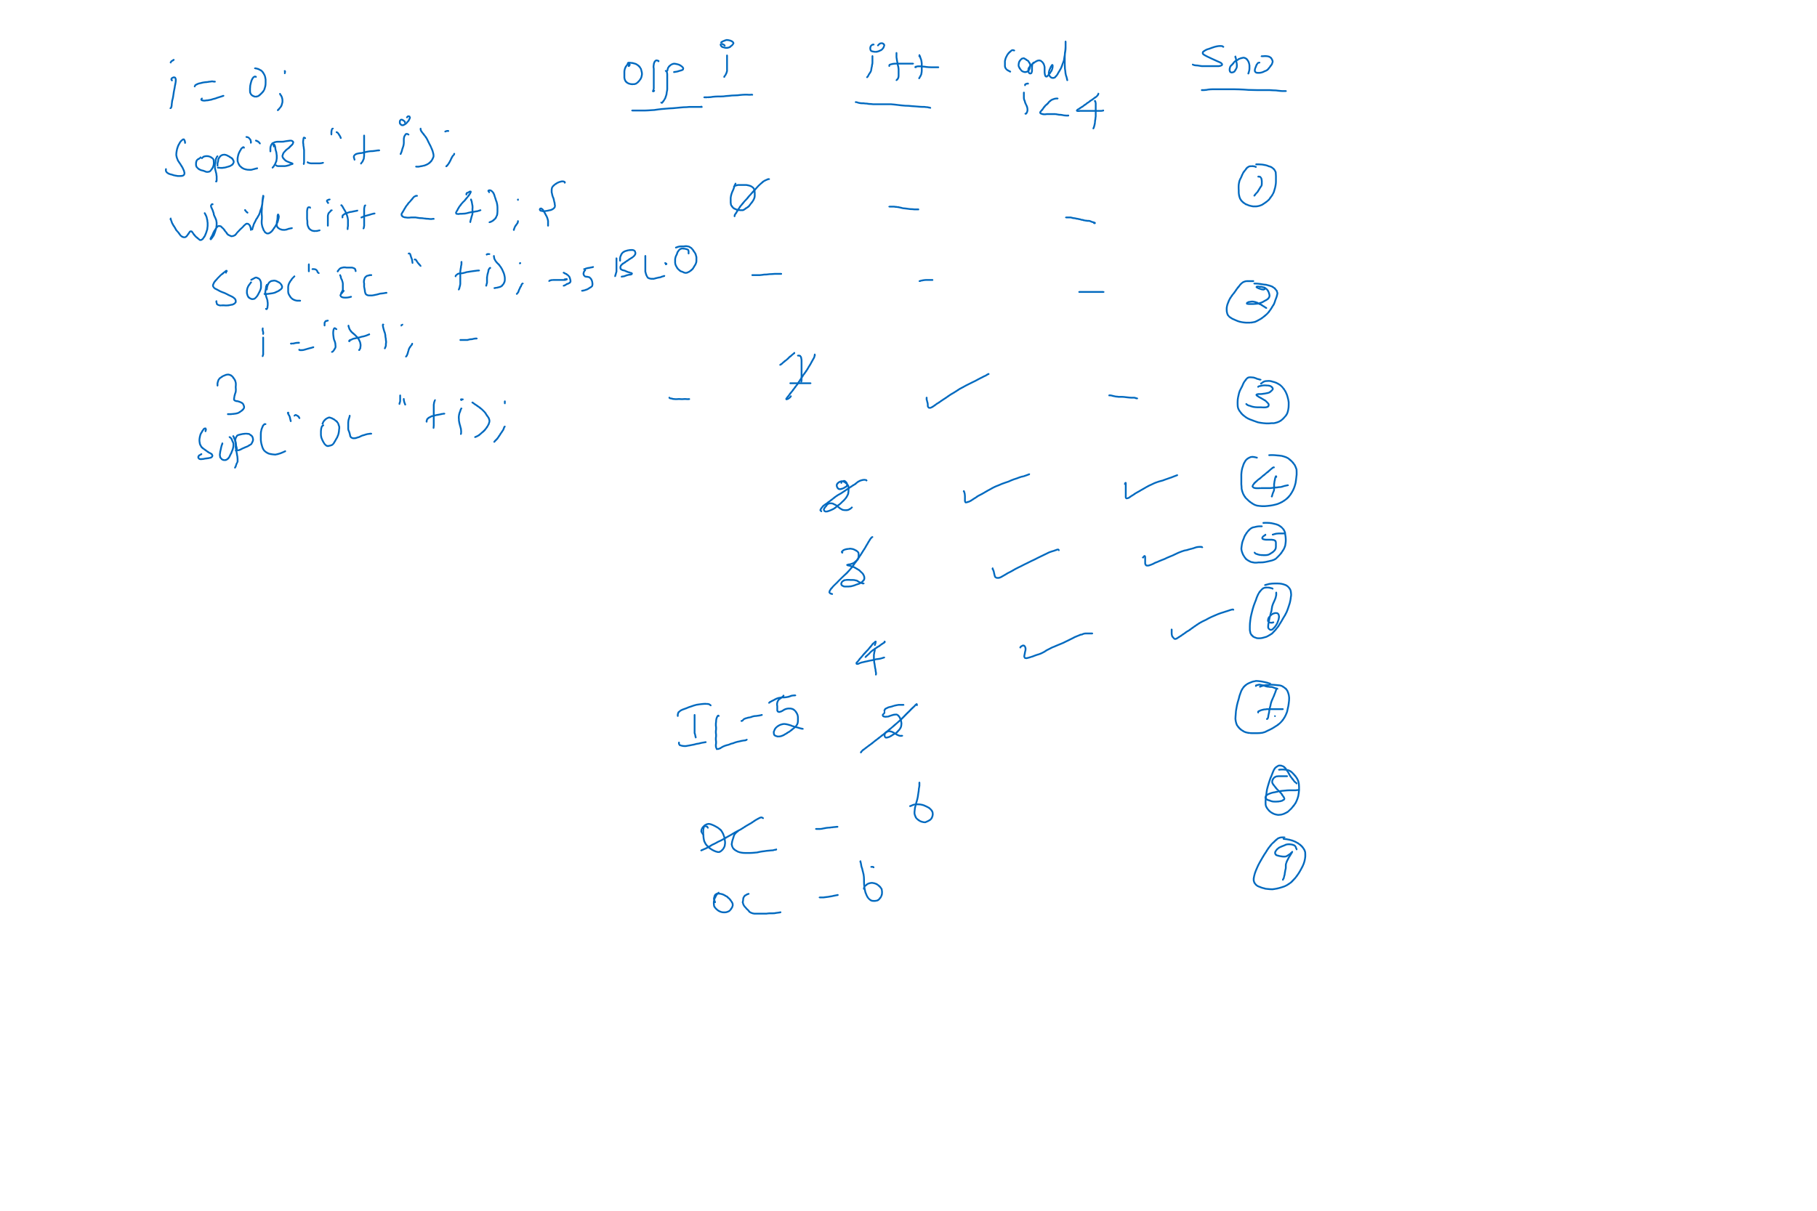
While Statement

Slide 48
For Statement
Syntax
E.g.
A for loop is a repetition control structure that allows you to efficiently write a loop that needs to be executed a specific number of times.
A for loop is useful when you know how many times a task is to be repeated
for( initial_expression;
termination_check;
index_updation)
{
statement (S);
}
for(i=1; i < 10; i++)
S.o.p(“i =“ +i);
(or)
i=1;
for(;i<10;)
{
S.o.p(“i =“ +i);
i=i+1;
}
Vijayarani A., AP SITE, VIT, Vellore

Slide 49
For Statement - Flow
The initialization step is executed first, and only once. This step allows you to declare and initialize any loop control variables and this step ends with a semi colon (;).
Next, the Boolean expression is evaluated. If it is true, the body of the loop is executed. If it is false, the body of the loop will not be executed and control jumps to the next statement past the for loop.
After the body of the for loop gets executed, the control jumps back up to the update statement. This statement allows you to update any loop control variables. This statement can be left blank with a semicolon at the end.
The Boolean expression is now evaluated again. If it is true, the loop executes and the process repeats (body of loop, then update step, then Boolean expression). After the Boolean expression is false, the for loop terminates.
Vijayarani A., AP SITE, VIT, Vellore

Slide 50
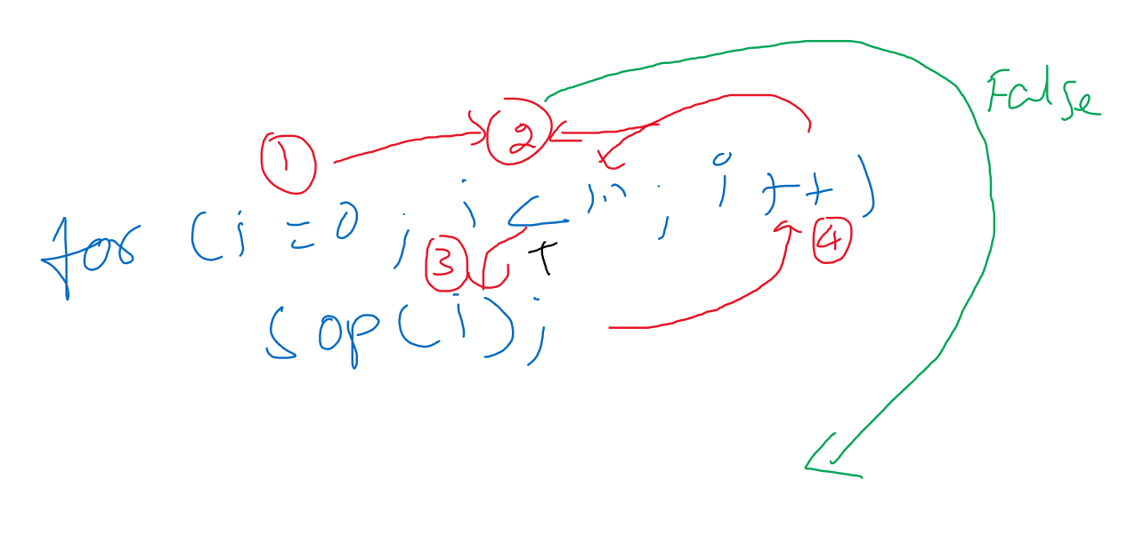
Class Board Image
Vijayarani A., AP SITE, VIT, Vellore

Slide 51
Do … While Statement
A do...while loop is similar to a while loop, except that a do...while loop is guaranteed to execute at least one time.
Syntax
E.g.
do
{
Statement (S);
}
while (<condition>);
do
{
i=i+1;
S.o.p(“i=“+i);
} while (i < 10);
Vijayarani A., AP SITE, VIT, Vellore

Slide 52
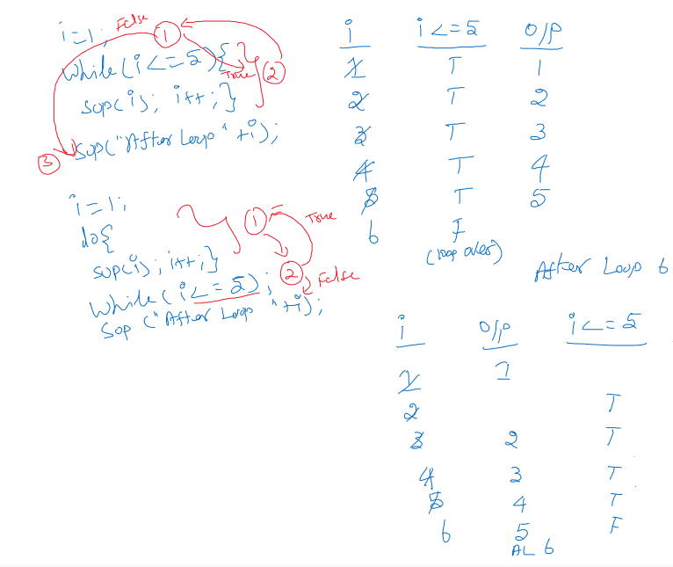
White Board Image

Slide 53
Loop Control Statements
Loop control statements change execution from its normal sequence. Java supports the following control statements. Click the following links to check their detail.
break statement -Terminates the loop or switch statement and transfers execution to the statement immediately following the loop or switch.
continue statement - Causes the loop to skip the remainder of its body and immediately retest its condition prior to reiterating.
Vijayarani A., AP SITE, VIT, Vellore

Slide 54


Arrays
An array is a group of liked-typed variables referred to by a common name, with individual variables accessed by their index.
Also, arrays can have one or several dimensions.
To use an array in a program, must declare it. Array declaration involves:
declaring an array identifier
declaring the number of dimensions
declaring the data type of the array elements
Col Index
Row Index
Vijayarani A., AP SITE, VIT, Vellore

Slide 55
Arrays – Creation
Can create an array by using the new operator with the following syntax:
arrayRefVar = new dataType[arraySize];
The above statement does two things:
It creates an array using new dataType[arraySize].
It assigns the reference of the newly created array to the variable arrayRefVar.
The array elements are accessed through the arrayRefVar[index]
Array indices are 0-based; that is, they start from 0 to arraySize-1.
length is the property of the array which denotes the size.
The Java run-time system makes sure that all array indexes are in the correct range, otherwise raises a run-time error.
Vijayarani A., AP SITE, VIT, Vellore

Slide 56
Arrays – Declaration and Creation
Declaring an array variable, creating an array, and assigning the reference of the array to the variable can be combined in one statement, as shown below:
dataType[] arrayRefVar = new dataType[arraySize];
or
dataType[] arrayRefVar = {value0, value1, ..., valuek};
Vijayarani A., AP SITE, VIT, Vellore

Slide 57
Example - Array
int []arr1 = new int[6];
int [2]arr1 =7;
int []arr2;
arr2[2]=5;
arr2 = new int[15];
arr2[3] = 5;
arr1
0 | 1 | 2 | 3 | 4 | 5
arr1
 |  | 7
0 | 1 | 2 | 3 | 4 | 5
arr2
← might not initialized error
arr2
0 | 1 | 2 | 3 | 4 | 5 | 6 | 7 | 8 | 9 | 10 | 11 | 12 | 13 | 14
arr2
 |  |  | 5
0 | 1 | 2 | 3 | 4 | 5 | 6 | 7 | 8 | 9 | 10 | 11 | 12 | 13 | 14
no error as the memory was created
Vijayarani A., AP SITE, VIT, Vellore

Slide 58
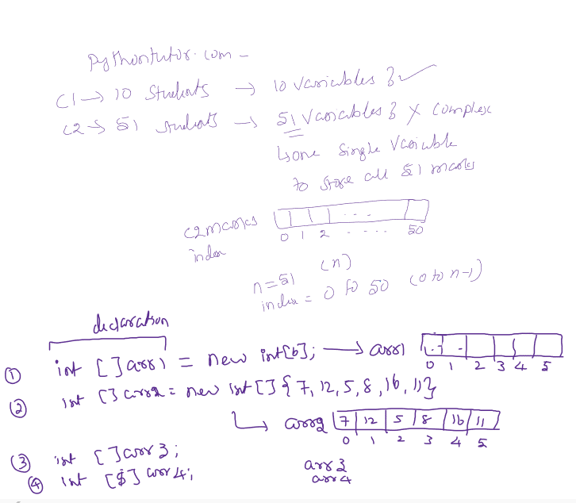
White Board Image
Vijayarani A., AP SITE, VIT, Vellore

Slide 59
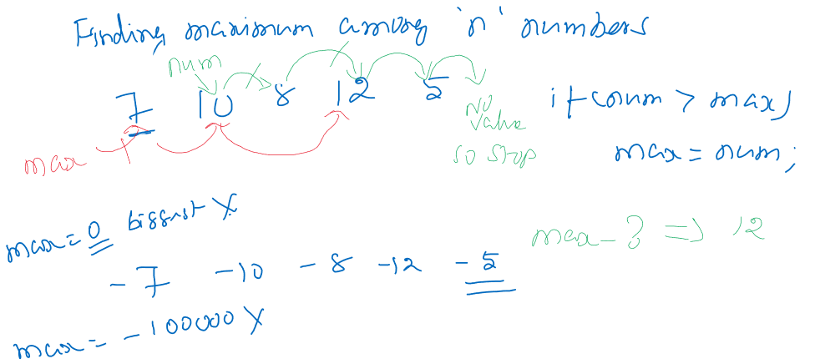
White Board Image
Vijayarani A., AP SITE, VIT, Vellore

Slide 60
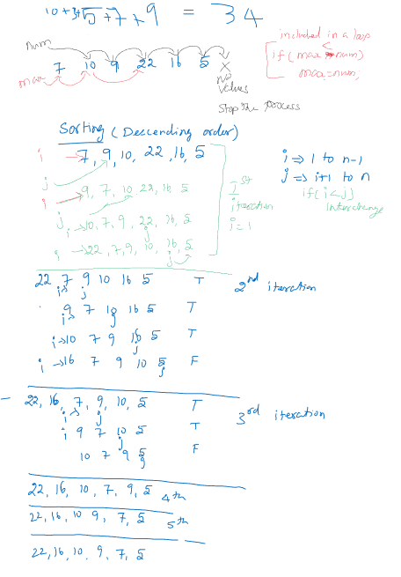
White Board Image
Vijayarani A., AP SITE, VIT, Vellore

Slide 61
Arrays – Multi Dimension
Multidimensional arrays are actually arrays of arrays. These look and act like regular multidimensional arrays. To declare a multidimensional array variable, specify each additional index using another set of square brackets.
The following declares a two-dimensional array variable called twoD.
int twoD[][] = new int[4][5];
This allocates a 4 by 5 array and assigns it to twoD. Internally this matrix is implemented as an array of arrays of int
Vijayarani A., AP SITE, VIT, Vellore

Slide 62
Array Initialization
Arrays can be initialized when they are declared:
int monthDays[] = {31,28,31,30,31,30,31,31,30,31,30,31};
Note:
1) there is no need to use the new operator
2) the array is created large enough to hold all specified element
3) Two dimensional array can be initialized as follows:
int twoDArr[][] = { {1, 2, 3}, {4, 5, 6} };
Vijayarani A., AP SITE, VIT, Vellore

Slide 63
Array Printing
Displaying one dimensional Array:
for(i=0;i<12;i++)
System.out.println(monthDays[i]);
Displaying two dimensional Array:
for(r=0;r<2;r++) {
for(c=0;c<3;c++)
System.out.print(twoDArr[r][c]+” “)
System.out.println(); //moves to next line
}
Vijayarani A., AP SITE, VIT, Vellore

Slide 64
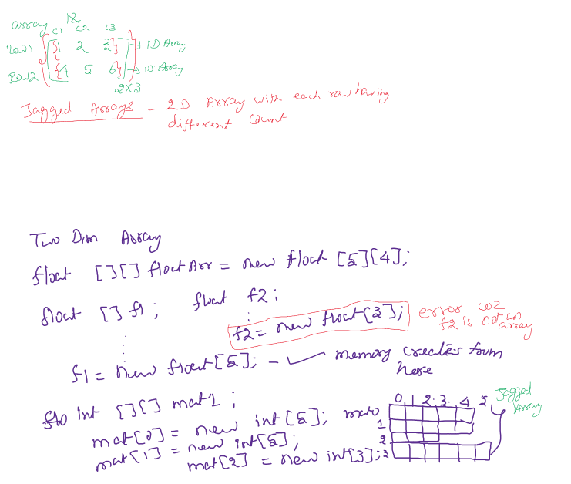
White Board Image
Vijayarani A., AP SITE, VIT, Vellore

Slide 65
Jagged Arrays
A jagged array is an array of arrays such that member arrays can be of different sizes, i.e., we can create a 2-D array but with a variable number of columns in each row. These types of arrays are also known as Jagged arrays.
Vijayarani A., AP SITE, VIT, Vellore

Slide 66
Jagged Array Creation
datatype jagArr[ ][ ] = new int[3][ ]
jagArr[0] = new int[5]
jagArr[1] = new int[3]
jagArr[2] = new int[4]
0 | 1 | 2 | 3 | 4
jagArr[0]
jagArr[1]
jagArr[2]
Vijayarani A., AP SITE, VIT, Vellore

Slide 67
For loop - Enhanced
How can you print this array??
0 | 1 | 2 | 3 | 4
jagArr[0]
jagArr[1]
jagArr[2]
Vijayarani A., AP SITE, VIT, Vellore

Slide 68
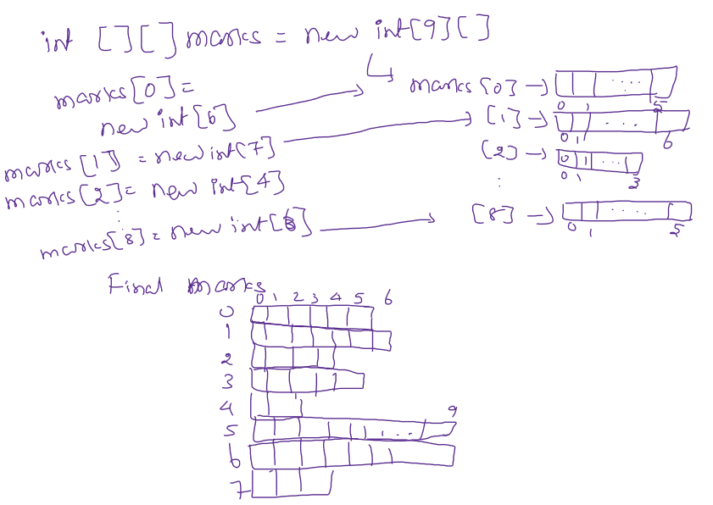
White Board Image
Vijayarani A., AP SITE, VIT, Vellore

Slide 69
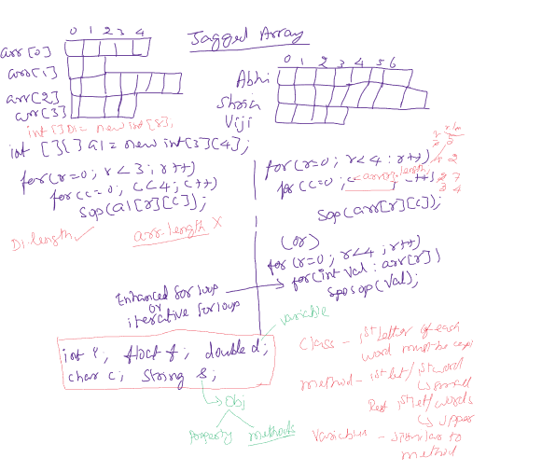
White Board Image
Vijayarani A., AP SITE, VIT, Vellore

Slide 70
Strings in Java
Strings, which are widely used in Java programming, are a sequence of characters. In Java programming language, strings are treated as objects.
The Java platform provides the String class to create and manipulate strings.
The most direct way to create a string is to write:
String greeting = "Hello world!";
Also, get input from user for a string through next() and nextLine() methods.
Whenever it encounters a string literal in the code, the compiler creates a String object with its value in this case, "Hello world!'.
Vijayarani A., AP SITE, VIT, Vellore

Slide 71
String and Character Methods
Character Class Methods
isLetter()
isDigit()
isLetterOrDigit()
isLowerCase()
isUpperCase()
toLowerCase()
toUpperCase()
String Class Methods
length()
charAt(index)
indexOf(char[, pos])
substring(start, end)
contains(substring)
replace(substring1, substring2)
isEmpty()
valueOf(values)
equals(string)
equalsIgnoreCase(String)
startsWith(String)
endsWith(String)
toLowerCase()
toUpperCase()
join(delimiter, string1, string2,....)
lastIndexOf
Vijayarani A., AP SITE, VIT, Vellore

Slide 72
Character Methods – Example
char c1 = ‘a’, c2=‘2’, c3 =‘$’;
isLetter() → Character.isLetter(‘a’) (or) Character.isLetter(c1) ➔
Character.isLetter(‘2’) (or) Character.isLetter(c2) ➔
isDigit() → Character.isDigit(‘a’) (or) Character.isDigit(c1) ➔
Character.isDigit(‘2’) (or) Character.isDigit(c2) ➔
isLetterOrDigit() → Character.isLetterOrDigit(‘a’) (or) Character.isLetterOrDigit(c2) ➔
Character.isLetterOrDigit(c3) ➔
isLowerCase() → Character.isLowerCase(‘r’) ➔
Character.isLowerCase(‘R’) ➔
isUpperCase() → Character.isUpperCase(‘r’) ➔
Character.isUpperCase(‘R’) ➔
toLowerCase() → Character.toLowerCase(‘A’) ➔
toUpperCase() → Character.toUpperCase(‘b’) ➔
true
true
false
true
true
false
true
false
false
true
a
B
Vijayarani A., AP SITE, VIT, Vellore

Slide 73
String Methods - Example
str1
str2
H | e | l | l | o |  | W | o | r | l | d | !
0 | 1 | 2 | 3 | 4 | 5 | 6 | 7 | 8 | 9 | 10 | 11
W | e | l | c | o | m | e
0 | 1 | 2 | 3 | 4 | 5 | 6
str1.length() ➔
str2.length() ➔
str1.charAt(8) ➔
str1.indexOf(‘l’) ➔
str1.indexOf(‘l’,6) ➔
str1.lastIndexOf(‘l’) ➔
str2.substring(3, 6) ➔
str1.contains(str2) ➔
str1.contains(“or”) ➔
str1.replace(“He”, ”Ha”) ➔
12
false
str2.isEmpty() ➔
str1.equals(str2) ➔
str2.equalsIgnoreCase(“welcome”) ➔
str2.startsWith(“Hel”) ➔
str2.startsWith(“Wel”) ➔
str1.endsWith(“me”) ➔
str2.endsWith(“me”) ➔
str2.toLowerCase() ➔
str2.toUpperCase() ➔
7
false
r
true
2
false
9
true
9
false
com
true
false
welcome
true
Hallo World!
WELCOME
Vijayarani A., AP SITE, VIT, Vellore

Slide 74
String Buffer and String Builder
Also Java supports StringBuffer and StringBuilder classes.
The StringBuffer and StringBuilder classes are used when there is a necessity to make a lot of modifications to Strings of characters.
Unlike Strings, objects of StringBuffer and String builder can be modified over and over again without leaving behind a lot of new unused objects.
The main difference between the StringBuffer and StringBuilder is that StringBuilders methods are not thread safe.
It is recommended to use StringBuilder whenever possible because it is faster than StringBuffer.
Vijayarani A., AP SITE, VIT, Vellore

Slide 75
String Buffer and Builder Methods
public StringBuffer append(String s) - Updates the value of the object that ininvoked the method. The method takes boolean, char, int, long, Strings, etc.
public StringBuffer reverse() - The method reverses the value of the StringBuffer object that invoked the method.
public delete(int start, int end) - Deletes the string starting from the start index until the end index.
public insert(int offset, int i) - This method inserts a string s at the position mentioned by the offset.
replace(int start, int end, String str) - This method replaces the characters in a substring of this StringBuffer with characters in the specified String.
Vijayarani A., AP SITE, VIT, Vellore

Slide 76
Math Class Methods in Java
Java Math class provides several methods to work on math calculations like min(), max(), avg(), sin(), cos(), tan(), round(), ceil(), floor(), abs() etc.
Method | Description
Math.log() | It returns the natural logarithm of a double value.
Math.ceil() | It is used to find the smallest integer value that is greater than or equal to the argument or mathematical integer.
Math.round() | It is used to round of the decimal numbers to the nearest value.
Math.abs() | It will return the Absolute value of the given value.
Math.exp() | It returns E raised to the power of a double value, where E is Euler's number and it is approximately equal to 2.71828.
Math.sqrt() | It is used to return the square root of a number.
Vijayarani A., AP SITE, VIT, Vellore

Slide 77
Math Class Methods in Java
Method | Description
Math.floor() | It is used to find the largest integer value which is less than or equal to the argument and is equal to the mathematical integer of a double value.
Math.random() | It returns a double value with a positive sign, greater than or equal to 0.0 and less than 1.0.
Math.sin() | It is used to return the trigonometric Sine value of a Given double value.
Math.cos() | It is used to return the trigonometric Cosine value of a Given double value.
Math.tan() | It is used to return the trigonometric Tangent value of a Given double value.
Math.max() | It returns the Largest of two values.
Math.min() | It is used to return the Smallest of two values.
Vijayarani A., AP SITE, VIT, Vellore

Slide 78
Java Methods
A method is a block of code or collection of statements or a set of code grouped together to perform a certain task or operation.
It is used to achieve the reusability of code. The most important method in Java is the main() method.
The method declaration provides information about method attributes, such as visibility, return-type, name, and arguments.
Vijayarani A., AP SITE, VIT, Vellore

Slide 79
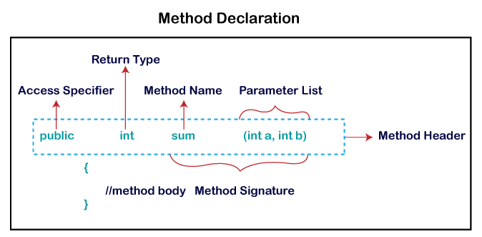
Java Methods - Declaration
Method declaration has six components that are known as method header, as shown below:
Method Signature: Every method has a method signature. It is a part of the method declaration. It includes the method name and parameter list.
Return Type: Return type is a data type that the method returns. It may have a primitive data type, object, collection, void, etc. If the method does not return anything, then it is void.
Vijayarani A., AP SITE, VIT, Vellore

Slide 80
Java Methods
Method Name: It is a unique name that is used to define the name of a method. It must be corresponding to the functionality of the method. A method is invoked by its name. Single-word method name: sum(), area(); Multi-word method name: areaOfCircle(), stringComparision()
Parameter List: It is the list of parameters separated by a comma and enclosed in the pair of parentheses. It contains the data type and variable name. If the method has no parameter, left the parentheses blank.
Method Body: It is a part of the method declaration. It contains all the actions to be performed. It is enclosed within the pair of curly braces.
Vijayarani A., AP SITE, VIT, Vellore

Slide 81
Java Methods
6. Access Specifier: Access specifier or modifier is the access type of the method. It specifies the visibility of the method. Java provides four types of access specifier:
Public: The method is accessible by all classes when we use public specifier in our application.
Private: When we use a private access specifier, the method is accessible only in the classes in which it is defined.
Protected: When we use protected access specifier, the method is accessible within the same package or subclasses in a different package.
Default: When we do not use any access specifier in the method declaration, Java uses default access specifier by default. It is visible only from the same package only.
Vijayarani A., AP SITE, VIT, Vellore

Slide 82
Java Methods
Types of Method - There are two types of methods in Java:
Predefined Method
Some pre-defined methods are length(), equals(), log(), sqrt(), println(), nextInt(), next(), etc.
User-defined Method
Static Method
A method that has static keyword is known as static method. In other words, a method that belongs to a class rather than an instance of a class is known as a static method.
2. Instance Method
The method of the class is known as an instance method. It is a non-static method defined in the class. Before calling or invoking the instance method, it is necessary to create an object of its class.
Vijayarani A., AP SITE, VIT, Vellore

Slide 83
Static Method
The static keyword is used to create methods that will exist independently of any instances created for the class.
Static methods do not use any instance variables of any object of the class they are defined in. Static methods take all the data from parameters and compute something from those parameters, with no reference to variables.
Class variables and methods can be accessed using the class name followed by a dot and the name of the variable or method.

Slide 84
Java Methods - Question
public class Demo {
public static void main(String[] args) {
System.out.print("The maximum number is: " + Math.max(9,7));
}
}
How many methods are used in the above code?
3
What are those methods?
main(), print(), max()
Vijayarani A., AP SITE, VIT, Vellore

Slide 85
Java Methods - Calling
The methods can be called whenever needed. Syntax of method calling is
[ variable name = ] methodName([Parameters]);
Generally, method is called by its name with parameters if any. The calling method will be assigned to a variable when it has return type as data.
methodName(); // method without return type and parameter
methodName(parameter); // method without return type, with parameter
v1 = methodName(); //method without parameter, with return type
V2 = methodName(parameters); // method with parameter and return type
Vijayarani A., AP SITE, VIT, Vellore

Slide 86
Java Methods – Static method
public class MethodExample1{
public static void main(String[] args){
int a=5,result;
OddOrEven(a);
MethodExample1.Print();
MethodExample1 obj = new MethodExample1(); result = obj.Sum(3,8);
}
public static void OddOrEven(int x){
if ((x%2) == 0))
System.out.println(x+” is even number”);
else
System.out.println(x+” is odd number”);
}
public static void Print( ){
System.out.println(“Welcome”);
}
public int Sum(int x, int y){
return(x+y);
}
}
Actual Parameter
Method calling with parameter, no return type
Static Method calling no parameter, no return type
Instance Method calling with parameter with return type
Formal Parameter
Method declarations
No Formal Parameter
Return Type
Return value
Vijayarani A., AP SITE, VIT, Vellore

Slide 87
Java Methods – Static method
public class MethodExample1{
public static void main(String[] args){
int a=5,b=2,result;
result = Add(a,b);
}
public static int Add(int x, int y){
return(x+y);
}
}
Vijayarani A., AP SITE, VIT, Vellore

Slide 88
Java Methods – Instance method
public class MethodExample1{
public static void main(String[] args){
MethodExample1 obj = new MethodExample1();
int a=5,b=2,result;
result = obj.Sub(a,b);
}
public int Sub(int x, int y){
return(x-y);
}
}
Vijayarani A., AP SITE, VIT, Vellore

Slide 89
Java Methods - Overview
public class MethodExample2{
public static void main(String[] args){
MethodExample2 obj = new MethodExample2();
int a=5,b=2,result1,result2;
result1 = obj.Sub(a,b);
result2 = MethodExample2.Add(a,b);
}
public int Sub(int x, int y){
return(x-y);
}
public static int Add(int x, int y){
return(x+y);
}
}
Vijayarani A., AP SITE, VIT, Vellore

Slide 90
Method Overloading
If a class has multiple methods having same name but difference in parameters is known as Method Overloading. The number of parameters may be varying, or data type of parameters are varying.
static int max(int x, int y) {
if (x >y)
return(x);
else
return(y);
}
static int max(int x, int y, int z) {
if ((x > y) && (x > z))
return(x);
else if (y > z)
return(y);
else
return(z);
}
public static void main(String[] a) {
max(5,7);
max(5, 8, 7);
}

Slide 91
References
www.javatpoint.com
www.javatutorialspoint.com
www.geeksforgeeks.com
https://techvidvan.com/tutorials/java-installation/
https://www.oracle.com/java/technologies/javase-jdk16-downloads.html
Herbert Schildt, The Complete Reference -Java, Tata McGraw-Hill Education, Tenth Edition, 2017.
Vijayarani A., AP SITE, VIT, Vellore

