Slide 1
PMCA502L – Java Programming
OOPS Concept
Java – Introduction, Classes – Objects – Methods – Constructors – this keyword – Method Overloading – Inheritance – Types – Method Overriding - super keyword – Abstract class – final keyword – Interface, Packages – predefined and User-defined, Stream based I/O and File I/O

Slide 2
Object Oriented Programming
OOP stands for Object-Oriented Programming. Object-oriented programming is about creating objects that contain both data and methods.
Advantage of OOPs:
Produce reliable software
Reduce production cost
Develop reusable software modules
Reduce maintenance cost
Quicken the completion time of software development

Slide 3
Object Oriented Technology
Built upon object models
Object- Entities in the real world
Model- description of specific view of a real world problem domain.
Object model- defined by means of classes and objects

Slide 4
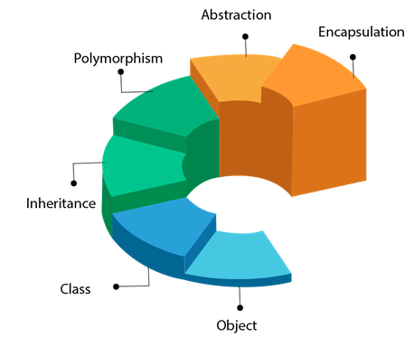
Object Oriented Programming
Fundamentals of OOPs:
Object
Class
Inheritance
Encapsulation
Abstraction
Polymorphism

Slide 5
Object Oriented Programming
Object:
Any entity that has state and behaviour is known as an object. For example: chair, pen, table, keyboard, bike etc. It can be physical and logical.
Class:
A class is a blueprint from which individual objects are created. It is a logical entity.
Inheritance:
When one object acquires all the properties and behaviours of parent object i.e. known as inheritance. It provides code reusability. It is used to achieve runtime polymorphism.

Slide 6
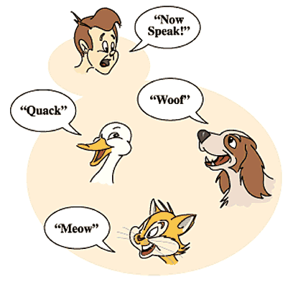
Object Oriented Programming
Polymorphism
When one task is performed by different ways i.e. known as polymorphism.
For example: to convenes the customer differently, to draw something e.g. shape or rectangle etc.
In Java, we use method overloading and method overriding to achieve polymorphism.
Another example can be to speak something e.g. cat speaks meaw, dog barks woof etc.

Slide 7
Object Oriented Programming
Abstraction:
Hiding internal details and showing functionality is known as abstraction. For example: phone call, we don't know the internal processing.
Encapsulation:
In java, we use abstract class and interface to achieve abstraction. Binding (or wrapping) code and data together into a single unit is known as encapsulation. For example: capsule, it is wrapped with different medicines.
A java class is the example of encapsulation. Java bean is the fully encapsulated class because all the data members are private here.

Slide 8
OOPs - Class
A class is a blueprint from which individual objects are created. A class in java can contain
data member
method
constructor
block
class and interface
Class Syntax:
Access specifier class ClassName{
data-member declaration(s);
method declaration(s);
}
In the above, block, class and interface are optional.

Slide 9
OOPs – Class
Example:
Class Name
public class Box
{
float height;
float width;
float depth;
void volume()
{
System.out.print("Volume is :");
System.out.println(width * height * depth);
}
}
Class Members
Class Medthod

Slide 10
OOPs - Object
An entity that has state and behaviour is known as an object e.g. chair, bike, marker, pen, table, car etc. It can be physical or logical (tangible and intangible). The example of intangible object is banking system.
There are three steps when creating an object from a class:
Declaration: A variable declaration with a variable name with an object type.
Instantiation: The 'new' keyword is used to create the object.
Initialization: The 'new' keyword is followed by a call to a constructor. This call initializes the new object.

Slide 11
OOPs - Object
// 1. obj b declaration
Box b;
// 2. b instantiation
b = new Box();
// 3.initializing members
b.height = 10.5;
b.width =12.3;
b.depth = 10.0;
// 4.method calling
b.volume();
b
b
volume()
height
width
depth
b
10.5
12.3
10.0
volume()
height
width
depth
b
Volume: 1291.5

Slide 12
OOPs - Object
An object has three characteristics:
State: represents the data (value) of an object.
Behaviour: represents the behavior (functionality) of an object such as deposit, withdraw, etc.
Identity: An object identity is typically implemented via a unique ID. The value of the ID is not visible to the external user. However, it is used internally by the JVM to identify each object uniquely.
State
Behaviour
b
10.5
12.3
10.0
volume()
height
width
depth

Slide 13
Classes Vs Object
Object | Class
Object is an instance of a class. | Class is a blueprint or template from which objects are created.
Object is a real world entity such as pen, laptop, mobile, bed, keyboard, mouse, chair etc. | Class is a group of similar objects.
Object is a physical entity. | Class is a logical entity.
Object is created through new keyword mainly e.g. Student s1=new Student(); | Class is declared using class keyword e.g. class Student{}
Object is created many times as per requirement. | Class is declared once.
Object allocates memory when it is created. | Class doesn't allocated memory when it is created.

Slide 14
Modifiers in Java
Java language has a wide variety of modifiers, including the following:
Access Modifiers
Non Access Modifiers
Java provides a number of access modifiers to set access levels for classes, variables, methods, and constructors. The four access levels are:
Visible to the package, the default. No modifiers are needed.
Visible to the class only (private).
Visible to the world (public).
Visible to the package and all subclasses (protected).

Slide 15
Access Modifiers - default
Default access modifier means we do not explicitly declare an access modifier for a class, field, method, etc.
A variable or method declared without any access control modifier is available to any other class in the same package. The fields in an interface are implicitly public static final and the methods in an interface are by default public.

Slide 16
Access Modifiers - private
Methods, variables, and constructors that are declared private can only be accessed within the declared class itself.
Private access modifier is the most restrictive access level. Class and interfaces cannot be private.
Using the private modifier is the main way that an object encapsulates itself and hides data from the outside world.

Slide 17
Access Modifiers - public
A class, method, constructor, interface, etc. declared public can be accessed from any other class. Therefore, fields, methods, blocks declared inside a public class can be accessed from any class belonging to the Java Universe.
However, if the public class we are trying to access is in a different package, then the public class still needs to be imported.

Slide 18
Access Modifiers - public
Variables, methods, and constructors, which are declared protected in a superclass can be accessed only by the subclasses in other package or any class within the package of the protected members' class.
The protected access modifier cannot be applied to class and interfaces. Methods, fields can be declared protected, however methods and fields in a interface cannot be declared protected.
Protected access gives the subclass a chance to use the helper method or variable, while preventing a nonrelated class from trying to use it.

Slide 19
Non Access Modifiers
Java provides a number of non-access modifiers to achieve many other functionalities.
The static modifier for creating class variables, methods, blocks and nested classes.
The final modifier for finalizing the implementations of classes, methods, and variables.
The abstract modifier for creating abstract classes and methods.

Slide 20
Constructor
A constructor initializes an object when it is created.
It has the same name as its class and is syntactically similar to a method. However, constructors have no explicit return type.
All classes have constructors, whether you define one or not, because Java automatically provides a default constructor that initializes all member variables to zero.
However, once you define your own constructor, the default constructor is no longer used.

Slide 21
Constructor
Here is a simple example that uses a constructor without parameters:
You will have to call constructor to initialize objects as follows:
class Box
{
float width, height, depth;
// Following is the constructor
Box()
{
width = 10;
height = 12.3;
depth = 13.5;
}
}
public class BoxDemo {
public static void main(String args[]) {
Box b1 = new Box();
Box b2 = new Box();
System.out.println(b1.width + " " + b1.height+ “ “+ b1.width);
}
}
Calling Constructor
Constructor

Slide 22
Constructor
Null constructor – this is the constructor without any parameter.
Parameterized constructor – this constructor has parameter(s) and those to be assigned to the members of the calling object.
Copy constructor – this constructor having another object of the same class as parameter. The new object has created as copy of the passed object.
class Box
{
float width, height, depth;
// Null constructor
Box() {
width = 0; height = 0; depth = 0; }
//Parameterized constructor
Box(int w, int h, int d) {
width = w; height = h; depth = d; }
//Copy Constructor
Box(Box b){
width = b.width;
height = b.height;
depth = b.depth;
}
}

Slide 23
this – Key Word
this is a keyword in Java which is used as a reference to the object of the current class, with in an instance method or a constructor.
Using this you can refer the members of a class such as constructors, variables and methods.
Differentiate the instance variables from local variables if they have same names, within a constructor or a method.
Call one type of constructor (parametrized constructor or default) from other in a class. It is known as explicit constructor invocation

Slide 24
this – Key word
Differentiate members and parameter.
Calling a constructor from other constructor.
Class Box{
float width, height, depth;
Box(float width, float height, float depth){
this.width = width;
this.height = height;
this.depth = depth;
}
}
Class Box{
float width, height, depth;
Box(float w, float h, float d){
this(w, h);
depth = d;
}
Box(float w, float h){
width = w;
height = h;
}
}

Slide 25
Object – Pointer Reference
ClassName Object1 = new ClassName();
ClassName Object2 = Object1;
In this case both Object1 and Object2 are pointing same memory location. Object2 is the reference pointer to Object1.

Slide 26
Array of Objects
Array Declaration
ClassName[] ObjectName = new ClassName[ArraySize];
Memory Creation
for(int i =0; i<ArraySize; i++)
ObjectName[i] = new ClassName();

Slide 27
Object – Parameter and Return
Object can be passed as parameter to methods. Also, a method can return object to the called program.
Time addTime(Time p1){
Time temp = new Time(); //local object
temp.s = this.s + p1.s;
temp.m = this.m + p1.m;
temp.h = this.h + p1.h;
return(temp);
}

Slide 28
Static – Variables
The static keyword belongs to the class than an instance of the class.
The static keyword is used to create variables that will exist independently of any instances created for the class.
Only one copy of the static variable exists regardless of the number of instances of the class.
Static variables are also known as class variables.
Saves memory
Both static methods and non-static methods can access static variables.

Slide 29
Static – Variables
Suppose there are 500 students in this college, then all instance data members will get memory each time when the object is created.
All students have its unique rollno and name, so instance data member is good in such case.
Here, "college" refers to the common property of all objects. If we make it static, this field will get the memory only once.
class Student{
String regNum;
String name;
String college;
}
Object1
19BIT0001 | Abhi | VIT
Object2
19BIT0002 | Vinu | VIT
Object3
19BIT0003 | Babu | VIT
class Student{
String regNum;
String name;
static String college;
}
VIT
Object1
19BIT0001 | Abhi
Object1
19BIT0002 | Vinu
Object1
19BIT0001 | Babu

Slide 30
Blocks – Static and Non-Static
The static block is used to initiate the static members of a class. This will be called only once before creating first object.
The non static or normal block is used to initiate the members of a class. This block will be called whenever an instance is creating for the class.
class Student{
String regNum;
String name;
int age;
static String college;
// static block
static{
college = “VIT”;
}
// non static block
{ age = 19;}
}

Slide 31
Static Method – Class
A static method belongs to the class rather than the object of a class.
A static method can be invoked without the need for creating an instance of a class.
A static method can access static data member and can change the value of it.

Slide 32
Encapsulation
Encapsulation in Java is a process of wrapping code(method) and data(member) together into a single unit.
We can create a fully encapsulated class in Java by making all the data members of the class private. Now we can use setter and getter methods to set and get the data in it.
In encapsulation, the variables of a class will be hidden from other classes, and can be accessed only through the methods of their current class. Therefore, it is also known as data hiding.
To achieve encapsulation in Java:
Declare the variables of a class as private.
Provide public setter and getter methods to modify and view the variables values.
A class can have total control over what is stored in its fields.

Slide 33
Encapsulation – Advantages
By providing only a setter or getter method, you can make the class read-only or write-only.
The fields of a class can be made read-only or write-only. A class can have total control over what is stored in its fields.
The users of a class do not know how the class stores its data. A class can change the data type of a field and users of the class do not need to change any of their code.
It provides you the control over the data. Suppose you want to set the value of id which should be greater than 100 only, you can write the logic inside the setter method. You can write the logic not to store the negative numbers in the setter methods.
It is a way to achieve data hiding in Java because other class will not be able to access the data through the private data members.
The encapsulate class is easy to test. So, it is better for unit testing.

Slide 34
Abstraction
Abstraction is a process of hiding the implementation details and showing only functionality to the user.
Another way, it shows only essential things to the user and hides the internal details, for example, sending SMS where you type the text and send the message. You don't know the internal processing about the message delivery.
Abstraction can be achieved through abstract class and interface.

Slide 35
Inheritance
One class acquires the properties (methods and fields) of another. With the use of inheritance the information is made manageable in a hierarchical order.
The class which inherits the properties of other is known as subclass (derived class, child class) and the class whose properties are inherited is known as superclass (base class, parent class).
extends is the keyword used to inherit the properties of a class .
Inheritance represents the IS-A relationship which is also known as a parent-child relationship.
class Super(A){
.....
}
class Sub(B) extends Super(A) {
.....
}
Class A
Class B
Class A

Slide 36
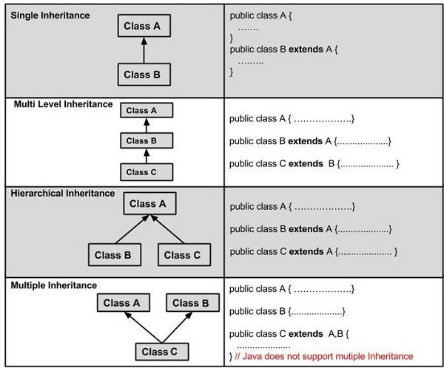
Types of Inheritance

Slide 37
Overriding
In object-oriented terms, overriding means to override the functionality of an existing method.
If a class inherits a method from its superclass, then there is a chance to override the method.
The benefit of overriding is: ability to define a behavior that's specific to the subclass type, which means a subclass can implement a parent class method based on its requirement
class A{
public void m1() {
System.out.println(“m1 from base class"); }
}
class B extends A {
public void m1() {
System.out.println(“m1 from derived class"); }
}
public class TestOverride {
public static void main(String args[]){
B o1 = new B();
o1.m1(); //Runs the method in B class }
}

Slide 38
Overriding - Rules
The argument list should be exactly the same as that of the overridden method.
The return type should be the same or a subtype of the return type declared in the original overridden method in the superclass.
The access level cannot be more restrictive than the overridden method's access level. For example: If the superclass method is declared public then the overridding method in the sub lass cannot be either private or protected.
Instance methods can be overridden only if they are inherited by the subclass.
A method declared final cannot be overridden.
Constructors cannot be overridden.

Slide 39
Overriding – Rules
A method declared static cannot be overridden but can be re-declared.
If a method cannot be inherited, then it cannot be overridden.
A subclass within the same package as the instance's superclass can override any superclass method that is not declared private or final.
A subclass in a different package can only override the non-final methods declared public or protected.
An overriding method can throw any uncheck exceptions, regardless of whether the overridden method throws exceptions or not. However, the overriding method should not throw checked exceptions that are new or broader than the ones declared by the overridden method. The overriding method can throw narrower or fewer exceptions than the overridden method.

Slide 40
Overriding – Example
class Animal{
public void move() {
System.out.println("Animals can move"); }
}
class Dog extends Animal{
public void move() {
System.out.println("Dogs can walk and run"); }
}
public class TestDog{
public static void main(String args[]){
Dog d = new Dog();
d.move(); //Runs the method in Dog class }
}
In this example, could not access the move() method of Animal class through the object of Dog class.

Slide 41
Super – Keyword
The super keyword is similar to this keyword. Following are the scenarios where the super keyword is used.
It is used to differentiate the members of superclass from the members of subclass, if they have same names.
It is used to invoke the superclass constructor from subclass.
If a class is inheriting the properties of another class. And if the members of the superclass have the names same as the sub class, to differentiate these variables we use super keyword as shown below.
super.variable
super.method();
super()

Slide 42
Overriding Method – Example
class Animal{
public void move() {
System.out.println("Animals can move");
}
}
class Dog extends Animal{
public void move() {
super.move(); // calls the move() of Animal class
System.out.println("Dogs can walk and run");
}
}
public class TestDog{
public static void main(String args[]){
Dog d = new Dog();
d.move(); //Runs the method in Dog class
}
}
In this example, could not access the move() method of Animal class through the object of Dog class.
To solve this issue Use super.move() inside the move() of Dog class.
Ouput:
Animals can move
Dogs can walk and run

Slide 43
Overriding Constructor – Example
class Base{
int x;
Base(int a) {
x =a;
System.out.println(“Inside Base constructor – x ”+ x); }
}
class Derived extends Base {
int y;
Derived(int a, int b) {
super(a); // calls the constructor of Base class
y = b;
System.out.println(“Inside Derived Class - y”+y); }
}
public class ConstructorOverride{
public static void main(String args[]){
System.out.println(“Creating Base class Object:”);
Base o1 = new Base(10);
System.out.println(“Creating Base class Object:”);
Derived o2 = new Derived(20, 30); }
}
Ouput:
Creating Base class Object:
Inside Base constructor-x 10
Creating Derived class Object:
Inside Base constructor-x 20
Inside Derived constructor-y 30

Slide 44
Abstract
Abstraction is a process of hiding the implementation details from the user, only the functionality will be provided to the user. Can be achieved through abstract class and interface.
A class which contains the abstract keyword in its declaration is known as abstract class.
Abstract classes may or may not contain abstract methods, i.e., methods without body ( public void get(); )
But, if a class has at least one abstract method, then the class must be declared abstract.
If a class is declared abstract, it cannot be instantiated.
To use an abstract class, you have to inherit it from another class, provide implementations to the abstract methods in it.
If you inherit an abstract class, you have to provide implementations to all the abstract methods in it.

Slide 45
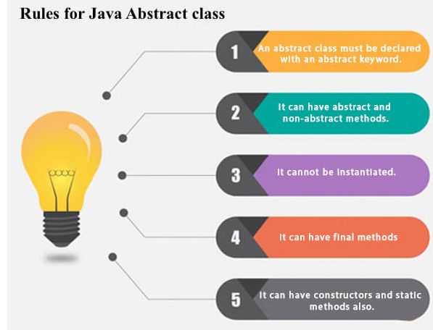
Abstract

Slide 46
Abstract Class – Example
abstract class Person {
int id;
String name;
int age;
Person(int a, String b, int c) {
id = a; name = b; age = c; }
void print() {
System.out.print(“Id – “+ id+” Name- “+ name +” Age – “+age); }
}
class Student extends Person {
String program;
Student(int a, String b, int c, String d ) {
super(a,b,c);
program = d; }
void print() {
super.print();
System.out.println(“Program – “+program); }
}
public class AbstractDemo {
public static void main(String[] args) {
Student s = new Student(1,”Aakash”,23,”BTECH”);
// Person p = new Person(2,”Abi”,23); this creates error as Person is abstract class
s.print();
}
}
Ouput:
Id- 1 Name- Aakash Age- 23 Program - BTECH

Slide 47
Abstract Method – Example
abstract class Person {
int id;
String name;
int age;
abstract void print();
}
class Student extends Person {
String program;
Student(int a, String b, int c, int d ) {
id = a; name = b; age = c; program = d;
}
void print() {
System.out.println((“Id – “+ id+” Name- “+ name +” Age – “+age+“Program – “+program);
}
}
public class AbstractDemo2 {
public static void main(String[] args) {
Student s = new
Student(1,”Aakash”,23,”BTECH”);
s.print();
}
}
Ouput:
Id- 1 Name- Aakash Age- 23 Program - BTECH

Slide 48
Final
Final Variables
A final variable can be explicitly initialized only once. A reference variable declared final can never be reassigned to refer to an different object.
Final Methods
A final method cannot be overridden by any subclasses. As mentioned previously, the final modifier prevents a method from being modified in a subclass.
The main intention of making a method final would be that the content of the method should not be changed by any outsider.
Final Classes
The main purpose of using a class being declared as final is to prevent the class from being subclassed. If a class is marked as final then no class can inherit any feature from the final class
public class Test {
// The following are examples of declaring constants:
final int value = 10;
public static final int BOXWIDTH = 6;
static final String TITLE = "Manager";
public void changeValue() {
value = 12; //will give an error
}
}

Slide 49
Polymorphism
Polymorphism in java is a concept by which we can perform a single action by different ways.
There are two types of polymorphism in java: compile time polymorphism and runtime polymorphism.
We can perform polymorphism in java by method overloading and method overriding.
Runtime polymorphism or Dynamic Method Dispatch is a process in which a call to an overridden method is resolved at runtime rather than compile-time.
In this process, an overridden method is called through the reference variable of a superclass. The determination of the method to be called is based on the object being referred to by the reference variable.

Slide 50
Polymorphism
class Bank{
int getRateOfInterest(){return 0;} }
class SBI extends Bank{
int getRateOfInterest(){return 8;} }
class ICICI extends Bank{
int getRateOfInterest(){return 7;} }
class AXIS extends Bank{
int getRateOfInterest(){return 9;} }
class Test3{
public static void main(String args[]){
Bank b1=new SBI();
Bank b2=new ICICI();
Bank b3=new AXIS();
System.out.println("SBI Rate of Interest: "+b1.getRateOfInterest());
System.out.println("ICICI Rate of Interest: "+b2.getRateOfInterest());
System.out.println("AXIS Rate of Interest: "+b3.getRateOfInterest());
}
}
Output:
SBI Rate of Interest: 8
ICICI Rate of Interest: 7
AXIS Rate of Interest: 9

Slide 51
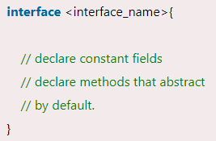
Interface
An interface in Java is a blueprint of a class. It has static constants and abstract methods.
The interface in Java is a mechanism to achieve abstraction. There can be only abstract methods in the Java interface, not method body. It is used to achieve abstraction and multiple inheritance in Java.
Usage of Interfaces:
It is used to achieve abstraction.
By interface, we can support the functionality of multiple inheritance.
It can be used to achieve loose coupling.

Slide 52
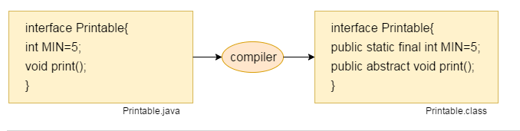
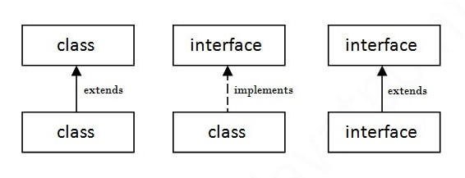
Interface

Slide 53
Interface
//Interface declaration: by first user
interface Drawable{
void findArea(); }
//Implementation: by second user
class Rectangle implements Drawable {
int len, breadth;
Rectangle(int l, int b) { len = l; breadth = b;}
public void findArea(){
System.out.println(“Rectangle Area “+(len * breadth));}
}
class Circle implements Drawable{
int radius;
Circle(int r) { radius = r; }
public void findArea(){
System.out.println(“Circle Area :”+ 3.14*radium *radius);}
}
//Using interface: by third user
class TestInterface1{
public static void main(String args[]){
Rectangle r = new Rectangle(10,7);
Circle c = new Circle(6);
r.findArea();
c.findArea(); }
}
Output:
Rectangle Area: 70
Circle Area: 113.04

Slide 54
Package
A java package is a group of similar types of classes, interfaces and sub-packages.
Package in java can be categorized in two form, built-in package and user-defined package.
There are many built-in packages such as java, lang, awt, javax, swing, net, io, util, sql etc.
1) Java package is used to categorize the classes and interfaces so that they can be easily maintained.
2) Java package provides access protection.
3) Java package removes naming collision.

Slide 55
Built-in Packages
1) java.lang - bundles the fundamental classes
2) java.io - classes for input, output functions are bundled in this package
3) java.util: Contains utility classes which implement data structures like Linked List, Dictionary and support ; for Date / Time operations.
4) java.applet: Contains classes for creating Applets.
5) java.awt: Contain classes for implementing the components for graphical user interfaces (like button , ;menus etc).

Slide 56
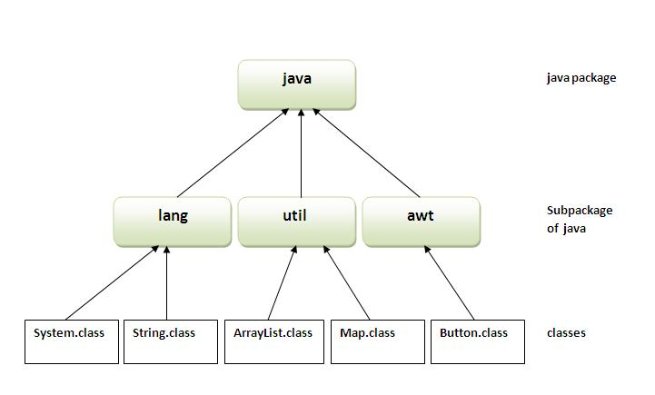
Built-in Package Hierarchy

Slide 57
Creating Package
While creating a package, you should choose a name for the package and include a package statement along with that name at the top of every source file.
The package statement should be the first line in the source file.
There can be only one package statement in each source file, and it applies to all types in the file.
To compile the Java programs with package statements, you have to use -d option as shown below.
javac -d Destination_folder FileName.java (or)
javac –d . FileName.java (creates the folder automatically as mentioned in the package)
Then a folder with the given package name is created in the specified destination, and the compiled class files will be placed in that folder.

Slide 58
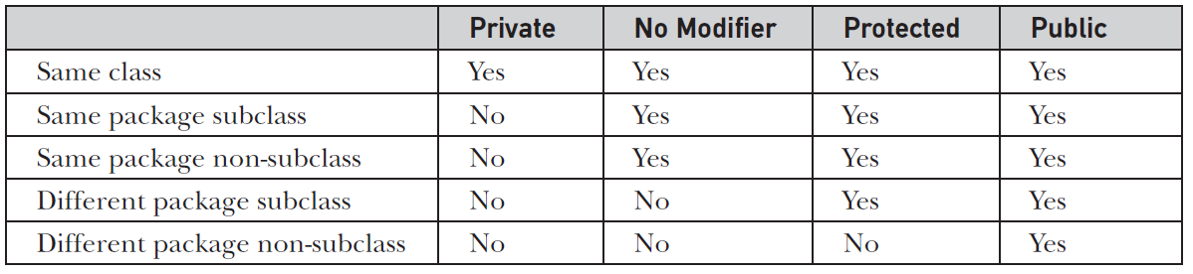
Accessing Package
There are three ways to access the package from outside the package.
import package.*; → import java.util.*;
import package.classname; → import java.util.Scanner;
fully qualified name → java.util.Scanner inp = new Scanner();
Access protection of class members and methods

Slide 59
Directory Structure of Package
Two major results occur when a class is placed in a package:
The name of the package becomes a part of the name of the class
The name of the package must match the directory structure where the corresponding bytecode resides.

Slide 60
Package - Example
package MyPack;
public class MyClass {
public void disp() {
System.out.println(“It is from package”);
}
}
Package creation
File Name: MyClass.java
Compilation:
Javac –d MyPack MyClass.java
Or
javac –d . MyClass.java
import MyPack.MyClass; // importing package
class Test {
public static void main(String a[]) {
// creating object of the package class
MyClass obj1= new MyClass();
//accessing method in package
obj1.disp();
}
}
Package accessing
File Name: Test.java
Compilation: javac Test.java
Execution: java Test
Output:
It is from package

Slide 61
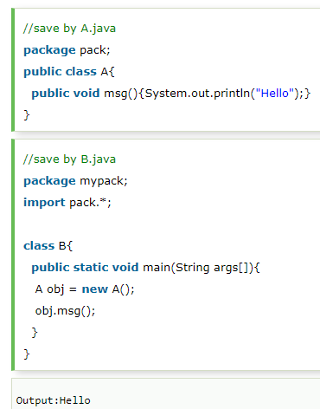
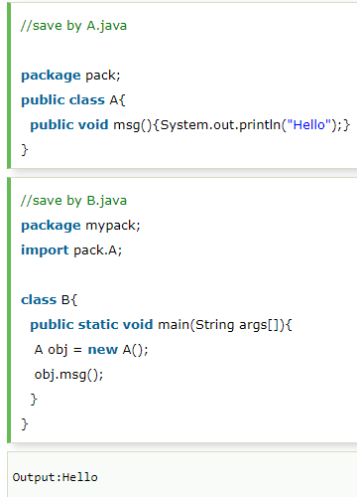
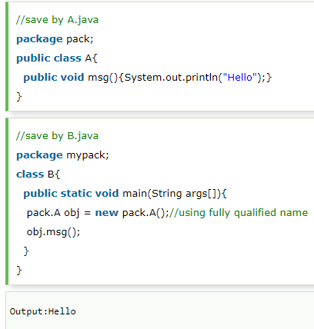
Package – Example
Various access models of package
Model - 1
Model - 2
Model - 3

Slide 62
Package with Multiple Classes
Multiple classes can be created under a package
package MyPack;
public class MyClass1 {
public void disp1() {
System.out.println(“It is from disp1”); }
}
File Name: MyClass1.java
package MyPack;
public class MyClass2 {
public void disp2() {
System.out.println(“It is from disp2”); }
}
File Name: MyClass2.java
Import MyPack.MyClass2; // importing only MyClass2
Import MyPack.MyClass1; // importing only MyClass1
Import MyPack.*; // importing all classes of MyPack

Slide 63
References
www.javatpoint.com
www.javatutorialspoint.com
www.geeksforgeeks.com
https://techvidvan.com/tutorials/java-installation/
https://www.oracle.com/java/technologies/javase-jdk16-downloads.html
Herbert Schildt, The Complete Reference -Java, Tata McGraw-Hill Education, Tenth Edition, 2017.
Vijayarani A., AP SITE, VIT, Vellore

