Slide 1
hibernate
Persistence with Hibernate - Domain Model Fundamentals - Transaction Management - Effective Testing

Slide 2
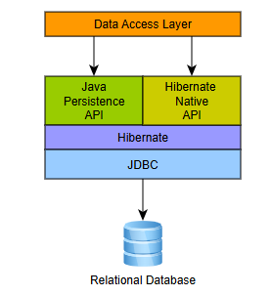
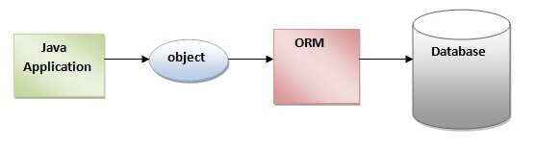
Hibernate
Hibernate is a Java framework that simplifies the development of Java application to interact with the database. It is an open source, lightweight, ORM (Object Relational Mapping) tool. Hibernate implements the specifications of JPA (Java Persistence API) for data persistence.
An ORM tool simplifies the data creation, data manipulation and data access. It is a programming technique that maps the object to the data stored in the database
Java Persistence API (JPA) is a Java specification that provides certain functionality and standard to ORM tools. The javax.persistence package contains the JPA classes and interfaces.

Slide 3
Hibernate
Advantages:
Open Source and Lightweight
Fast Performance
Database Independent Query (HQL)
Automatic Table Creation
Simplifies Complex Join
Provides Query Statistics and Database Status

Slide 4
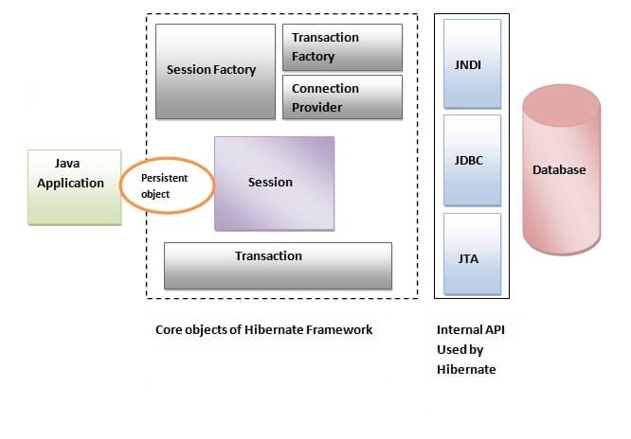
Hibernate - Architecture
The Hibernate architecture includes many objects such as persistent object, session factory, transaction factory, connection factory, session, transaction etc.
The Hibernate architecture is categorized in four layers.
Java application layer
Hibernate framework layer
Backhand API layer
Database layer

Slide 5
Hibernate - Elements
SessionFactory – The SessionFactory is a factory of session and client of ConnectionProvider. It holds second level cache (optional) of data. The org.hibernate.SessionFactory interface provides factory method to get the object of Session.
Session - The session object provides an interface between the application and data stored in the database. It is a short-lived object and wraps the JDBC connection. It is factory of Transaction, Query and Criteria. It holds a first-level cache (mandatory) of data. The org.hibernate.Session interface provides methods to insert, update and delete the object. It also provides factory methods for Transaction, Query and Criteria.
Transaction - The transaction object specifies the atomic unit of work. It is optional. The org.hibernate.Transaction interface provides methods for transaction management.
ConnectionProvider - It is a factory of JDBC connections. It abstracts the application from DriverManager or DataSource. It is optional.
TransactionFactory - It is a factory of Transaction. It is optional.

Slide 6

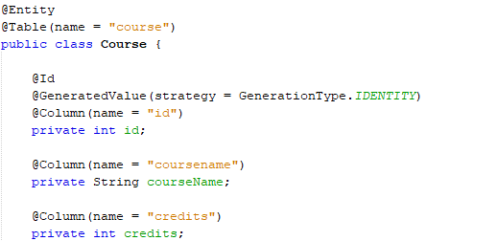
Mapping Annotations-Domain Model
Historically applications using Hibernate would have used its proprietary XML mapping file format for this purpose. With the coming of Jakarta Persistence, most of this information is now defined in a way that is portable across ORM/Jakarta Persistence providers using annotations (and/or standardized XML format).
A simple table and domain model
Table Domain Model
JAKARTA PERSISTENCE

Slide 7
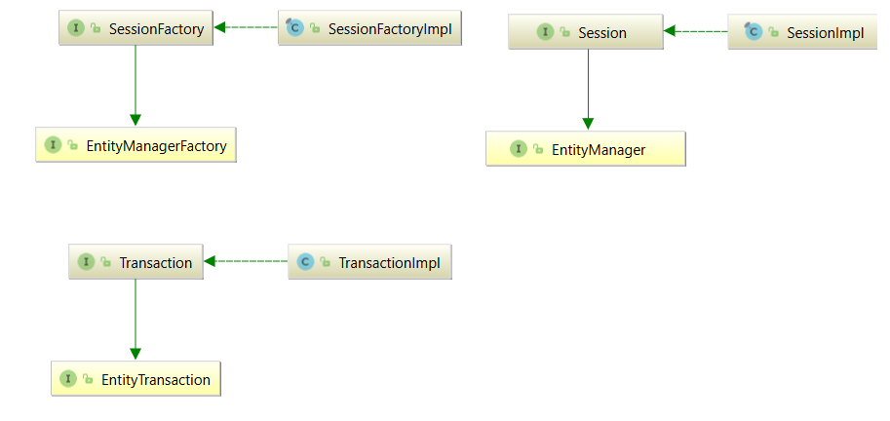
Hibernate Implements JPA Specification

Slide 8
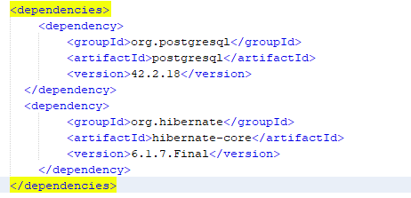
Console based Hibernate Application
Create a Maven Project (Refer Project titled ‘Simple Hibernate’)
Add below dependencies in pom.xml
Required four packages for managing
pojo classes- com.vit.hib.entity.Course
dao classes - com.vit.hib.dao.CourseDao
Util class - com.vit.hib.util. HibernateUtil
Driver class-com.vit.hib.driver.App
For Derby, include appropriate dependency file

Slide 9
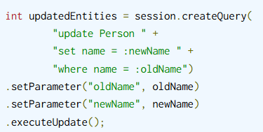
HQL
DML, or Data Manipulation Language, refers to SQL statements such as INSERT, UPDATE, and DELETE. Hibernate provides methods for bulk SQL-style DML statement execution, in the form of Hibernate Query Language (HQL).
Pseudo-syntax for UPDATE and DELETE statements using HQL
UPDATE FROM EntityName e WHERE e.name = ?
DELETE FROM EntityName e WHERE e.name = ?
The FROM clause can only refer to a single entity, which can be aliased.
Executing an HQL UPDATE, using the Query.executeUpdate()

Slide 10
Hibernate Transactions
Generally transactions,
It might refer to the physical transaction with the database.
It might refer to the logical notion of a transaction as related to a persistence context.
It might refer to the application notion of a Unit-of-Work, as defined by the archetypal pattern.
Hibernate supports both mechanisms for integrating with transactions and allowing applications to manage physical transactions.
JDBC itself and JTA.
Hibernate uses JDBC connections and JTA resources directly, without adding any additional locking behavior. Hibernate does not lock objects in memory. The behavior defined by the isolation level of your database transactions does not change when you use Hibernate.
The Hibernate Session acts as a transaction-scoped cache providing repeatable reads for lookup by identifier and queries that result in loading entities.

Slide 11

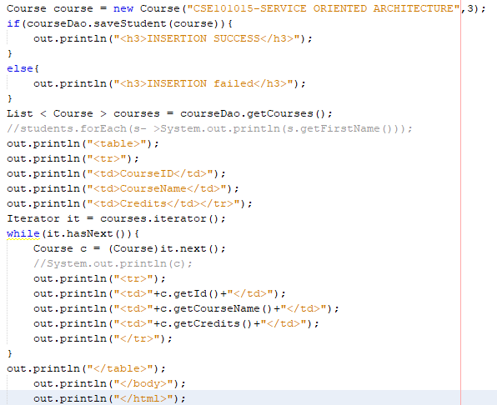

Hibernate – Web Application
Create a Maven Project (Refer Project titled ‘mavenproject’)
ControllerServlet
Index.jsp

Slide 12
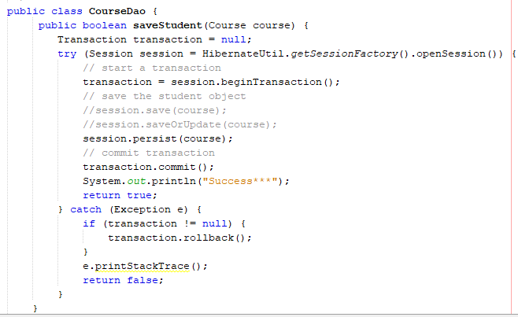
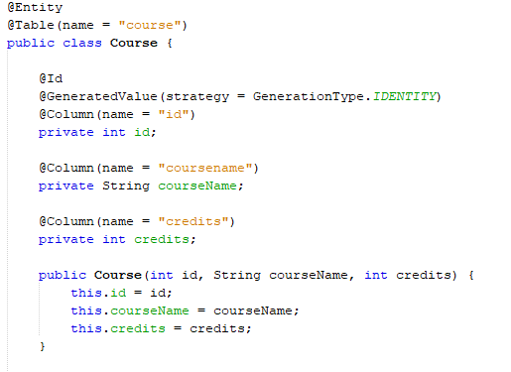
Hibernate – Web Application
CourseDao
PoJO class : Course

Slide 13
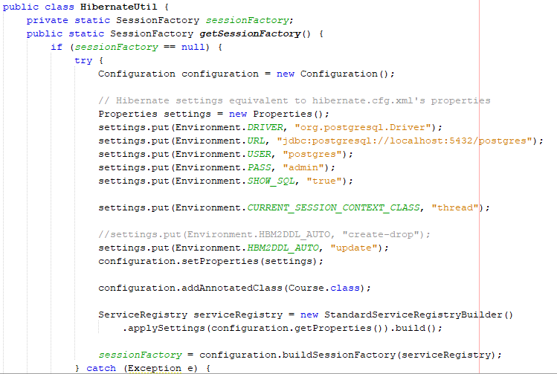
Hibernate – Web Application
Util Class

Slide 14
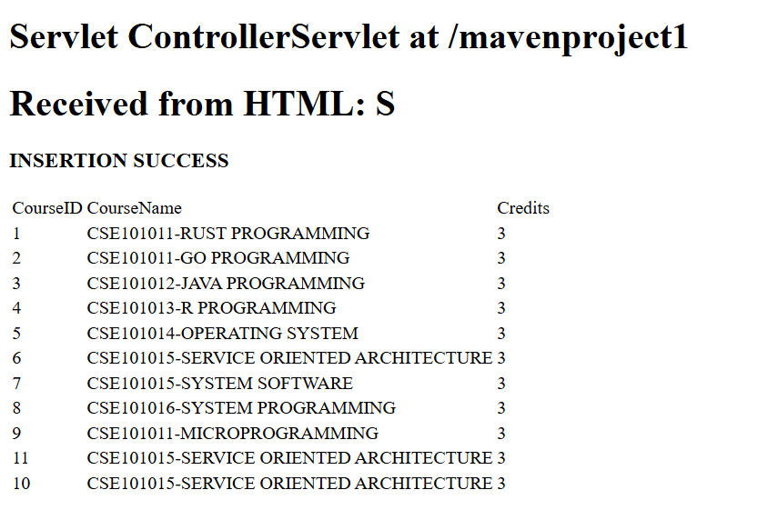
Hibernate – Web Application Output

