Slide 1
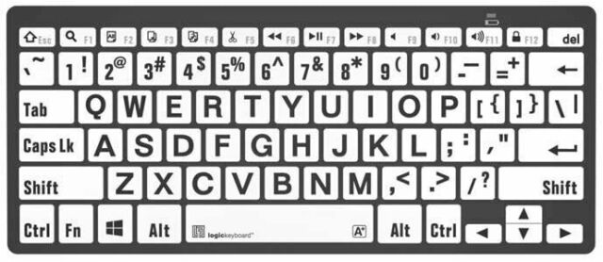
SAVE
CHANGES
CREATE TAGS
TO EVENLY SPACE OUR CODE
WE USE THESE NUMBERS

