Slide 1
(WEBSITE NAME HERE)
Discover movies you will love!
Answer (4) easy questions & we take care of the rest.
Start Now
Might have button here that takes you to another page, or just have filter selections on main page.

Slide 2
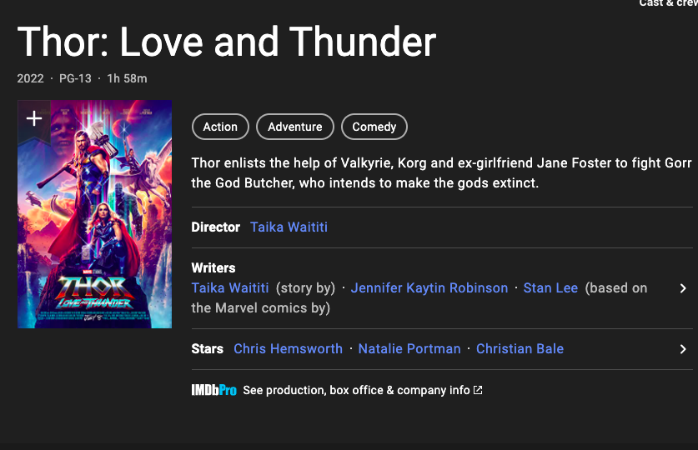
Let’s Watch a Movie
(WEBSITE NAME HERE)
What type of movie are you looking for?
How much time do you have?
How old would you like the movie to be?
Is the rating of the movie important to you?
Dropdown with genre options
Dropdown with duration buckets
Dropdown
Dropdown
Probably ambitious, but something over here with the movie recommendation.

