Slide 1
Strategy pattern

Slide 2
What
Behavioral design pattern
Switch between similar algorithms at runtime

Slide 3
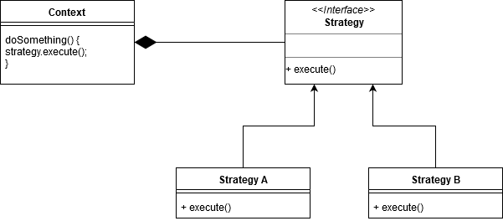
How

Slide 4
+
-
Prevent conditional statements
Loose coupling
Open/Closed
Very easy extendable
Composition over inheritance
Knowledge of different strategies
Overcomplicating model

Slide 5
Ventouris
Maatwerk
…

Slide 6
https://github.com/mattiaromeo/bool-strategy-pattern

