Slide 1
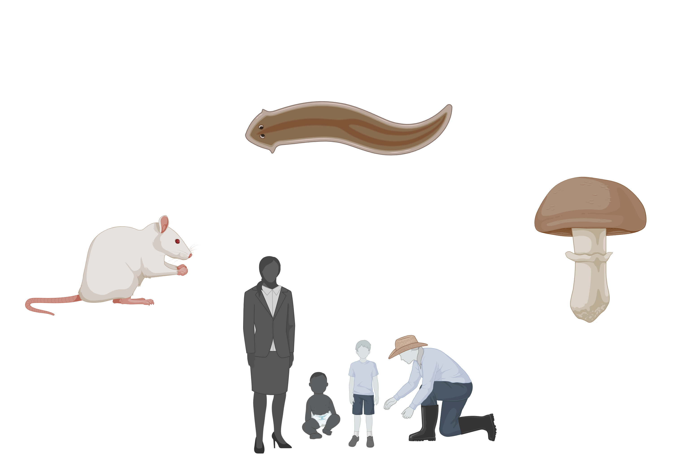
NEST Neuroplasticity in Environmental & Social Trajectory
Bart Ellenbroek
Jiun Youn
NEST

Slide 2
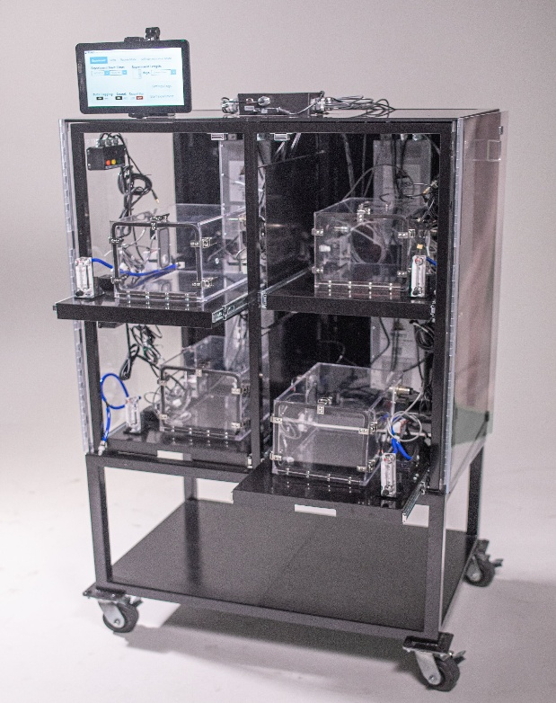
NEST Research – Rat Research
Research in rats:
Focus on tobacco/nicotine
Why is tobacco more addictive?
Tobacco contains additional substance
MAO inhibitors
Enhance dopamine and are antidepressants
Research question:
Does it enhance self-administration?
New vaping set-up
NEST

Slide 3
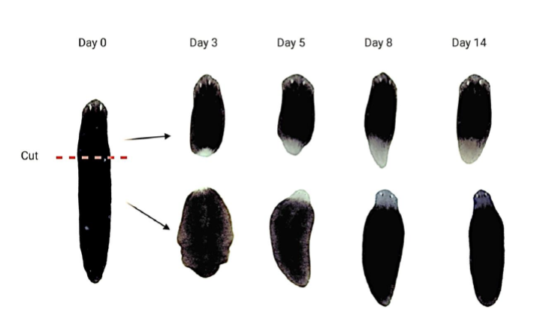
NEST Research – Planaria Research
Research in Planaria:
Focus on neuroplasticity.
Planaria can regrow a complete new brain from “scratch”.
Planaria can regrowth new neurons after damage.
NEST

Slide 4
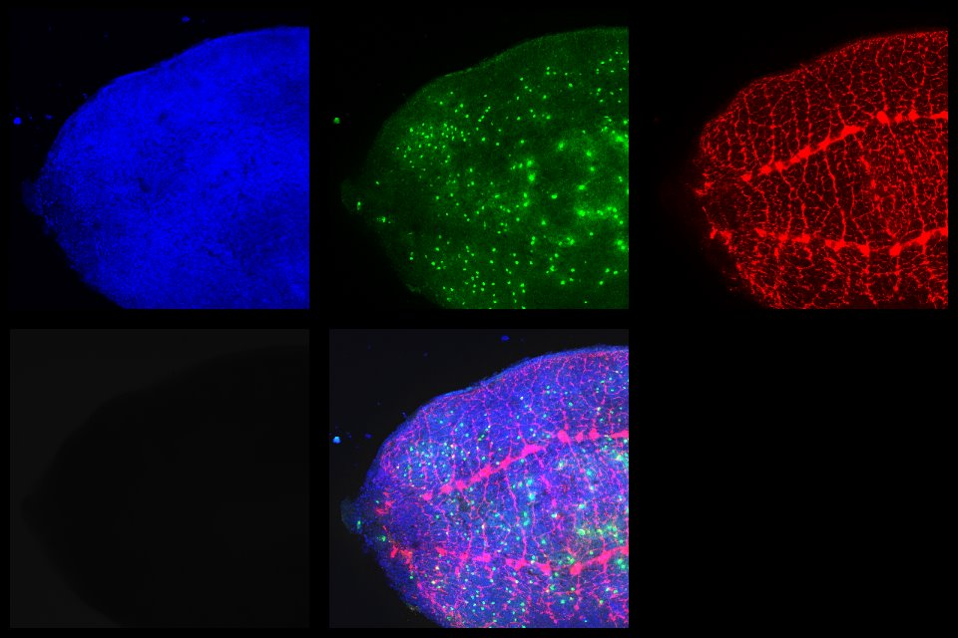
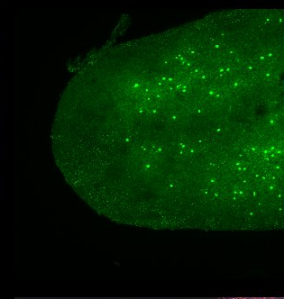
NEST Research – Planaria Research
4 days
6 days
4 days
NEST

Slide 5
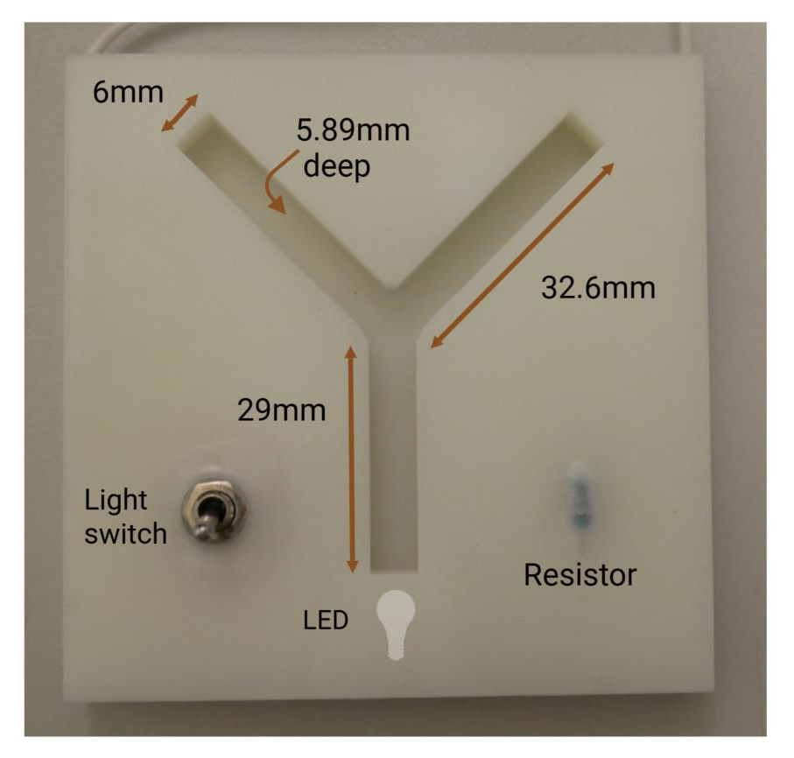
NEST Research – Planaria Research
Research in Planaria:
Focus on neuroplasticity.
Planaria can regrow a complete new brain from “scratch”.
Planaria can regrowth new neurons after damage.
Planaria can learn.
And retain their memory?
Research questions:
Do planaria retain memory after dissection?
Do planaria show behavioural and plasticity changes after psilocybin/ketamine?
Do planaria have social behaviour?
NEST

Slide 6
NEST Research –Population Research
ABCD Study.
11,000 children
Followed from age 9 to ultimately 24.
Yearly analysis of behaviour, cognition, s/fMRI, etc.
Currently 4 yearly cohorts available.
Lifelines study
160,000 participants (age 0 to 80)
Followed for ultimately 30 years.
5 yearly analysis of many aspects (lifestyle, health, physiology, etc).
Currently 3 cohorts available.
Research questions:
Is there a bidirectional relationship between sleep quality and familial conflict? Mediated by emotional regulation?
Is there a bidirectional relationship between screen time and inhibitory control? Mediated by sleep quality?
NEST

Slide 7
NEST Research – Other Human Research
AI and psychology.
AI is rapidly changing the way we interact with the world.
How does it influence our behaviour?
Research questions:
Does AI affect cognitive flexibility and creativity?
What is the relationship between stress, AI, cognitive rigidity and polarization.
Psychedelic experiences:
Psychedelic drugs such as psilocybin, LSD have intriguing therapeutic potential for depression, anxiety, addiction, PTSD.
However, these drugs induce very unique and highly personalized changes in individuals, that seem to be different for each individual and even within the same individual.
Online resources (Reddit, Erowid) are used to analyse the psychedelic experience and its determinants.
NEST

